Slide 1
CODE FOR GOOD TEAM 3

Slide 2
CHALLENGE
STATEMENT
WHAT IS IT?
Common Shared Appointment
Platform where the SSK members
and medical professionals can see
and track these appointments.
KEY FEATURES
Support Appointment Scheduling.
Role Based access control for Scheduling Appointments.
Ability to categorize and view appointments.
Beneficiary History.
Progress of Each Beneficiary.
More info on : www.spasticssocietyofkarnataka.org

Slide 3

THE IDEA!
A Web App.
Facilitate easy usage to members and professionals.

Slide 4
1.
Key Points

Slide 5
A platform for different Roles to Login in the common dashboard according to his/her Role.

Slide 6
A common dashboard to see and track appointments.

Slide 7
Receptionist
The Receptionist would have the option to search about a particular patient either by his/her Name or by RegId.
On the basis of the input given by the Receptionist ,the child history and the available appointments would be displayed.

Slide 8
Medical Professionals
Have the option to schedule his availability.
The particular changes would be reflected in the receptionist and SuperUser portal

Slide 9
Super Users
Have the option to see appointment history with basic details about the beneficiary.
They can schedule and approve/accept appointment on behalf of all medical professionals.

Slide 10
Execution

Slide 11
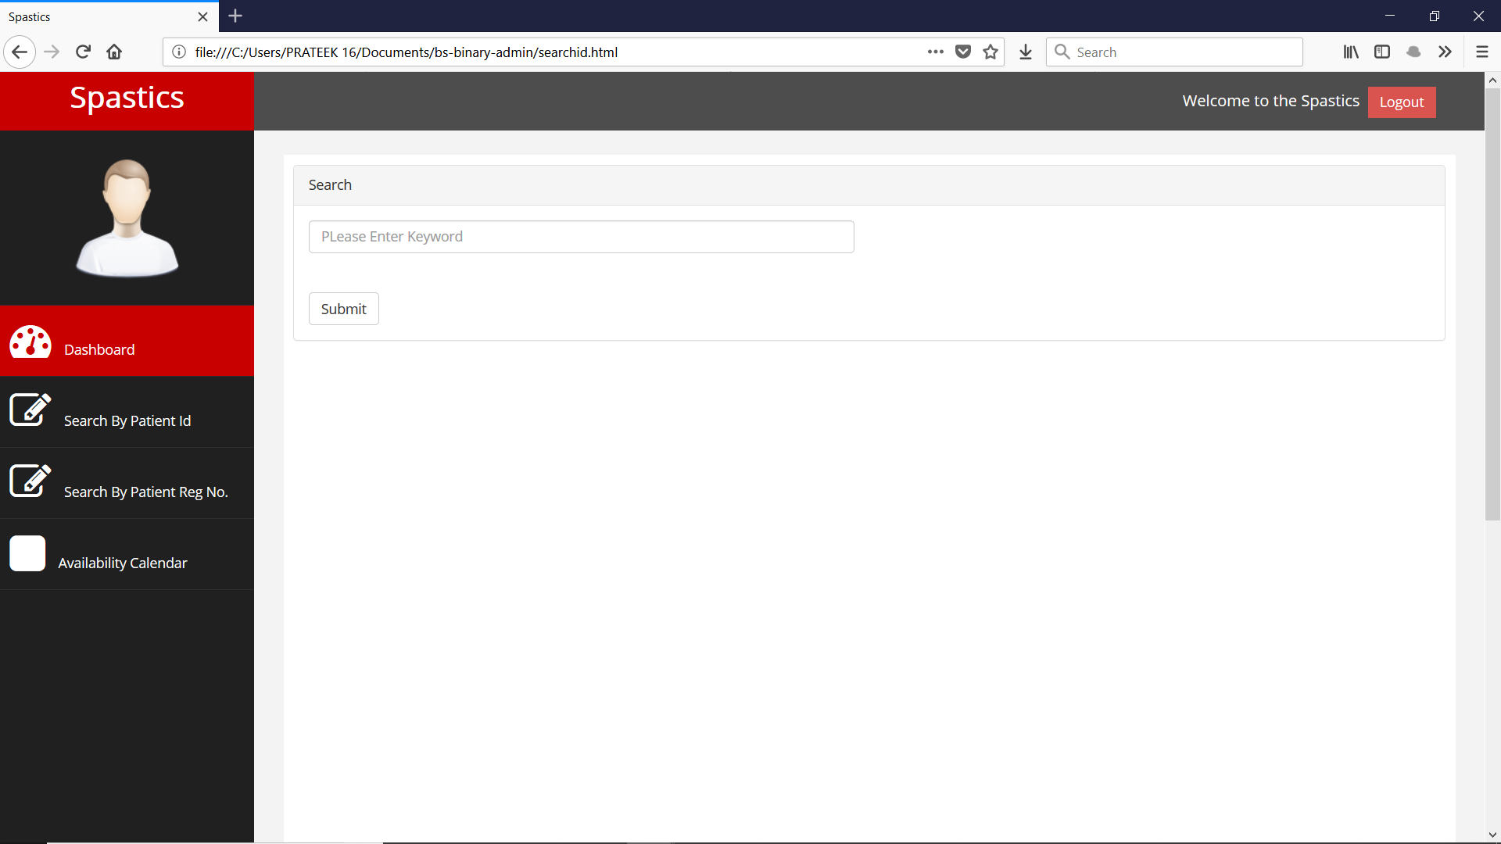
Snap - Shots

Slide 12
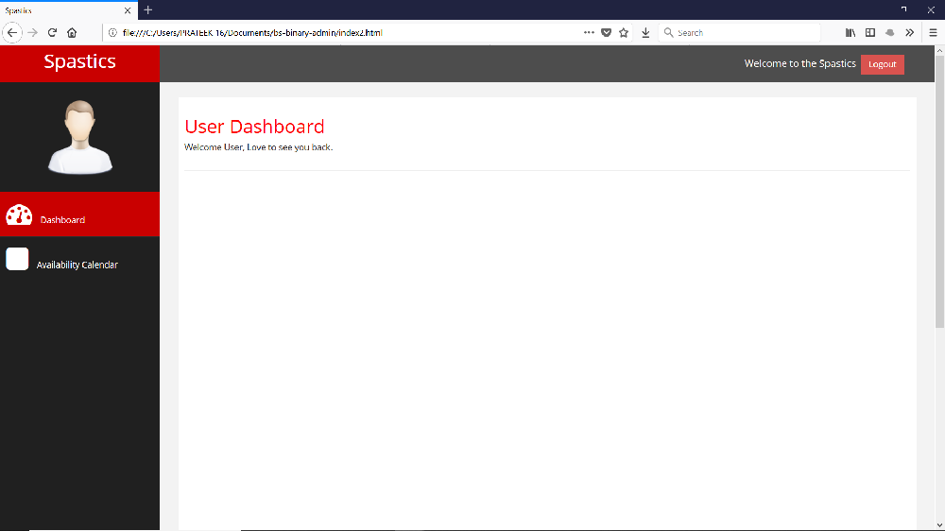
Snap - Shots

Slide 13
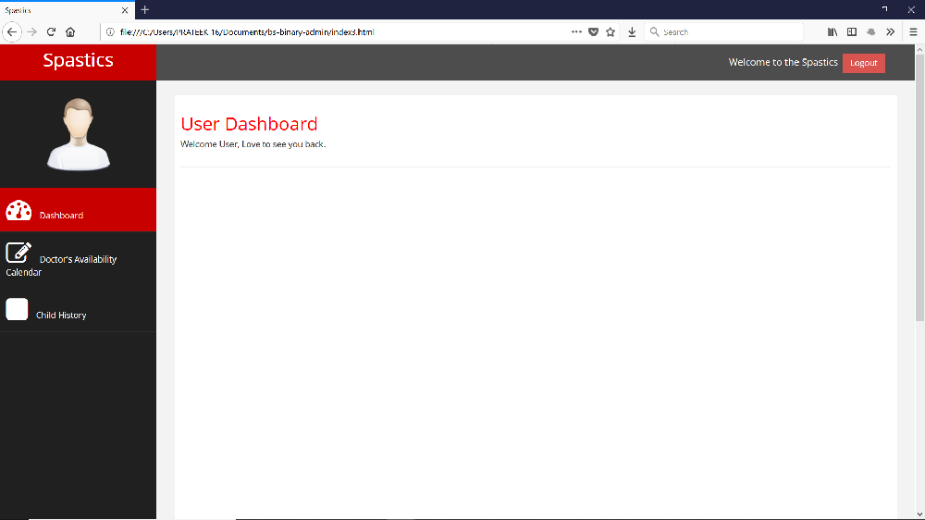
Snap - Shots

Slide 14
Additional Features
Allowing professionals
to make themselves
‘Available’ or
‘Unavailable’
Publishing Calendars
in advance.
No necessary
requirement to have
Internet Connection.
Interactions between
members and
professionals where
changes made by one
is reflected on the
other’s portal.

Slide 15
Future RoadMap
Contingency plan in case of doctor cancellation.
Priority based appointment Scheduling.
Report generation shared by doctors.
Track Progress using Data Science.
The medical care given to the patient is appreciable or not using previous data.
Efficiency rate of a particular type of doctor.

Slide 16
Technologies Used
HTML , CSS , JavaScript for the User interface .
JSP for Server Side Configuration.
MySqlDb.

Slide 17
References
https://spasticssocietyofkarnataka.org
www.colorlib.com/wp
https://www.slidescarnival.com
https://www.free-css.com

Slide 18
Thanks!

