Slide 1
CODE FOR GOOD

Slide 2
CHALLENGE
STATEMENT
WHAT IS IT?
Common Shared Appointment
Platform where the SSK members
and medical professionals can see
and track these appointments.
KEY FEATURES
Support Appointment Scheduling.
Role Based access control for Scheduling Appointments.
Ability to categorize and view appointments.
Beneficiary History.
Progress of Each Beneficiary.
More info on : www.spasticssocietyofkarnataka.org

Slide 3

THE IDEA!
A Web App.
Facilitate easy usage to members and professionals.

Slide 4
1.
Key Points

Slide 5
A platform for different Roles to Login in the common dashboard according to his/her Role.

Slide 6
A common dashboard to see and track appointments.

Slide 7
Receptionist
The Receptionist would have the option to search about a particular patient either by his/her Name or by RegId.
On the basis of the input given by the Receptionist ,the child history and the available appointments would be displayed.

Slide 8
Medical Professionals
Have the option to schedule his availability.
The particular changes would be reflected in the receptionist and SuperUser portal

Slide 9
Super Users
Have the option to see appointment history with basic details about the beneficiary.
They can schedule and approve/accept appointment on behalf of all medical professionals.

Slide 10
Execution

Slide 11
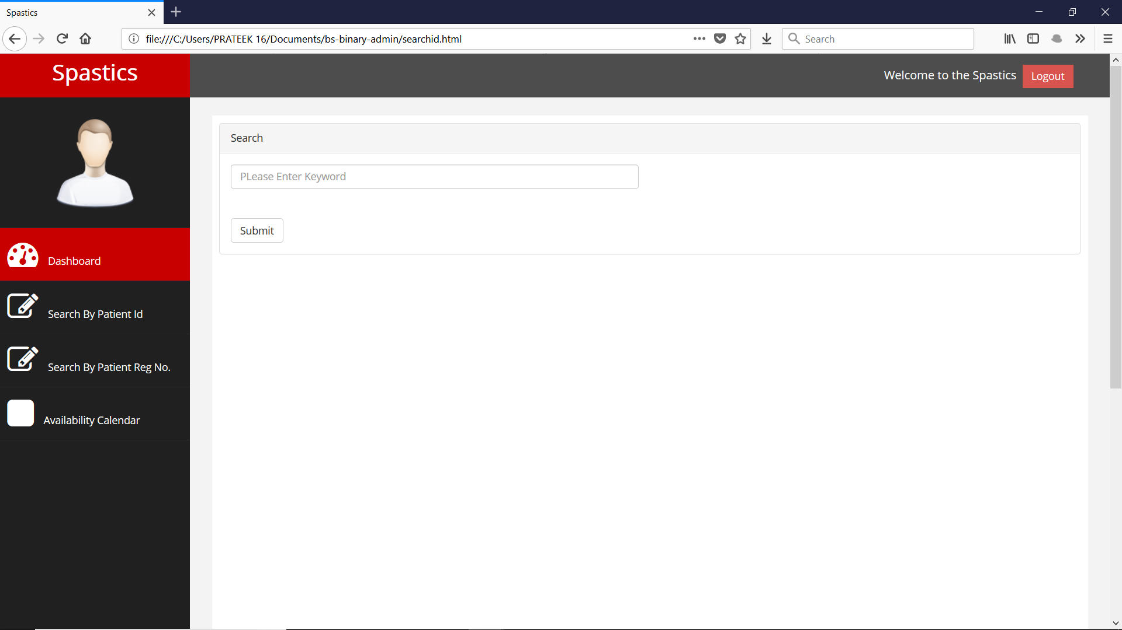
Snap - Shots

Slide 12
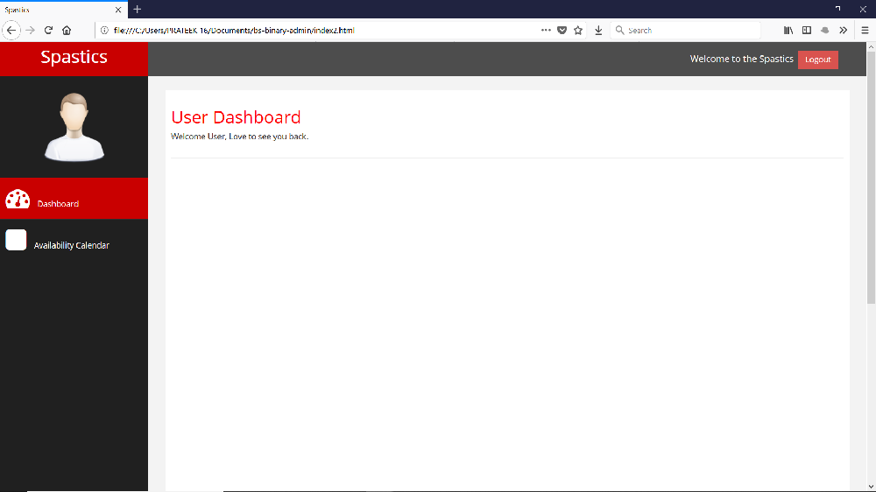
Snap - Shots

Slide 13
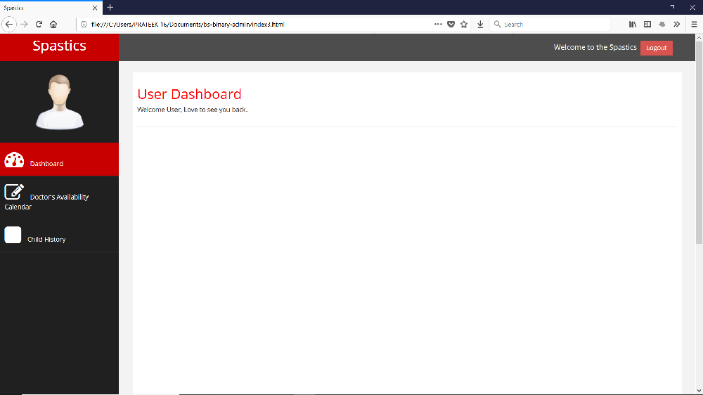
Snap - Shots

Slide 14
Additional Features
Allowing professionals
to make themselves
‘Available’ or
‘Unavailable’
Publishing Calendars
in advance.
No necessary requirement to have Internet Connection.
Interactions between
members and
professionals where
changes made by one
is reflected on the
other’s portal.

Slide 15
Future RoadMap
Ability to go through appointments of various doctors and check if one cancels , the process to change further appointments.
Priority based appointment Scheduling.
Report generated by one doctor to be available online that can be accessed by other common doctors of the patient as well.

Slide 16
Future RoadMap
Using Data Science to track the progress of NGO as well as the patient in terms of the success rate.
The NGO can use data to check whether the medical care which was given to the patient was useful or not.
The efficiency rate of a particular type of doctor to a particular patient in case there is no appreciable change in the patient.

Slide 17
Technologies Used
HTML , CSS , JavaScript for the User interface .
JSP for Server Side Configuration.
MySqlDb.

Slide 18
References
https://spasticssocietyofkarnataka.org
www.colorlib.com/wp
https://www.slidescarnival.com
https://www.free-css.com

Slide 19
Thanks!

