Slide 1
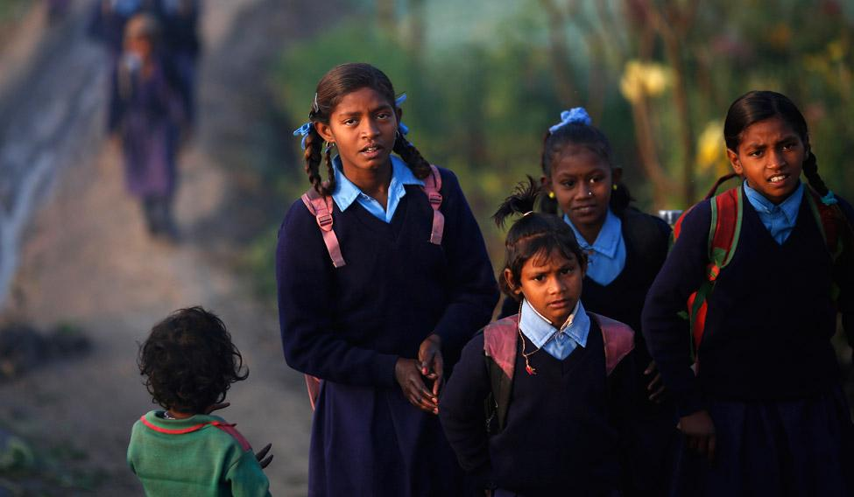
CAREWORKS FOUNDATION
CODE FOR GOOD CHALLENGE

Slide 2
PROBLEM STATEMENT
Development of an application to facilitate the collection of the data required to conduct a ‘Need Assessment’ on the government schools visited.

Slide 3
PROPOSED MODEL
PROPOSED MODEL
1
MOBILE APP

Slide 4
PROPOSED MODEL
1
MOBILE APP
2
WEB APP

Slide 5
PROPOSED MODEL
PROPOSED MODEL
1
MOBILE APP
2
WEB APP
3
REPORTS

Slide 6
PROPOSED MODEL
PROPOSED MODEL
1
MOBILE APP
2
WEB APP
3
REPORTS
4
VISUALIZATION

Slide 7
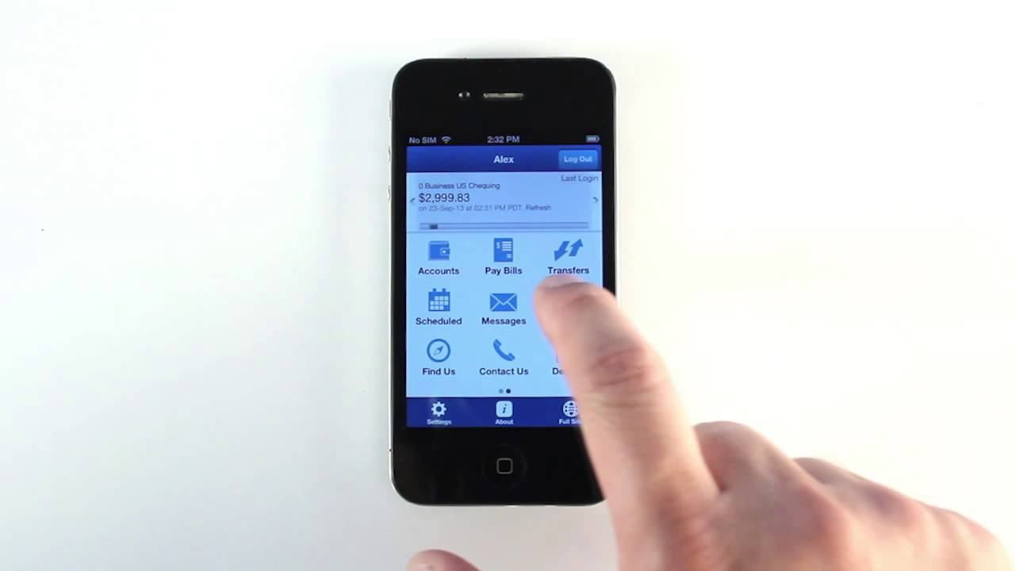
DEMO

Slide 8
FUTURE WORK
Portal for extensive outreach towards wider audience
Means to donate an amount through the app
WIder collaboration with corporates

Slide 9
THANK YOU

