Slide 1

CAREWORKS FOUNDATION
CODE FOR GOOD CHALLENGE

Slide 2
PROBLEM STATEMENT
Development of an application to facilitate the collection of the data required to conduct a ‘Need Assessment’ on the government schools visited.

Slide 3
CURRENT TRENDS
1.
Time Consuming.
2.
Input is taken on unreliable sources.
3
Poor means to visualize and compare

Slide 4
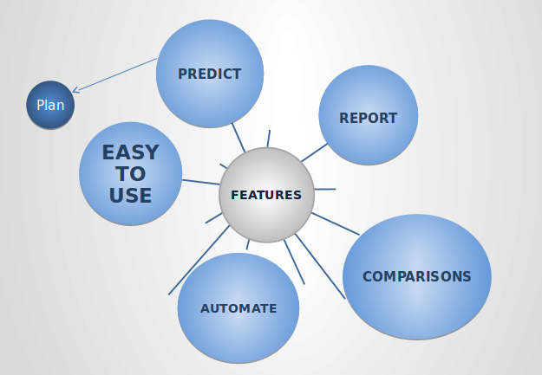
NEED ASSESSMENT APP

Slide 5
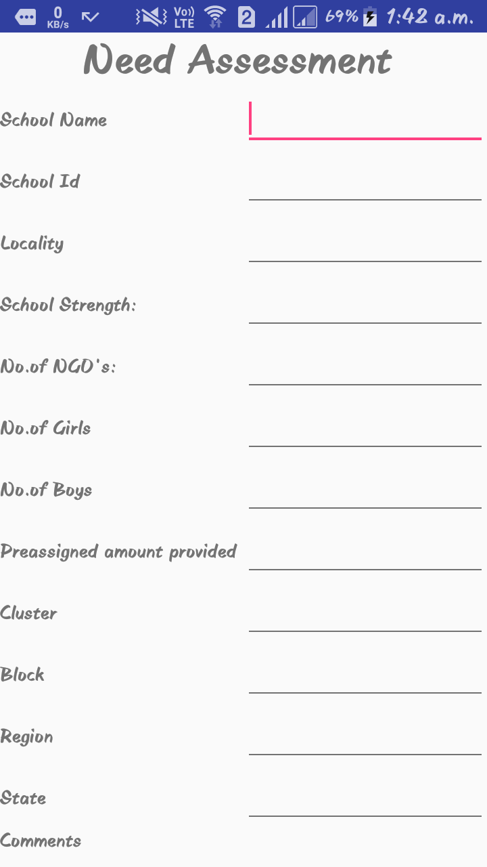
PROPOSED MODEL
PROPOSED MODEL
1
MOBILE APP

Slide 6
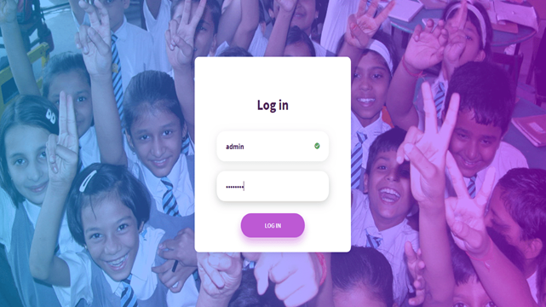
PROPOSED MODEL
1
MOBILE APP
2
WEB APP

Slide 7

PROPOSED MODEL
PROPOSED MODEL
1
MOBILE APP
2
WEB APP
3
REPORTS

Slide 8
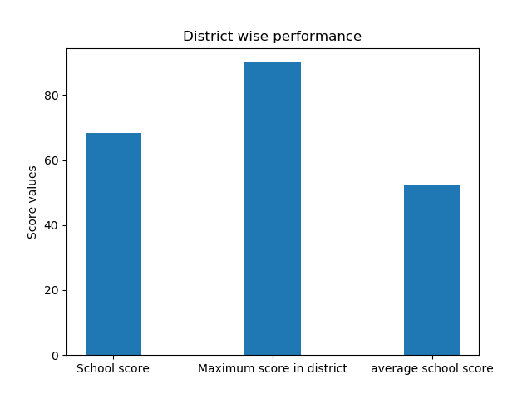
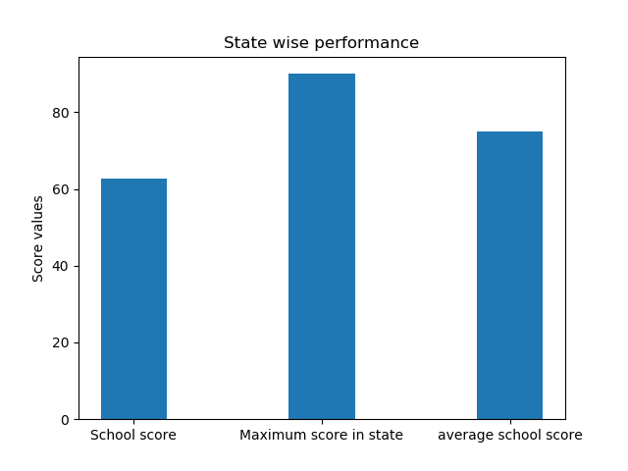
PROPOSED MODEL
PROPOSED MODEL
1
MOBILE APP
2
WEB APP
3
REPORTS
4
ANALYSIS

Slide 9
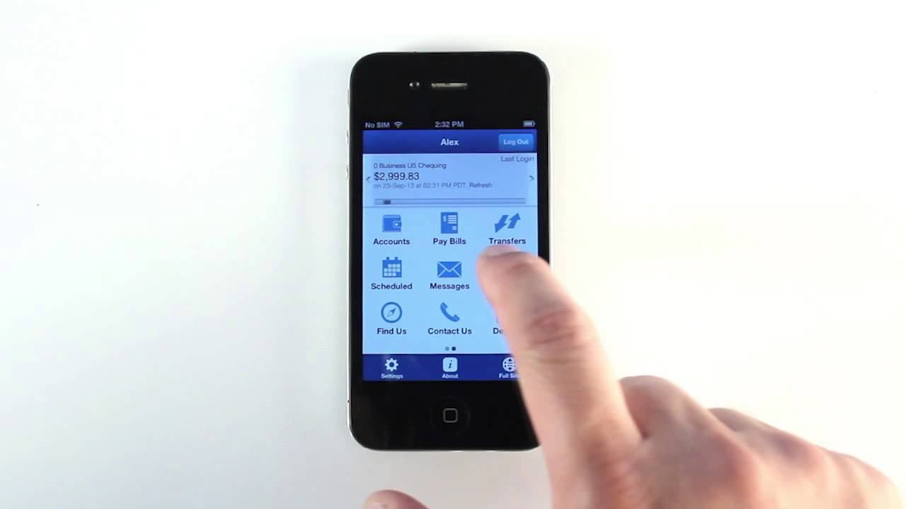
DEMO

Slide 10
TECH STACK
Front end
Html
CSS
Back end
Python
MySQL
Add-ons
SVM
ANN(using tensor flow and keras).
JavaScript
XML
Java

Slide 11
FUTURE WORK
Implementation of action plan with time stamping
Means to donate an amount through the app
Wider collaboration with corporates

Slide 12
THANK YOU

