Slide 1
PROBLEM STATEMENT
Careworks Foundation requires an application to facilitate the collection of the data required to conduct a ‘Need Assessment’ on the government schools they visit. The ‘Need Assessment’ is the evaluation performed by the Foundation, based on which, a decision is made to either accept or reject the project.
Once a project is accepted, the application should allow the Foundation to add, view and track each individual activity within a project through an Action Plan.

Slide 2
APPROACH TO PROBLEM STATEMENT
USER INTERFACE FOR ASSESSMENT FORM PROVIDED TO NGO’s Employees TO SURVEY DETAILS FOR DIFFERENT SCHOOLS IN KARNATAKA.
USER INTERACE PROVIDED TO ADMINISTRATOR FOR FOLLOWING OPERATIONS:-
1. Review Applications submitted by NGO’s employees.
2. View Accepted School Applications.
3. Resource Allocation for Accepted Projects.
4. Report Generation.
HTML, CSS AND BOOTSTRAP USED FOR FRONT END DEVELOPMENT.
MySQL USED FOR DATABASE DEVELOPMENT.
PHP USED FOR CONNECTION BETWEEN BACKEND AND FRONTEND.

Slide 3
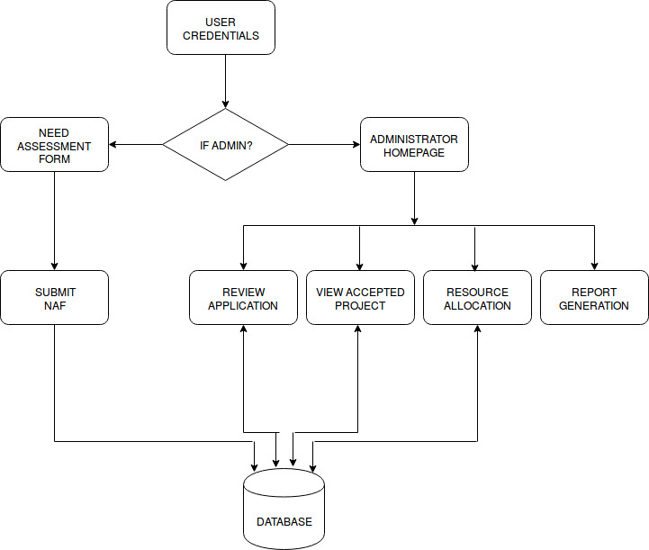
THE ARCHITECTURE

Slide 4
BENEFITS AND FUTURE WORK
BENEFITS:-
1. PORTABILITY
2. DYNAMICITY
3. REDUCE PAPERWORK
4. REDUCE WORKLOAD
5. ANALYSIS OF DATA FOR REPORT GENERATION
FUTURE WORK:-
1. SAVING THE DATA INTO LOCAL CACHE STORAGE IF INTERNET CONNECTION IS LOST.
2. COMPARISON BEFORE AND AFTER.

Slide 5
Q & A…
?

