Slide 1
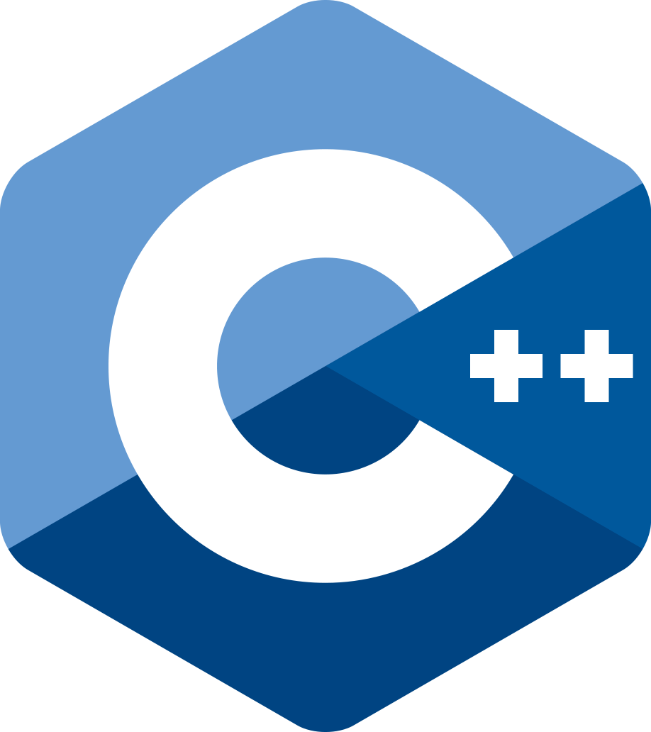
P3183R1
Contract testing support
Bengt Gustafsson
SG21 telecon, December 12, 2024

Slide 2
Motivation
Contract conditions are hard to test.
Without proper testing the value of contracts is reduced.
Throwing out of the violation handler is a hack.
A solution needs to fit within regular test harnesses.
Testing should be easy to integrate into CI.

Slide 3
Proposed solution
Magic check functions are added to the library.
Check functions only evaluate pre- or post conditions.
Function under test is a template parameter.
Test cases provide example parameters to check functions.
Check functions return true iff all contracts pass.
Check functions don’t intercept exceptions from conditions.

Slide 4
Advantages
Negative testing is easy as the function is never called.
Check functions work the same regardless of enforcement.
Contract violation handler is not involved.
No throwing is involved, so nothrow functions are not a problem.

Slide 5
Proposed check functions
template<auto F, typename... Args>
constexpr bool check_preconditions(Args&&... args);
template<auto F, typename R, typename... Args>
constexpr bool check_postconditions(const R& r, Args&&... args);
template<auto F, typename... Args>
constexpr bool check_postconditions_void(Args&&... args);

Slide 6
Examples
float f(float x) pre(x > 0) post(r: r >= 0) {
return sqrt(x);
}
// Check that the pre condition is correct.
CHECK(check_preconditions<f>(1));
CHECK(!check_preconditions<f>(0));
CHECK(!check_preconditions<f>(-1));
// Check post condition
CHECK(check_postconditions<f>(1, 0));
CHECK(check_postconditions<f>(0, 0));
CHECK(!check_postconditions<f>(-1, 0));

Slide 7
Pseudocode for examples
float f(float x) pre(x > 0) post(r: r >= 0) {
return sqrt(x);
}
template<> bool check_precondition<f>(float x) {
return x > 0; }
template<> bool check_postconditions<f>(float r, float x) {
return r >= 0;
}

Slide 8
Member function example
struct X {
float f(float x) pre(x * m > 0) post(r: r >= 0) {
return sqrt(x * m);
}
float m;
};
// Check that the pre condition is correct.
CHECK(check_preconditions<&X::f>(X{3}, 1));
CHECK(!check_preconditions<&X::f>(X{-3}, 1));

Slide 9
Pseudocode for member function example
struct X {
float f(float x) pre(x * m > 0) post(r: r >= 0) {
return sqrt(x * m);
}
float m;
};
template<> bool check_precondition<&X::f>(X& obj, float x) {
return x * obj.m > 0; }

Slide 10
Overloaded functions
Overloaded functions require static_cast.
Constructors and destructors can’t be tested.
P2825 declcall offers some help, but only partially:
#define CHECK_PRECONDITION_VIOLATION(F, ...) \ CHECK(!check_preconditions<declcall(F(__VA_ARGS__))>(__VA_ARGS__))
P3312 overload set types solves these problems.
As the check function are magic anyway they could also work as-if P3312 is standardized.

Slide 11
P3312 on a slide
Overloaded functions get a overload set type.
Overload set types are similar to generic lambdas.
The name of an overloaded function is an instance of its overload set type.
Works also for member functions, constructors and destructors.
Unoverloaded constructors and destructors also have overload set types.
Function templates in the overload set are included.

Slide 12
Checking virtual function contracts
Each override of a virtual function is tested separately.
Even pure virtual functions can be tested as only the contract conditions are actually compiled into the check function specialization.
Testing pure virtual functions works as it is allowed to take the address of a pure function (there is normally a thunk involved).
As no call is made the thunk is not used.

Slide 13
Checking function template contracts
static_cast must be used to select specialization
With P2825 declcall this is maybe solved.
With P3312 this is solved.
Explicitly specified template arguments can maybe somehow be provided along with the function name:
template<size_t IX, typename Tup> auto get(Tup& tup);
check_preconditions<get<2>>(testTuple);

Slide 14
Future directions
Clear up the explicit template argument issue.
Check functions could identify which contract failed.
A check_invariant function could be added.
Allow checking contracts on function pointer types when that gets standardized.

