Slide 1
Preparing for Technical Workshops
This workshop will be delivered through an iPython Notebook. Please take some time to ensure you can run iPython Notebooks before arriving at the workshop. If you would like help getting set up, you may want to arrive at 3:30 (30 minutes prior to the start of the workshop) to receive help with installing the required components for the workshop.
If you can’t currently run an iPython notebook, we recommend the following (instructions to follow):
Downlad and install Anaconda
https://www.continuum.io/downloads
Download the GitHub repository for our workshop
https://github.com/BeniamG/Text_Analysis_Fundamentals_3session
Run the iPython Notbook “Installation Check.ipynb”
Text_Analysis_Fundamentals_3session/00-Resources/Installation Check.ipynb

Slide 2
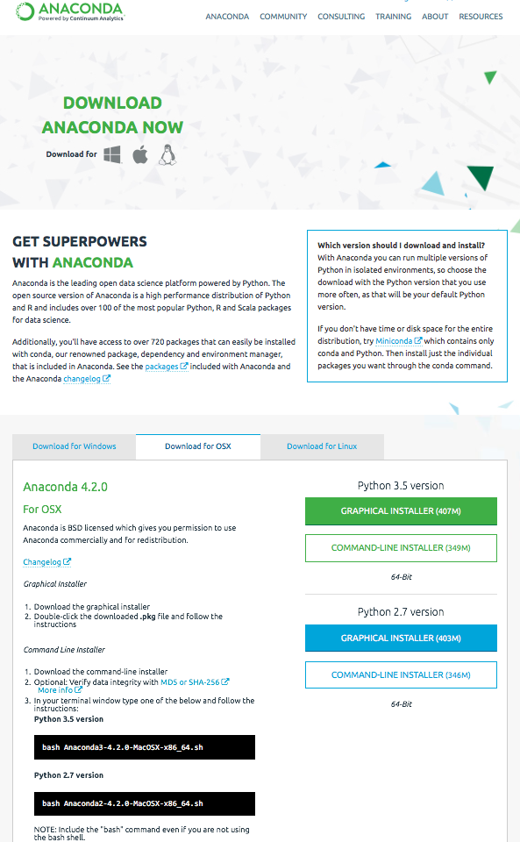
Download Anaconda https://www.continuum.io/downloads

Slide 3
Download Anaconda https://www.continuum.io/downloads

Slide 4
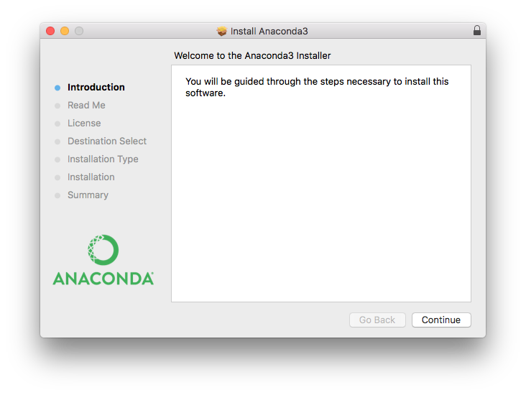
Install Anaconda

Slide 5
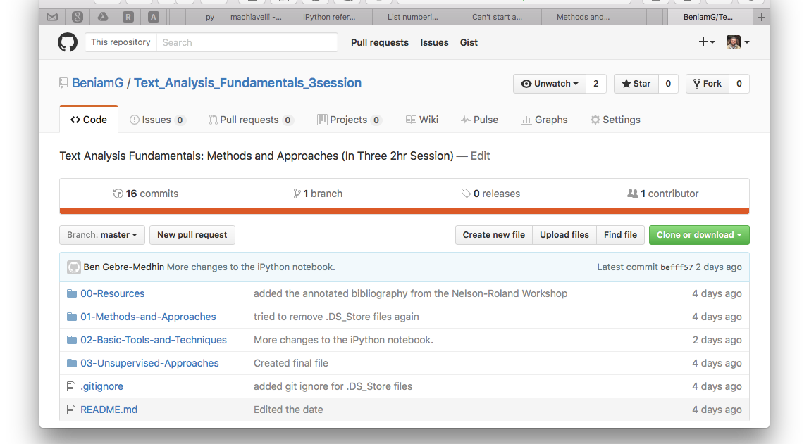
Download GitHub Repository https://github.com/BeniamG/Text_Analysis_Fundamentals_3session

Slide 6
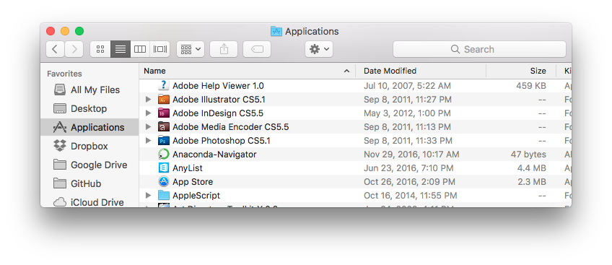
Launch Anaconda-Navigator

Slide 7
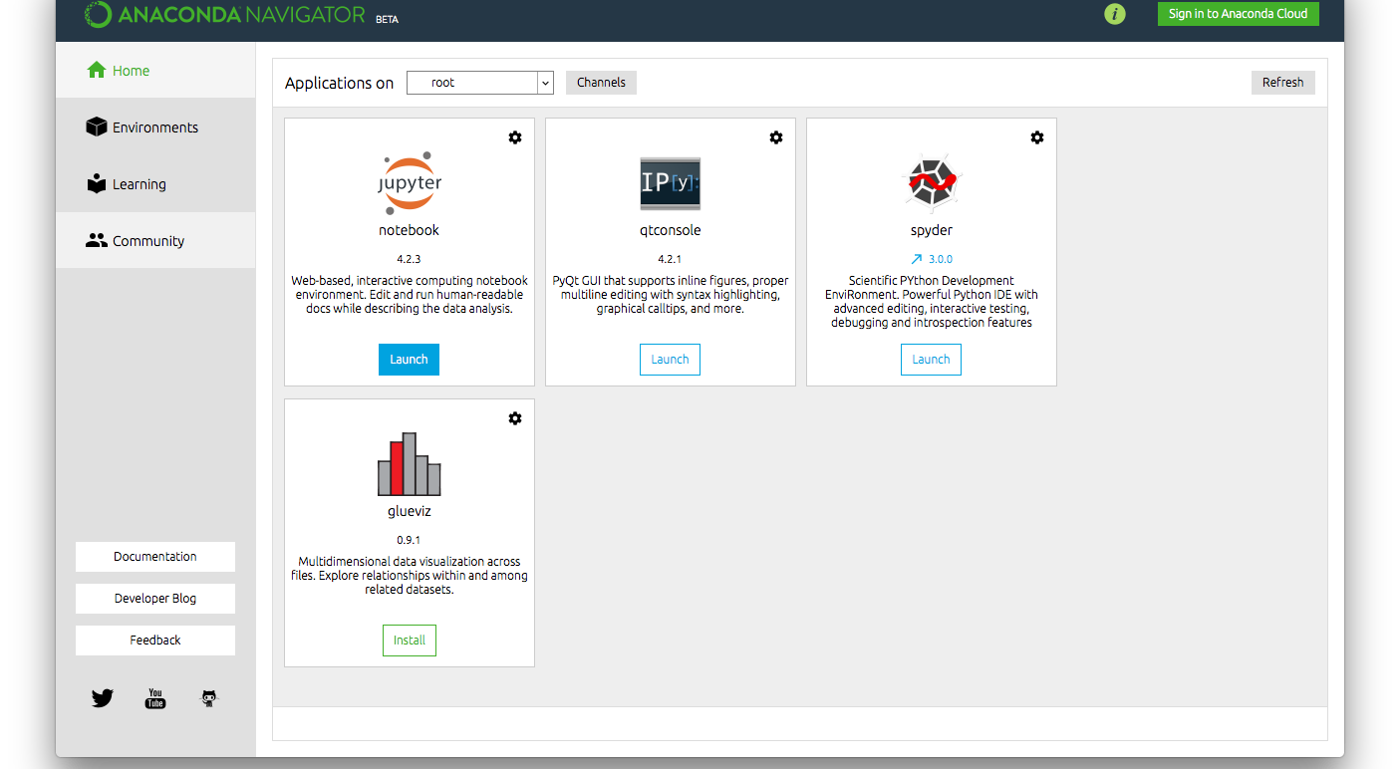
Launch jupyter

Slide 8
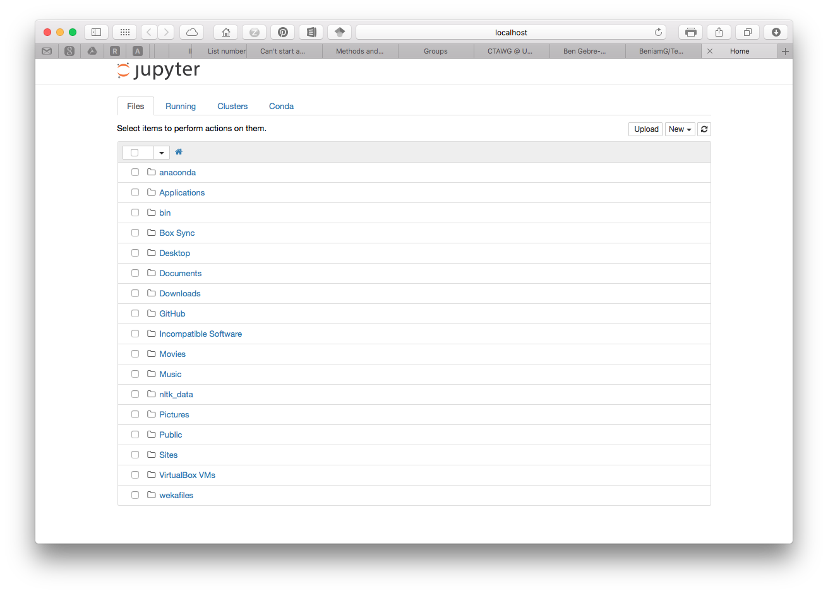
Lunch “Intro to Python.ipynb”

Slide 9
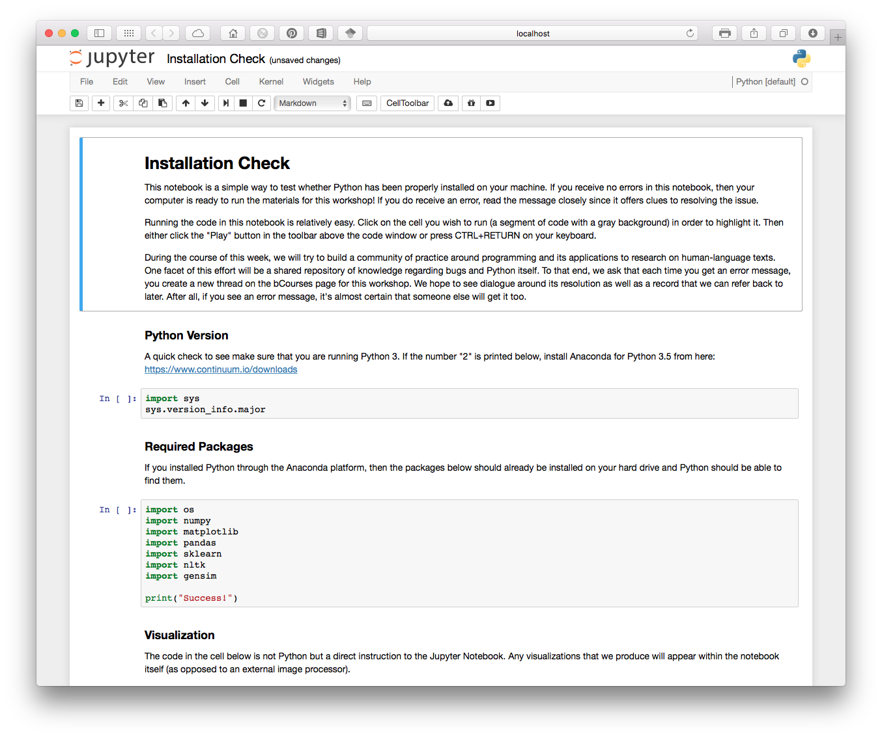
Run “Installation Check.ipynb” Within GitHub Repository: Text_Analysis_Fundamentals_3session/00-Resources/Installation Check.ipynb

