Slide 1
TutorHub
Beniamin Rekala, Mahdi Mahmody, Hasan Kizilirmak, Marvin Keiblinger
Supervisor: Mr. Martin Pazderka

Slide 2
Project Background
Time consuming
Not user-friendly
Difficult to arrange meet ups
Project Proposal
Mobile and Web App
Useful functions (filter, rating, chat, Q&A, etc.)
Build study groups

Slide 3
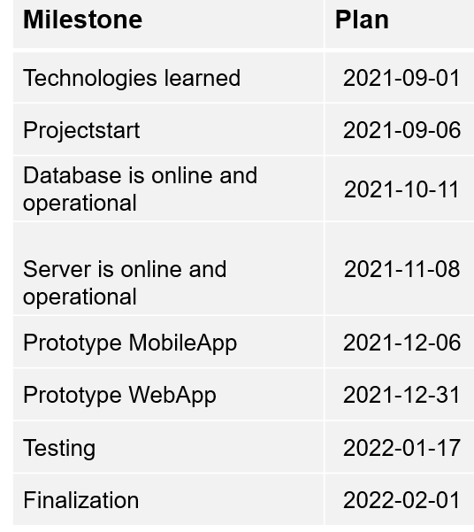
Milestones

Slide 4
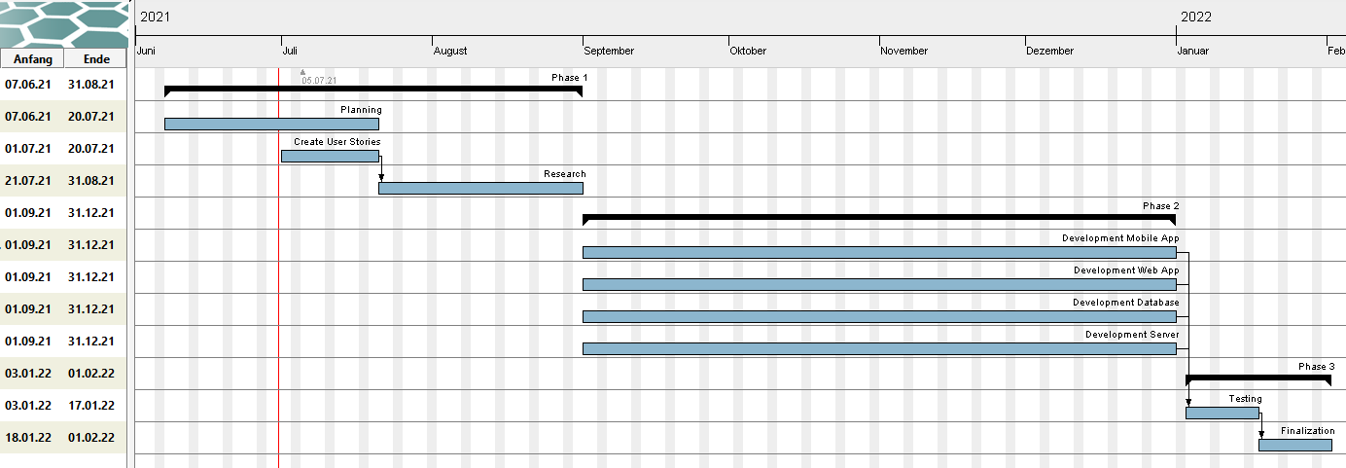
Gantt chart

Slide 5
Technologies
Database: MySQL
Web-Application: React
Mobile-Application: Java/XML
Backend: Node.js

Slide 6
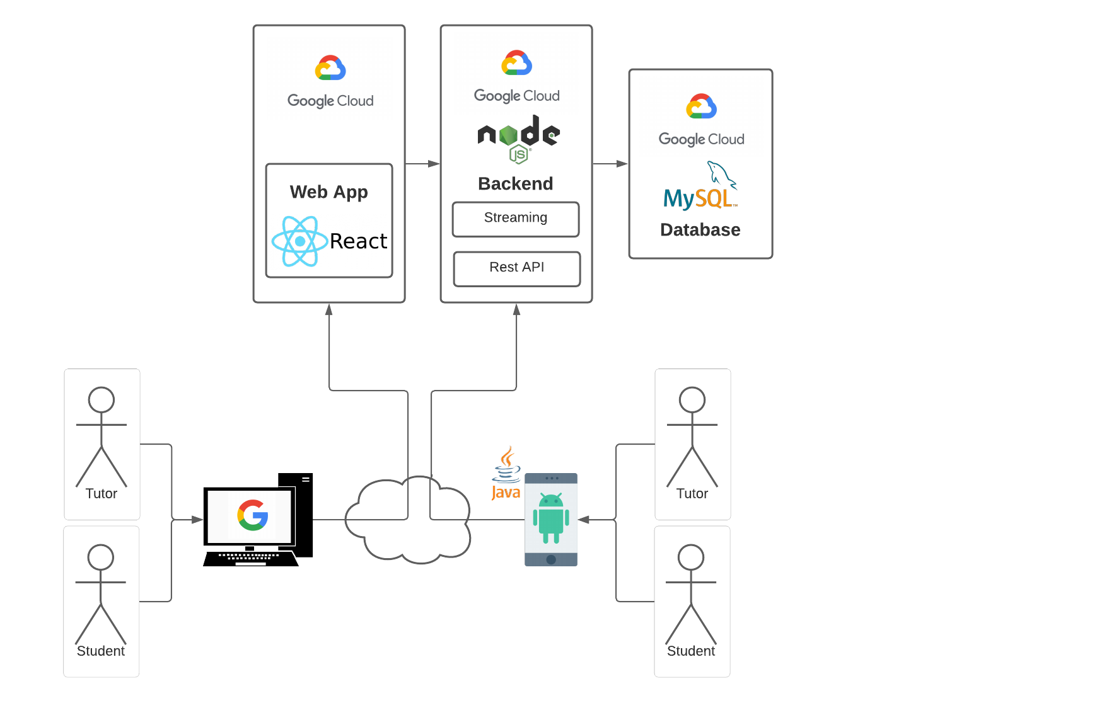
Architectural Overview

Slide 7
Roles
Mahdi Mahmody
Backend
Hasan Kizilirmak
Web-App Frontend
Marvin Keiblinger
Mobile-App Frontend
Beniamin-Vasile Rekala
Database

Slide 8
Thank you for your attention

