Slide 1
Tutor App Feasibility Study
Beniamin Rekala, Hasan kizilirmak, Marvin Keiblinger,
Mahdi Mahmody, Vratislav Doronenko

Slide 2


Agenda
Introduction
Market Study
Product Scope
Technologies
Available skills
Risk & Mitigation

Slide 3
Introduction
Project Background
Existing tutor system: complicated and time-consuming
Bad communication
Difficult to arrange meetups
Project Proposal
Mobile application and web application
Useful functions (filter, rating, chat, Q&A, screen share)
Build study groups

Slide 4
Market Study
 | NetSupportSchoolTutor | StudySmarter | tutorhunt.com | wyzant.com | Tutor App
Rating | 4.2 ⭐ | 4.4 ⭐ | 4.1 ⭐ | 4.1 ⭐ | -
Price | Free In app payment Tutor payment | Free In app payment Tutor payment | Free Tutor payment (ca. $ 40) | Free Tutor payment | Free Tutor payment
Chat | ✓ | ✓ | ✓ | ✓ | ✓
Study groups | X | ✓ | ✓ | X | ✓
Online Lessons | ✓ | ✓ | ✓ | ✓ | ✓
Feedback system | ✓ | X | ✓ | ✓ | ✓
Advanced Whiteboard | X | X | ✓ | X | X
Q&A | X | X | X | ✓ | ✓
Manage lessons | ✓ | X | ✓ | X | ✓

Slide 5
Product Scope
Create Profile Tutor/Student
Tutor can declare (their schedule, costs, contact details and the subject)
Filter
Rating
Chat
Q&A
Screenshare
Build study groups

Slide 6
Product Variants
Product Options
 | PRO | CON
Mobile app | Everyone has a mobile phone No internet needed Easier accessibility | You do not need to download anything as a user Always available
Website | You do not need to download anything as a user Always available | Website could go down (DDOS) Internet needed
Product Scope
Mobile app
Display the information
Different roles (Admin, Teacher, User)

Slide 7
Frontend technologies - Mobile App
 | Compatibility | Documentation | Our knowledge
Flutter | -------------------- Business logic in Dart | -------------------- Sufficient documentation is available | -------------------- Little to non-existent
Java/XML | -------------------- Business logic in Java | ~~~~~~~~~~~ Documentation is old | -------------------- Basic knowledge in Java
React Native | ~~~~~~~~~~~ Business logic in JavaScript | -------------------- Sufficient documentation is available | -------------------- Little to non-existent

Slide 8
Frontend technologies - Web App
 | Compatibility | Documentation | Our knowledge
HTML/CSS | -------------------- Basic HTML and CSS | -------------------- Sufficient documentation is available | -------------------- Good knowledge
React | ~~~~~~~~~~~ Business logic in JavaScript | -------------------- Sufficient documentation is available | -------------------- Little to non-existent
Angular | ~~~~~~~~~~~ Business logic in JavaScript | -------------------- Sufficient documentation is available | -------------------- Little to non-existent

Slide 9
Backend Technologies
 | Compatibility | Documentation | Our knowledge
Xamarin | -------------------- Business logic in C# | -------------------- Sufficient documentation is available | -------------------- Little to non-existent
Java Spring | -------------------- Business logic in Java | -------------------- Documentation old | -------------------- Little to non-existent
Node.js | ~~~~~~~~~~~ Business logic in JavaScript | -------------------- Sufficient documentation is available | ~~~~~~~~~~~ Basic knowledge in Node.js

Slide 10
Database Technologies
 | Compatibility | Documentation | Our knowledge
MongoDB | -------------------- Fast and can store any format | -------------------- Sufficient documentation is available | -------------------- Little to non-existent
Oracle | ~~~~~~~~~~~ Saving JSON files is supported, but it is very complex | -------------------- Sufficient documentation is available | -------------------- One-year experience in Oracle
MySQL | -------------------- Fast and can store any format | ~~~~~~~~~~~ Limited documentation is available | -------------------- Good knowledge

Slide 11
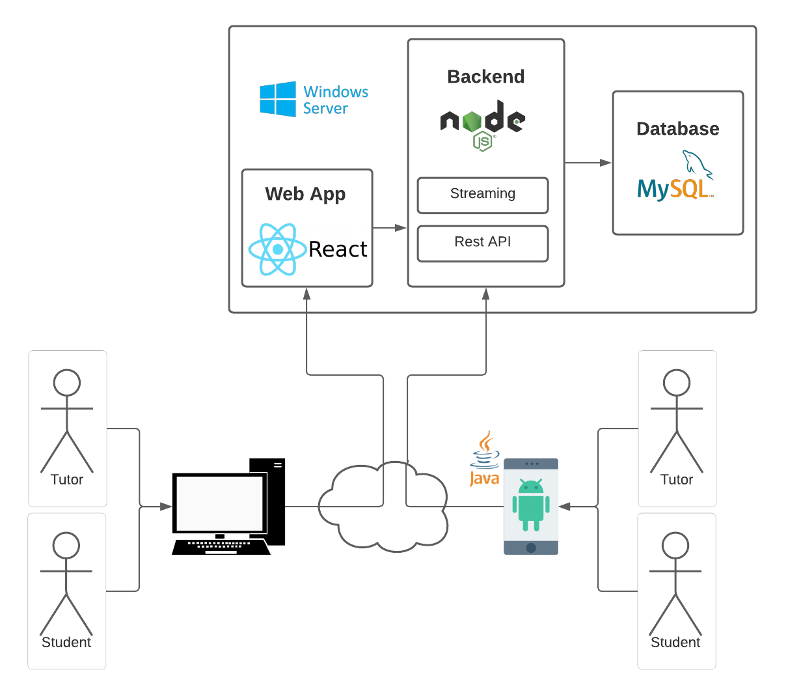

Architectural Overview

Slide 12
Available skills
 | Java | NodeJS | MySQL | JavaScript
Hasan | + | ~ | + | +
Mahdi | ~ | + | ~ | +
Beni | ~ | ~ | + | +
Vratislav | ~ | - | ~ | -
Marvin | + | ~ | + | ~

Slide 13
Risk & Mitigation
Division of work
Lockdown
Web App
Missing Manpower

Slide 14
Summary

Slide 15
THANK YOU FOR YOUR ATTENTION

