Slide 1
ST414 – Spectral Analysis of Time Series Data
Lecture 1
8 January 2015

Slide 2
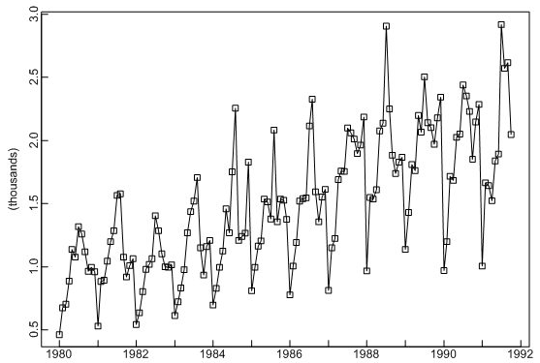
Examples
Brockwell and Davis, 2002

Slide 3
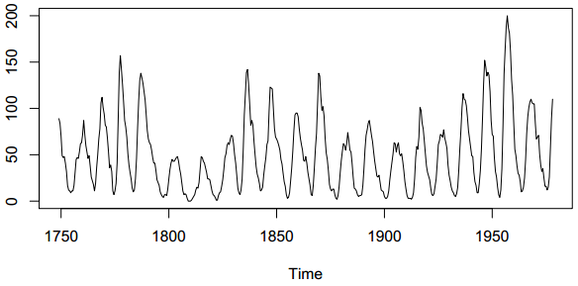
Examples
Shumway & Stoffer, 2004

Slide 4
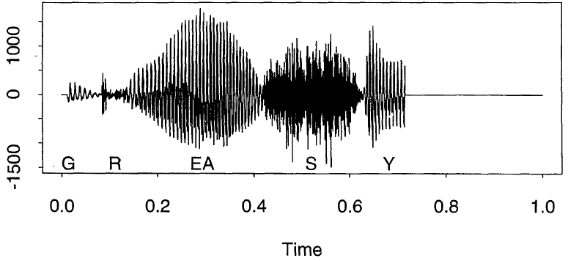
Examples
Ombao et al, 2001

Slide 5
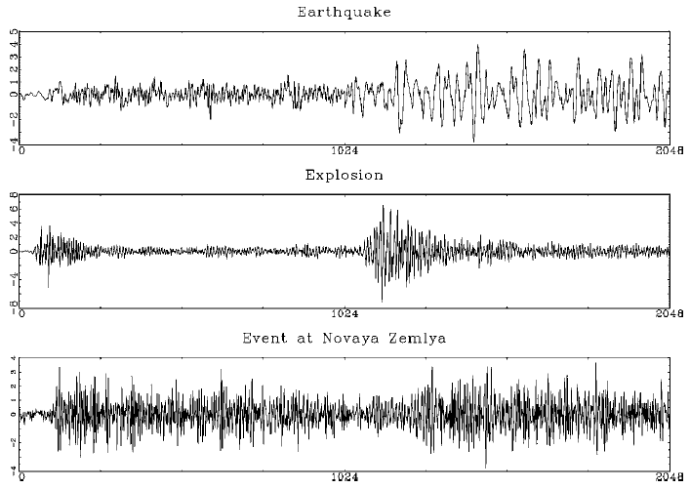
Examples
Huang et al, 2004

Slide 6
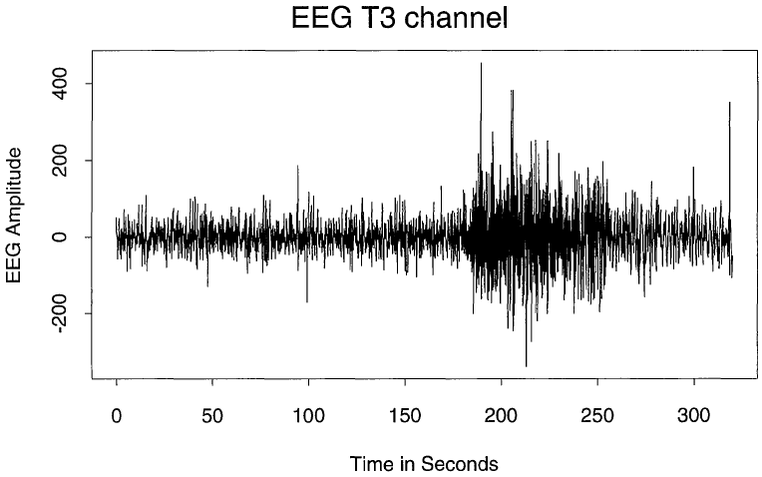
Examples
Ombao et al, 2001

Slide 7
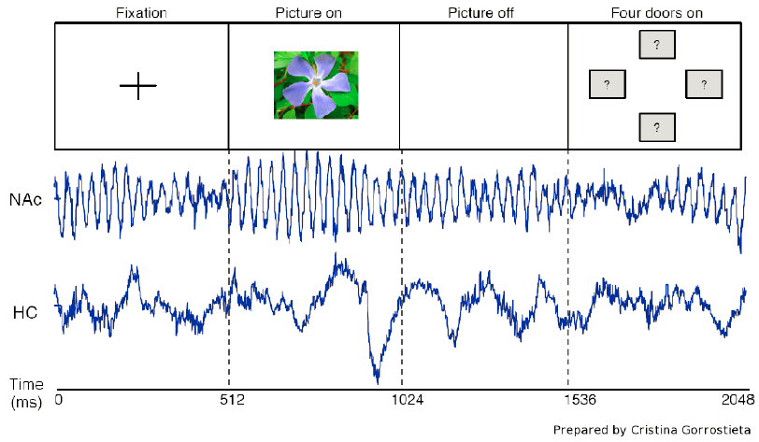
Examples

Slide 8
Overall Objective
Develop a working knowledge of statistical theories and methodologies for spectral analysis of time series data.

Slide 9
Today’s Objectives
Discuss basic time series models
Discuss periodicity
Notes: 1.1

Slide 10

Preliminaries
$X_{t}$ is said to be strictly stationary if the probabilistic behaviour of every collection of values $X_{t_{1}},…,X_{t_{k}}$ is identical to that of the shifted set $X_{t_{1}+h},…,X_{t_{k}+h}$.

Slide 11
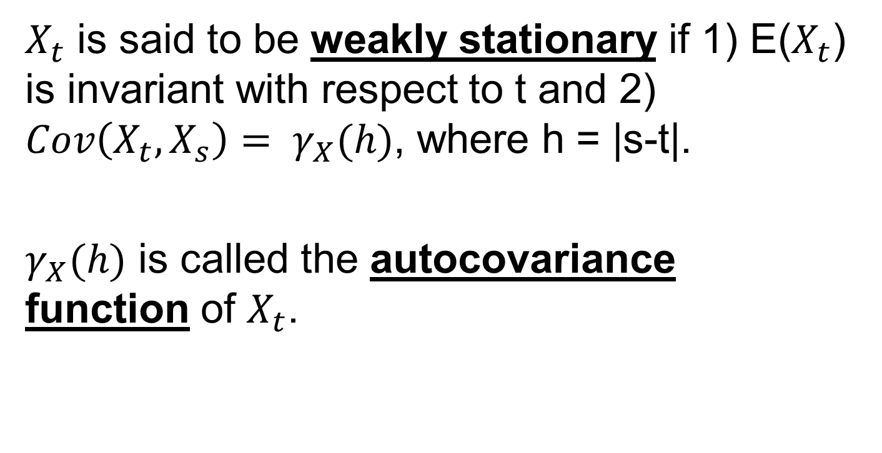
Preliminaries
$X_{t}$ is said to be weakly stationary if 1) E($X_{t}$) is invariant with respect to t and 2) $Cov\left(X_{t},X_{s}\right)= γ_{X}(h)$, where h = |s-t|.
$γ_{X}(h)$ is called the autocovariance function of $X_{t}$.

Slide 12

Preliminaries
$γ_{X}\left(0\right)≥0$
$|γ_{X}\left(h\right)|≤γ_{X}\left(0\right)$
$γ_{X}\left(h\right)$=$γ_{X}\left(−h\right)$

Slide 13
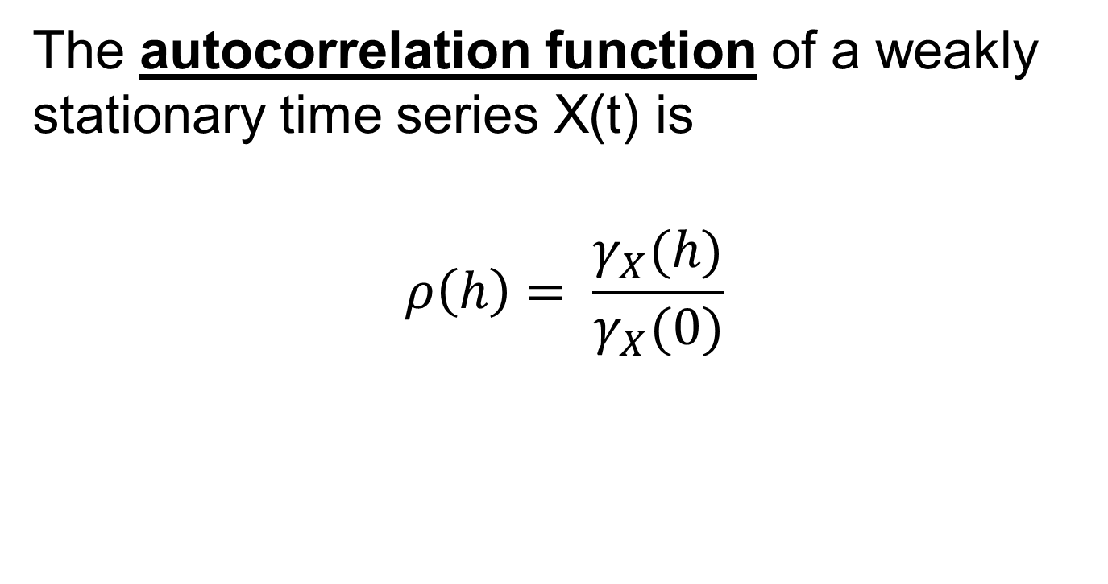
Preliminaries
The autocorrelation function of a weakly stationary time series X(t) is
$$ρ\left(h\right)= \frac{γ_{X}(h)}{γ_{X}(0)}$$

Slide 14
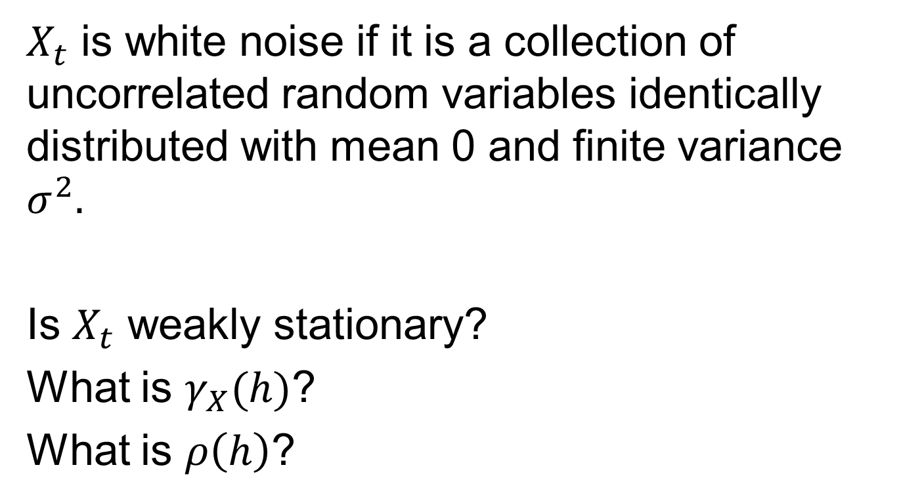
White Noise
$X_{t}$ is white noise if it is a collection of uncorrelated random variables identically distributed with mean 0 and finite variance $σ^{2}.$
Is $X_{t}$ weakly stationary?
What is $γ_{X}(h)$?
What is $ρ\left(h\right)$?

Slide 15
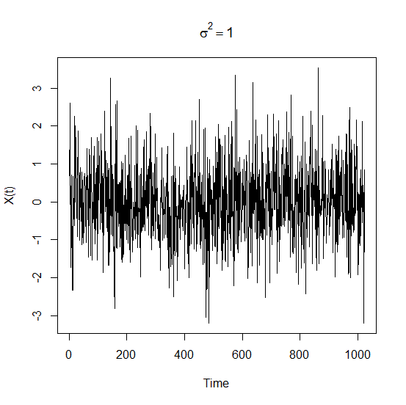
White Noise

Slide 16
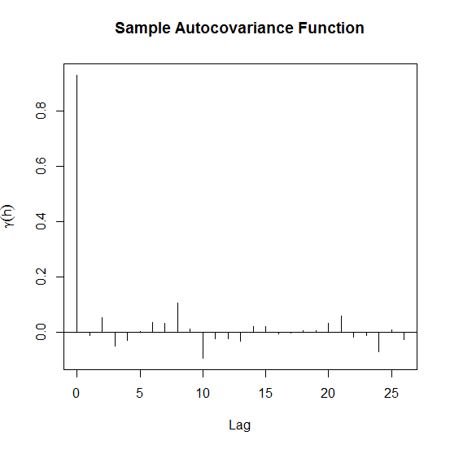
White Noise

Slide 17
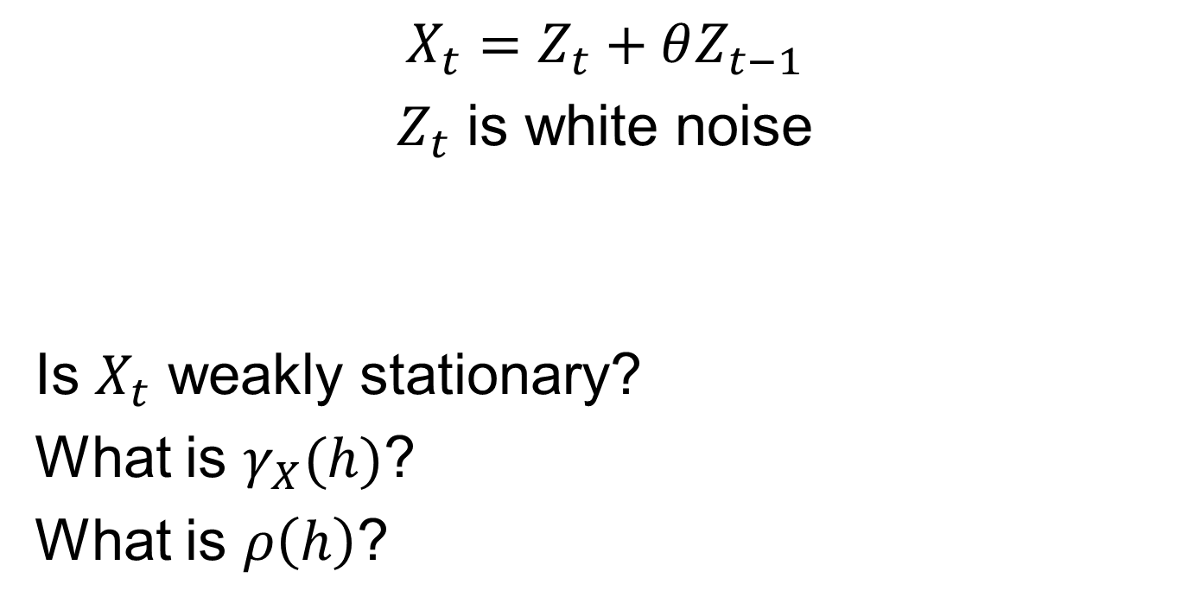
MA(1)
$$X_{t}=Z_{t}+θZ_{t−1}$$
$Z_{t}$ is white noise
Is $X_{t}$ weakly stationary?
What is $γ_{X}(h)$?
What is $ρ\left(h\right)$?

Slide 18
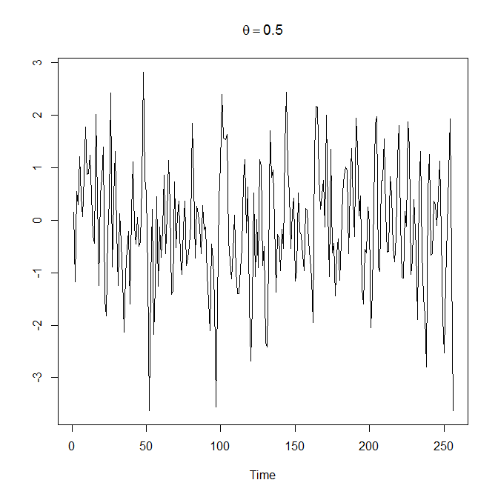
MA(1)

Slide 19
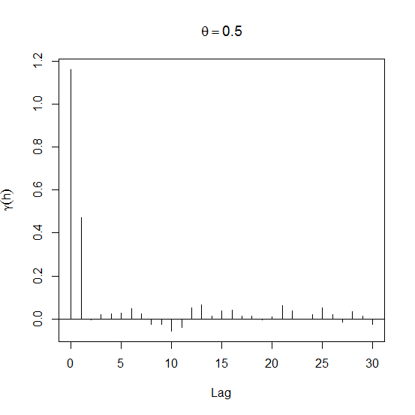
MA(1)

Slide 20
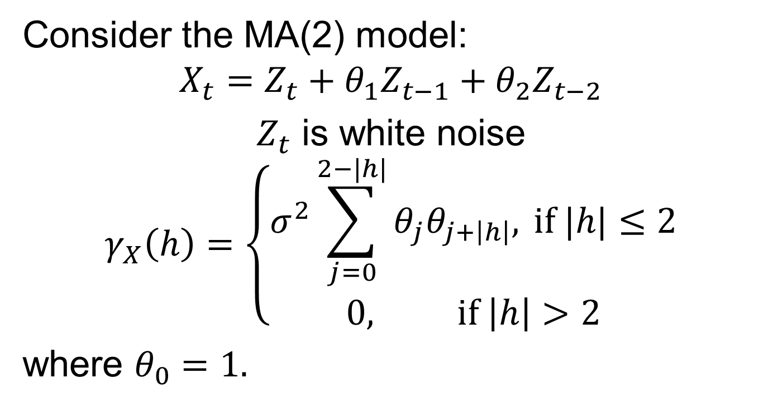
MA(2)
Consider the MA(2) model:
$$X_{t}=Z_{t}+θ_{1}Z_{t−1}+θ_{2}Z_{t−2}$$
$Z_{t}$ is white noise
$$γ_{X}\left(h\right)=\left\{\begin{aligned}σ^{2}\sum_{j=0}^{2−|h|}{θ_{j}θ_{j+\left|h\right|}, }if |h|≤2 \\ 0, \text{if} \left|h\right|>2\end{aligned}\right.$$
where $θ_{0}=1.$

Slide 21
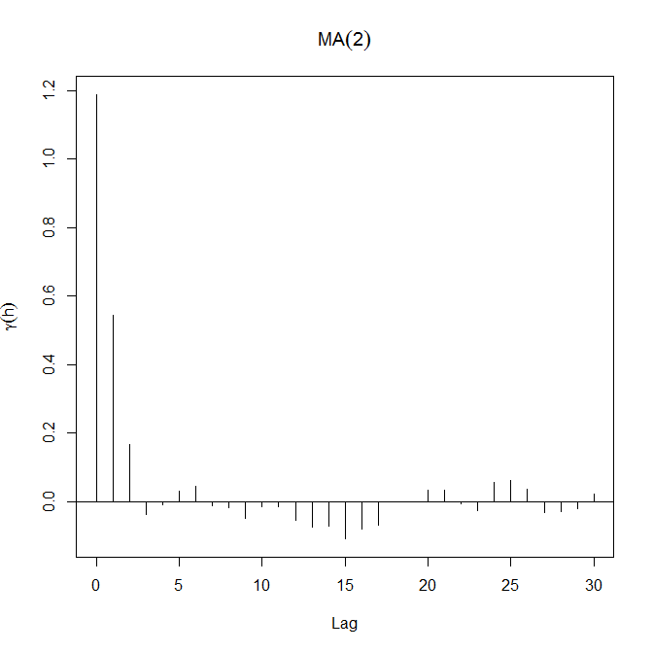
MA(2)

Slide 22
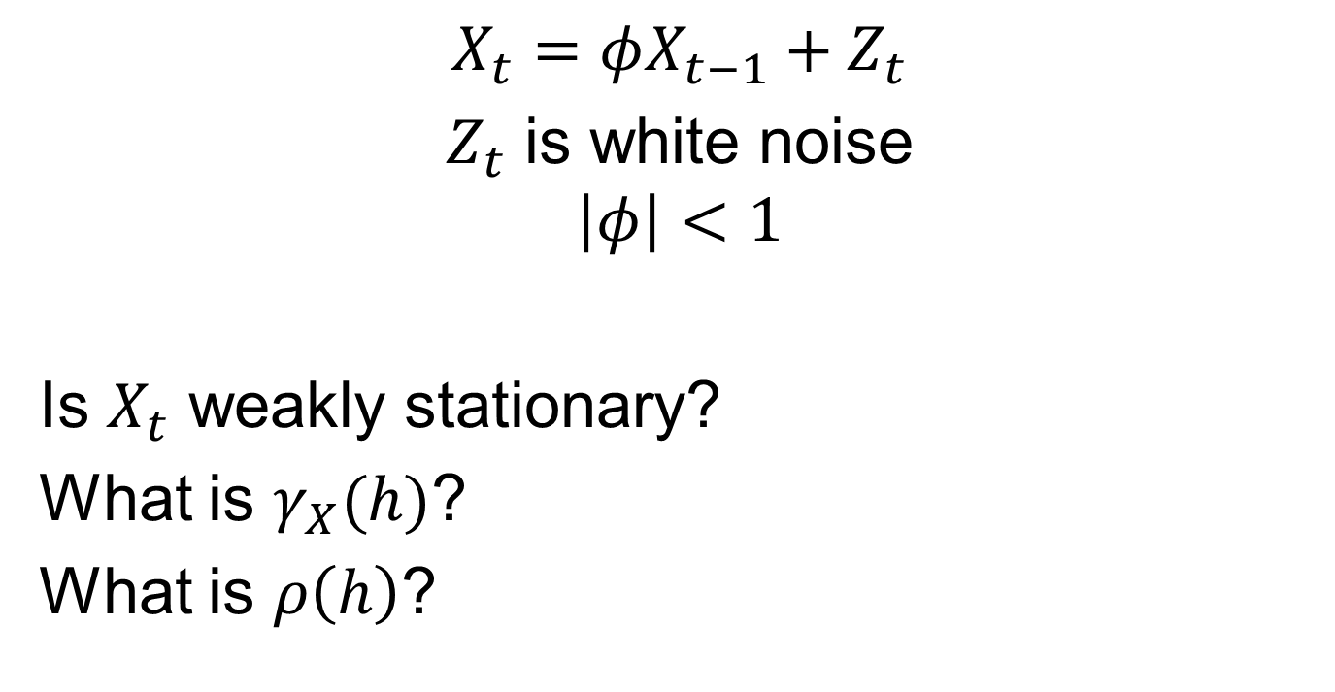
AR(1)
$$X_{t}=φX_{t−1}+Z_{t}$$
$Z_{t}$ is white noise
$$\left|φ\right|<1$$
Is $X_{t}$ weakly stationary?
What is $γ_{X}(h)$?
What is $ρ\left(h\right)$?

Slide 23
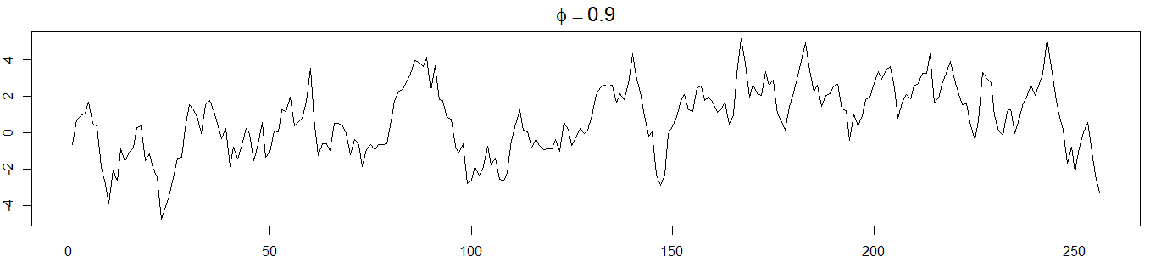
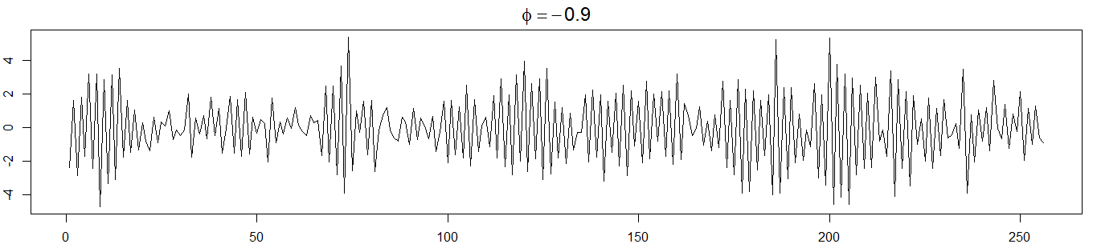
AR(1)

Slide 24
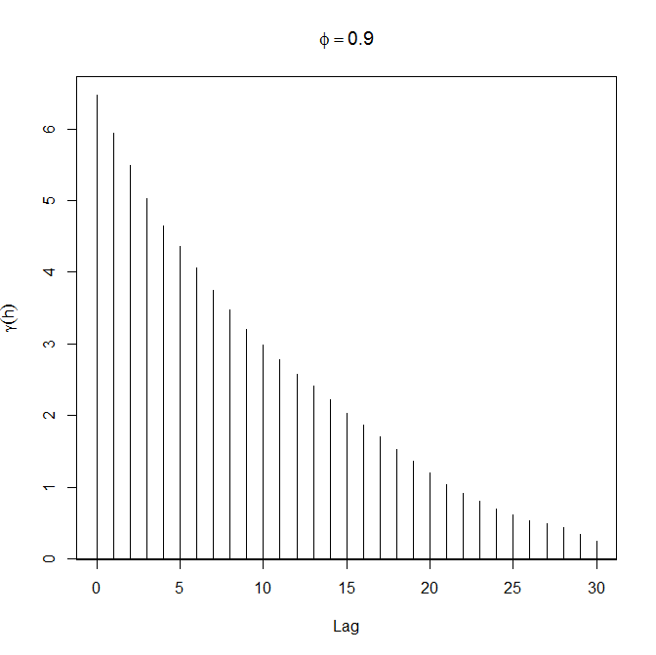
AR(1)

Slide 25
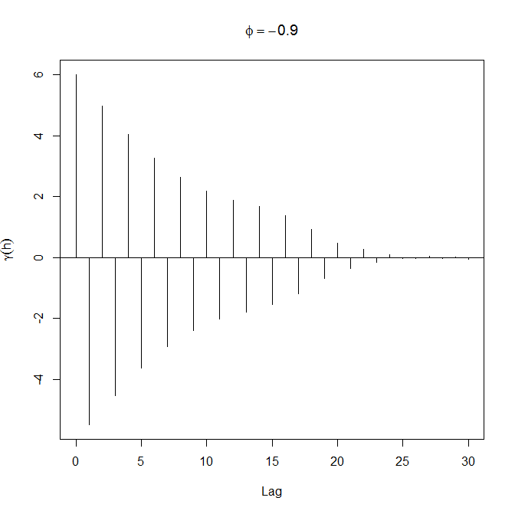
AR(1)

Slide 26
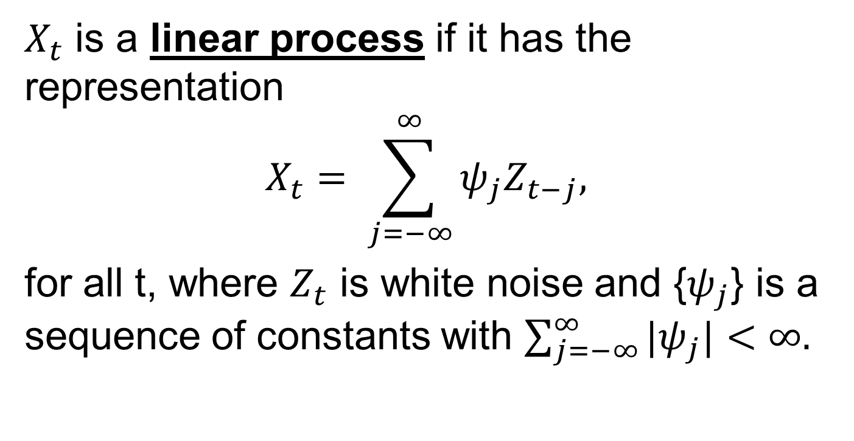
Linear Processes
$X_{t}$ is a linear process if it has the representation
$$X_{t}= \sum_{j=−∞}^{∞}{ψ_{j}Z_{t−j},}$$
for all t, where $Z_{t}$ is white noise and {$ψ_{j}$} is a sequence of constants with $\sum_{j=−∞}^{∞}{{|ψ}_{j}|<∞.}$

Slide 27

Linear Processes
White Noise
$$ψ_{j}=\left\{\begin{aligned}1, if j=0 \\ 0, otherwise\end{aligned}\right.$$

Slide 28

Linear Processes
MA(1): $X_{t}=Z_{t}+θZ_{t−1}$
$$ψ_{j}=\left\{\begin{aligned}1, if j=0 \\ θ, if j=1 \\ 0, otherwise\end{aligned}\right.$$

Slide 29

Linear Processes
AR(1): $X_{t}=φX_{t−1}+Z_{t}=\sum_{j=0}^{∞}{φ^{j}Z_{t−j}}$
$$ψ_{j}=\left\{\begin{aligned}φ^{j}, if j≥0 \\ 0, otherwise\end{aligned}\right.$$

Slide 30
The PACF
For MA(q) models, the ACF vanishes after q lags. This is not the case for AR(p) models.

Slide 31
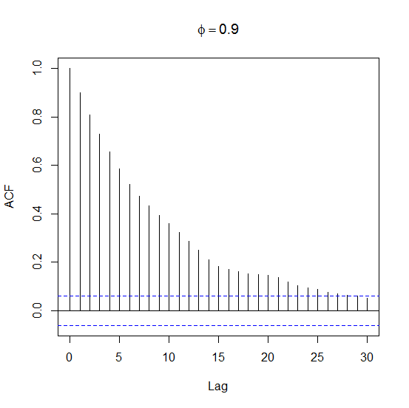
ACF of AR(1)

Slide 32

The PACF
In a (causal) AR(1) model, $X_{t}$ is linearly related to $X_{t−2}$ through $X_{t−1}$.
However, $X_{t}−φX_{t−1}$ and $X_{t−2}−φX_{t−1}$ are uncorrelated.

Slide 33
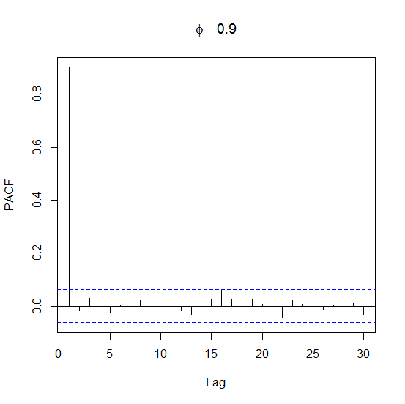
PACF of AR(1)

Slide 34

The PACF
Heuristically, take the correlation between $X_{t}$ and $X_{s}$ after removing the effecting of everything in between.

Slide 35
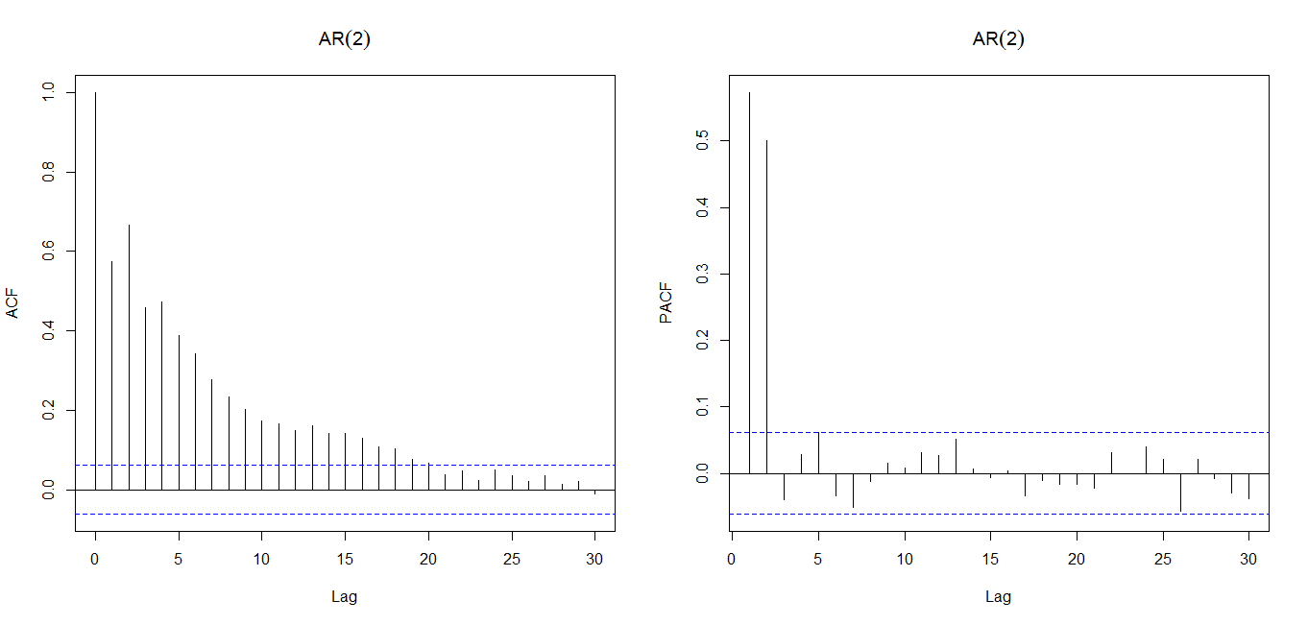
PACF of AR(2)

Slide 36
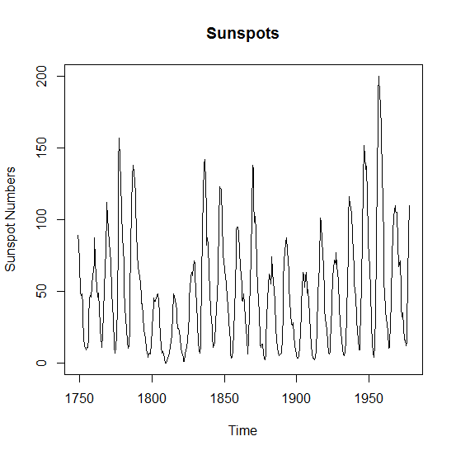
Example

Slide 37
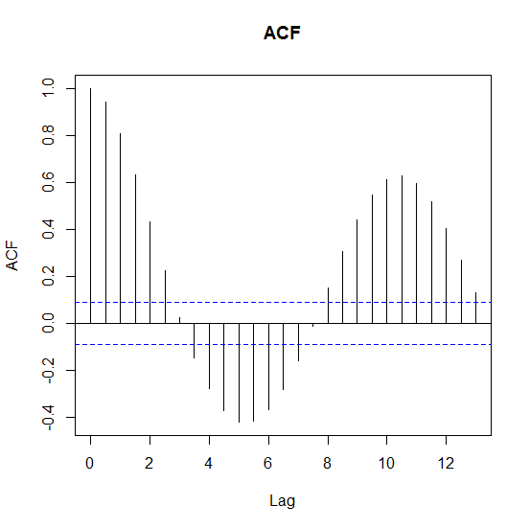
Example

Slide 38
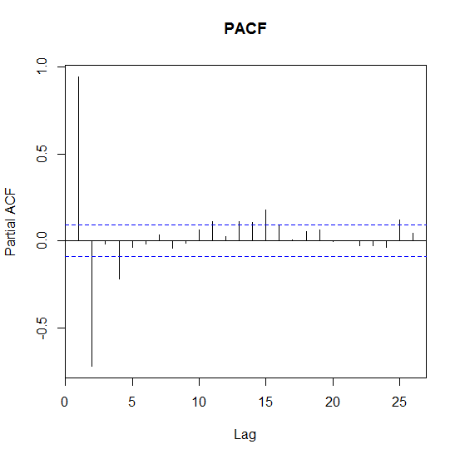
Example

Slide 39
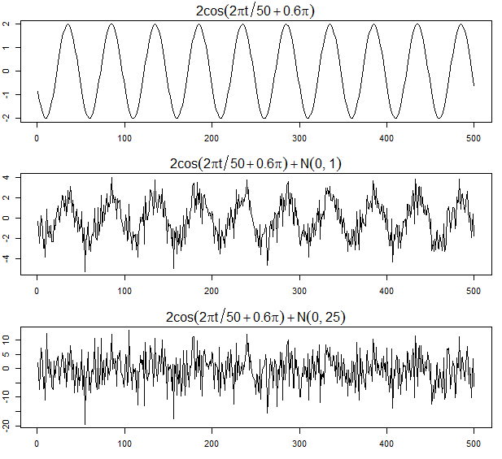
Periodic Models
Shumway & Stoffer, 2004

Slide 40
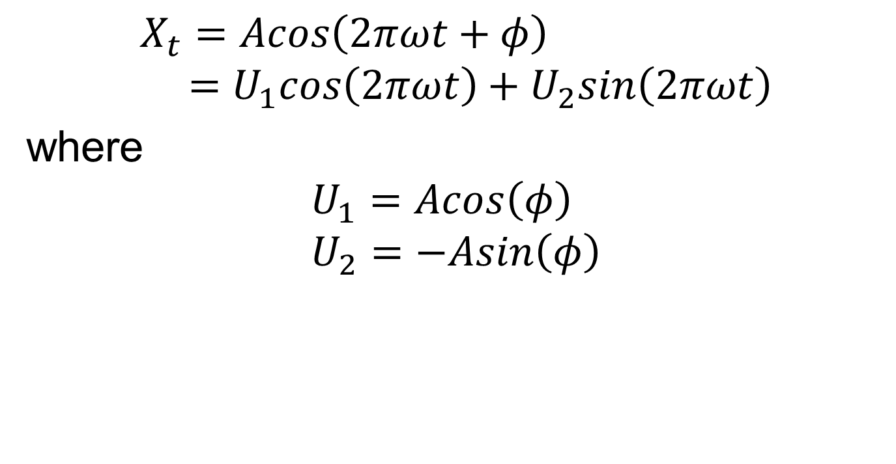
Periodic Models
$$X_{t}=Acos\left(2πωt+φ\right) \\ =U_{1}cos\left(2πωt\right)+U_{2}sin\left(2πωt\right)$$
where
$$U_{1}=Acos\left(φ\right) \\ U_{2}=−Asin\left(φ\right)$$

Slide 41
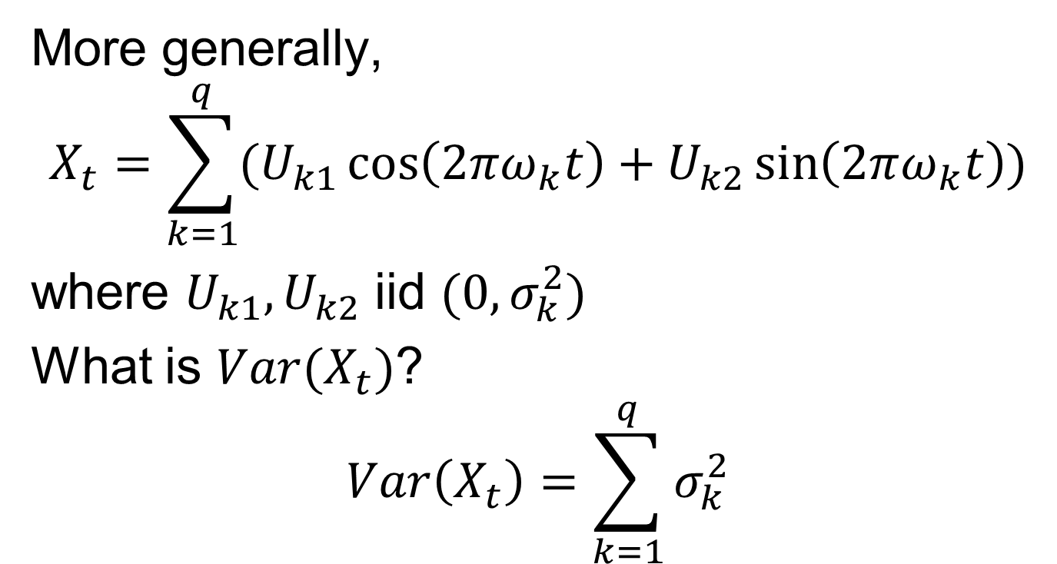
Periodic Models
More generally,
$$X_{t}=\sum_{k=1}^{q}{(U_{k1}\cos\left(2πω_{k}t\right)+U_{k2}\sin\left(2πω_{k}t\right))}$$
where $U_{k1},U_{k2}$ iid $(0,σ_{k}^{2})$
What is $Var(X_{t})$?
$$Var\left(X_{t}\right)=\sum_{k=1}^{q}{σ_{k}^{2}}$$

Slide 42
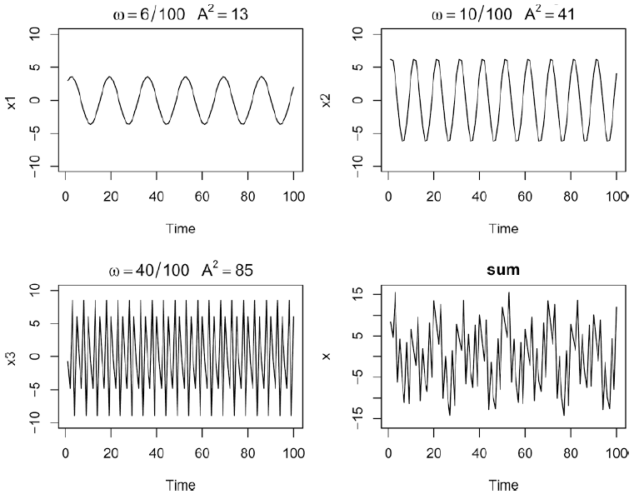
Periodic Models
Shumway & Stoffer, 2004

Slide 43
Next Time
Notes: 2.1
Univariate spectral analysis

