Slide 1
ST414 – Spectral Analysis of Time Series Data
Lecture 2
30 January 2014

Slide 2
Last Time
Weak stationarity
The autocovariance function
MA & AR models
Notes: 1.1

Slide 3
Today’s Objectives
Periodic Models
Introduce the spectral density function
Derive the spectral density function for time domain models
Notes: 2.1, 2.2, and 2.3.

Slide 4
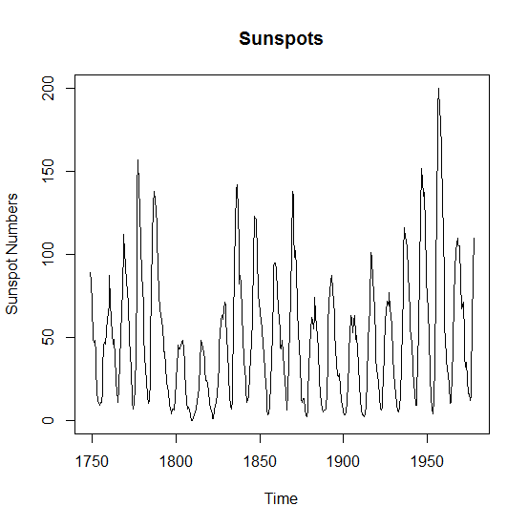
Example

Slide 5
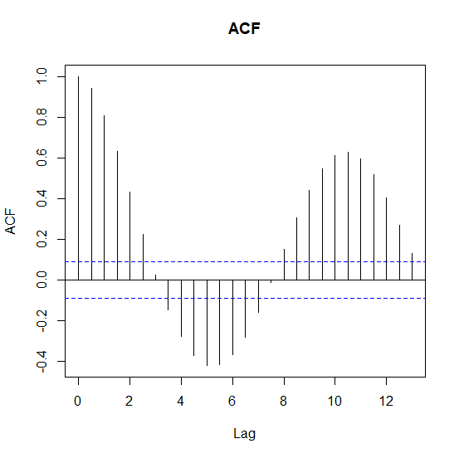
Example

Slide 6
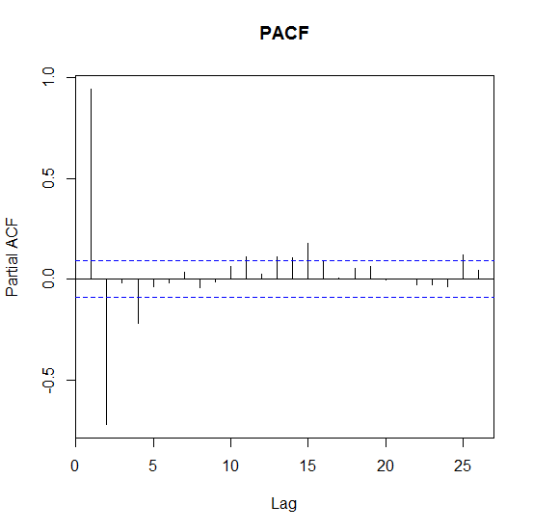
Example

Slide 7
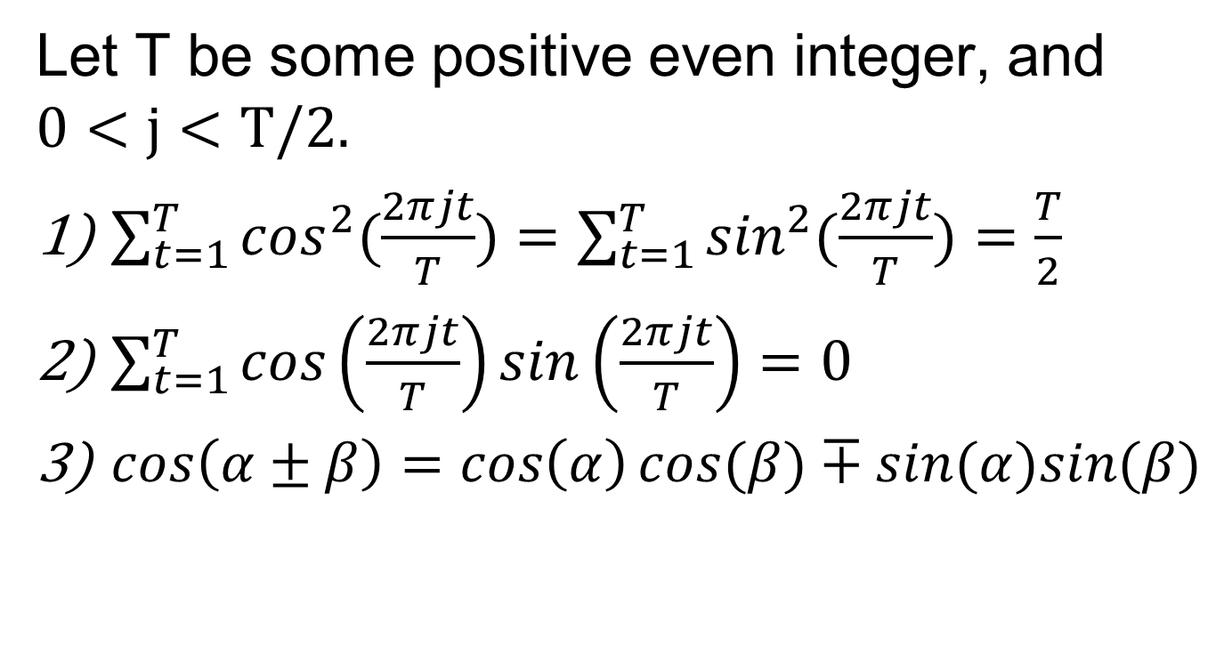
Some Useful Identities
Let T be some positive even integer, and $0<j<T/2.$
$\sum_{t=1}^{T}{\cos^{2}(\frac{2πjt}{T})}=\sum_{t=1}^{T}{\sin^{2}(\frac{2πjt}{T})}=\frac{T}{2}$
$\sum_{t=1}^{T}{\cos\left(\frac{2πjt}{T}\right)}sin\left(\frac{2πjt}{T}\right)=0$
$cos\left(α±β\right)=\cos\left(α\right)cos⁡(β)∓sin(α)sin⁡(β)$

Slide 8
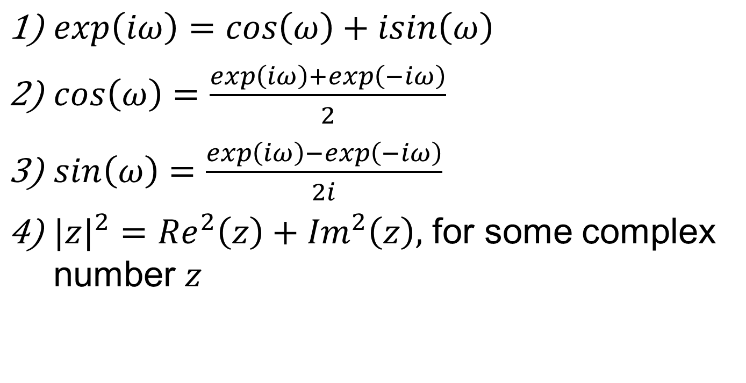
Some Useful Identities
$\exp\left(iω\right)=\cos\left(ω\right)+isin\left(ω\right)$
$\cos\left(ω\right)=\frac{\exp\left(iω\right)+\exp\left(−iω\right)}{2}$
$\sin\left(ω\right)=\frac{\exp\left(iω\right)−\exp\left(−iω\right)}{2i}$
${|z|}^{2}={Re}^{2}\left(z\right)+{Im}^{2}\left(z\right),$ for some complex number $z$

Slide 9
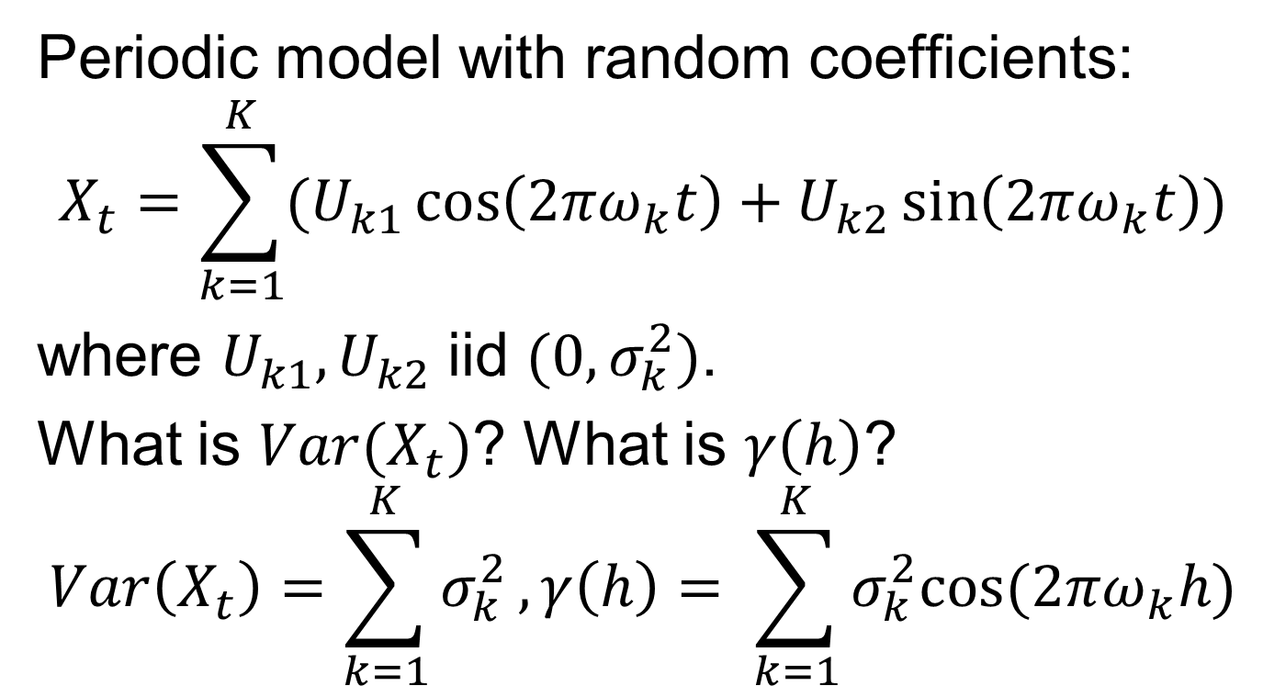
Periodic Models
Periodic model with random coefficients:
$$X_{t}=\sum_{k=1}^{K}{(U_{k1}\cos\left(2πω_{k}t\right)+U_{k2}\sin\left(2πω_{k}t\right))}$$
where $U_{k1},U_{k2}$ iid $(0,σ_{k}^{2})$.
What is $Var(X_{t})$? What is $γ\left(h\right)$?
$$Var\left(X_{t}\right)=\sum_{k=1}^{K}{σ_{k}^{2}},γ\left(h\right)= \sum_{k=1}^{K}{σ_{k}^{2}cos⁡(2πω_{k}h)}$$

Slide 10
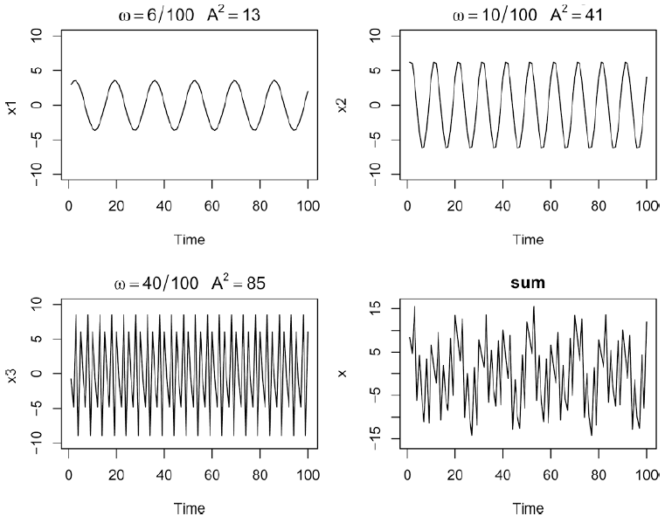
Periodic Models
Shumway & Stoffer, 2004

Slide 11
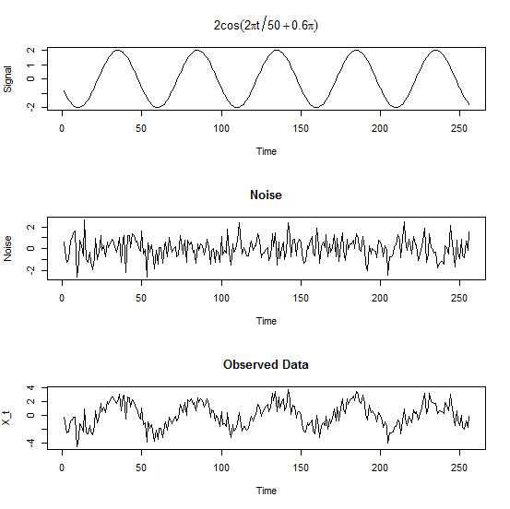
Example

Slide 12
Two Problems
What is the amplitude for the oscillations?
How do you pick the frequencies that drive the data?

Slide 13
Problem 1
Regress the data on the sines and cosines that oscillate at the frequency of interest.

Slide 14
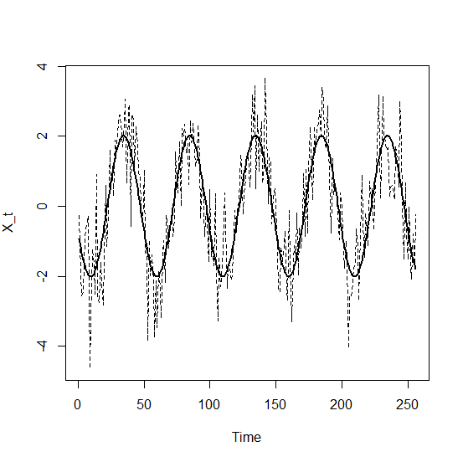
Problem 1

Slide 15
Problem 2
Regress sine and cosine waves oscillating at each frequency.

Slide 16
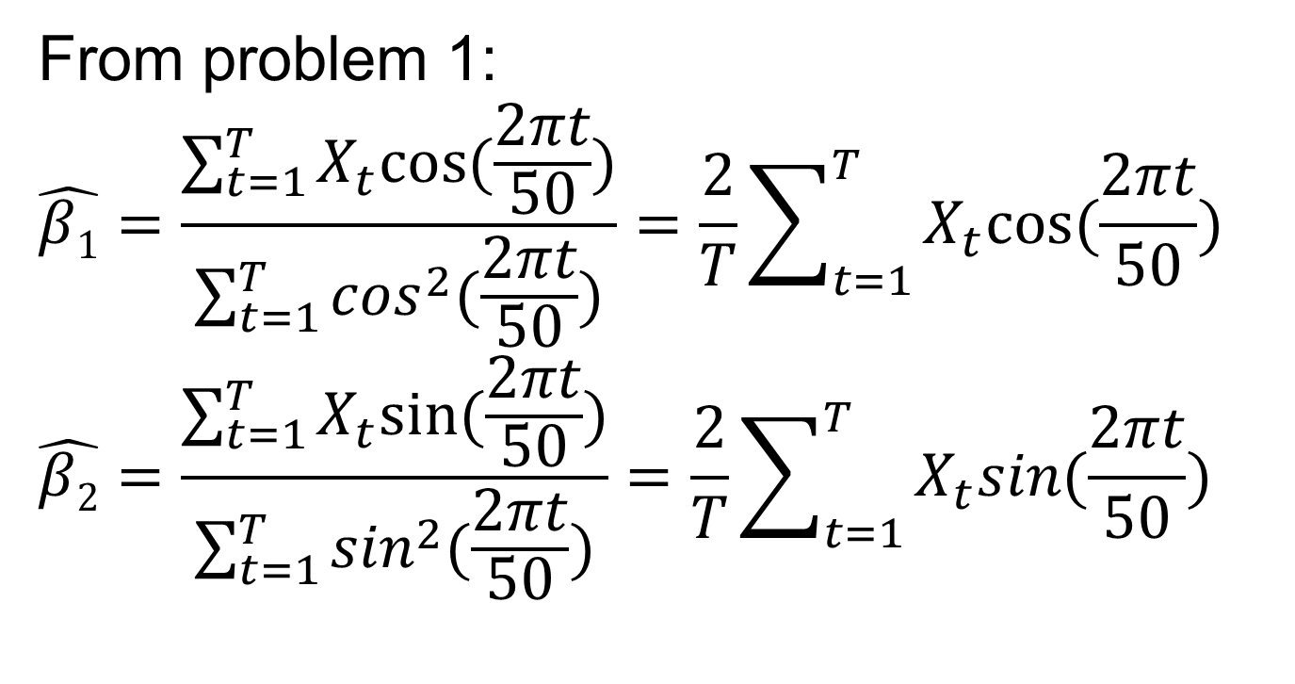
Problem 2
From problem 1:
$$\hat{β1}=\frac{\sum_{t=1}^{T}{X_{t}cos⁡(\frac{2πt}{50})}}{\sum_{t=1}^{T}{\cos^{2}(\frac{2πt}{50})}}=\frac{2}{T}\sum_{t=1}^{T}{X_{t}cos⁡(\frac{2πt}{50})}$$
$$\hat{β2}=\frac{\sum_{t=1}^{T}{X_{t}sin⁡(\frac{2πt}{50})}}{\sum_{t=1}^{T}{\sin^{2}(\frac{2πt}{50})}}=\frac{2}{T}\sum_{t=1}^{T}{X_{t}sin(\frac{2πt}{50})}$$

Slide 17
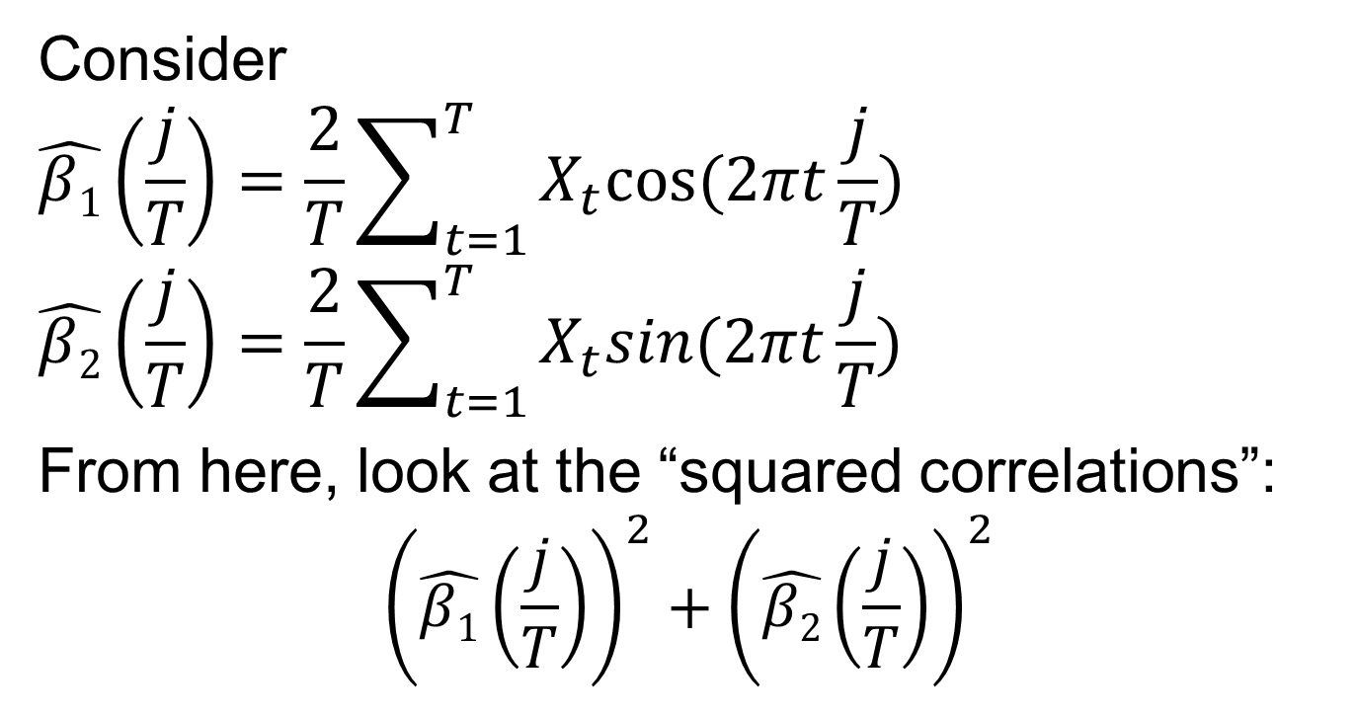
Problem 2
Consider
$$\hat{β1}\left(\frac{j}{T}\right)=\frac{2}{T}\sum_{t=1}^{T}{X_{t}cos⁡(2πt\frac{j}{T})}$$
$$\hat{β2}\left(\frac{j}{T}\right)=\frac{2}{T}\sum_{t=1}^{T}{X_{t}sin(2πt\frac{j}{T})}$$
From here, look at the “squared correlations”:
$${\left(\hat{β1}\left(\frac{j}{T}\right)\right)}^{2}+{\left(\hat{β2}\left(\frac{j}{T}\right)\right)}^{2}$$

Slide 18
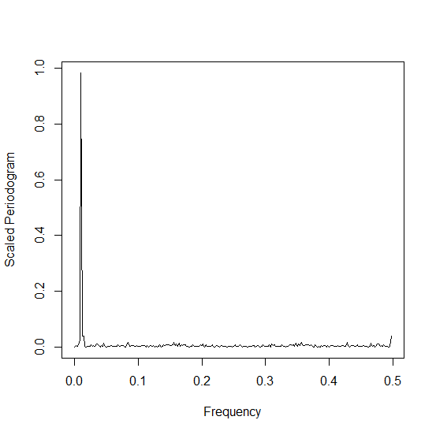
Problem 2

Slide 19
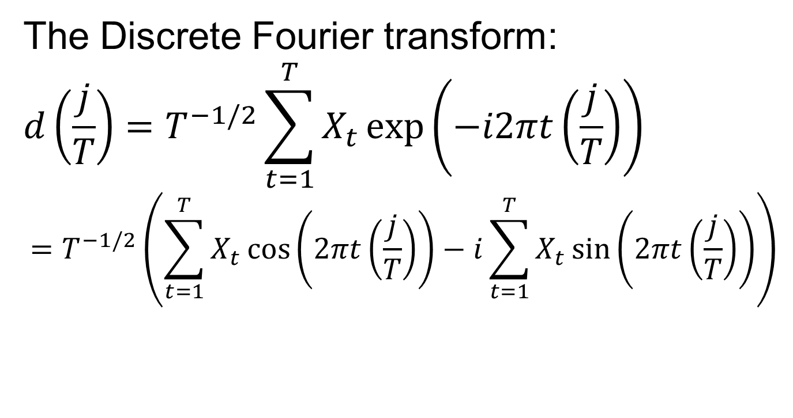
The Periodogram
The Discrete Fourier transform:
$$d\left(\frac{j}{T}\right)=T^{−1/2}\sum_{t=1}^{T}{X_{t}\exp\left(−i2πt\left(\frac{j}{T}\right)\right)}$$
$$=T^{−1/2}\left(\sum_{t=1}^{T}{X_{t}\cos\left(2πt\left(\frac{j}{T}\right)\right)−i}\sum_{t=1}^{T}{X_{t}\sin\left(2πt\left(\frac{j}{T}\right)\right)}\right)$$

Slide 20
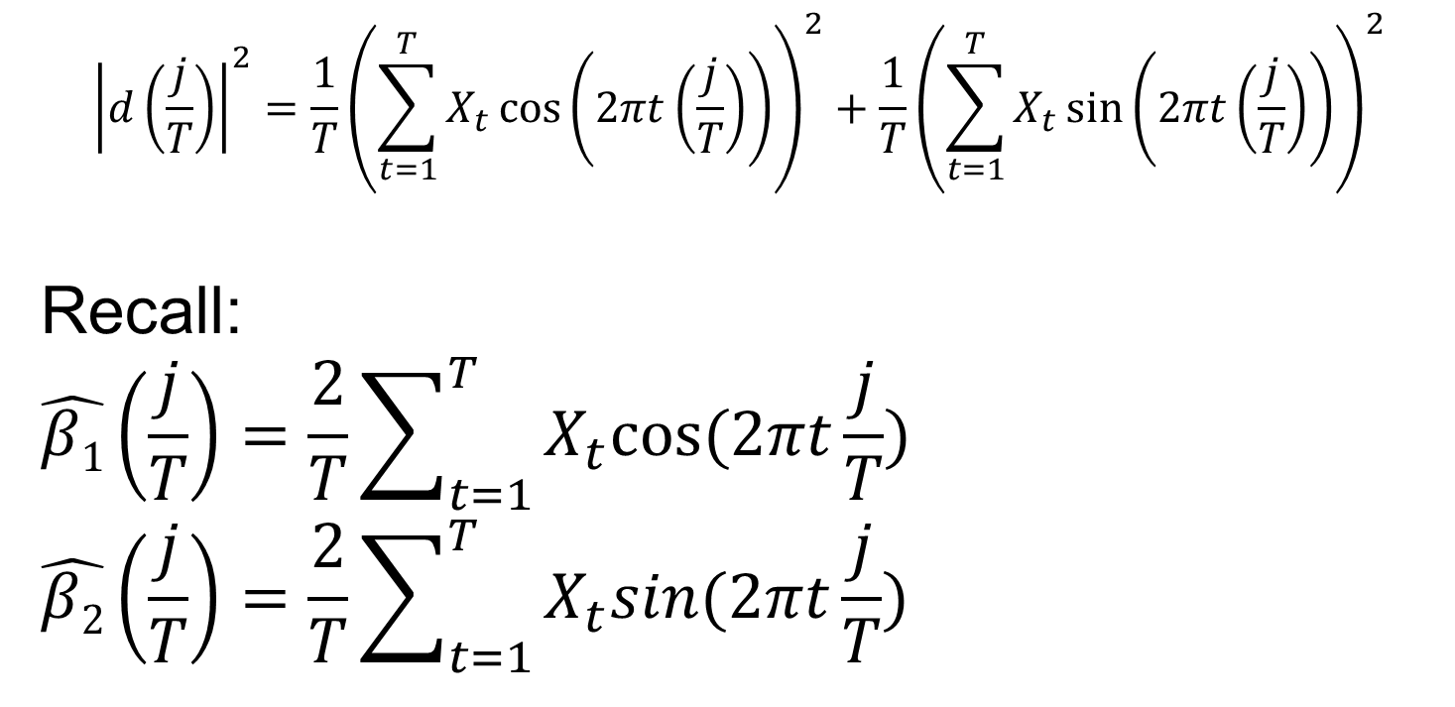
The Periodogram
$${\left|d\left(\frac{j}{T}\right)\right|}^{2}={\frac{1}{T}\left(\sum_{t=1}^{T}{X_{t}\cos\left(2πt\left(\frac{j}{T}\right)\right)}\right)}^{2}+{\frac{1}{T}\left(\sum_{t=1}^{T}{X_{t}\sin\left(2πt\left(\frac{j}{T}\right)\right)}\right)}^{2}$$
Recall:
$$\hat{β1}\left(\frac{j}{T}\right)=\frac{2}{T}\sum_{t=1}^{T}{X_{t}cos⁡(2πt\frac{j}{T})}$$
$$\hat{β2}\left(\frac{j}{T}\right)=\frac{2}{T}\sum_{t=1}^{T}{X_{t}sin(2πt\frac{j}{T})}$$

Slide 21
The Periodogram
The periodogram can be easily (and quickly!) computed using the Fast Fourier transform.

Slide 22
The Periodogram
Shumway & Stoffer, 2004

Slide 23
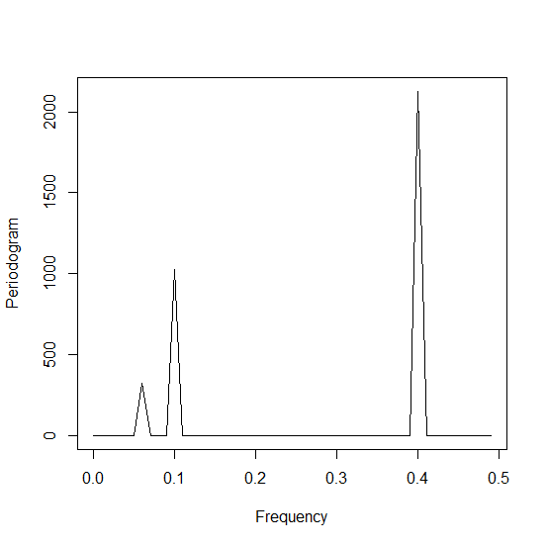
The Periodogram

Slide 24
Example

Slide 25
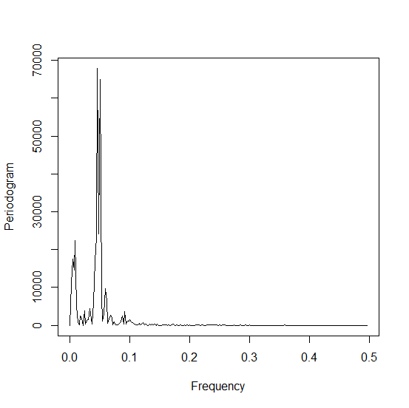
Example

Slide 26
The Spectral Density
The periodogram is an estimator for a parameter called the spectral density function.

Slide 27
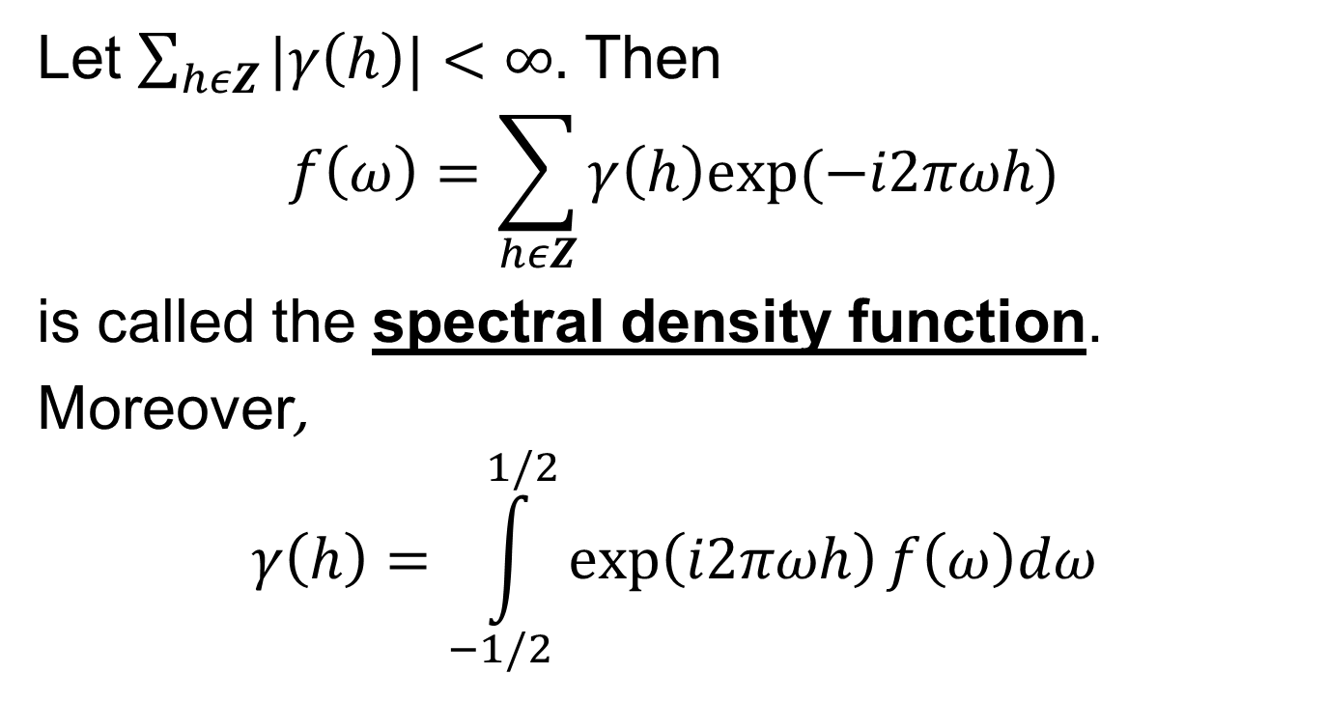
The Spectral Density
Let $\sum_{hεZ}{|γ\left(h\right)|}<∞.$ Then
$$f\left(ω\right)=\sum_{hεZ}{γ\left(h\right)exp⁡(−i2πωh)}$$
is called the spectral density function.
Moreover,
$$γ\left(h\right)=\int_{−1/2}^{1/2}{\exp\left(i2πωh\right)f\left(ω\right)dω}$$

Slide 28

The Spectral Density
$γ\left(h\right)$ and $f\left(ω\right)$ are Fourier transform pairs. (The spectral density is uniquely determined given an autocovariance function, and vice-versa.)

Slide 29

The Spectral Density
$f\left(ω\right)≥0$
$f\left(ω\right)=f(−ω)$
$f\left(ω\right)=f(1−ω)$

Slide 30
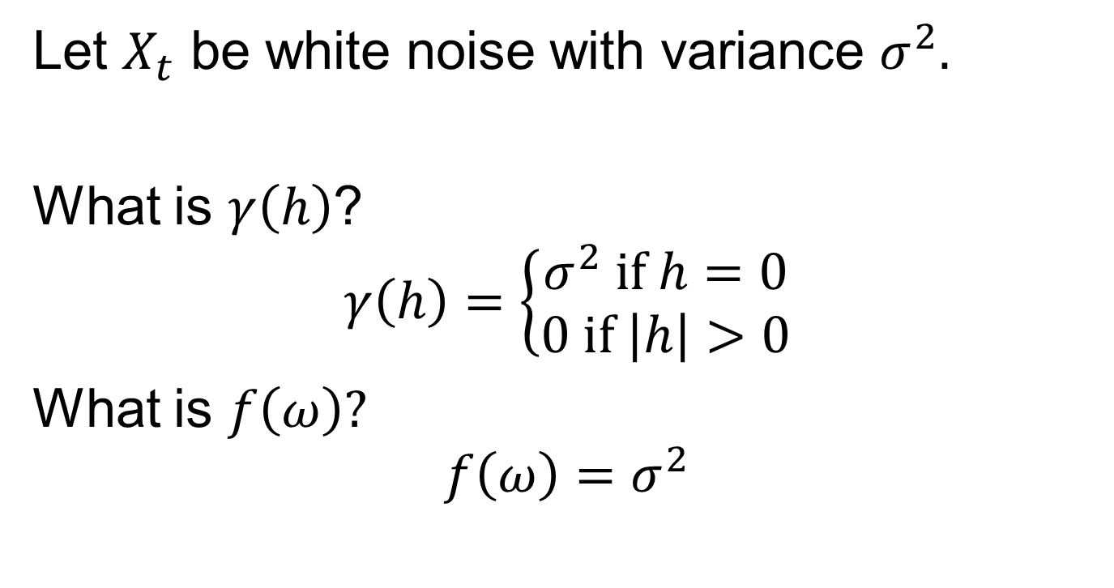
White Noise
Let $X_{t}$ be white noise with variance $σ^{2}.$
What is $γ\left(h\right)$?
$$γ\left(h\right)=\left\{\begin{aligned}σ^{2} if h=0 \\ 0 if \left|h\right|>0\end{aligned}\right.$$
What is $f\left(ω\right)?$
$$f\left(ω\right)=σ^{2}$$

Slide 31
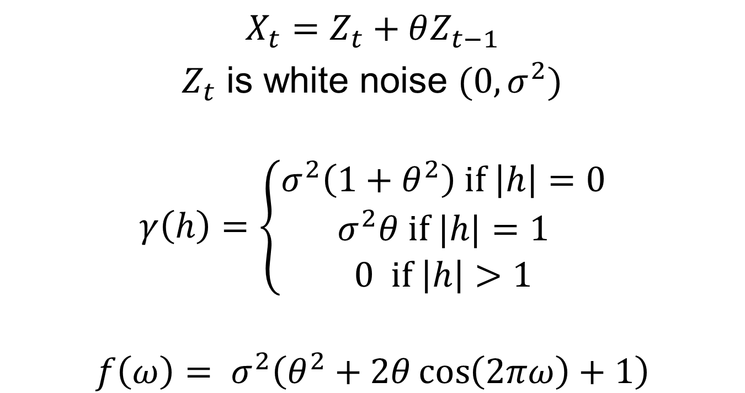
MA(1)
$$X_{t}=Z_{t}+θZ_{t−1}$$
$Z_{t}$ is white noise ${(0,σ}^{2})$
$$γ\left(h\right)=\left\{\begin{aligned}\begin{aligned}σ^{2}\left(1+θ^{2}\right) if \left|h\right|=0 \\ σ^{2}θ \text{if} |h|=1\end{aligned} \\ 0 \text{if} \left|h\right|>1\end{aligned}\right.$$
$$f\left(ω\right)= σ^{2}\left(θ^{2}+2θ\cos\left(2πω\right)+1\right)$$

Slide 32
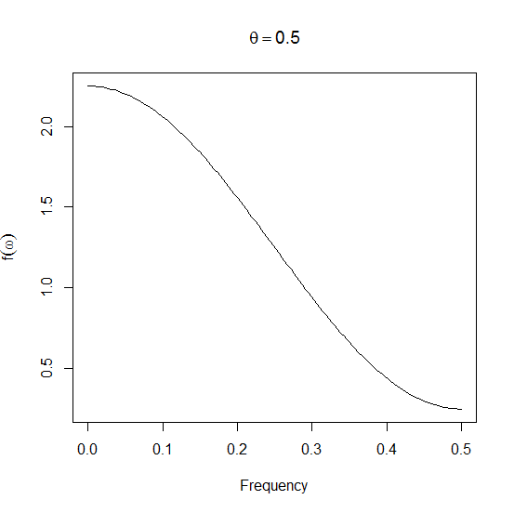
MA(1)

Slide 33
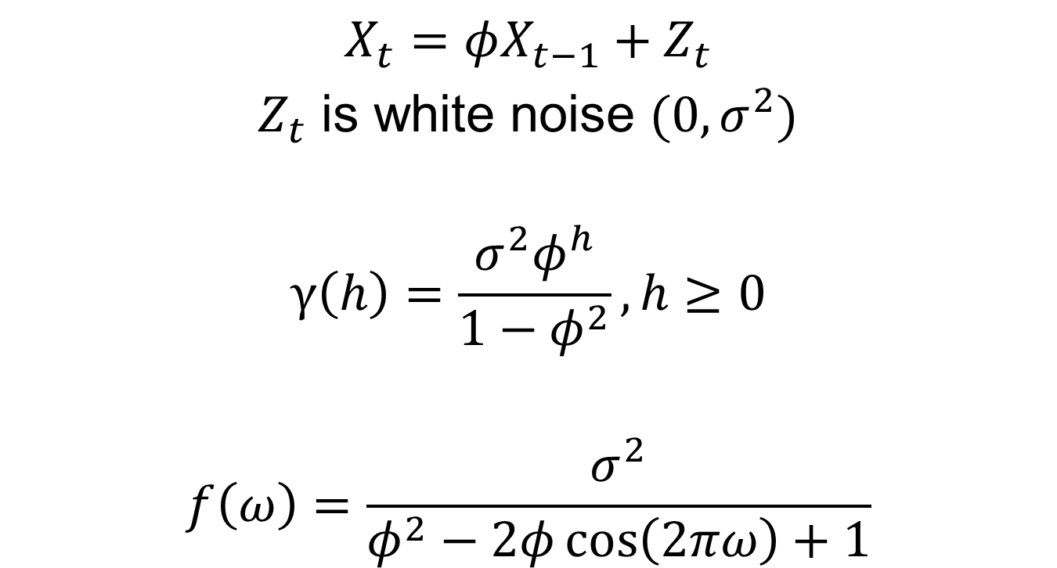
AR(1)
$$X_{t}=φX_{t−1}+Z_{t}$$
$Z_{t}$ is white noise ${(0,σ}^{2})$
$$γ\left(h\right)=\frac{σ^{2}φ^{h}}{1−φ^{2}}, h≥0$$
$$f\left(ω\right)=\frac{σ^{2}}{φ^{2}−2φ\cos\left(2πω\right)+1}$$

Slide 34
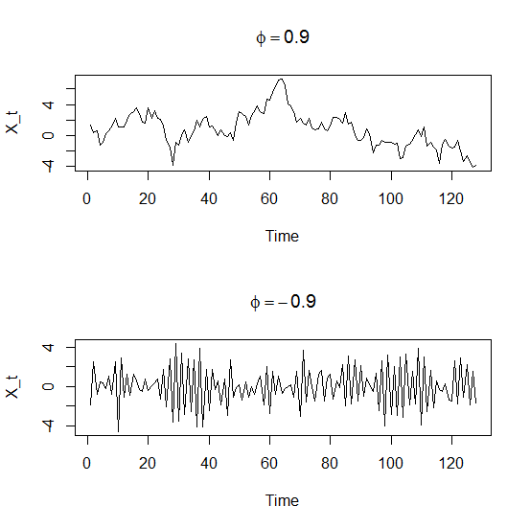
AR(1)

Slide 35
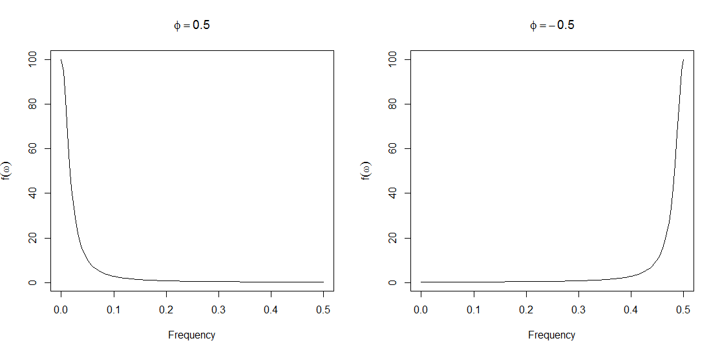
AR(1)

Slide 36
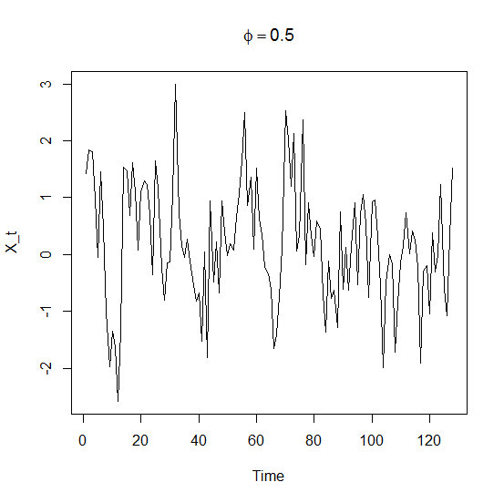
AR(1)

Slide 37
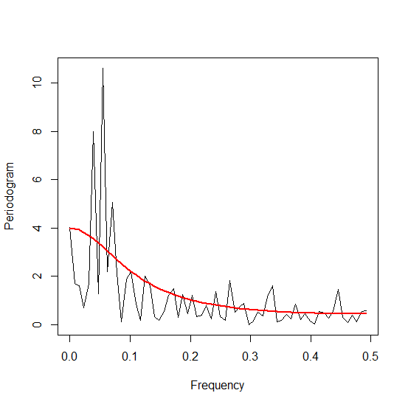
AR(1)

Slide 38
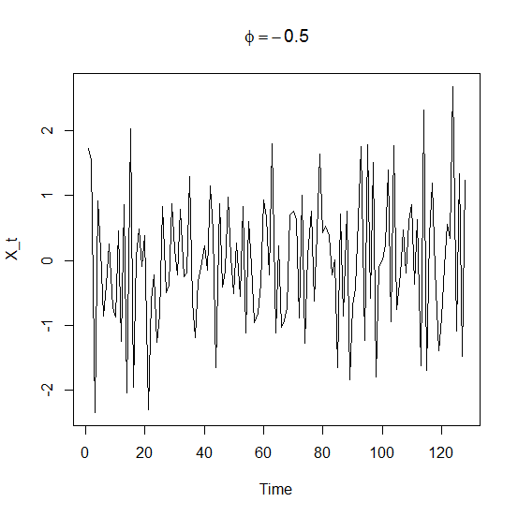
AR(1)

Slide 39
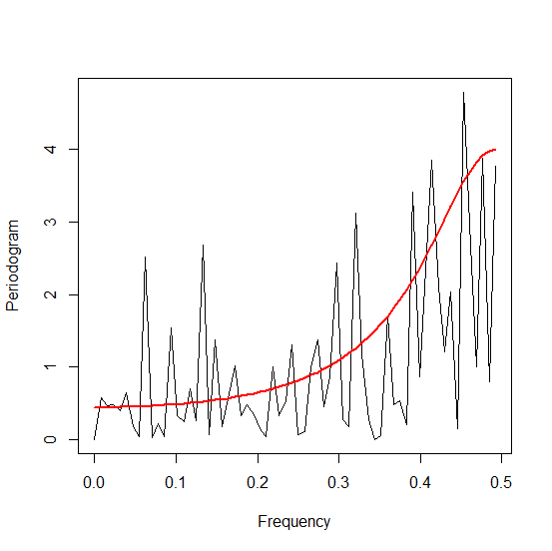
AR(1)

Slide 40
Next Time
Asymptotics of the periodogram.
The smoothed periodogram.
Notes: 2.3 and 2.4.

