Slide 1
ST414 – Spectral Analysis of Time Series Data
Lecture 3
22 January 2015

Slide 2
Last Time
Periodic Models
Introduce the spectral density function
Derive the spectral density function for time domain models
Notes: 2.1, 2.2, and 2.3.

Slide 3
Today’s Objectives
Resume discussion on the spectral density function
Discuss the periodogram and its properties
Discuss the smoothed periodogram and its properties
Notes: 2.1, 2.2, 2.3, and 2.4

Slide 4
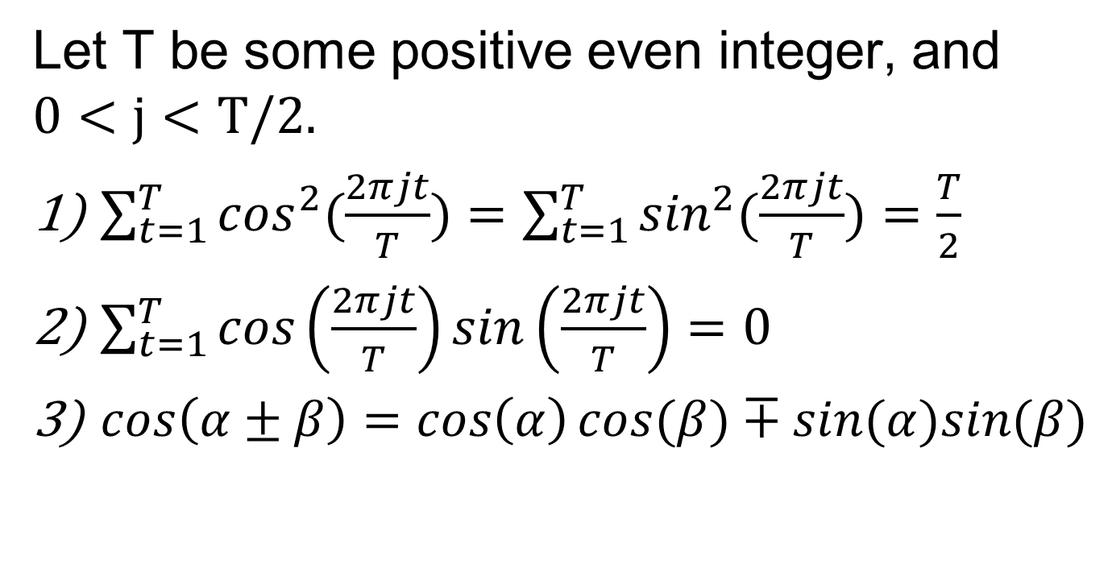
Some Useful Identities
Let T be some positive even integer, and $0<j<T/2.$
$\sum_{t=1}^{T}{\cos^{2}(\frac{2πjt}{T})}=\sum_{t=1}^{T}{\sin^{2}(\frac{2πjt}{T})}=\frac{T}{2}$
$\sum_{t=1}^{T}{\cos\left(\frac{2πjt}{T}\right)}sin\left(\frac{2πjt}{T}\right)=0$
$cos\left(α±β\right)=\cos\left(α\right)cos⁡(β)∓sin(α)sin⁡(β)$

Slide 5
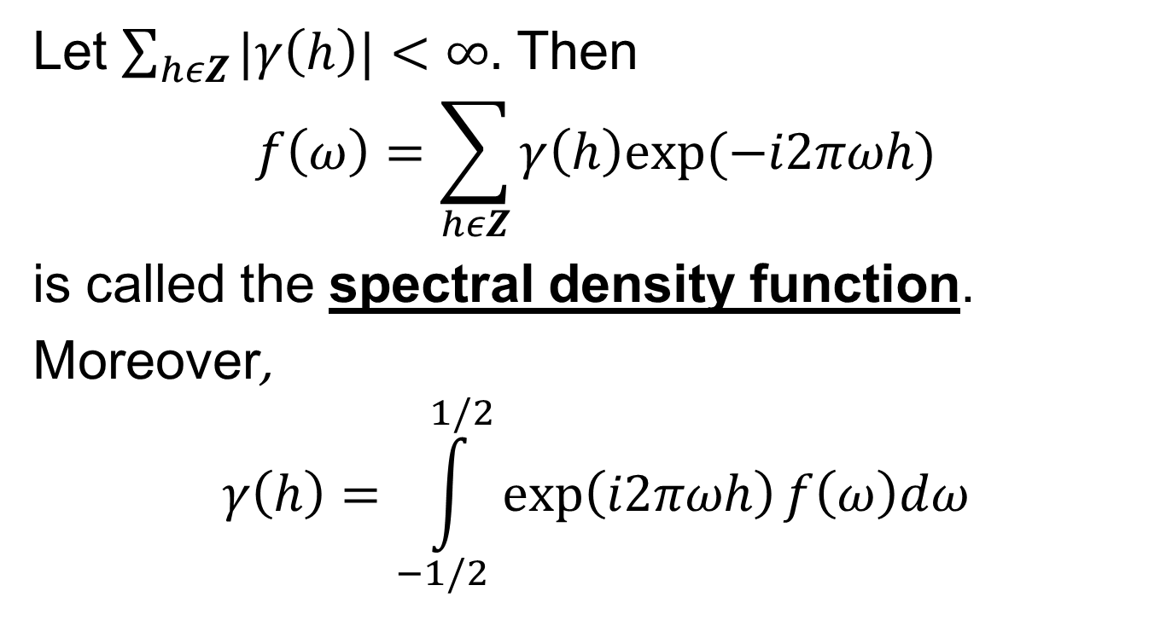
The Spectral Density
Let $\sum_{hεZ}{|γ\left(h\right)|}<∞.$ Then
$$f\left(ω\right)=\sum_{hεZ}{γ\left(h\right)exp⁡(−i2πωh)}$$
is called the spectral density function.
Moreover,
$$γ\left(h\right)=\int_{−1/2}^{1/2}{\exp\left(i2πωh\right)f\left(ω\right)dω}$$

Slide 6
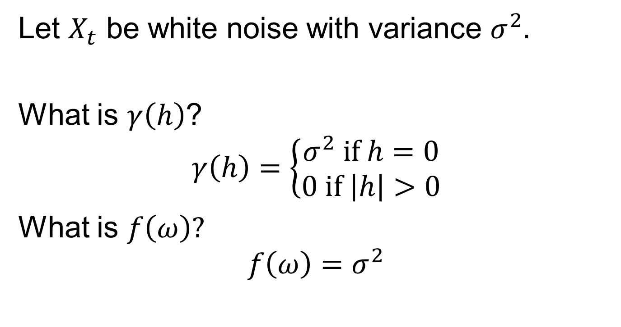
White Noise
Let $X_{t}$ be white noise with variance $σ^{2}.$
What is $γ\left(h\right)$?
$$γ\left(h\right)=\left\{\begin{aligned}σ^{2} if h=0 \\ 0 if \left|h\right|>0\end{aligned}\right.$$
What is $f\left(ω\right)?$
$$f\left(ω\right)=σ^{2}$$

Slide 7
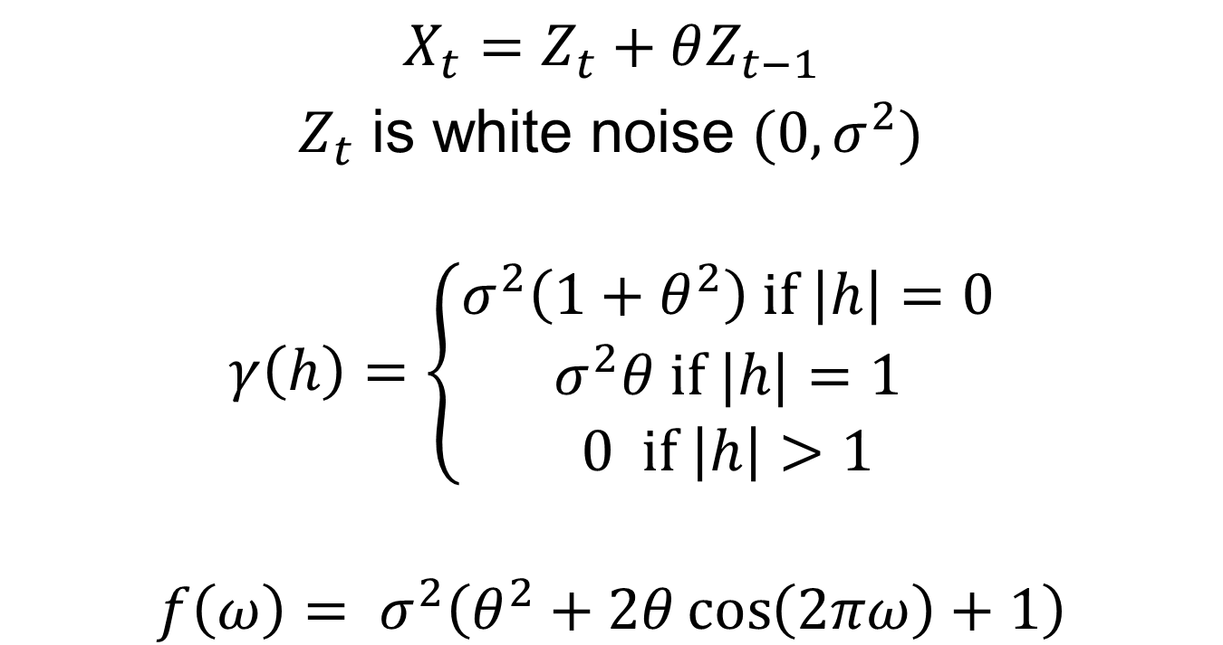
MA(1)
$$X_{t}=Z_{t}+θZ_{t−1}$$
$Z_{t}$ is white noise ${(0,σ}^{2})$
$$γ\left(h\right)=\left\{\begin{aligned}\begin{aligned}σ^{2}\left(1+θ^{2}\right) if \left|h\right|=0 \\ σ^{2}θ \text{if} |h|=1\end{aligned} \\ 0 \text{if} \left|h\right|>1\end{aligned}\right.$$
$$f\left(ω\right)= σ^{2}\left(θ^{2}+2θ\cos\left(2πω\right)+1\right)$$

Slide 8
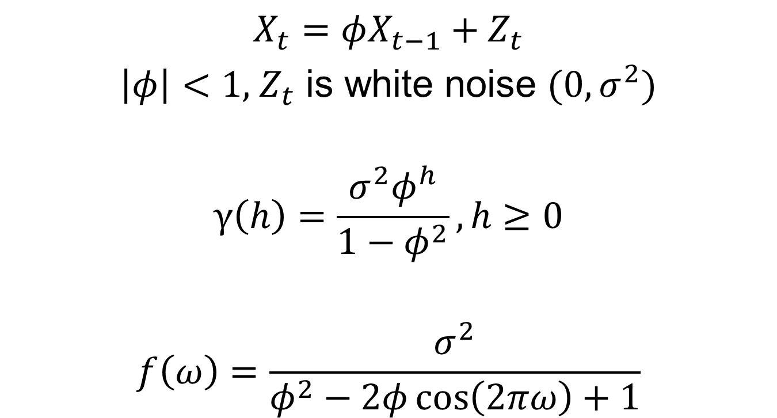
AR(1)
$$X_{t}=φX_{t−1}+Z_{t}$$
$\left|φ\right|<1, { Z}_{t}$ is white noise ${(0,σ}^{2})$
$$γ\left(h\right)=\frac{σ^{2}φ^{h}}{1−φ^{2}}, h≥0$$
$$f\left(ω\right)=\frac{σ^{2}}{φ^{2}−2φ\cos\left(2πω\right)+1}$$

Slide 9
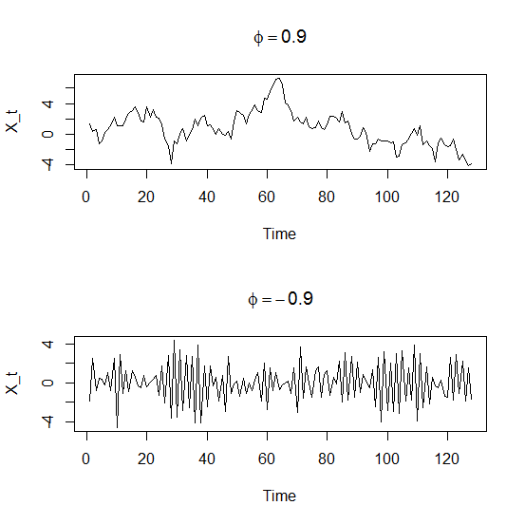
AR(1)

Slide 10
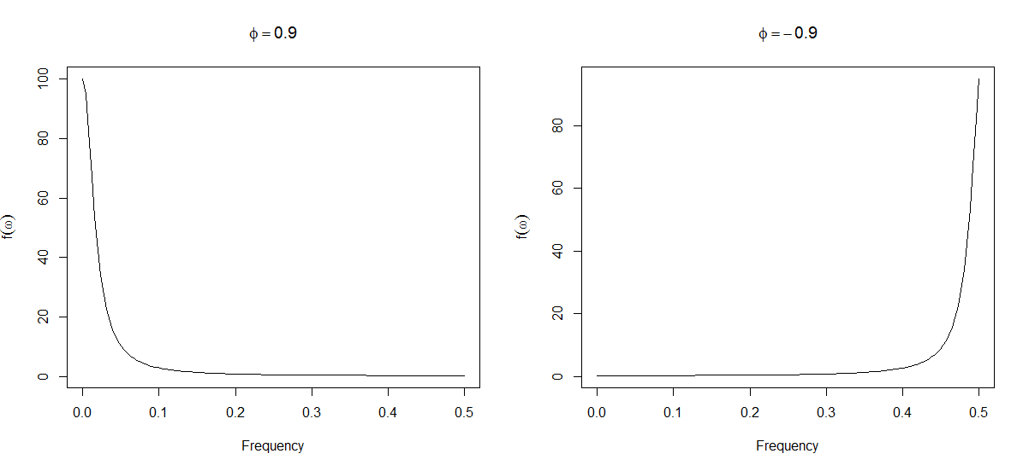
AR(1)

Slide 11
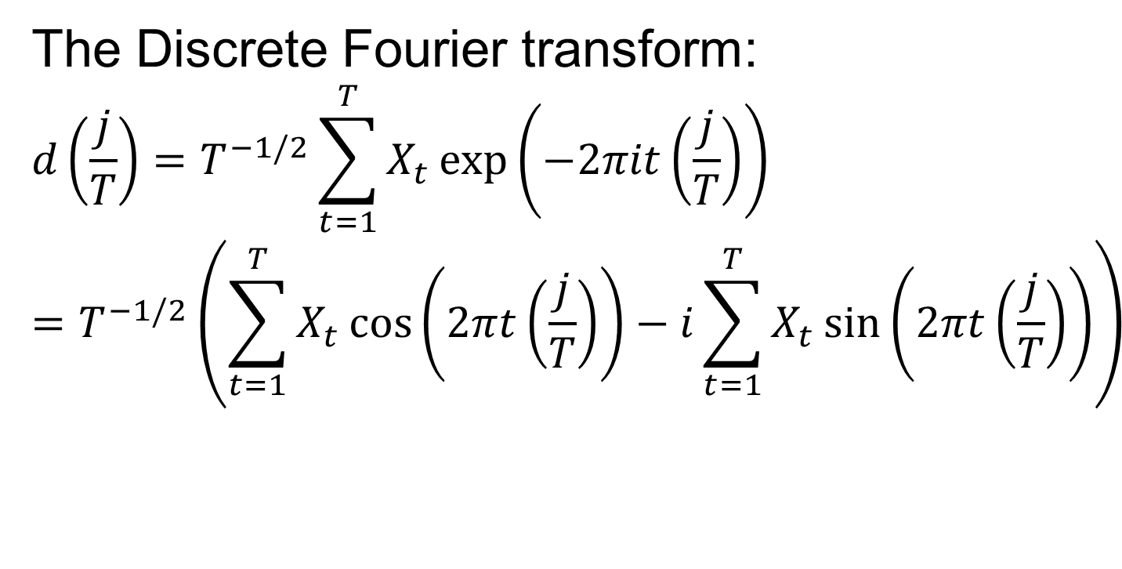
The Periodogram
The Discrete Fourier transform:
$$d\left(\frac{j}{T}\right)=T^{−1/2}\sum_{t=1}^{T}{X_{t}\exp\left(−2πit\left(\frac{j}{T}\right)\right)}$$
$$=T^{−1/2}\left(\sum_{t=1}^{T}{X_{t}\cos\left(2πt\left(\frac{j}{T}\right)\right)−i}\sum_{t=1}^{T}{X_{t}\sin\left(2πt\left(\frac{j}{T}\right)\right)}\right)$$

Slide 12

The Periodogram
The periodogram:
$${I\left(ω_{j}\right)=\left|d\left(ω_{j}\right)\right|}^{2}$$

Slide 13
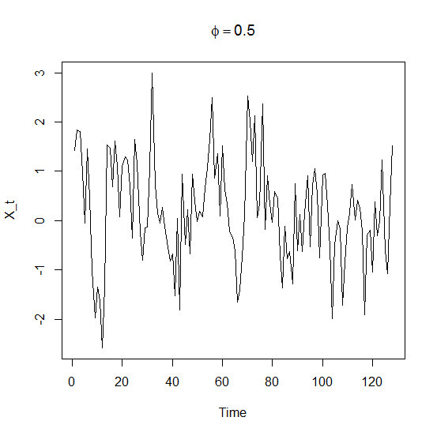
AR(1)

Slide 14
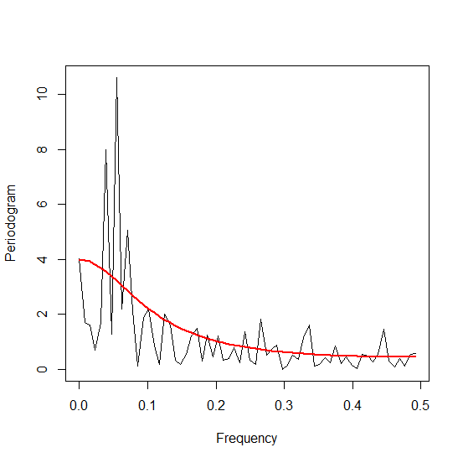
AR(1)

Slide 15
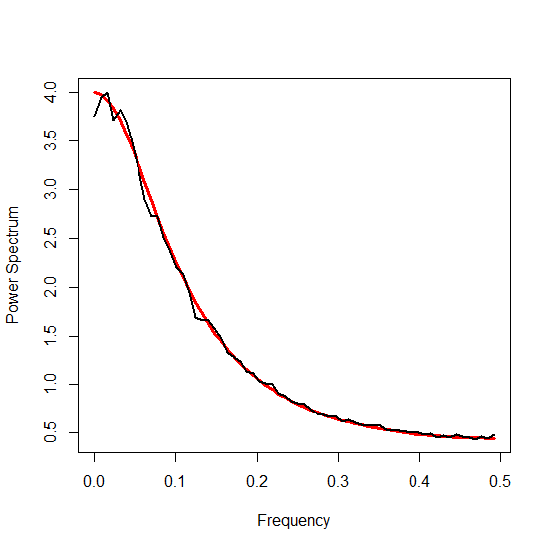
AR(1) Periodogram (Averaged)

Slide 16
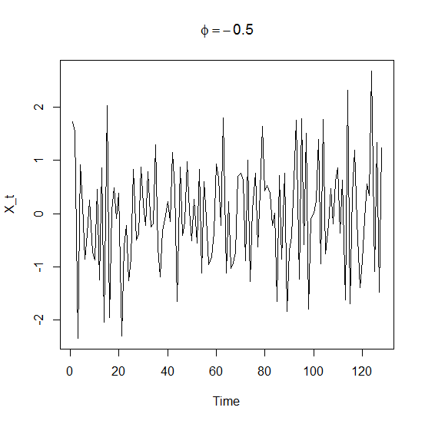
AR(1)

Slide 17
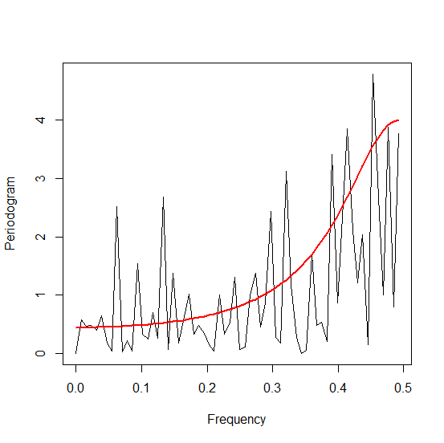
AR(1)

Slide 18
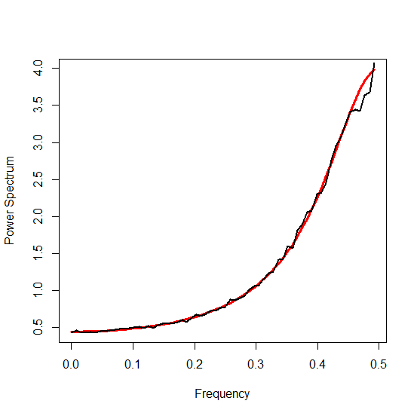
AR(1) Periodogram (Averaged)

Slide 19
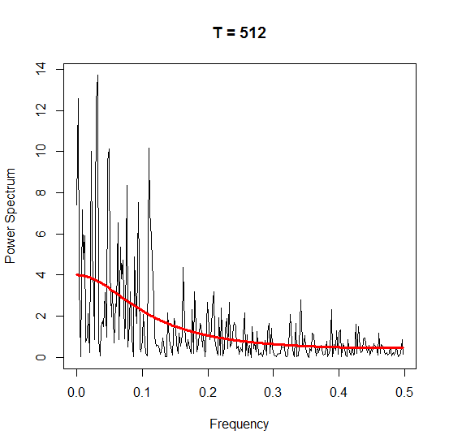
AR(1), T = 512

Slide 20
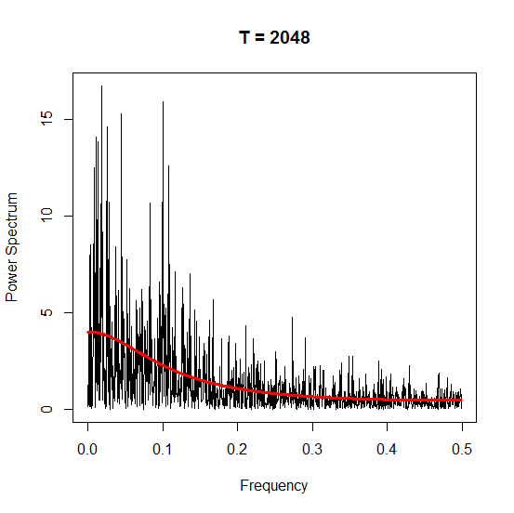
AR(1), T = 2048

Slide 21
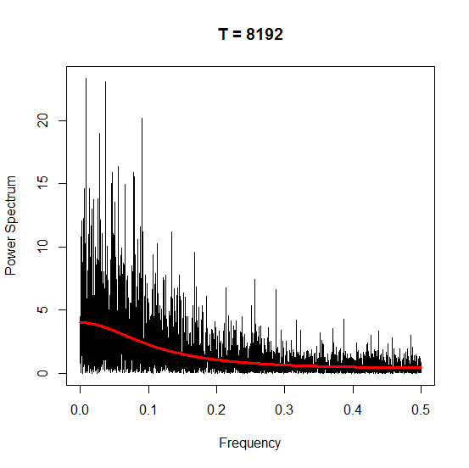
AR(1), T = 8192

Slide 22
The Periodogram
The periodogram is an (asymptotically) unbiased estimator, but it is not consistent.

Slide 23
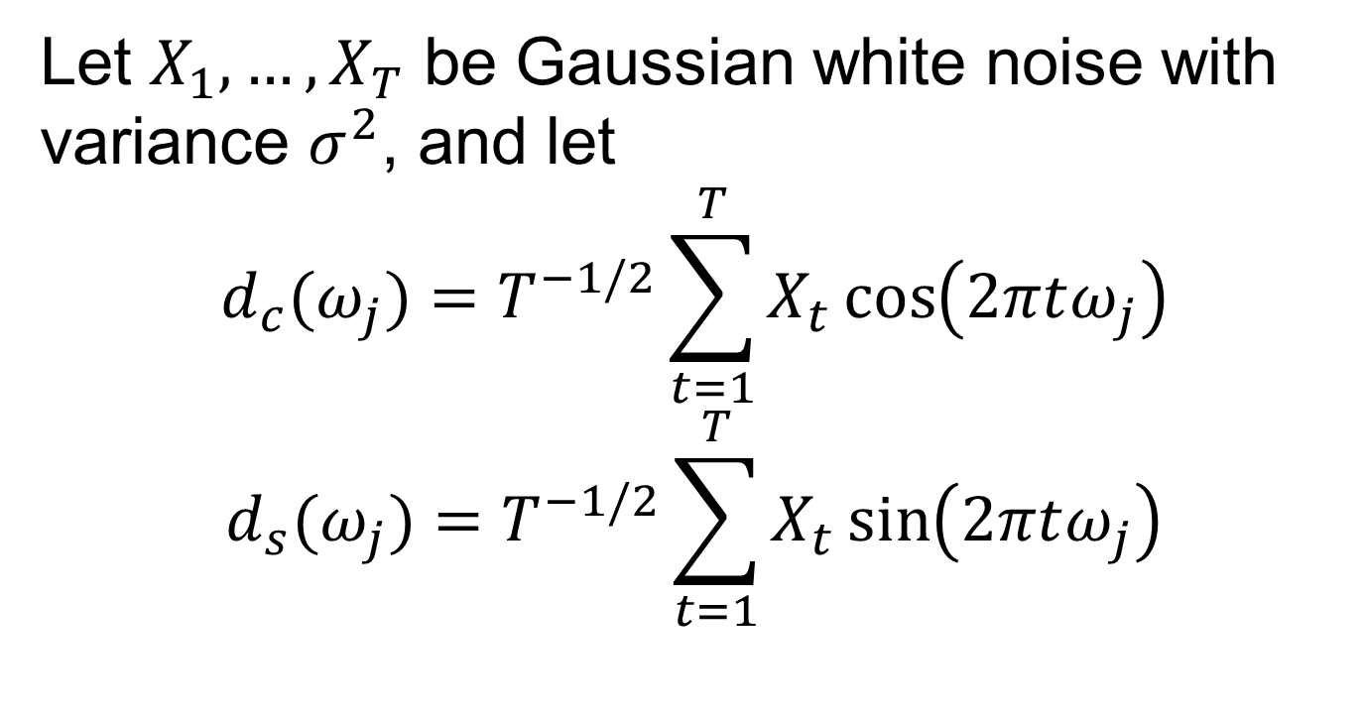
Asymptotic Distribution of the Periodogram
Let $X_{1},…,X_{T}$ be Gaussian white noise with variance $σ^{2}$, and let
$$d_{c}(ω_{j})=T^{−1/2}\sum_{t=1}^{T}{X_{t}\cos\left(2πtω_{j}\right)}$$
$$d_{s}(ω_{j})=T^{−1/2}\sum_{t=1}^{T}{X_{t}\sin\left(2πtω_{j}\right)}$$

Slide 24
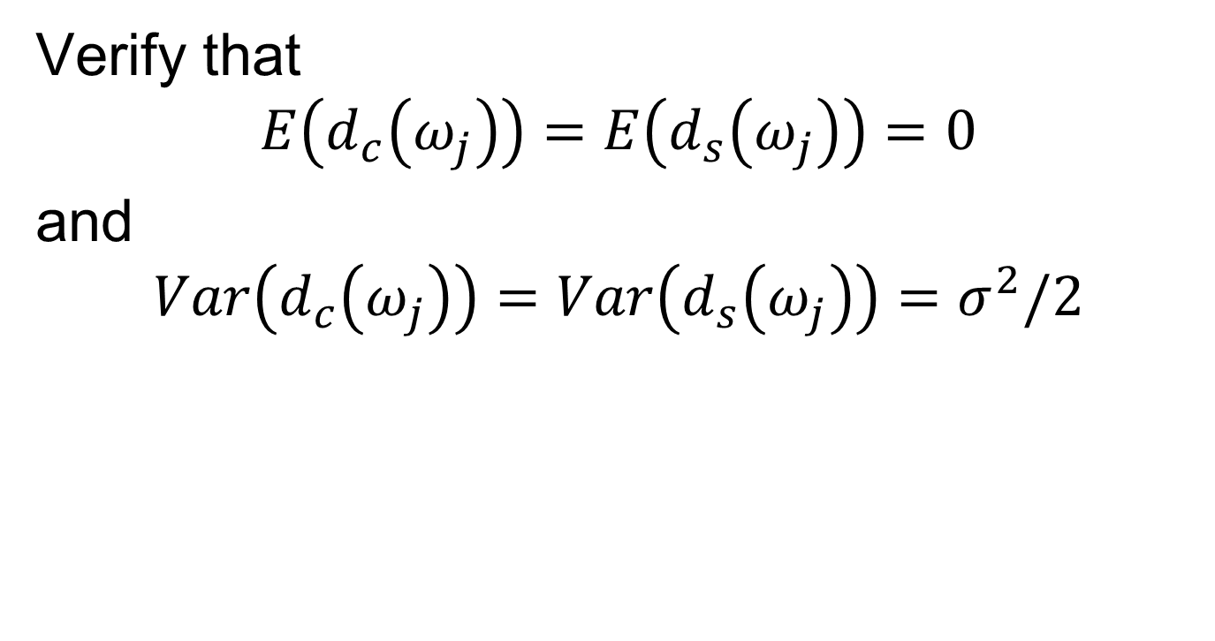
Asymptotic Distribution of the Periodogram
Verify that
$$E\left(d_{c}\left(ω_{j}\right)\right)=E\left(d_{s}\left(ω_{j}\right)\right)=0$$
and
$$Var\left(d_{c}\left(ω_{j}\right)\right)=Var\left(d_{s}\left(ω_{j}\right)\right)=σ^{2}/2$$

Slide 25
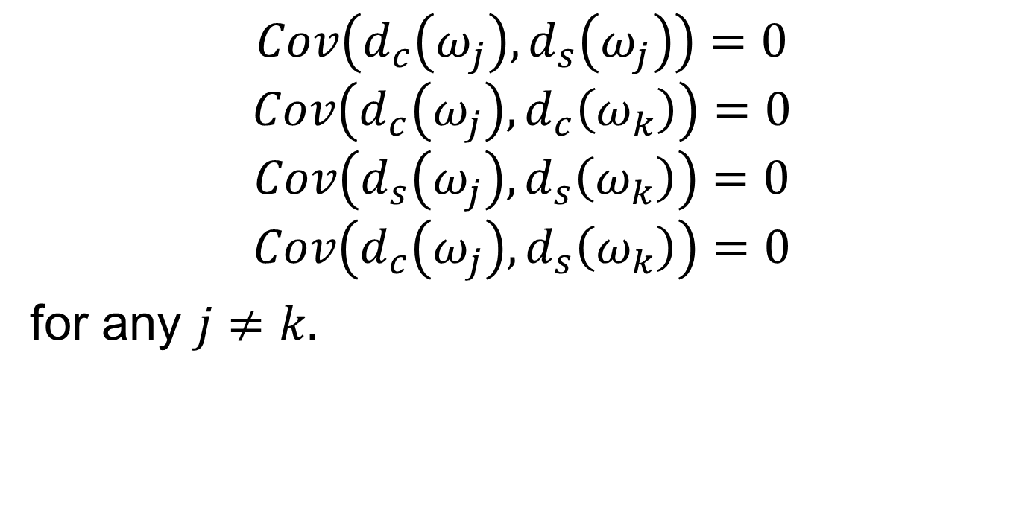
Asymptotic Distribution of the Periodogram
$$Cov\left(d_{c}\left(ω_{j}\right),d_{s}\left(ω_{j}\right)\right)=0$$
$$Cov\left(d_{c}\left(ω_{j}\right),d_{c}\left(ω_{k}\right)\right)=0$$
$$Cov\left(d_{s}\left(ω_{j}\right),d_{s}\left(ω_{k}\right)\right)=0$$
$$Cov\left(d_{c}\left(ω_{j}\right),d_{s}\left(ω_{k}\right)\right)=0$$
for any $j≠k.$

Slide 26
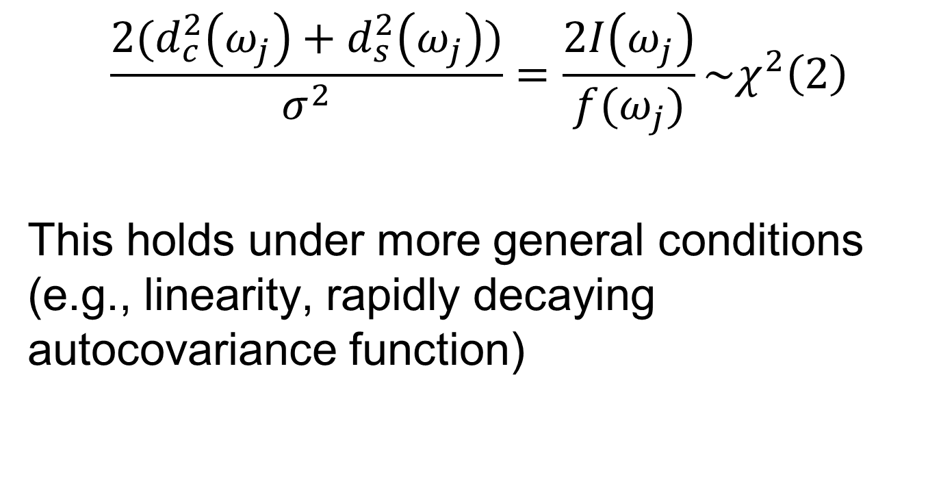
Asymptotic Distribution of the Periodogram
$$\frac{2(d_{c}^{2}\left(ω_{j}\right)+d_{s}^{2}\left(ω_{j}\right))}{σ^{2}}=\frac{2I\left(ω_{j}\right)}{f(ω_{j})}\sim χ^{2}\left(2\right)$$
This holds under more general conditions (e.g., linearity, rapidly decaying autocovariance function)

Slide 27
The Smoothed Periodogram
Idea: borrow information from neighbouring frequencies.

Slide 28

The Smoothed Periodogram
$$\hat{f}\left(ω_{j}\right)=\frac{1}{2M+1}\sum_{k=−M}^{M}{I(ω_{j}+\frac{k}{T})}$$

Slide 29
The Smoothed Periodogram
Under appropriate conditions,
$$\frac{2(2M+1)\hat{f}\left(ω_{j}\right)}{f(ω_{j})}\dot{\sim }χ^{2}\left(2(2M+1)\right)$$

Slide 30
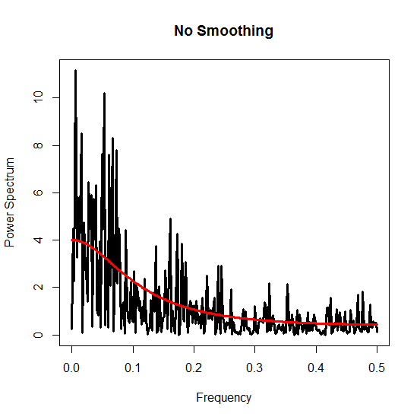
The Smoothed Periodogram

Slide 31
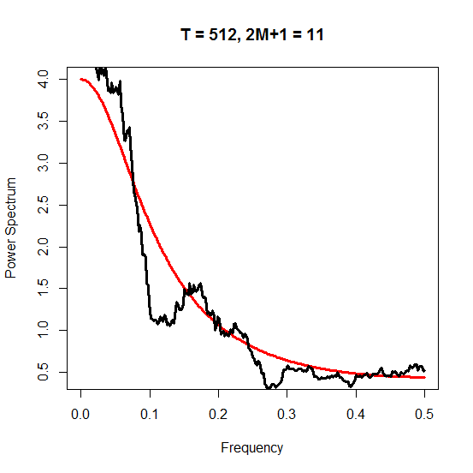
The Smoothed Periodogram

Slide 32
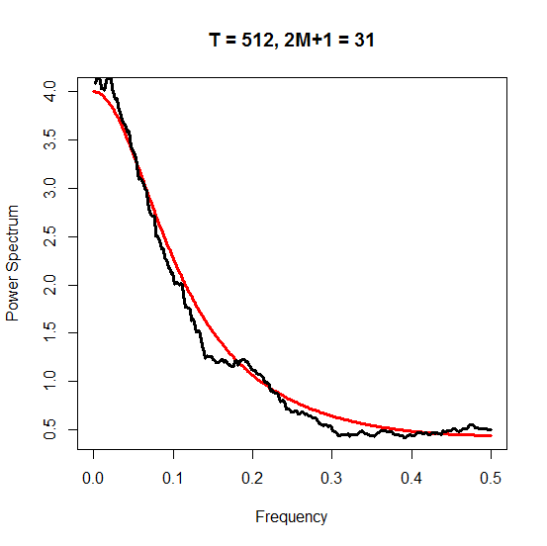
The Smoothed Periodogram

Slide 33
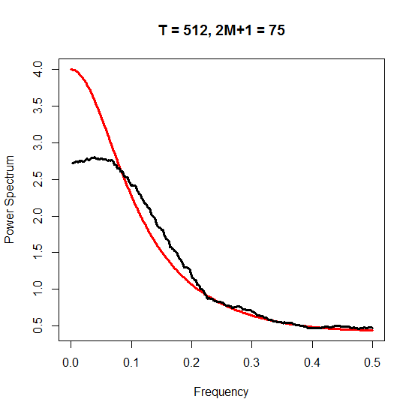
The Smoothed Periodogram

Slide 34
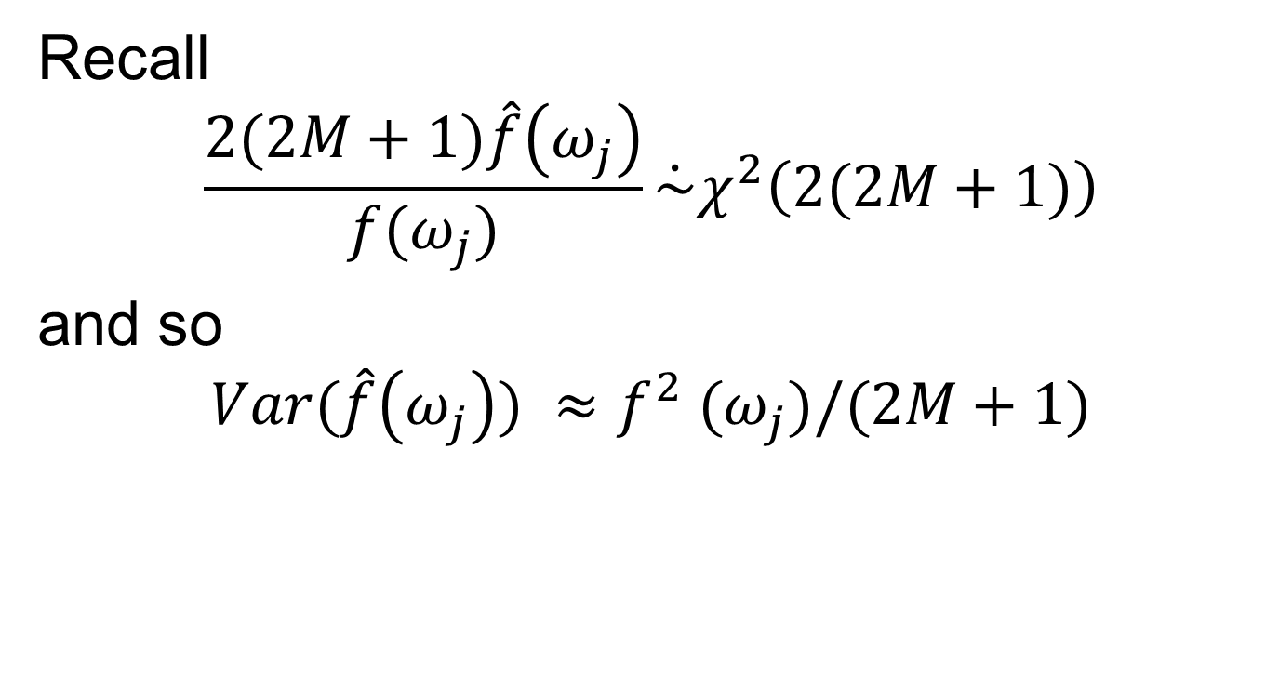
The Smoothed Periodogram
Recall
$$\frac{2(2M+1)\hat{f}\left(ω_{j}\right)}{f(ω_{j})}\dot{\sim }χ^{2}\left(2(2M+1)\right)$$
and so
$$Var(\hat{f}\left(ω_{j}\right)) ≈f^{2} (ω_{j})/(2M+1)$$

Slide 35
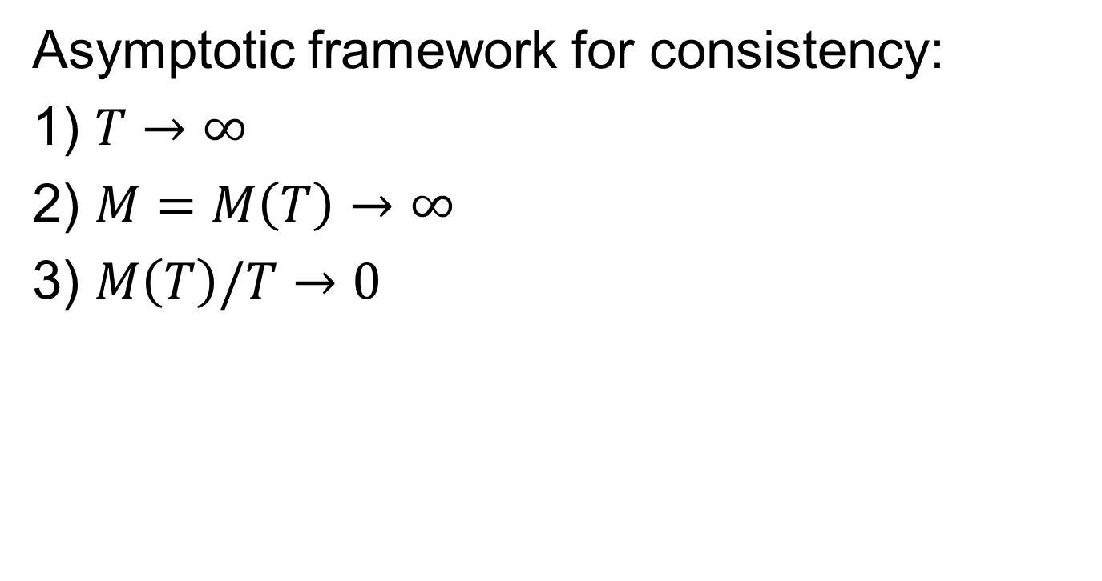
The Smoothed Periodogram
Asymptotic framework for consistency:
1) $T→∞$
2) $M=M\left(T\right)→∞$
3) $M\left(T\right)/T→0$

Slide 36
Next Time
The smoothed periodogram
Parametric estimates of the spectrum
Notes: 2.3, 2.4, and 2.5.

