Slide 1
ST414 – Spectral Analysis of Time Series Data
Lecture 4
27 January 2015

Slide 2
Last Time
Resume discussion on the spectral density function
Discuss the periodogram and its properties
Discuss the smoothed periodogram
Notes: 2.1, 2.2, 2.3, and 2.4

Slide 3
Today’s Objectives
The smoothed periodogram
Estimating AR parameters
Notes: 1.2, 2.3, and 2.4

Slide 4
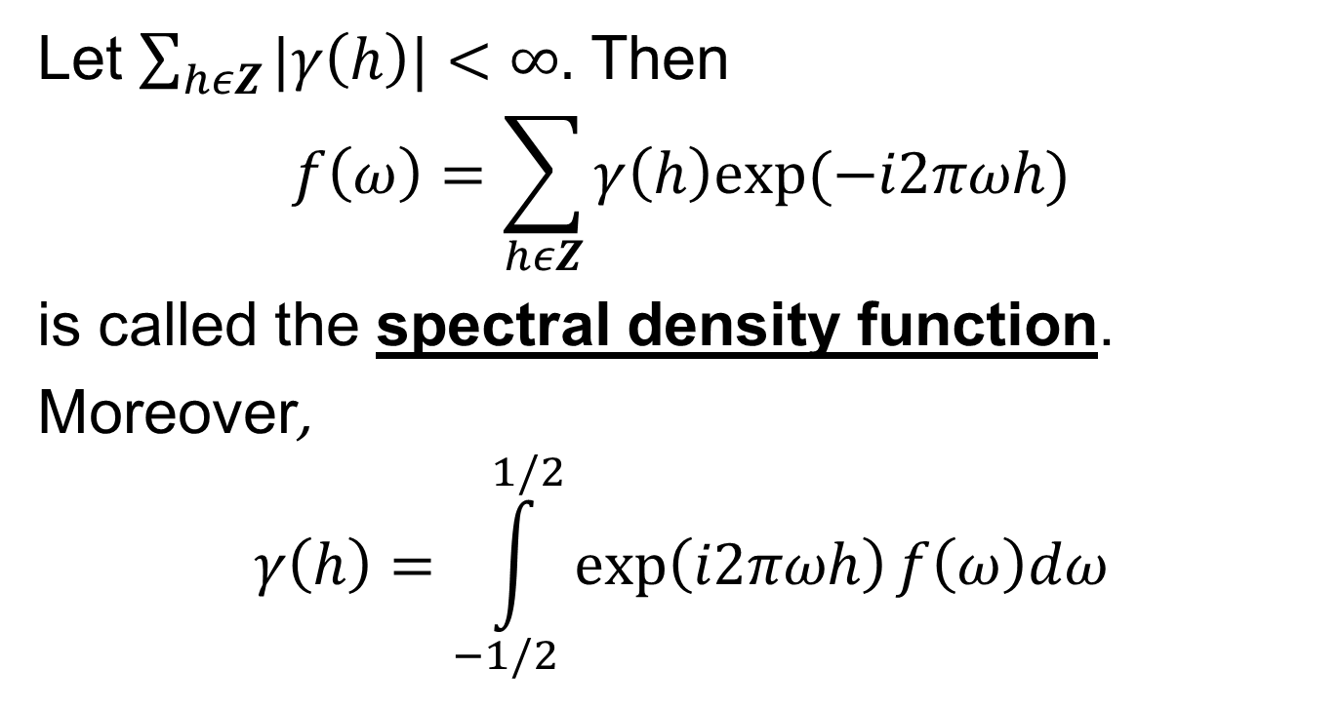
The Spectral Density
Let $\sum_{hεZ}{|γ\left(h\right)|}<∞.$ Then
$$f\left(ω\right)=\sum_{hεZ}{γ\left(h\right)exp⁡(−i2πωh)}$$
is called the spectral density function.
Moreover,
$$γ\left(h\right)=\int_{−1/2}^{1/2}{\exp\left(i2πωh\right)f\left(ω\right)dω}$$

Slide 5

The Spectral Density
$f\left(ω\right)≥0$
$f\left(ω\right)=f(−ω)$
$f\left(ω\right)=f(1−ω)$

Slide 6
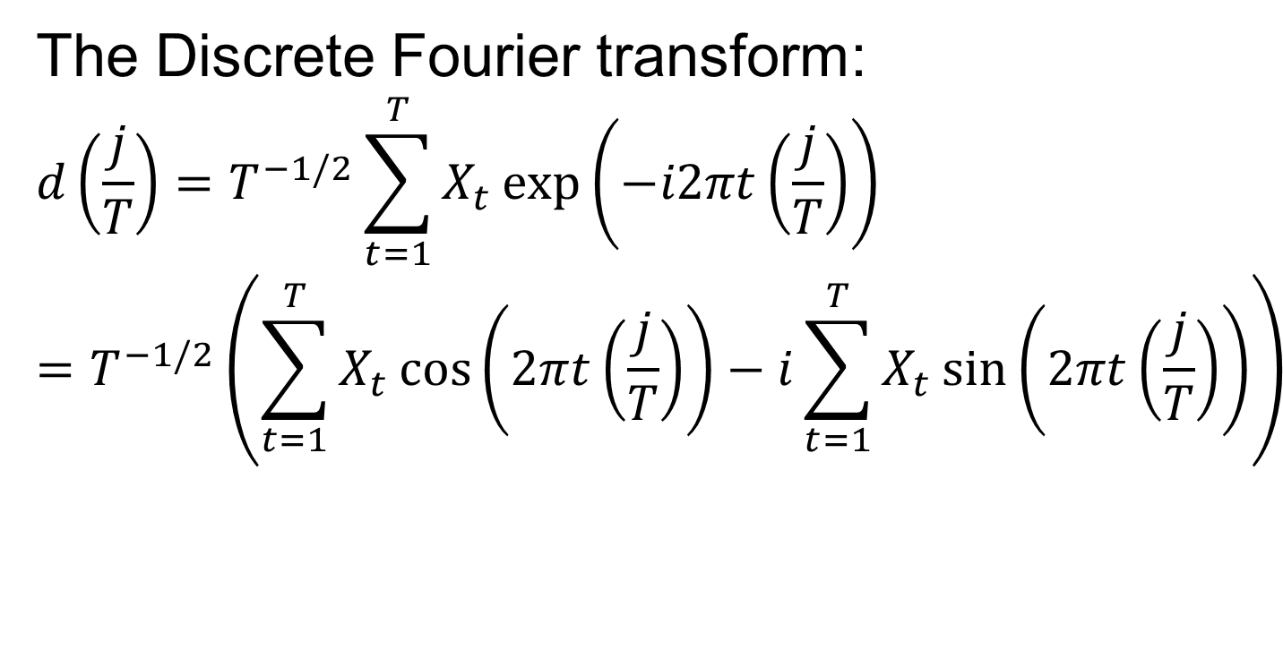
The Periodogram
The Discrete Fourier transform:
$$d\left(\frac{j}{T}\right)=T^{−1/2}\sum_{t=1}^{T}{X_{t}\exp\left(−i2πt\left(\frac{j}{T}\right)\right)}$$
$$=T^{−1/2}\left(\sum_{t=1}^{T}{X_{t}\cos\left(2πt\left(\frac{j}{T}\right)\right)−i}\sum_{t=1}^{T}{X_{t}\sin\left(2πt\left(\frac{j}{T}\right)\right)}\right)$$

Slide 7

The Periodogram
The periodogram:
$${I\left(ω_{j}\right)=\left|d\left(ω_{j}\right)\right|}^{2}$$

Slide 8
The Periodogram
The periodogram is an (asymptotically) unbiased estimator, but it is not consistent.

Slide 9
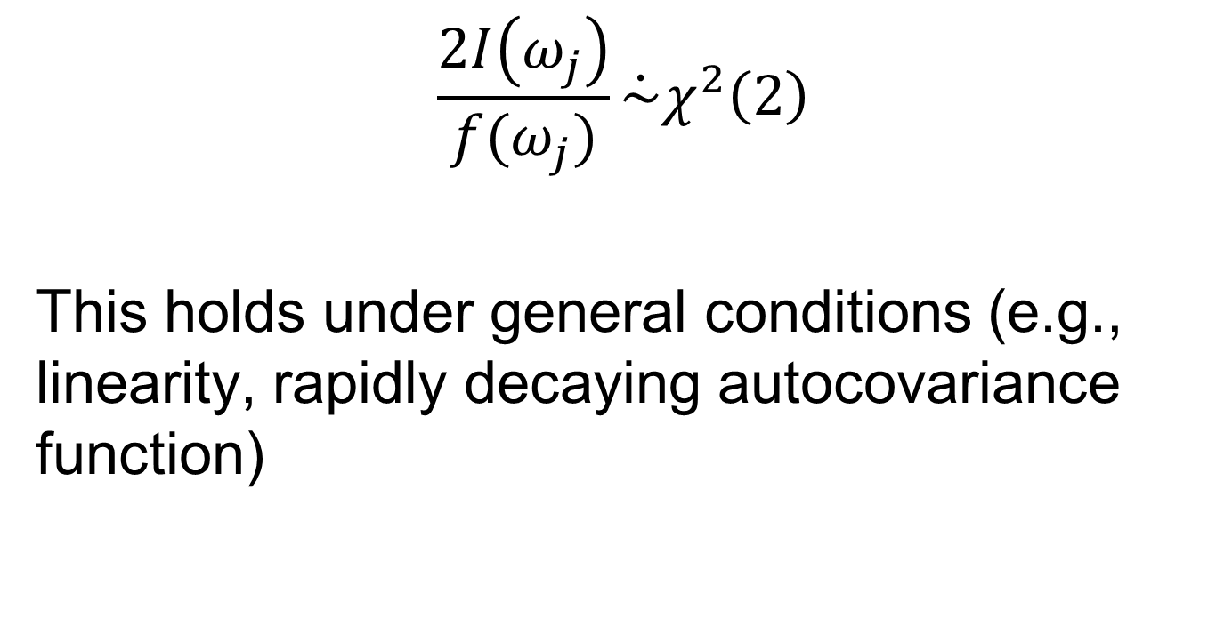
Asymptotic Distribution of the Periodogram
$$\frac{2I\left(ω_{j}\right)}{f(ω_{j})}\dot{\sim }χ^{2}\left(2\right)$$
This holds under general conditions (e.g., linearity, rapidly decaying autocovariance function)

Slide 10
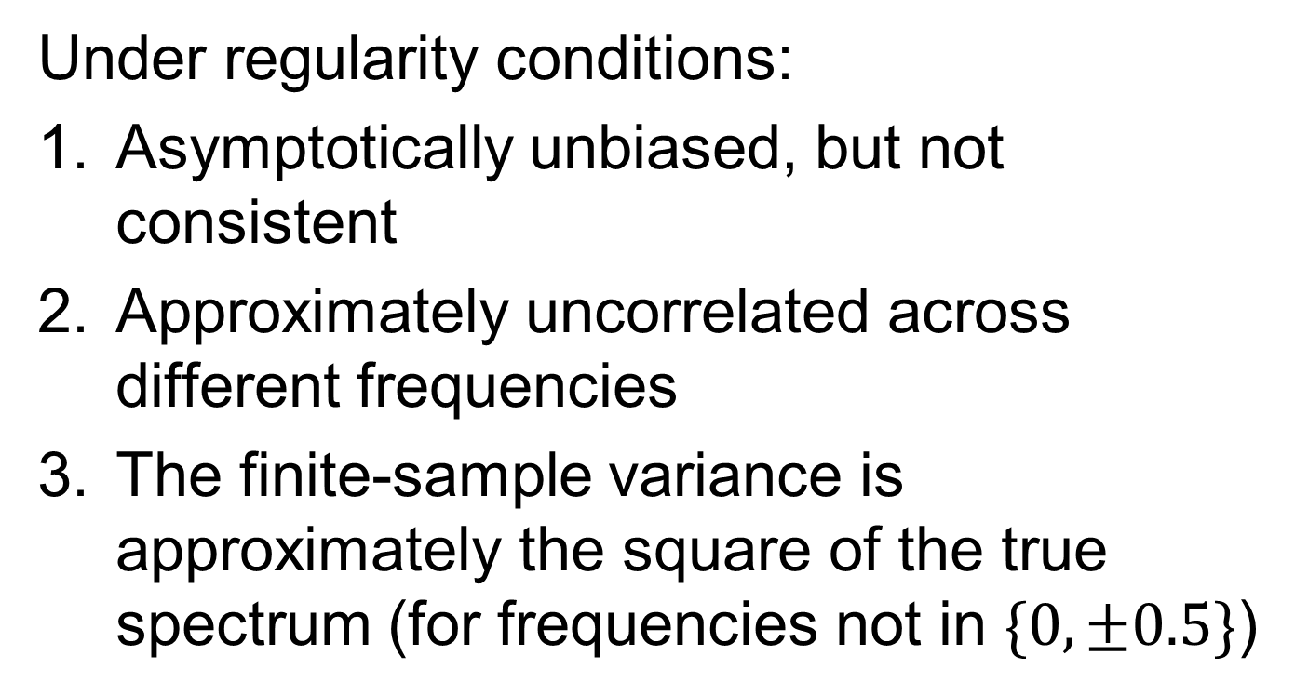
Theoretical Properties of the Periodogram
Under regularity conditions:
Asymptotically unbiased, but not consistent
Approximately uncorrelated across different frequencies
The finite-sample variance is approximately the square of the true spectrum (for frequencies not in $\{0,±0.5\}$)

Slide 11
The Smoothed Periodogram
Idea: borrow information from neighbouring frequencies.

Slide 12

The Smoothed Periodogram
$$\hat{f}\left(ω_{j}\right)=\frac{1}{2M+1}\sum_{k=−M}^{M}{I(ω_{j}+\frac{k}{T})}$$

Slide 13
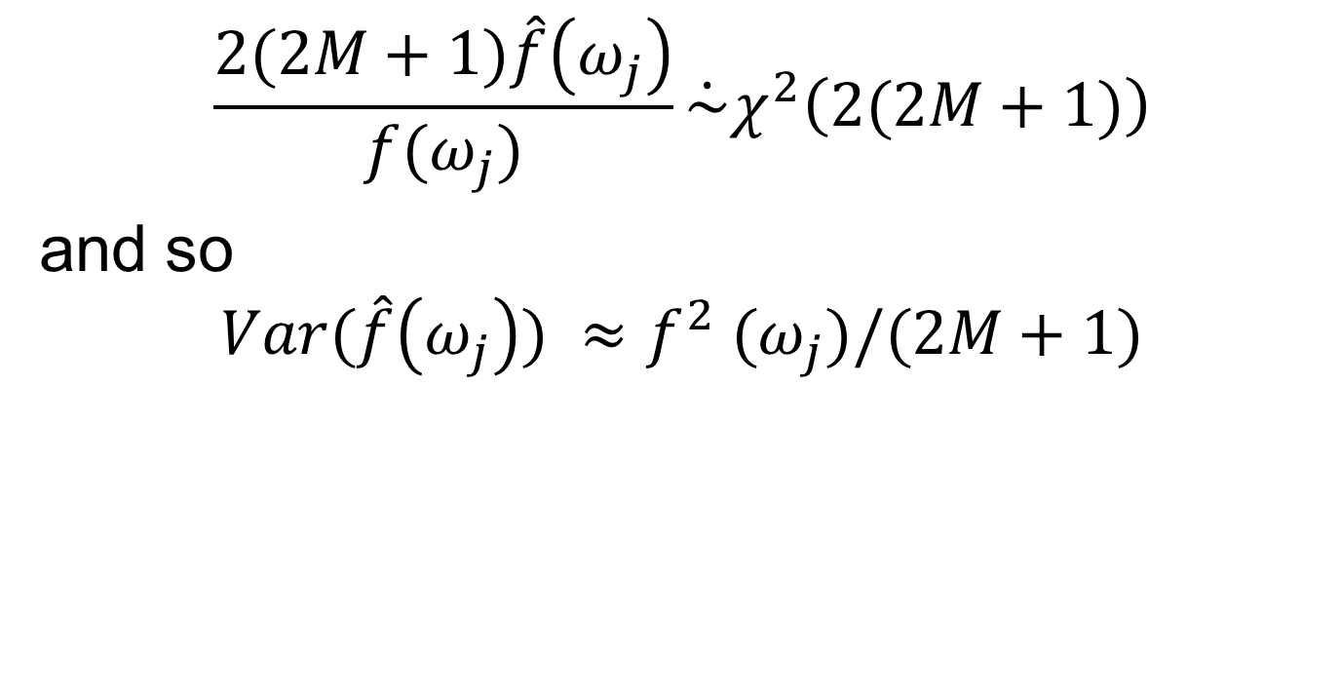
The Smoothed Periodogram
$$\frac{2(2M+1)\hat{f}\left(ω_{j}\right)}{f(ω_{j})}\dot{\sim }χ^{2}\left(2(2M+1)\right)$$
and so
$$Var(\hat{f}\left(ω_{j}\right)) ≈f^{2} (ω_{j})/(2M+1)$$

Slide 14
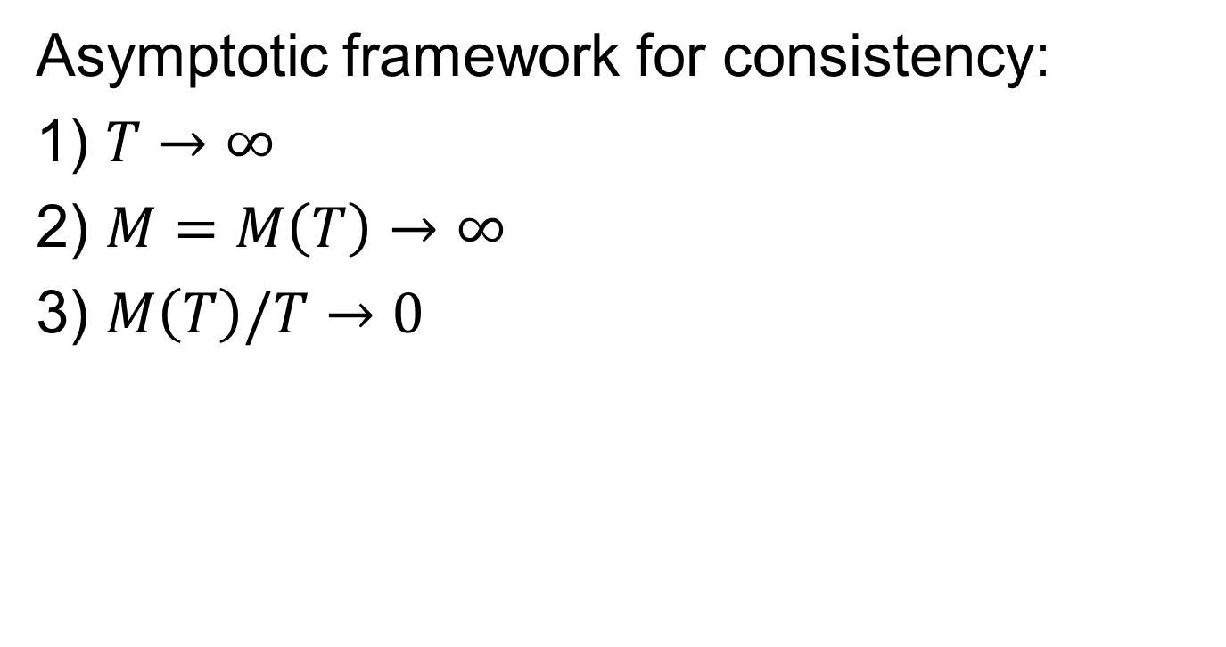
The Smoothed Periodogram
Asymptotic framework for consistency:
1) $T→∞$
2) $M=M\left(T\right)→∞$
3) $M\left(T\right)/T→0$

Slide 15
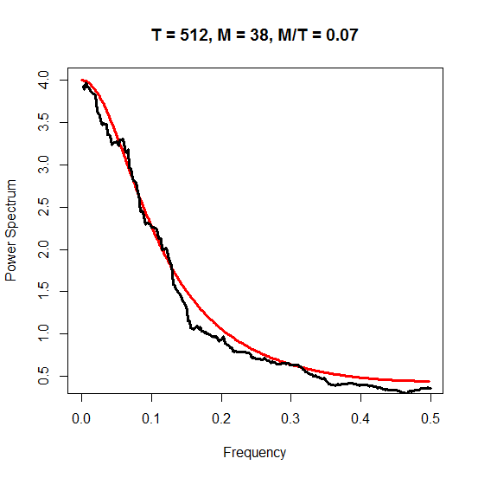
The Smoothed Periodogram

Slide 16
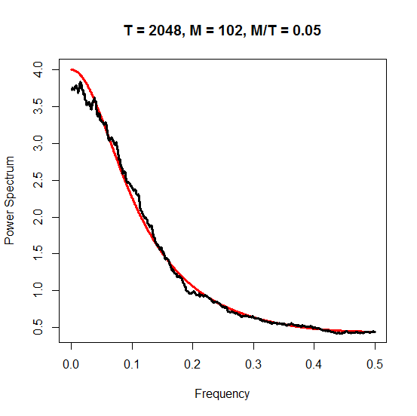
The Smoothed Periodogram

Slide 17
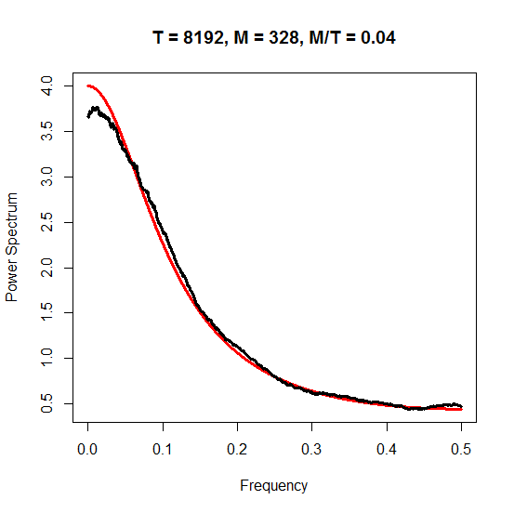
The Smoothed Periodogram

Slide 18
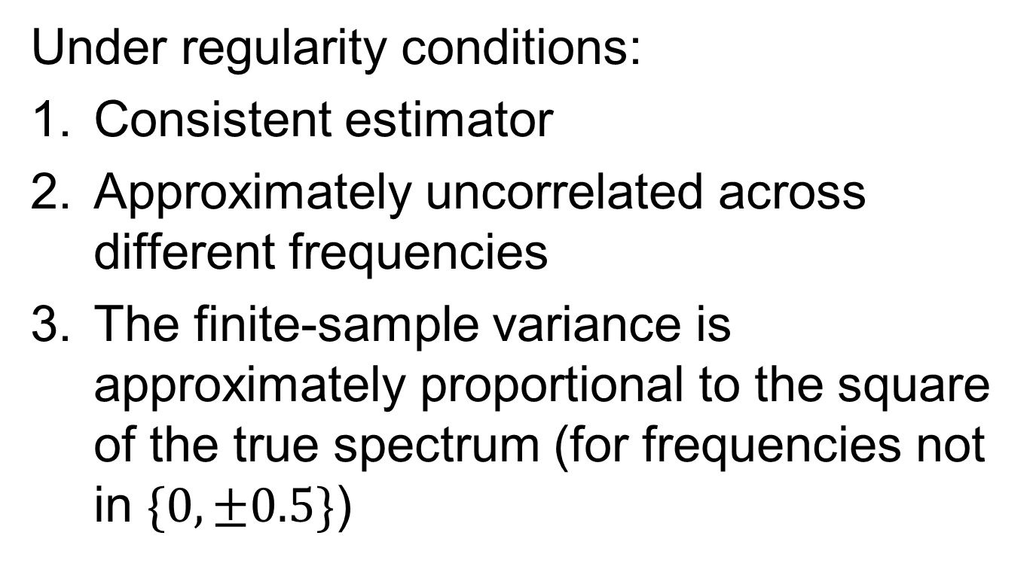
Theoretical Properties of the Smoothed Periodogram
Under regularity conditions:
Consistent estimator
Approximately uncorrelated across different frequencies
The finite-sample variance is approximately proportional to the square of the true spectrum (for frequencies not in $\{0,±0.5\}$)

Slide 19
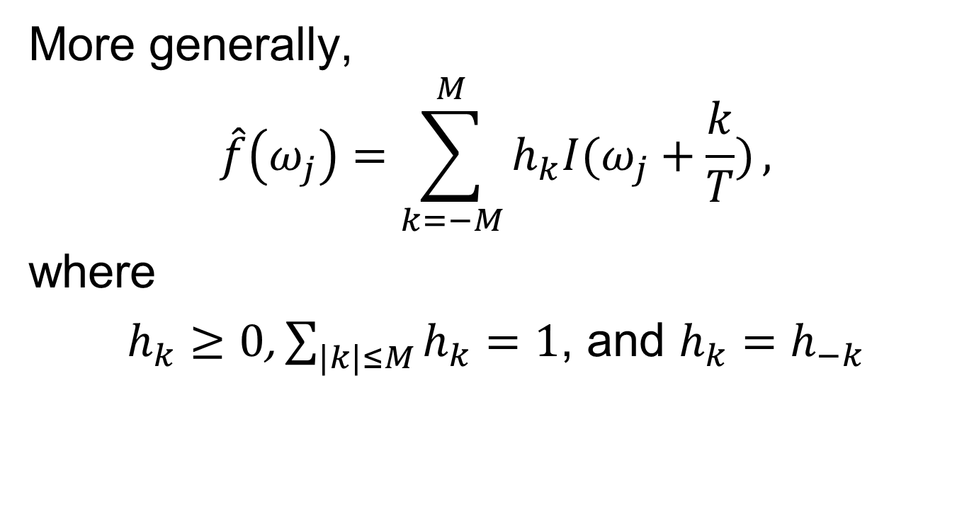
The Smoothed Periodogram
More generally,
$$\hat{f}\left(ω_{j}\right)=\sum_{k=−M}^{M}{h_{k}I(ω_{j}+\frac{k}{T})},$$
where
$h_{k}≥0$, $\sum_{|k|≤M}{h_{k}}=1$, and $h_{k}=h_{−k}$

Slide 20
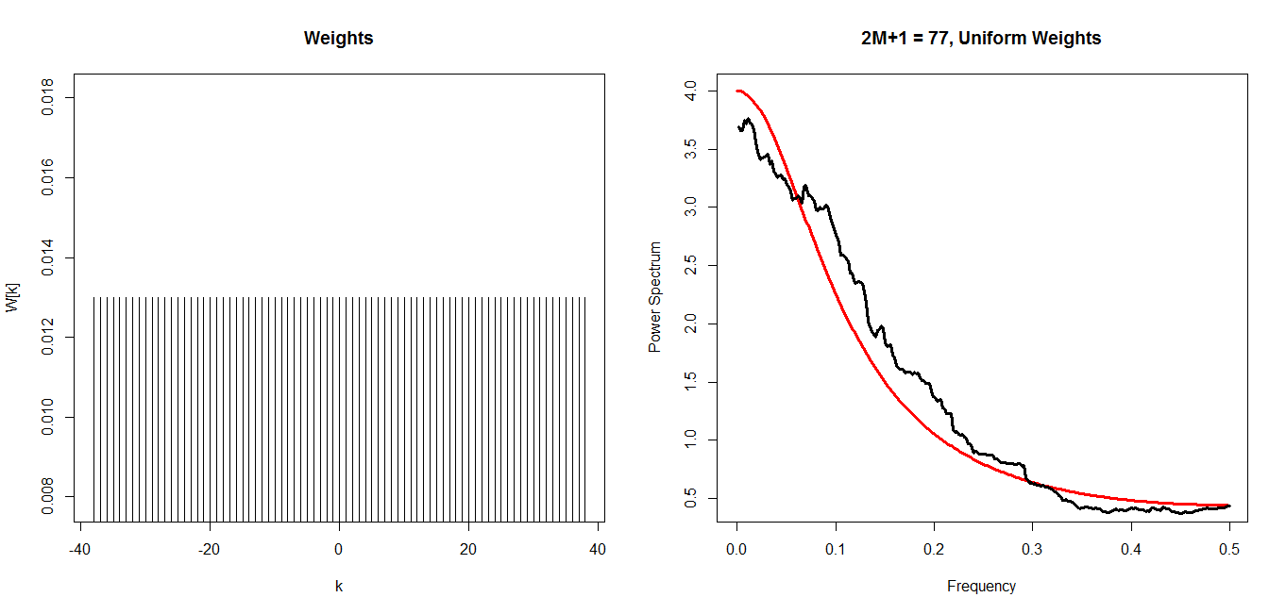
The Smoothed Periodogram

Slide 21
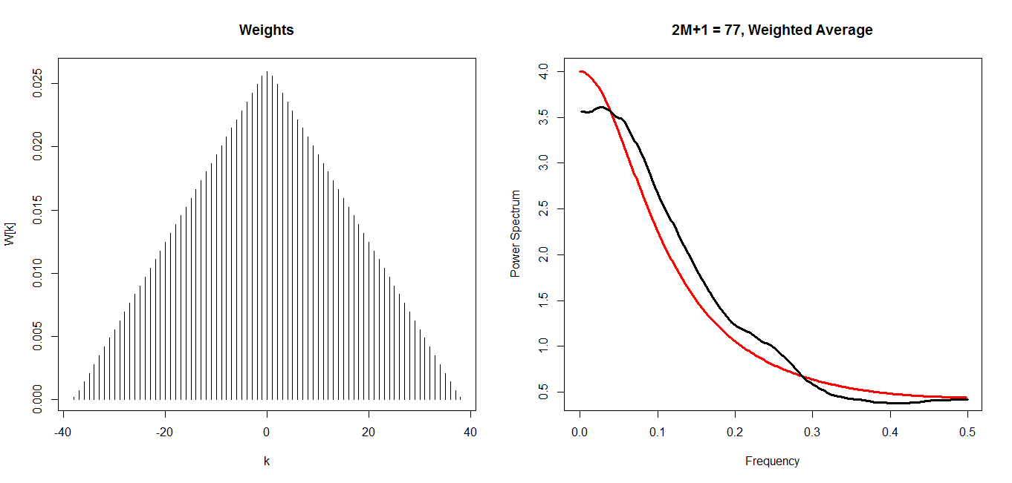
The Smoothed Periodogram

Slide 22
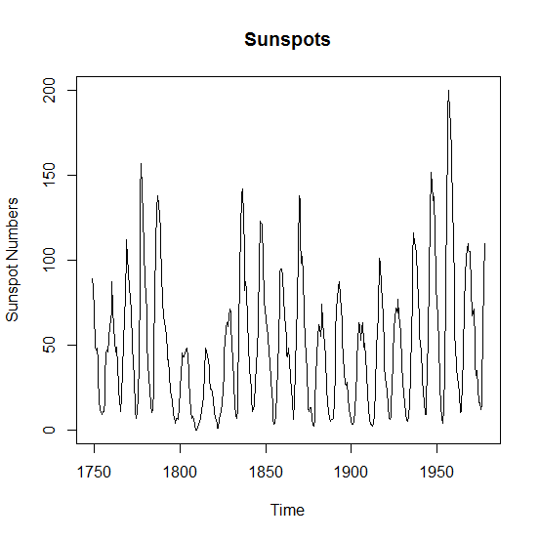
Sunspots Example

Slide 23
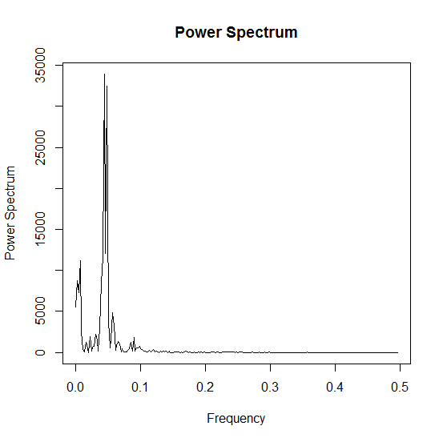
Sunspots Example – The Periodogram

Slide 24
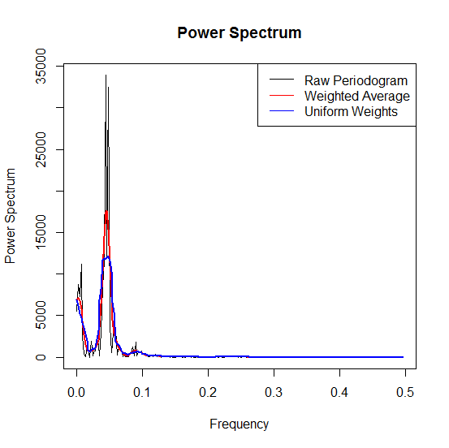
Sunspots Example – Estimates of the Spectrum

Slide 25
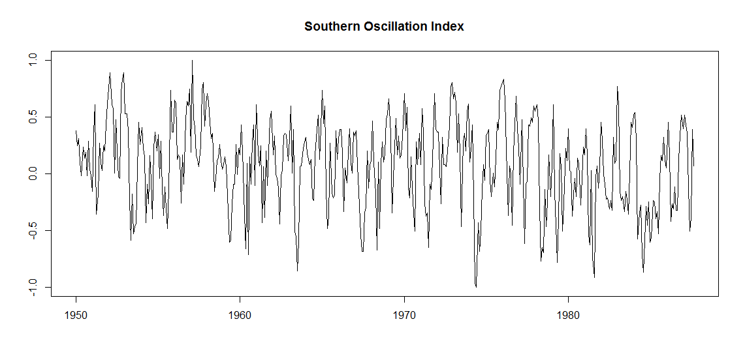
SOI Example

Slide 26
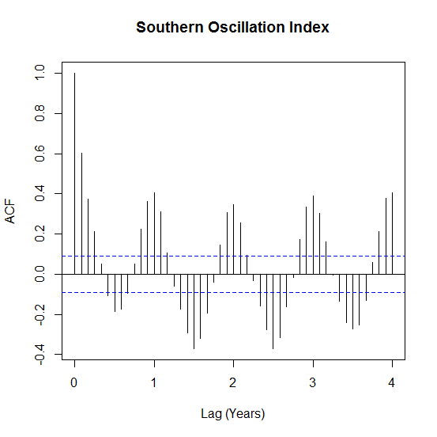
SOI Example - ACF

Slide 27
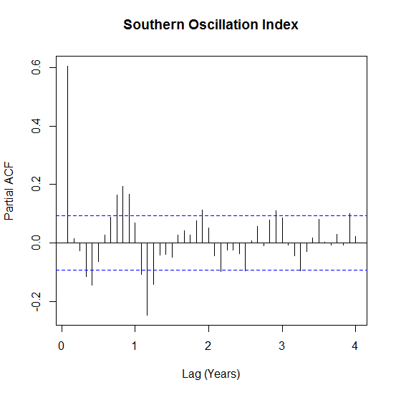
SOI Example - PACF

Slide 28
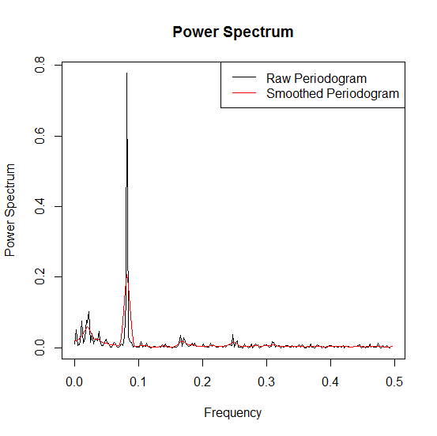
SOI Example - Estimates of the Spectrum

Slide 29
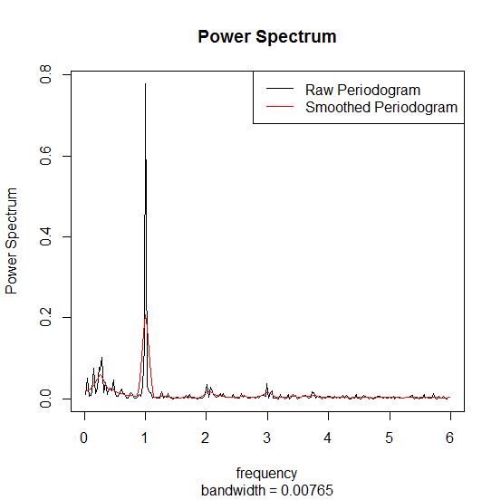
SOI Example - Estimates of the Spectrum

Slide 30
Remarks
Practical considerations:
The (sample) mean is removed so that the process is mean zero.
(Linear) Trends are often assumed to be part of the mean, and is hence removed, i.e., spectral analysis is performed on the residuals.
The FFT is very fast when the length of the time series is a highly composite number. To this end, we sometimes pad the time series with 0s.
In a future lecture, we will discuss tapering and filtering for improving the estimates of the spectral density.

Slide 31
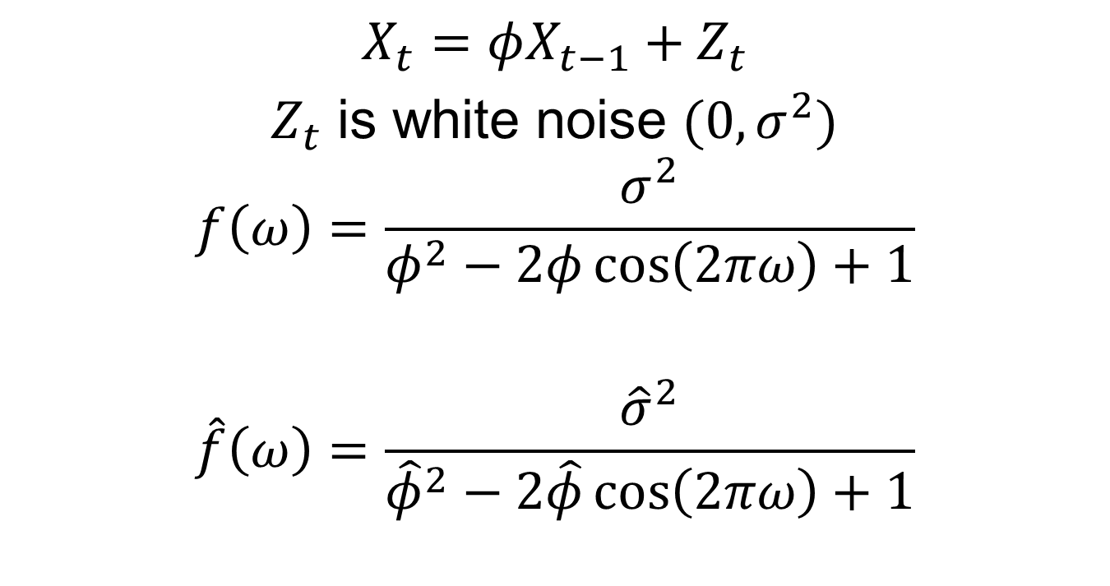
AR(1)
$$X_{t}=φX_{t−1}+Z_{t}$$
$Z_{t}$ is white noise ${(0,σ}^{2})$
$$f\left(ω\right)=\frac{σ^{2}}{φ^{2}−2φ\cos\left(2πω\right)+1}$$
$$\hat{f}\left(ω\right)=\frac{{\hat{σ}}^{2}}{{\hat{φ}}^{2}−2\hat{φ}\cos\left(2πω\right)+1}$$

Slide 32
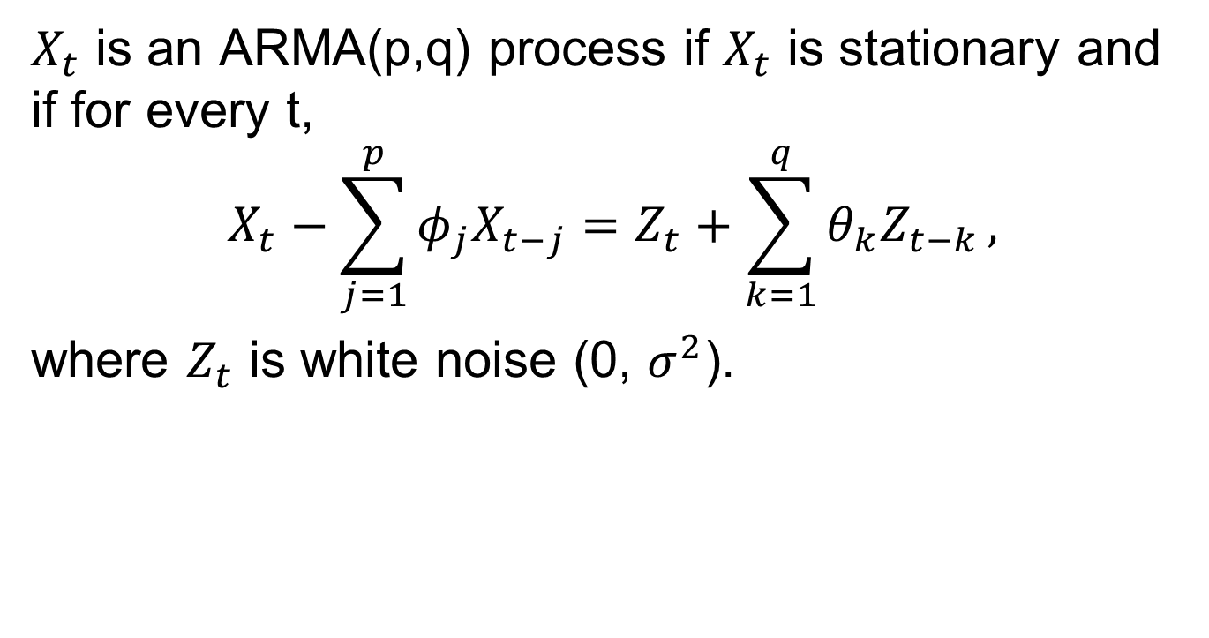
Some Preliminaries
$X_{t}$ is an ARMA(p,q) process if $X_{t}$ is stationary and if for every t,
$$X_{t}−\sum_{j=1}^{p}{φ_{j}X_{t−j}}=Z_{t}+\sum_{k=1}^{q}{θ_{k}Z_{t−k}},$$
where $Z_{t}$ is white noise (0, $σ^{2}$).

Slide 33
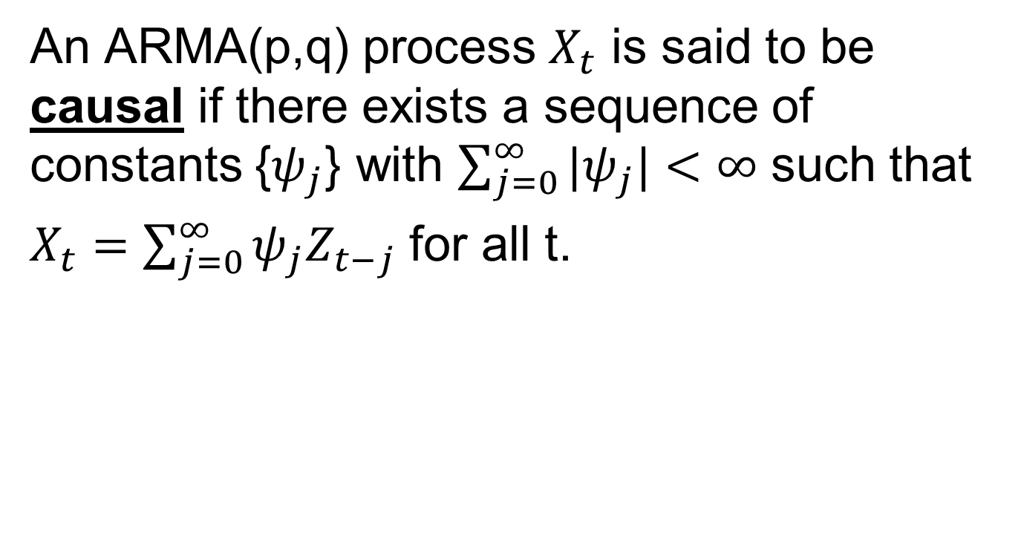
Some Preliminaries
An ARMA(p,q) process $X_{t}$ is said to be causal if there exists a sequence of constants {$ψ_{j}$} with $\sum_{j=0}^{∞}{{|ψ}_{j}|<∞}$ such that
$X_{t}=\sum_{j=0}^{∞}{ψ_{j}Z_{t−j}}$ for all t.

Slide 34

The Sample Mean
$$\overline{X}=T^{−1}\sum_{t=1}^{T}{X_{t}}$$
$$Var\left(\overline{X}\right)=T^{−1}\sum_{h=−T}^{T}{\left(1−\frac{\left|h\right|}{T}\right)γ(h)}$$

Slide 35
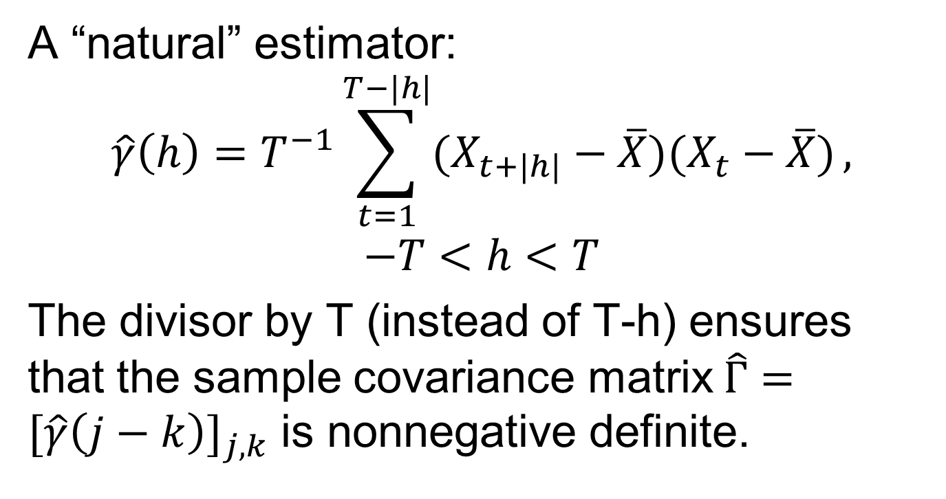
The Sample Autocovariance
A “natural” estimator:
$$\hat{γ}\left(h\right)=T^{−1}\sum_{t=1}^{T−|h|}{(X_{t+|h|}−\overline{X})(X_{t}−\overline{X})},$$
$$−T<h<T$$
The divisor by T (instead of T-h) ensures that the sample covariance matrix$\hat{Γ}=[\hat{γ}\left(j−k\right)]_{j,k}$ is nonnegative definite.

Slide 36
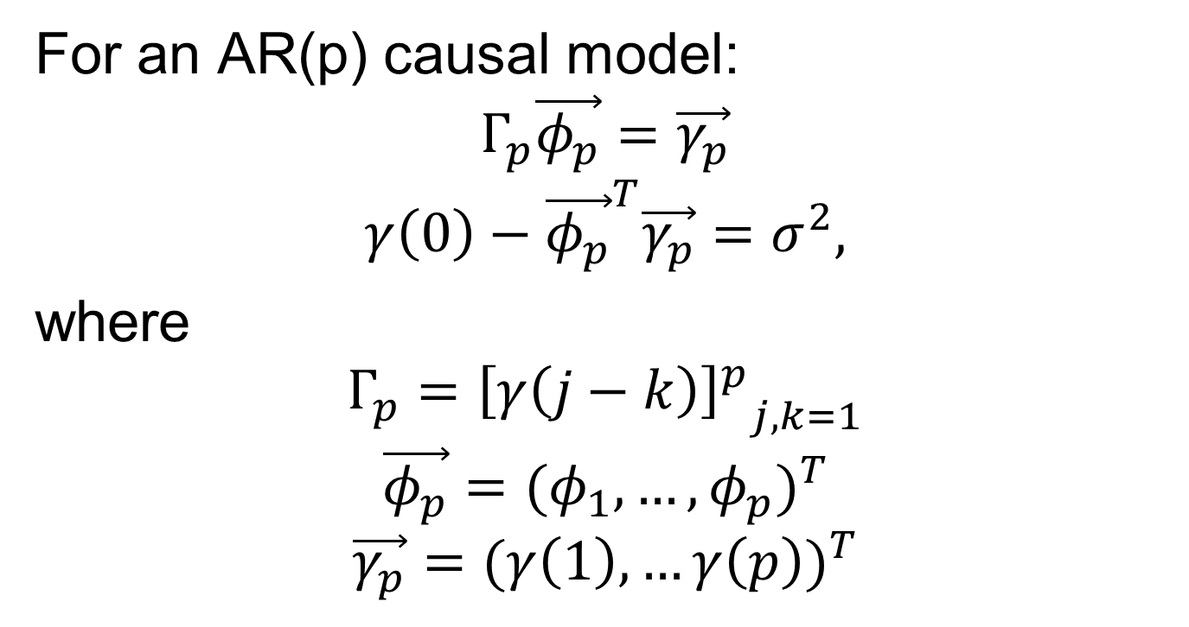
The Yule-Walker Equations
For an AR(p) causal model:
$$Γ_{p}\vec{φ_{p}}=\vec{γ_{p}}$$
$$γ\left(0\right)−{\vec{φ_{p}}}^{T}\vec{γ_{p}}=σ^{2},$$
where
$$Γ_{p}={{\left[γ\left(j−k\right)\right]}^{p}}_{j,k=1}$$
$$\vec{φ_{p}}={(φ_{1},…,φ_{p})}^{T}$$
$$\vec{γ_{p}}={(γ\left(1\right),…γ\left(p\right))}^{T}$$

Slide 37
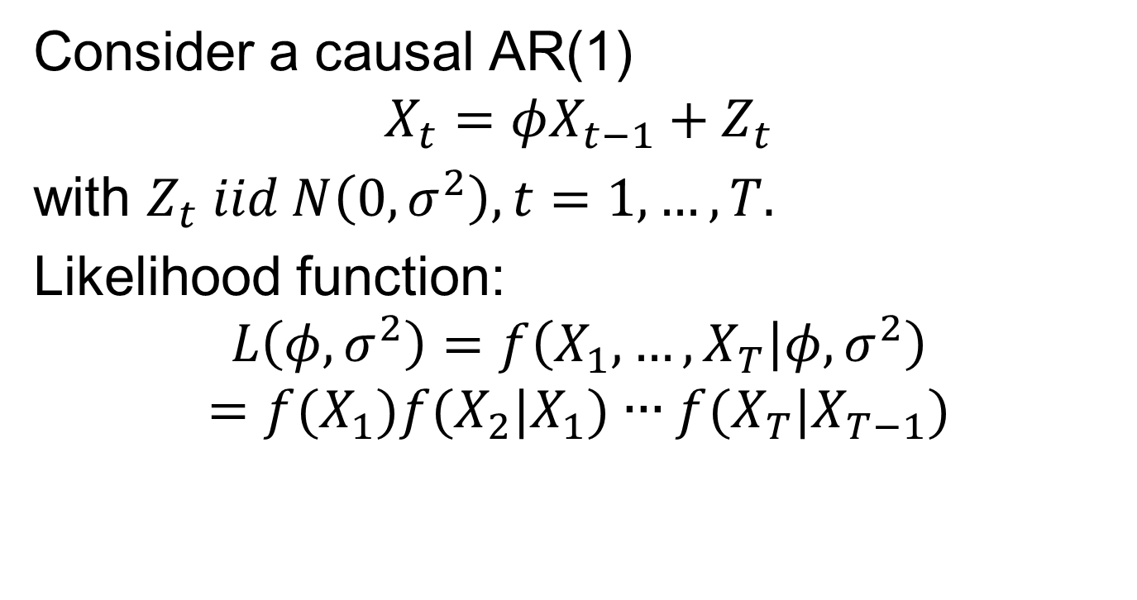
Conditional MLE
Consider a causal AR(1)
$$X_{t}=φX_{t−1}+Z_{t}$$
with $Z_{t} iid N\left(0,σ^{2}\right), t=1,…,T.$
Likelihood function:
$$L\left(φ,σ^{2}\right)=f\left(X_{1},…,X_{T} | φ,σ^{2}\right)$$
$$=f(X_{1})f(X_{2}|X_{1})∙∙∙f(X_{T}|X_{T−1})$$

Slide 38
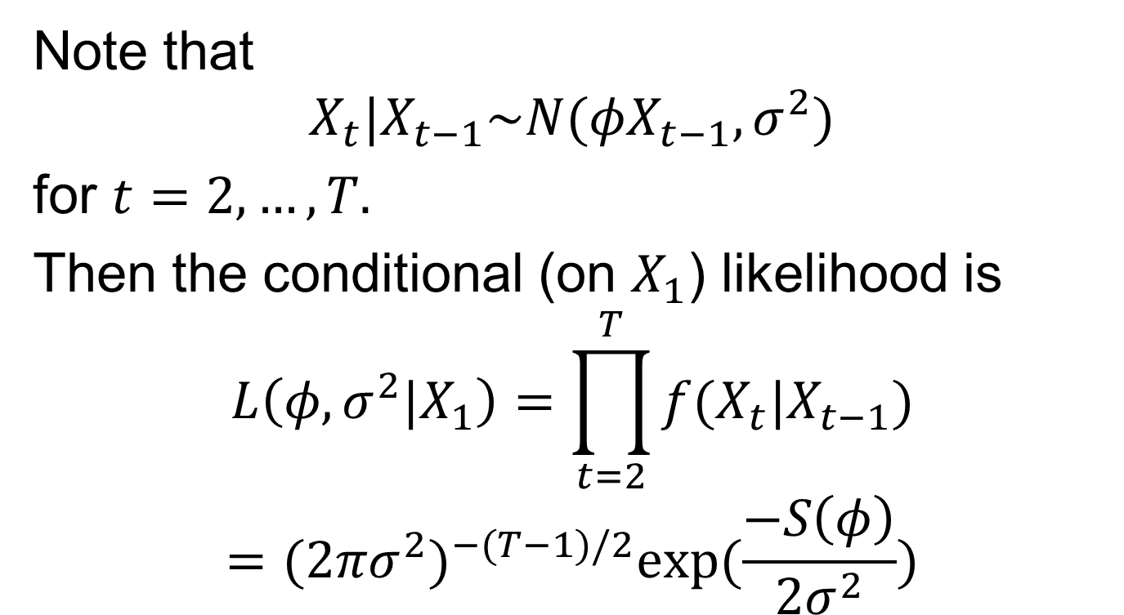
Conditional MLE
Note that
$$X_{t}|X_{t−1}\sim N(φX_{t−1},σ^{2})$$
for $t=2,…,T.$
Then the conditional (on $X_{1}$) likelihood is
$$L\left(φ,σ^{2}|X_{1}\right)=\prod_{t=2}^{T}{f(X_{t}|X_{t−1})}$$
$$={(2πσ^{2})}^{−(T−1)/2}exp⁡(\frac{−S\left(φ\right)}{2σ^{2}})$$

Slide 39
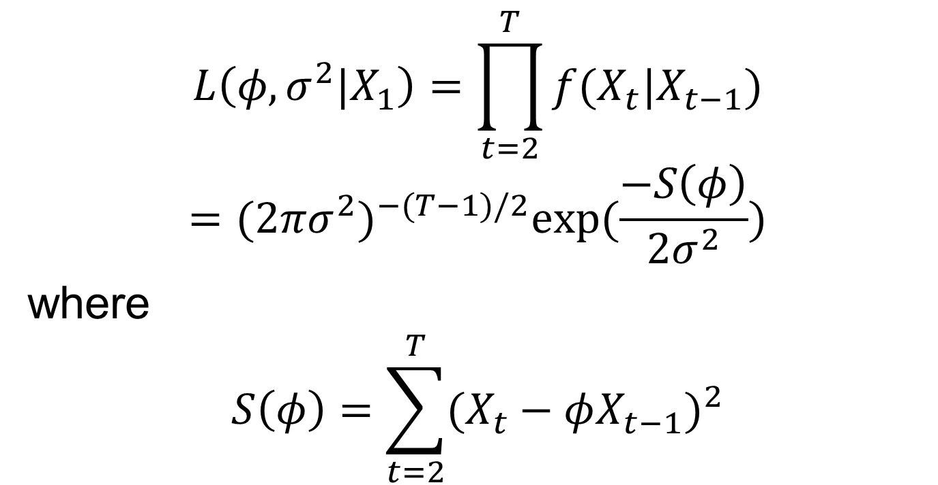
Conditional MLE
$$L\left(φ,σ^{2}|X_{1}\right)=\prod_{t=2}^{T}{f(X_{t}|X_{t−1})}$$
$$={(2πσ^{2})}^{−(T−1)/2}exp⁡(\frac{−S\left(φ\right)}{2σ^{2}})$$
where
$$S\left(φ\right)=\sum_{t=2}^{T}{{(X_{t}−φX_{t−1})}^{2}}$$

Slide 40
Conditional MLE
The conditional MLE approach reduces to a regression problem!
This approach can be generalised to the AR(p) model.

Slide 41
Next Time
Resume discussion on parametric estimates of the spectral density function
Notes: 1.2, 2.5

