Slide 1
ST414 – Spectral Analysis of Time Series Data
Lecture 5
5 February 2015

Slide 2
Last Time
The smoothed periodogram
Notes: 2.3, and 2.4

Slide 3
Today’s Objectives
Estimating AR parameters
Parametric estimates of the spectrum
Notes: 1.2, 2.5

Slide 4

The Smoothed Periodogram
$$\hat{f}\left(ω_{j}\right)=\frac{1}{2M+1}\sum_{k=−M}^{M}{I(ω_{j}+\frac{k}{T})}$$

Slide 5
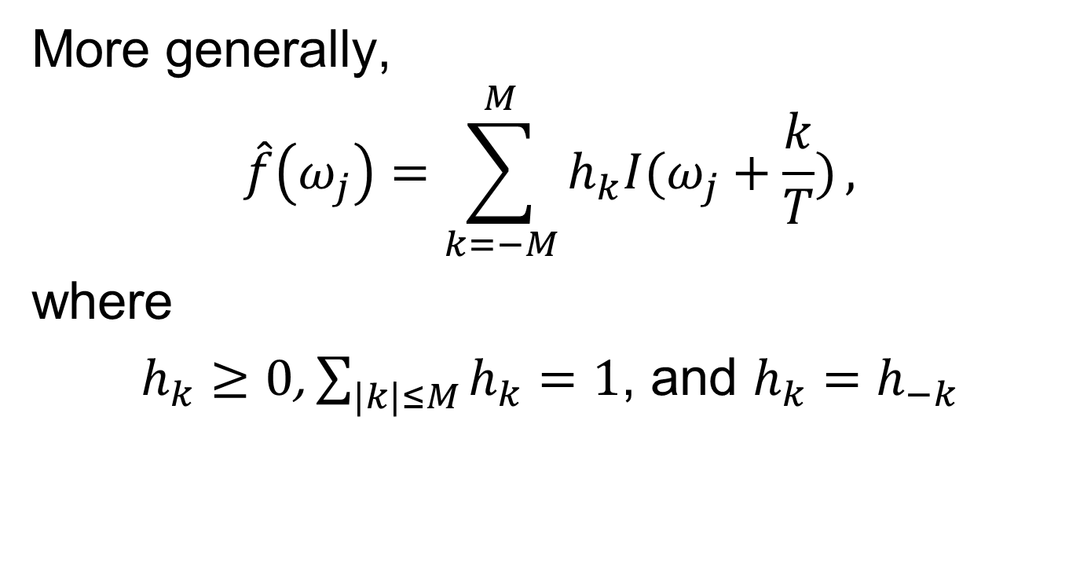
The Smoothed Periodogram
More generally,
$$\hat{f}\left(ω_{j}\right)=\sum_{k=−M}^{M}{h_{k}I(ω_{j}+\frac{k}{T})},$$
where
$h_{k}≥0$, $\sum_{|k|≤M}{h_{k}}=1$, and $h_{k}=h_{−k}$

Slide 6
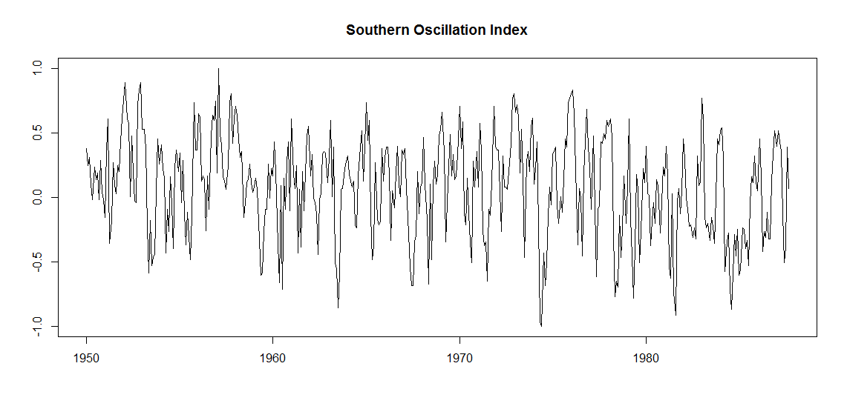
SOI Example

Slide 7
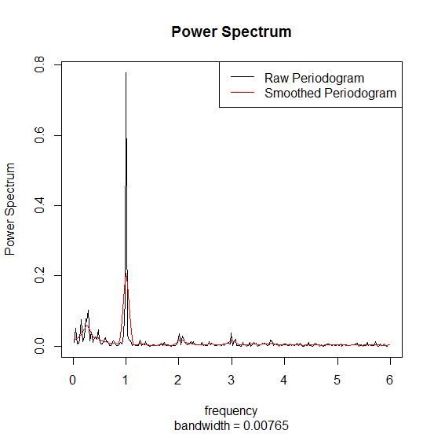
SOI Example - Estimates of the Spectrum

Slide 8
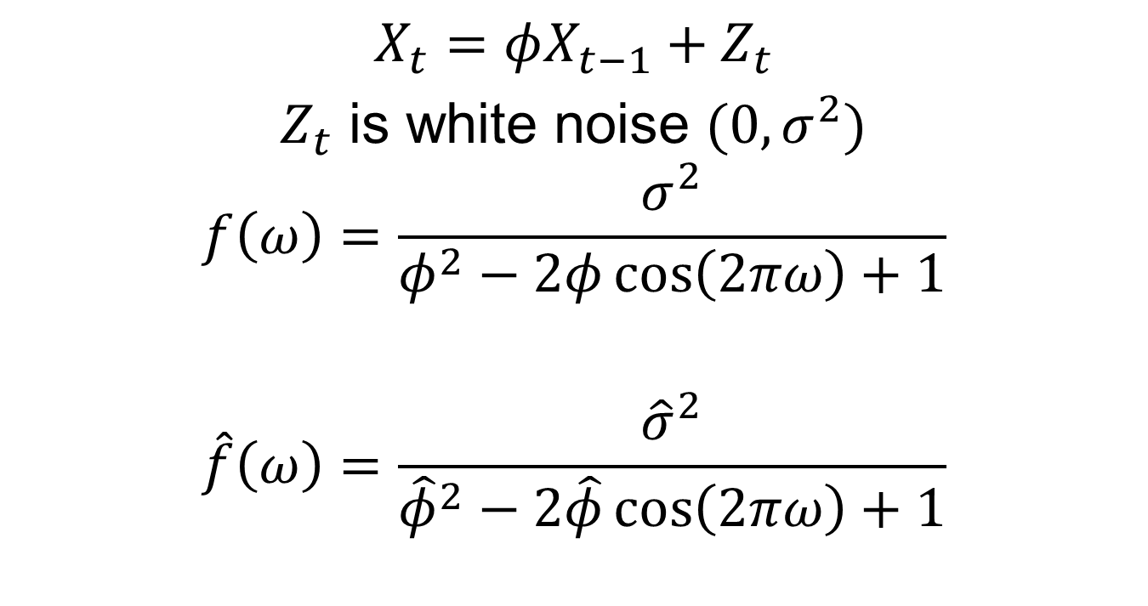
AR(1)
$$X_{t}=φX_{t−1}+Z_{t}$$
$Z_{t}$ is white noise ${(0,σ}^{2})$
$$f\left(ω\right)=\frac{σ^{2}}{φ^{2}−2φ\cos\left(2πω\right)+1}$$
$$\hat{f}\left(ω\right)=\frac{{\hat{σ}}^{2}}{{\hat{φ}}^{2}−2\hat{φ}\cos\left(2πω\right)+1}$$

Slide 9
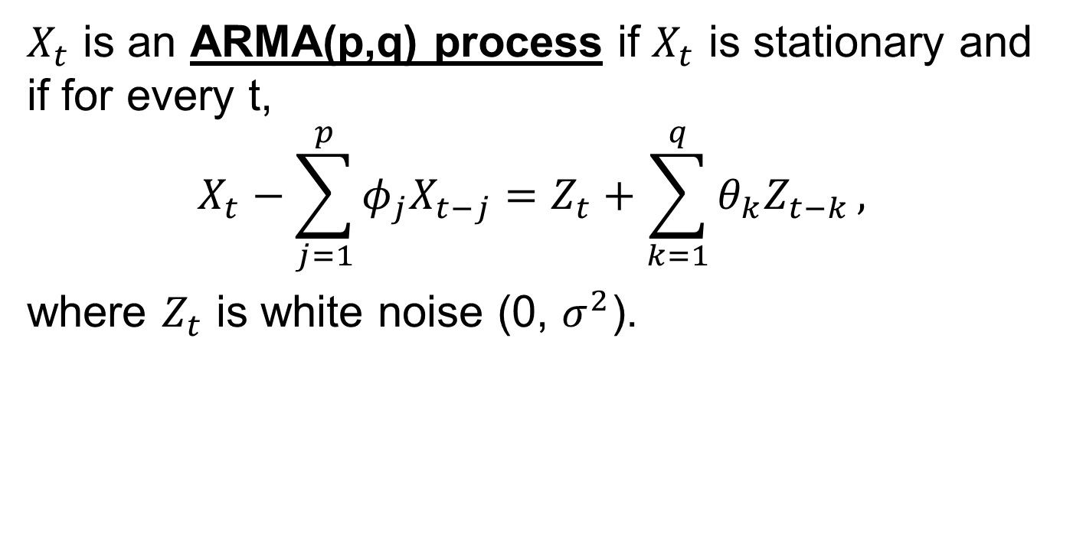
Some Preliminaries
$X_{t}$ is an ARMA(p,q) process if $X_{t}$ is stationary and if for every t,
$$X_{t}−\sum_{j=1}^{p}{φ_{j}X_{t−j}}=Z_{t}+\sum_{k=1}^{q}{θ_{k}Z_{t−k}},$$
where $Z_{t}$ is white noise (0, $σ^{2}$).

Slide 10
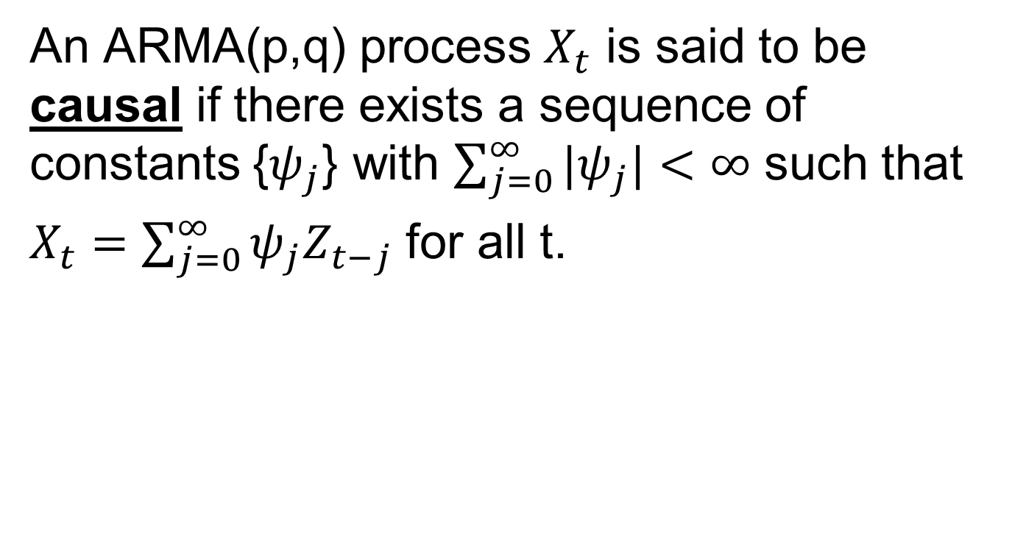
Some Preliminaries
An ARMA(p,q) process $X_{t}$ is said to be causal if there exists a sequence of constants {$ψ_{j}$} with $\sum_{j=0}^{∞}{{|ψ}_{j}|<∞}$ such that
$X_{t}=\sum_{j=0}^{∞}{ψ_{j}Z_{t−j}}$ for all t.

Slide 11

The Sample Mean
$$\overline{X}=T^{−1}\sum_{t=1}^{T}{X_{t}}$$
$$Var\left(\overline{X}\right)=T^{−1}\sum_{h=−T}^{T}{\left(1−\frac{\left|h\right|}{T}\right)γ(h)}$$

Slide 12
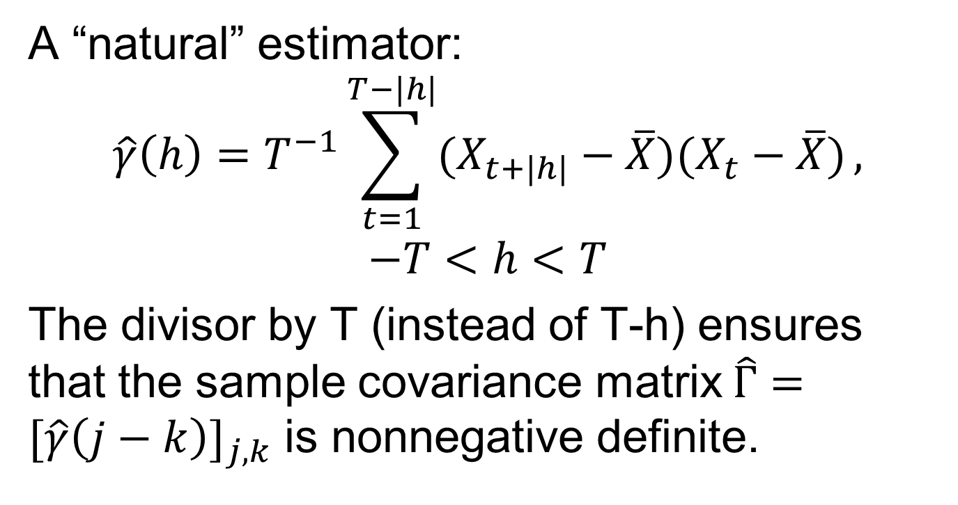
The Sample Autocovariance
A “natural” estimator:
$$\hat{γ}\left(h\right)=T^{−1}\sum_{t=1}^{T−|h|}{(X_{t+|h|}−\overline{X})(X_{t}−\overline{X})},$$
$$−T<h<T$$
The divisor by T (instead of T-h) ensures that the sample covariance matrix$\hat{Γ}=[\hat{γ}\left(j−k\right)]_{j,k}$ is nonnegative definite.

Slide 13
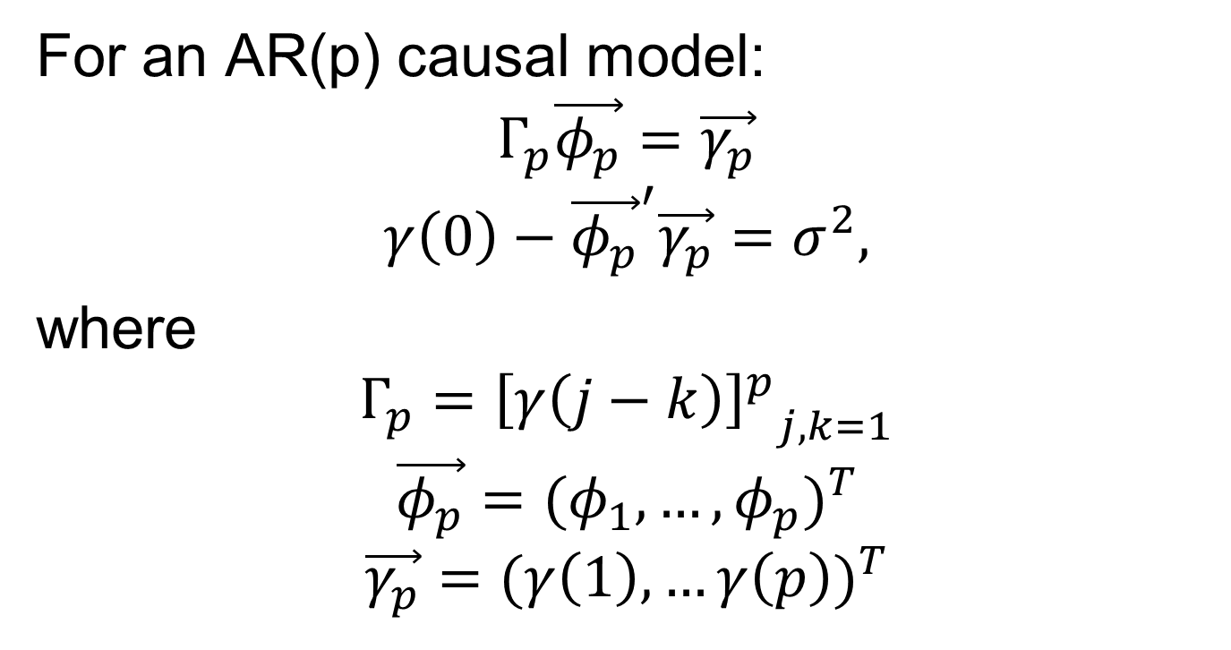
The Yule-Walker Equations
For an AR(p) causal model:
$$Γ_{p}\vec{φ_{p}}=\vec{γ_{p}}$$
$$γ\left(0\right)−{\vec{φ_{p}}}^{′}\vec{γ_{p}}=σ^{2},$$
where
$$Γ_{p}={{\left[γ\left(j−k\right)\right]}^{p}}_{j,k=1}$$
$$\vec{φ_{p}}={(φ_{1},…,φ_{p})}^{T}$$
$$\vec{γ_{p}}={(γ\left(1\right),…γ\left(p\right))}^{T}$$

Slide 14
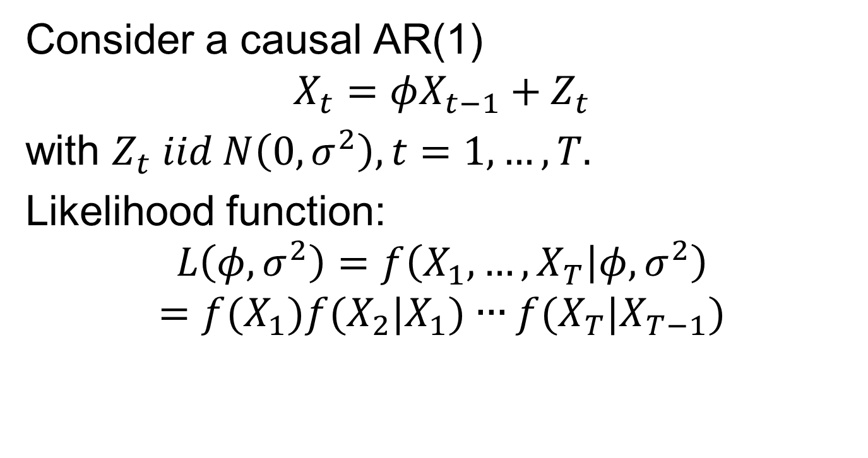
Conditional MLE
Consider a causal AR(1)
$$X_{t}=φX_{t−1}+Z_{t}$$
with $Z_{t} iid N\left(0,σ^{2}\right), t=1,…,T.$
Likelihood function:
$$L\left(φ,σ^{2}\right)=f\left(X_{1},…,X_{T} | φ,σ^{2}\right)$$
$$=f(X_{1})f(X_{2}|X_{1})∙∙∙f(X_{T}|X_{T−1})$$

Slide 15
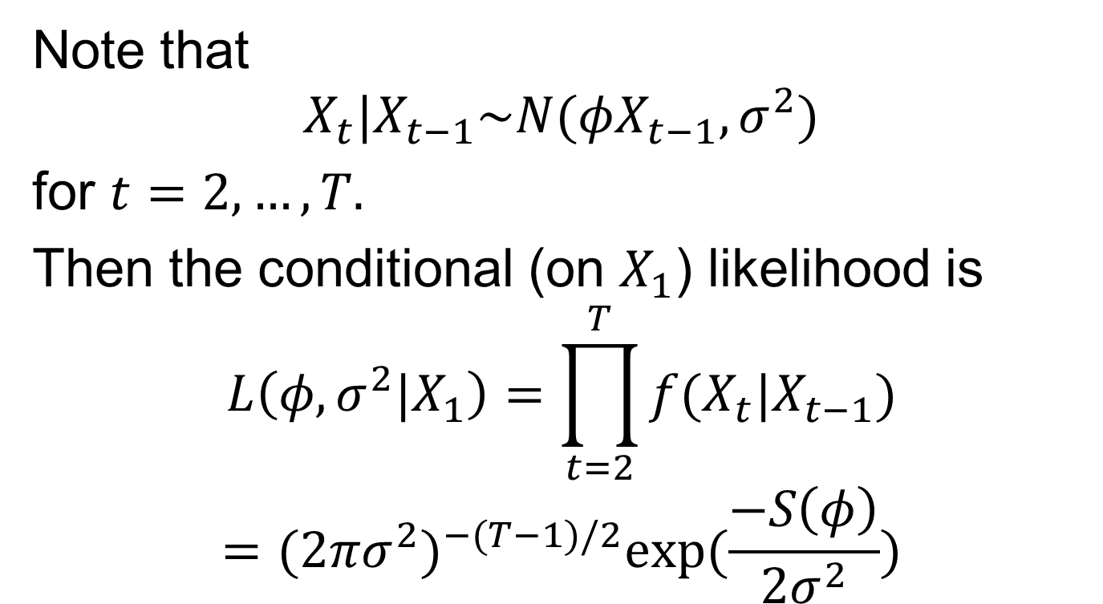
Conditional MLE
Note that
$$X_{t}|X_{t−1}\sim N(φX_{t−1},σ^{2})$$
for $t=2,…,T.$
Then the conditional (on $X_{1}$) likelihood is
$$L\left(φ,σ^{2}|X_{1}\right)=\prod_{t=2}^{T}{f(X_{t}|X_{t−1})}$$
$$={(2πσ^{2})}^{−(T−1)/2}exp⁡(\frac{−S\left(φ\right)}{2σ^{2}})$$

Slide 16
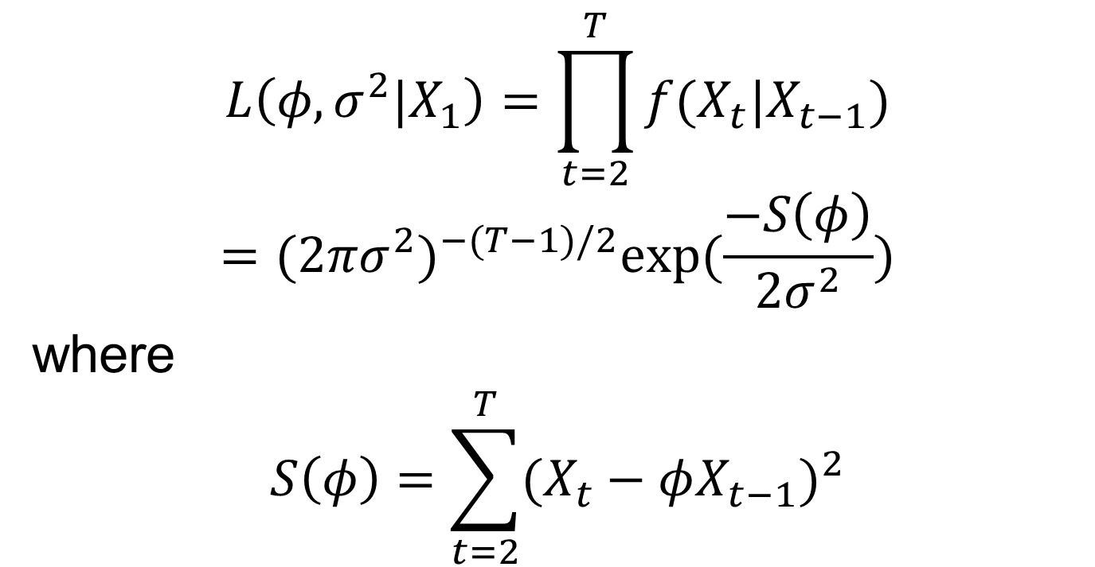
Conditional MLE
$$L\left(φ,σ^{2}|X_{1}\right)=\prod_{t=2}^{T}{f(X_{t}|X_{t−1})}$$
$$={(2πσ^{2})}^{−(T−1)/2}exp⁡(\frac{−S\left(φ\right)}{2σ^{2}})$$
where
$$S\left(φ\right)=\sum_{t=2}^{T}{{(X_{t}−φX_{t−1})}^{2}}$$

Slide 17
Conditional MLE
The conditional MLE approach reduces to a regression problem!
This approach can be generalised to the AR(p) model.

Slide 18
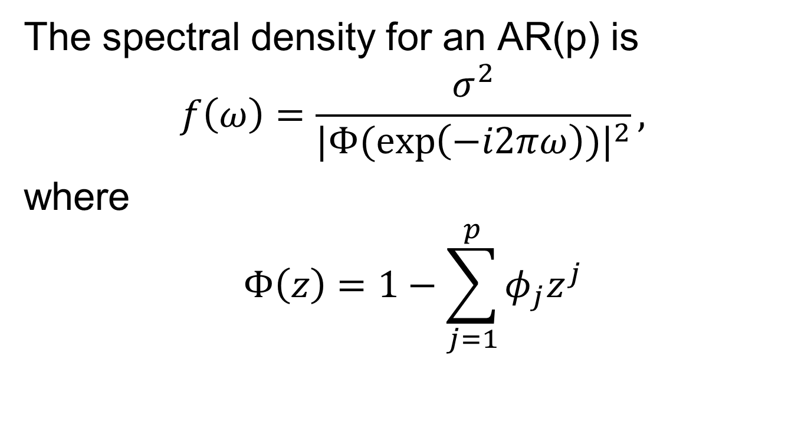
The AR Spectrum
The spectral density for an AR(p) is
$$f\left(ω\right)=\frac{σ^{2}}{{|Φ(\exp\left(−i2πω\right))|}^{2}},$$
where
$$Φ\left(z\right)=1−\sum_{j=1}^{p}{φ_{j}z^{j}}$$

Slide 19
The AR Spectrum
The spectral density of any weakly stationary process can be approximated arbitrarily close by the spectrum of an AR(p).

Slide 20
The AR Spectrum
Problem: how large must the order p be for the approximation to be reasonable?

Slide 21
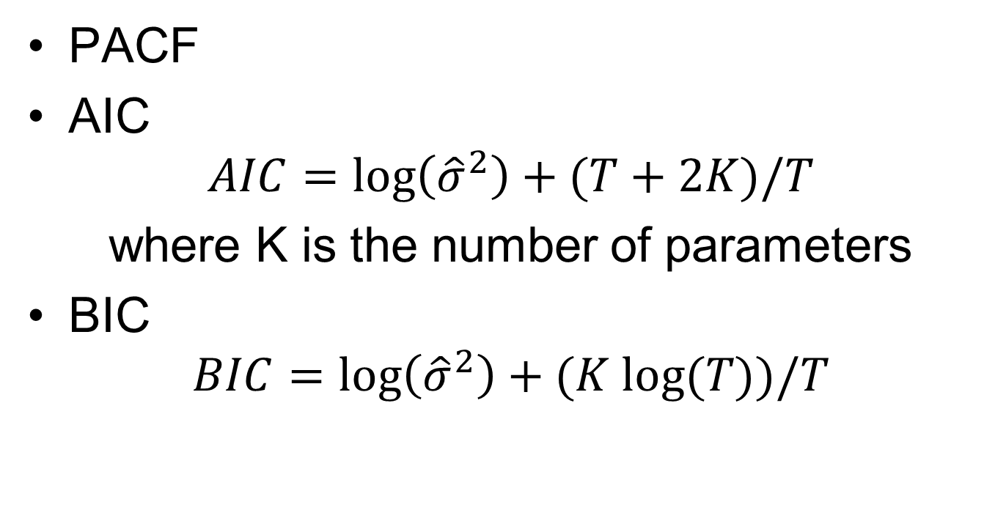
Model Selection
PACF
AIC
$$AIC=\log\left({\hat{σ}}^{2}\right)+(T+2K)/T$$
where K is the number of parameters
BIC
$$BIC=\log\left({\hat{σ}}^{2}\right)+(K log⁡(T))/T$$

Slide 22
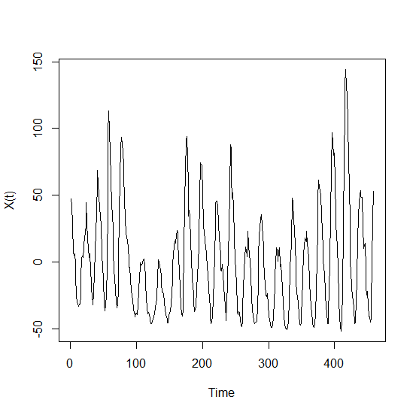
Example: Sunspots

Slide 23
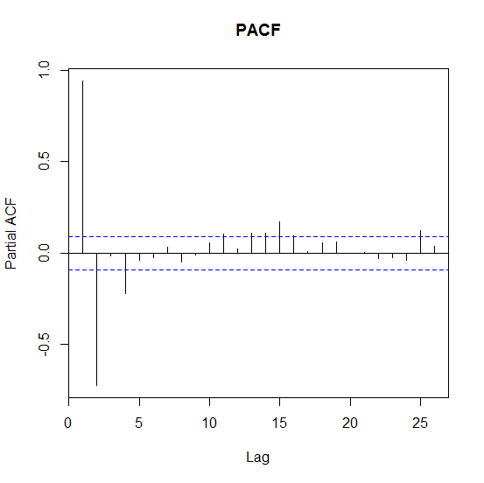
Example: Sunspots

Slide 24
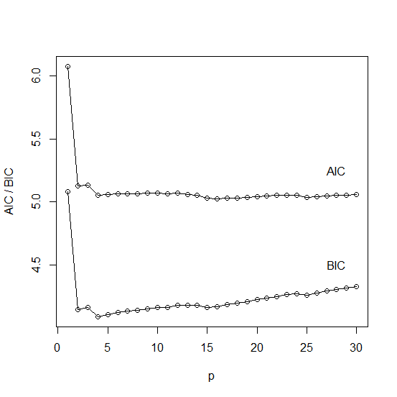
Example: Sunspots

Slide 25
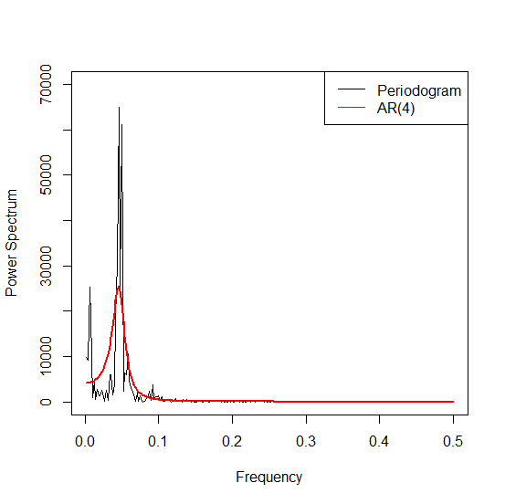
Example: Sunspots

Slide 26
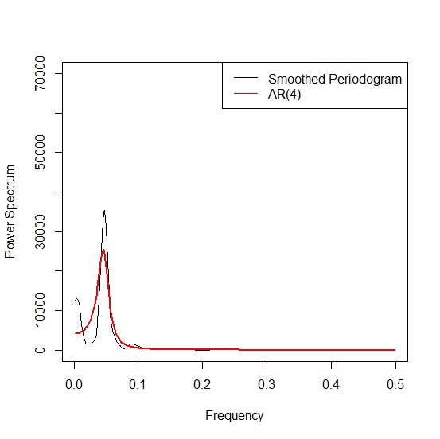
Example: Sunspots

Slide 27
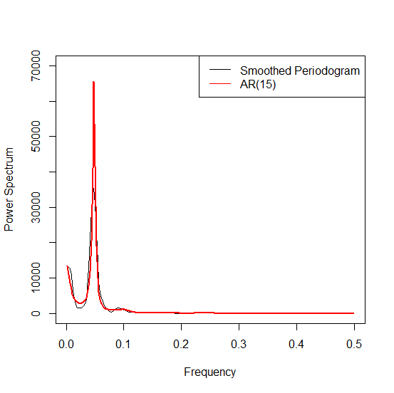
Example: Sunspots

Slide 28
Example: SOI

Slide 29
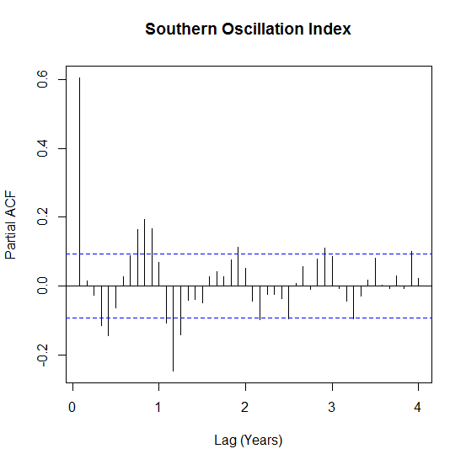
Example: SOI

Slide 30
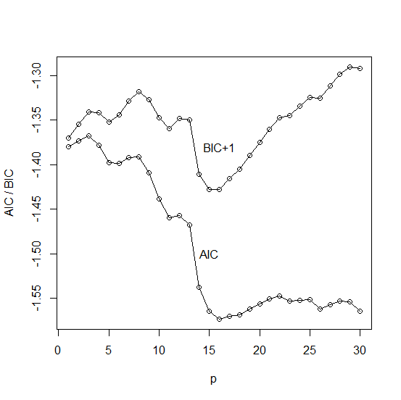
Example: SOI

Slide 31
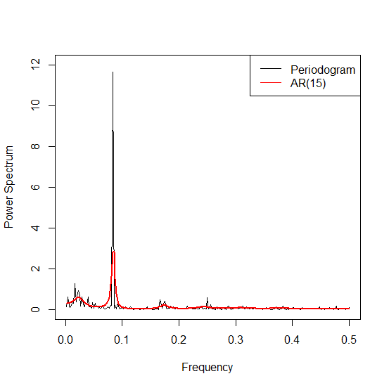
Example 2

Slide 32
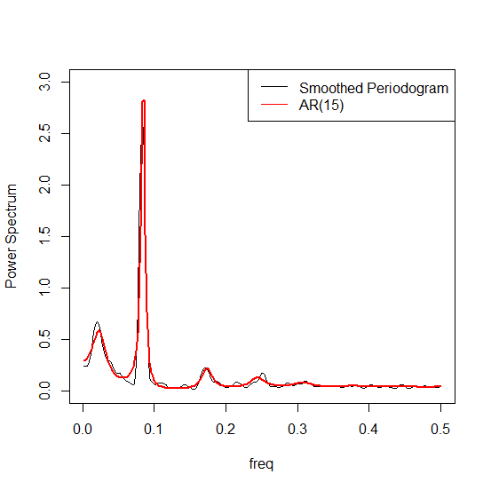
Example 2

Slide 33
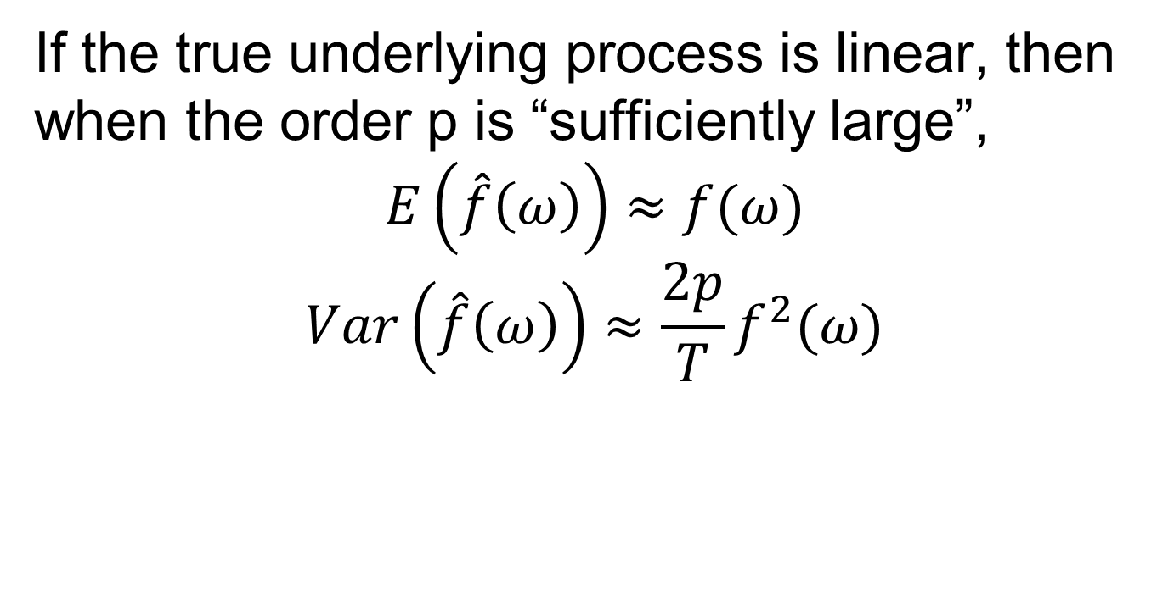
The AR Spectrum
If the true underlying process is linear, then when the order p is “sufficiently large”,
$$E\left(\hat{f}\left(ω\right)\right)≈f(ω)$$
$$Var\left(\hat{f}\left(ω\right)\right)≈\frac{2p}{T}f^{2}(ω)$$

Slide 34
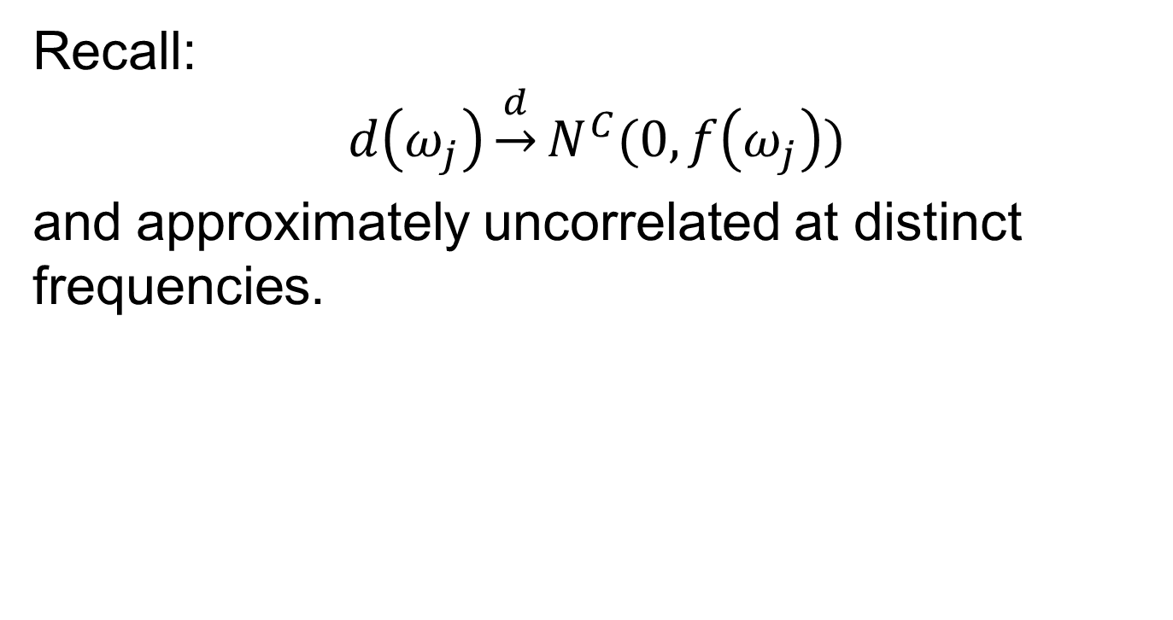
The Whittle Likelihood
Recall:
$$d\left(ω_{j}\right)\underset{→}{d}N^{C}(0, f\left(ω_{j}\right))$$
and approximately uncorrelated at distinct frequencies.

Slide 35
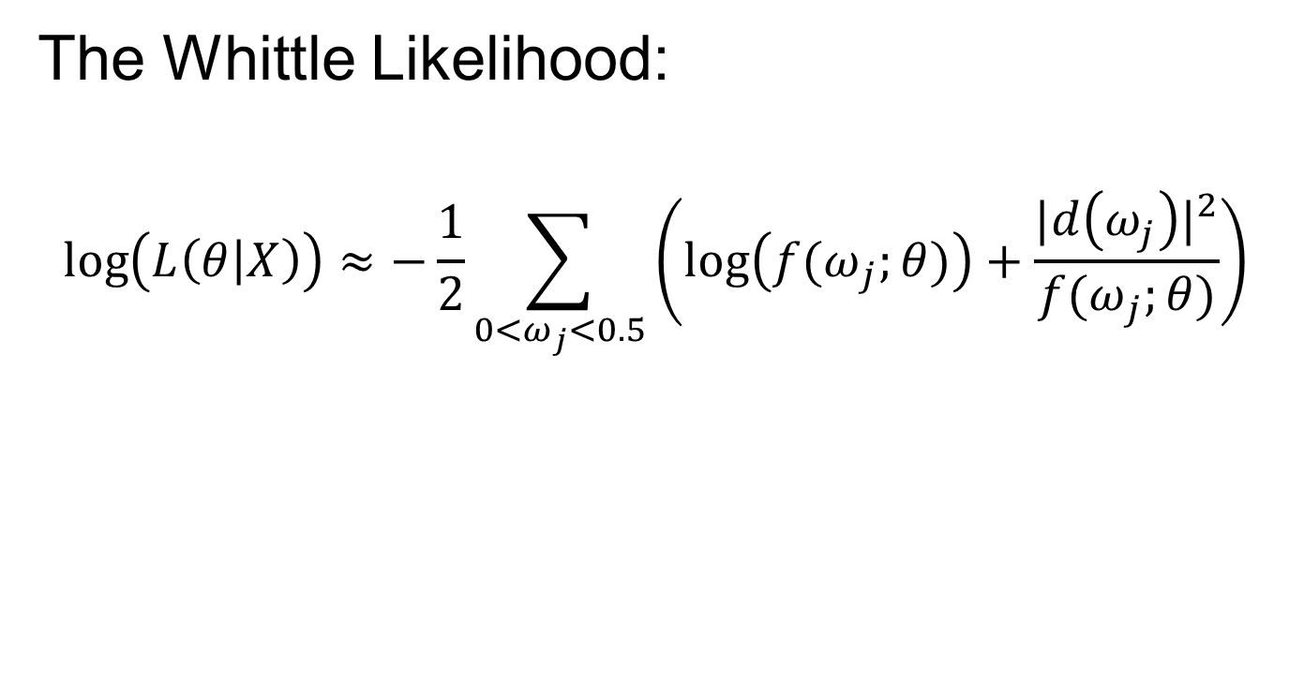
The Whittle Likelihood
The Whittle Likelihood:
$$\log\left(L\left(θ | X\right)\right)≈−\frac{1}{2}\sum_{0<ω_{j}<0.5}{\left(\log\left({f(ω}_{j};θ)\right)+\frac{{|d\left(ω_{j}\right)|}^{2}}{{f(ω}_{j};θ)}\right)}$$

Slide 36
Comparisons
AR spectrum
Good frequency resolution, even for low-order models
Potential for model misspecification
Periodogram
Frequency resolution is a function of the length of the time series
Some form of smoothing is necessary for a stable estimate

Slide 37
Next Time
Bivariate time series
Notes: 3.1

