Slide 1
ST414 – Spectral Analysis of Time Series Data
Lecture 6
12 February 2015

Slide 2
Last Time
Estimating AR parameters
Parametric estimates of the spectrum
Notes: 1.2, 2.5

Slide 3
Today’s Objectives
Parametric estimates of the spectrum
Introduce bivariate (multivariate) models
Notes: 1.2, 2.5, 3.1, 3.2

Slide 4
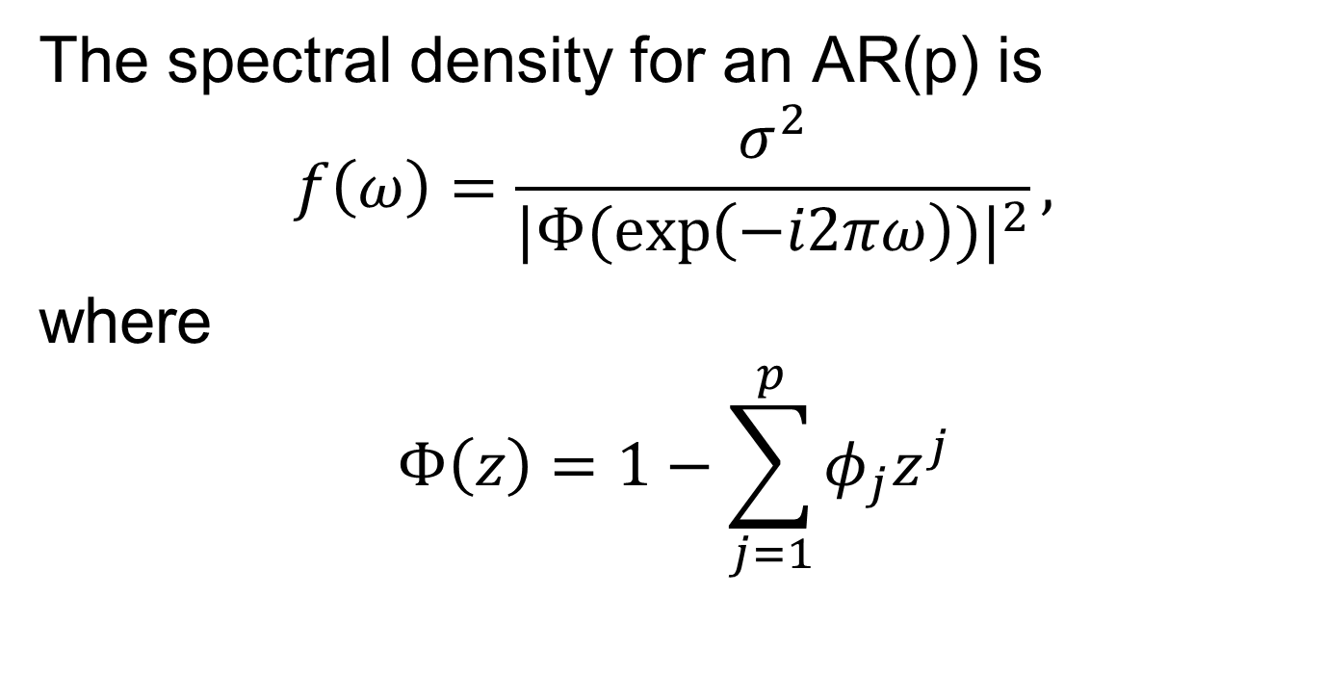
The AR Spectrum
The spectral density for an AR(p) is
$$f\left(ω\right)=\frac{σ^{2}}{{|Φ(\exp\left(−i2πω\right))|}^{2}},$$
where
$$Φ\left(z\right)=1−\sum_{j=1}^{p}{φ_{j}z^{j}}$$

Slide 5
The AR Spectrum
The spectral density of any weakly stationary process can be approximated arbitrarily close by the spectrum of an AR(p).

Slide 6
The AR Spectrum
Problem: how large must the order p be for the approximation to be reasonable?

Slide 7
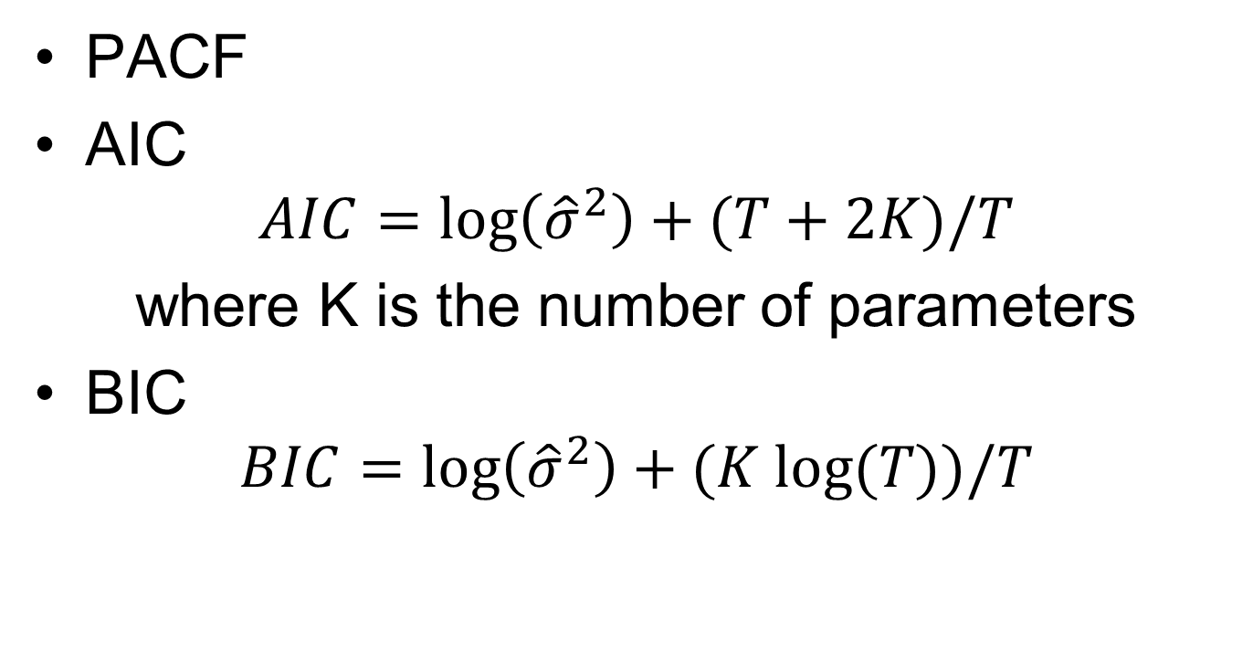
Model Selection
PACF
AIC
$$AIC=\log\left({\hat{σ}}^{2}\right)+(T+2K)/T$$
where K is the number of parameters
BIC
$$BIC=\log\left({\hat{σ}}^{2}\right)+(K log⁡(T))/T$$

Slide 8
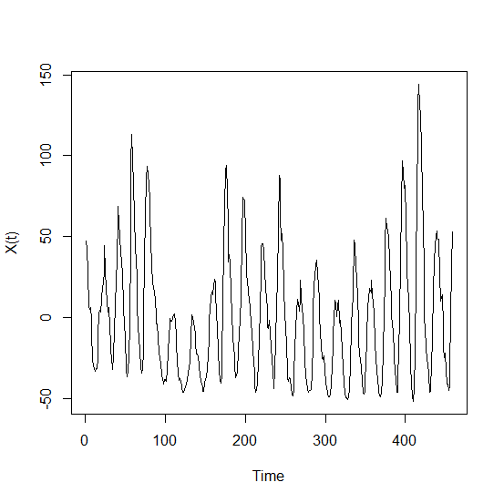
Example: Sunspots

Slide 9
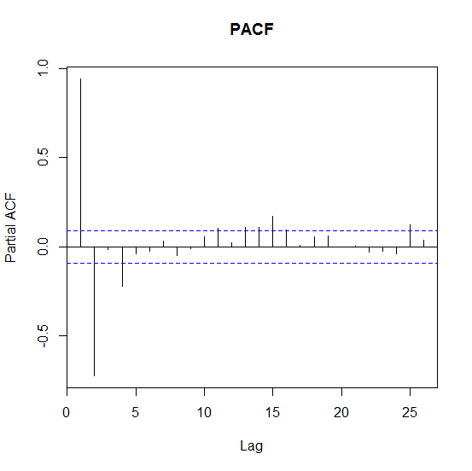
Example: Sunspots

Slide 10
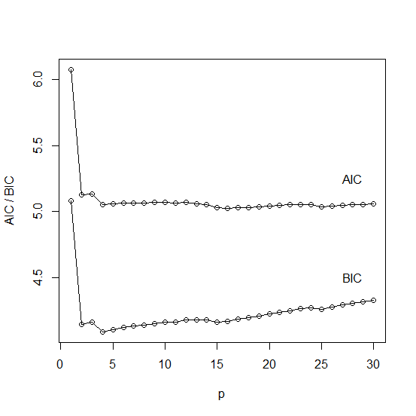
Example: Sunspots

Slide 11
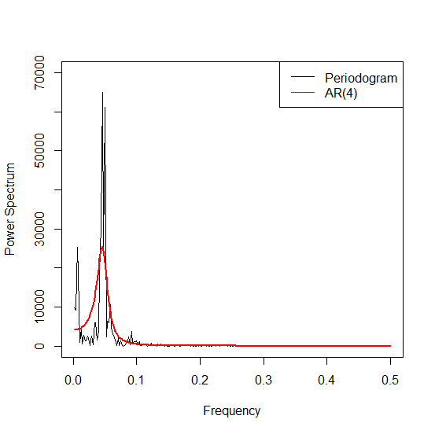
Example: Sunspots

Slide 12
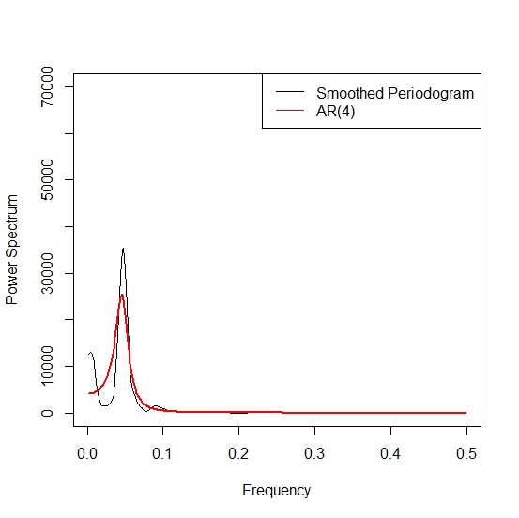
Example: Sunspots

Slide 13
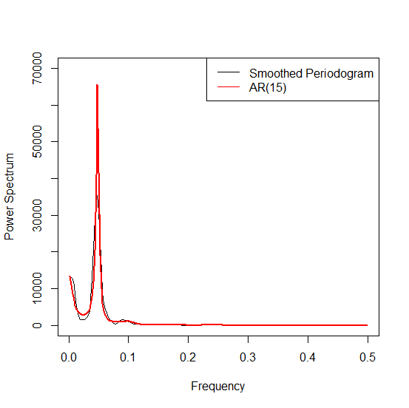
Example: Sunspots

Slide 14
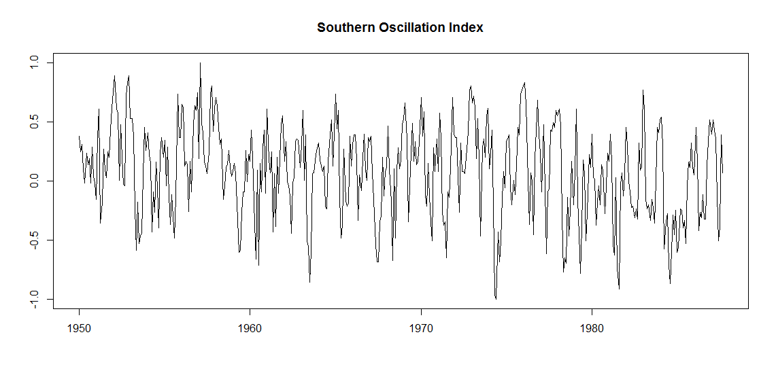
Example: SOI

Slide 15
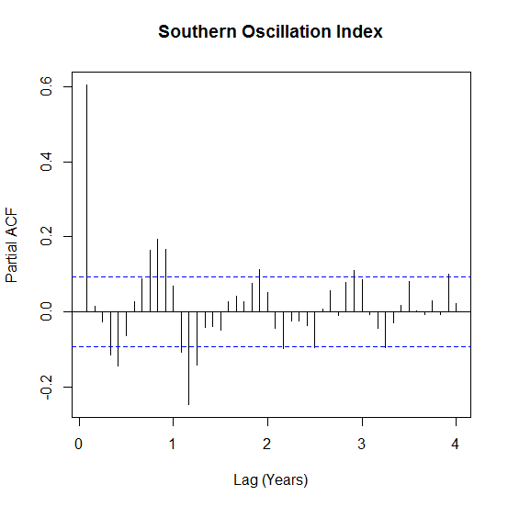
Example: SOI

Slide 16
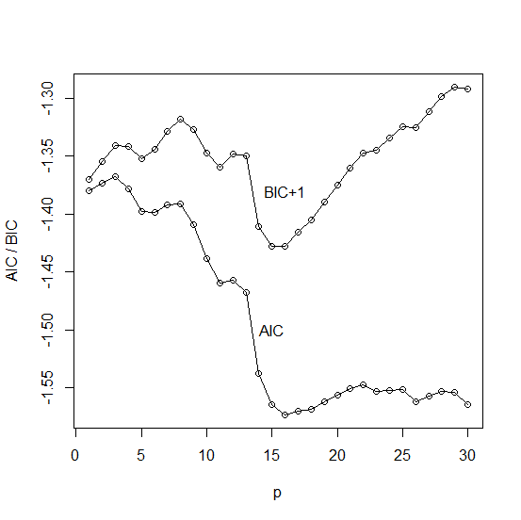
Example: SOI

Slide 17
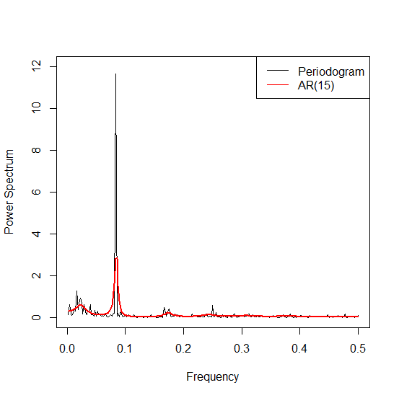
Example: SOI

Slide 18
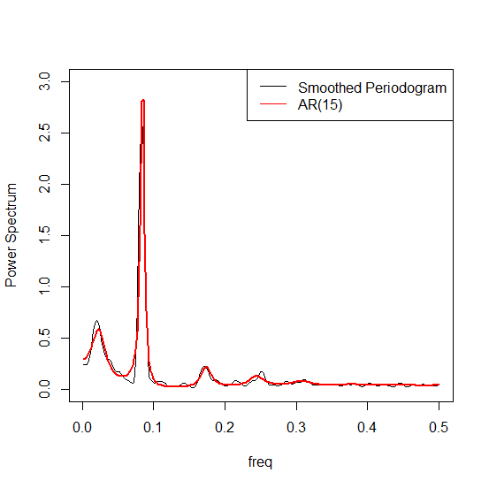
Example: SOI

Slide 19
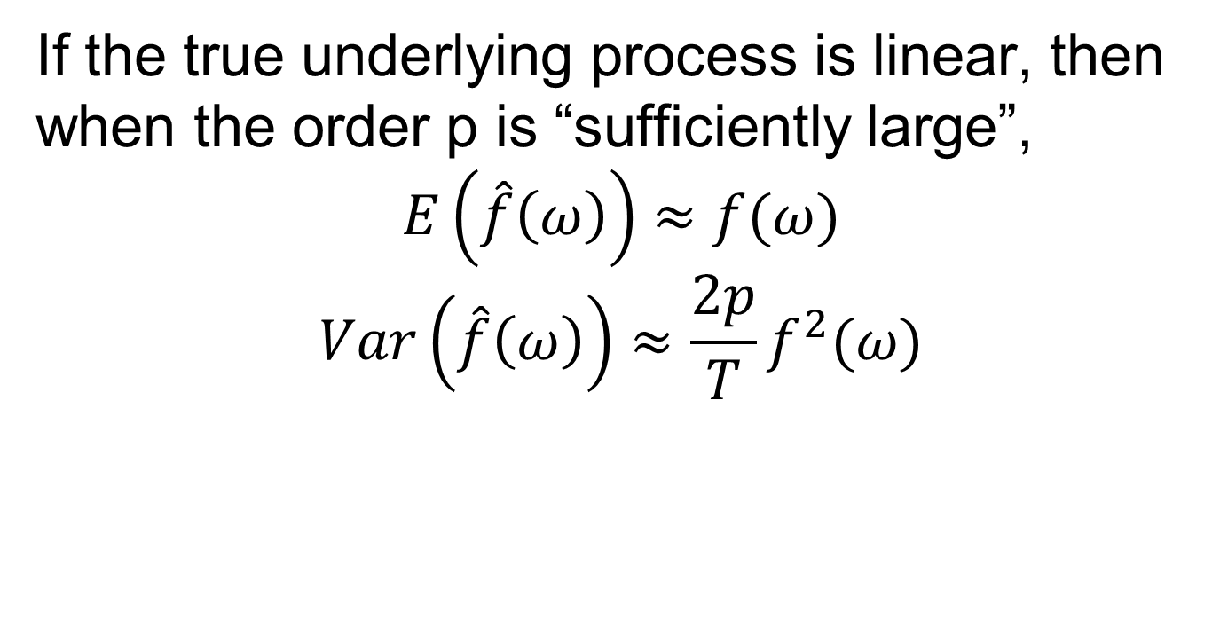
The AR Spectrum
If the true underlying process is linear, then when the order p is “sufficiently large”,
$$E\left(\hat{f}\left(ω\right)\right)≈f(ω)$$
$$Var\left(\hat{f}\left(ω\right)\right)≈\frac{2p}{T}f^{2}(ω)$$

Slide 20
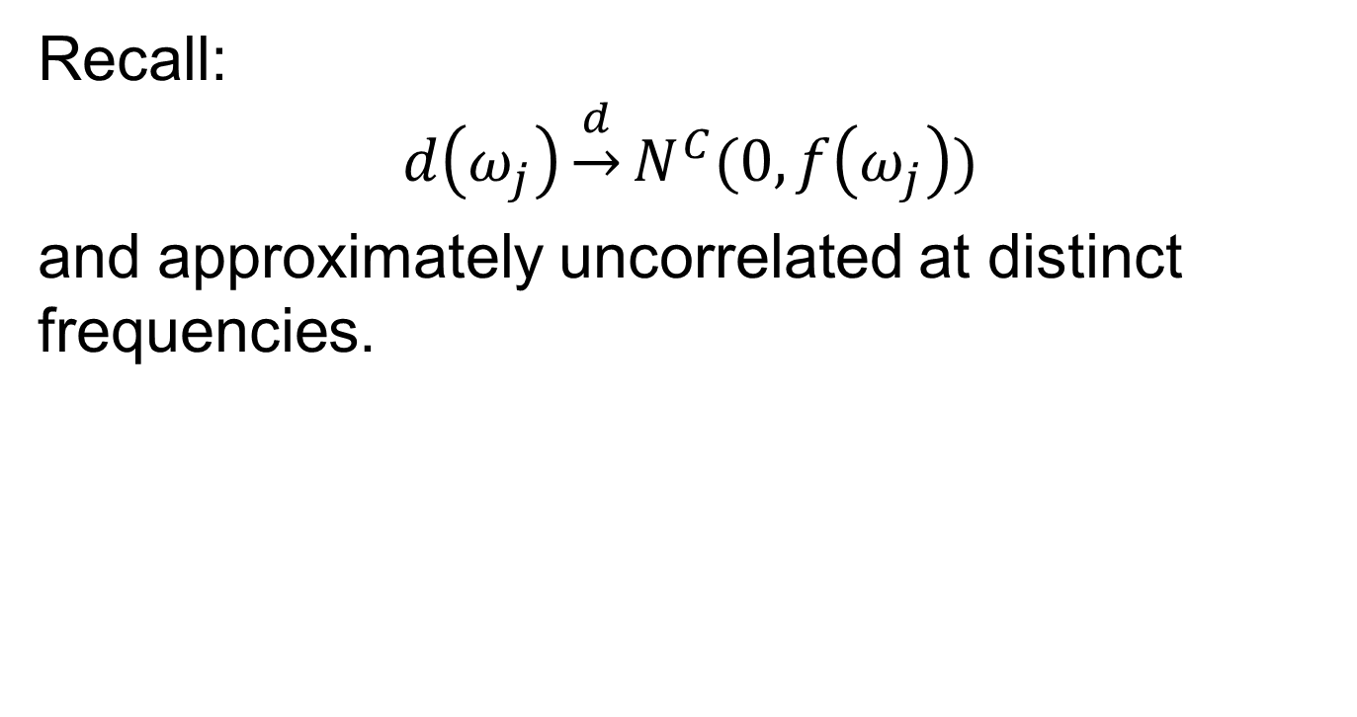
The Whittle Likelihood
Recall:
$$d\left(ω_{j}\right)\underset{→}{d}N^{C}(0, f\left(ω_{j}\right))$$
and approximately uncorrelated at distinct frequencies.

Slide 21
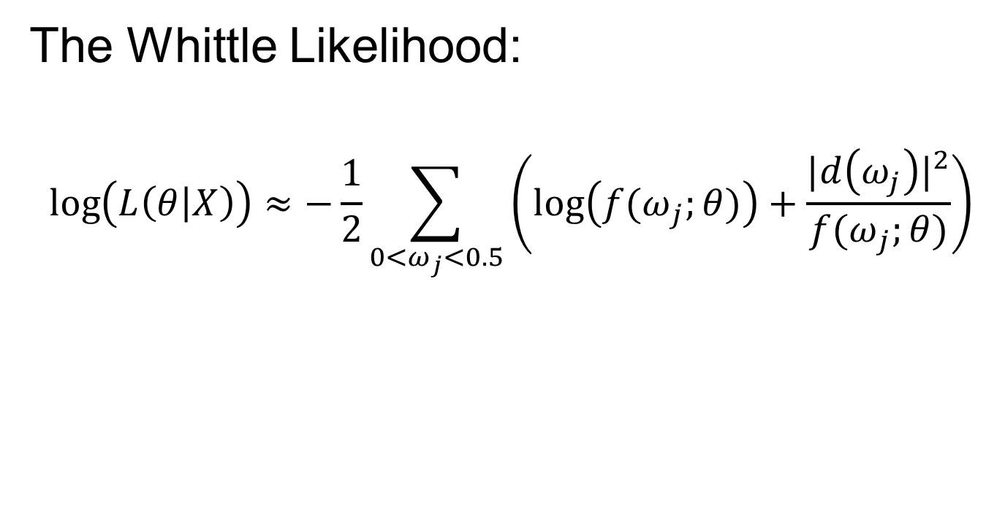
The Whittle Likelihood
The Whittle Likelihood:
$$\log\left(L\left(θ | X\right)\right)≈−\frac{1}{2}\sum_{0<ω_{j}<0.5}{\left(\log\left({f(ω}_{j};θ)\right)+\frac{{|d\left(ω_{j}\right)|}^{2}}{{f(ω}_{j};θ)}\right)}$$

Slide 22
Comparisons
AR spectrum
Good frequency resolution, even for low-order models
Potential for model misspecification
Periodogram
Frequency resolution is a function of the length of the time series
Some form of smoothing is necessary for a stable estimate

Slide 23
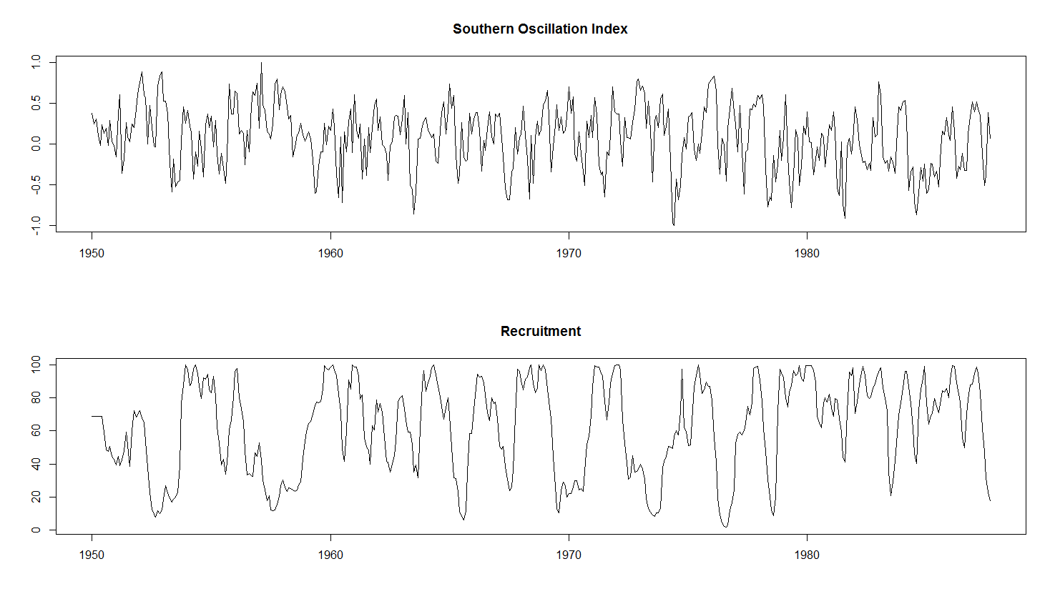
Bivariate Time Series

Slide 24
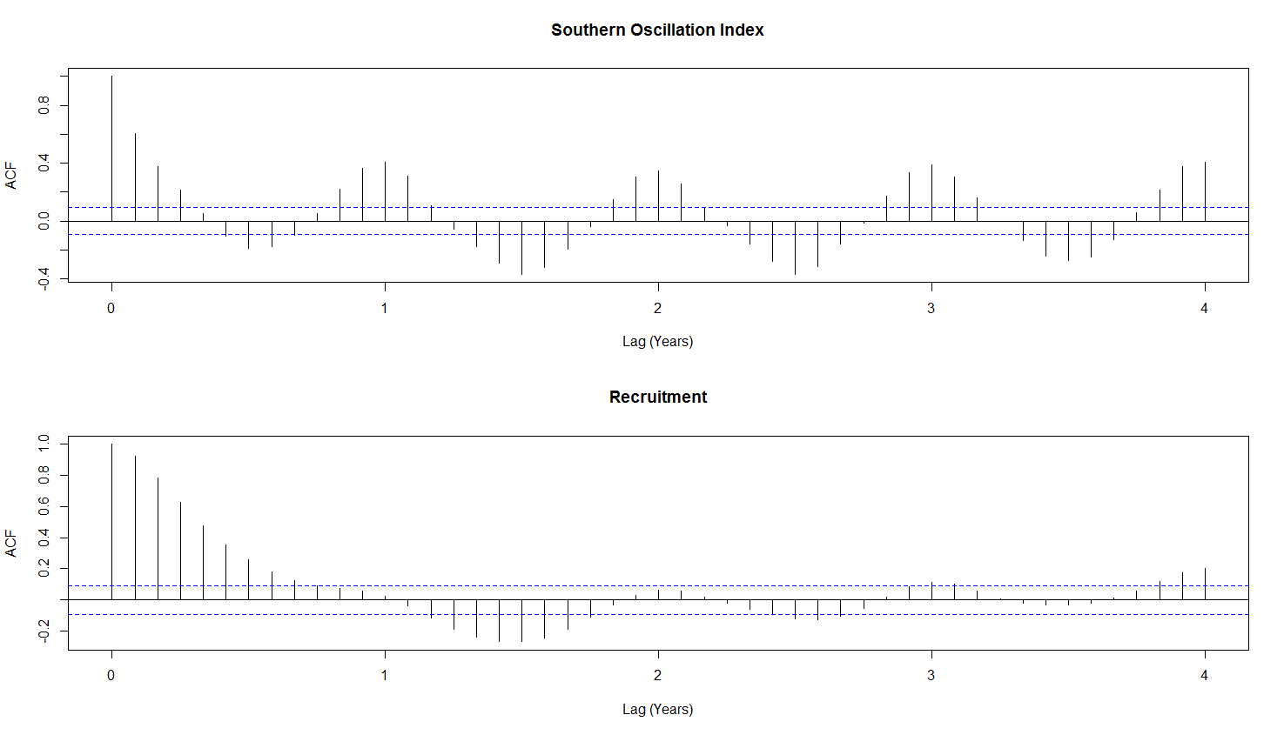
Bivariate Time Series

Slide 25
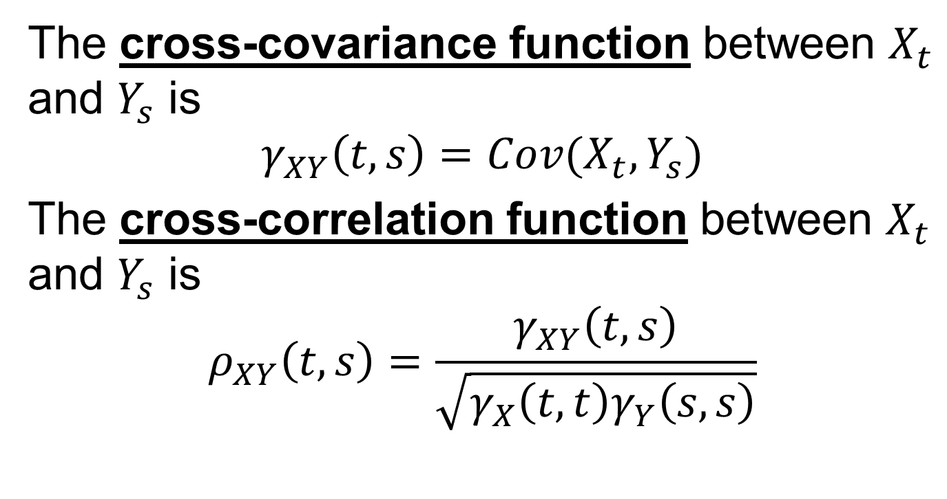
Preliminaries
The cross-covariance function between $X_{t}$ and $Y_{s}$ is
$$γ_{XY}\left(t,s\right)=Cov(X_{t},Y_{s})$$
The cross-correlation function between $X_{t}$ and $Y_{s}$ is
$$ρ_{XY}\left(t,s\right)=\frac{γ_{XY}\left(t,s\right)}{\sqrt{γ_{X}\left(t,t\right)γ_{Y}\left(s,s\right)}}$$

Slide 26
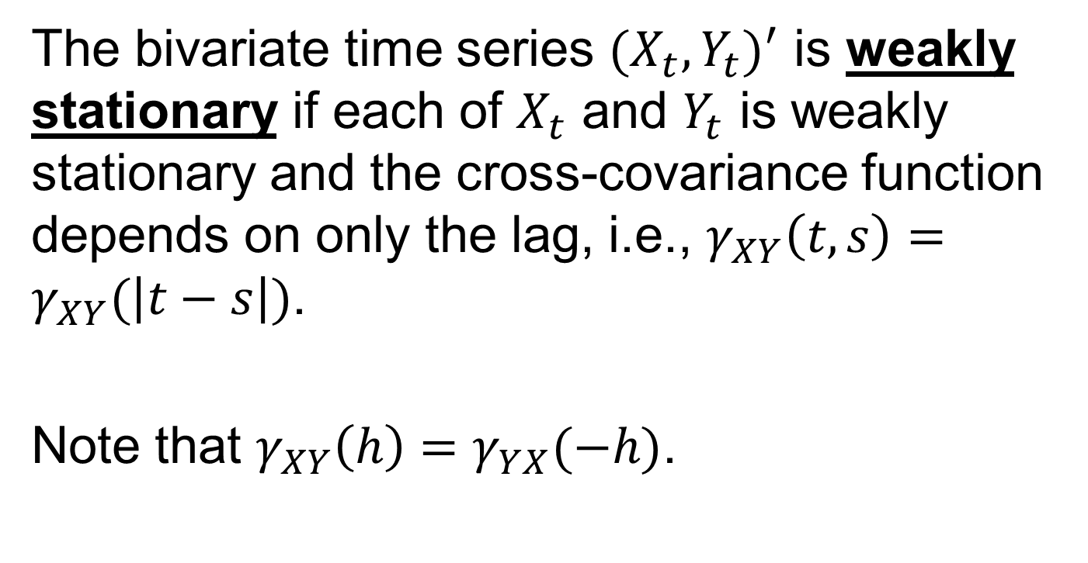
Preliminaries
The bivariate time series ${(X}_{t},Y_{t})^{′}$ is weakly stationary if each of $X_{t}$ and $Y_{t}$ is weakly stationary and the cross-covariance function depends on only the lag, i.e., $γ_{XY}\left(t,s\right)=γ_{XY}(\left|t−s\right|)$.
Note that $γ_{XY}\left(h\right)=γ_{YX}(−h)$.

Slide 27
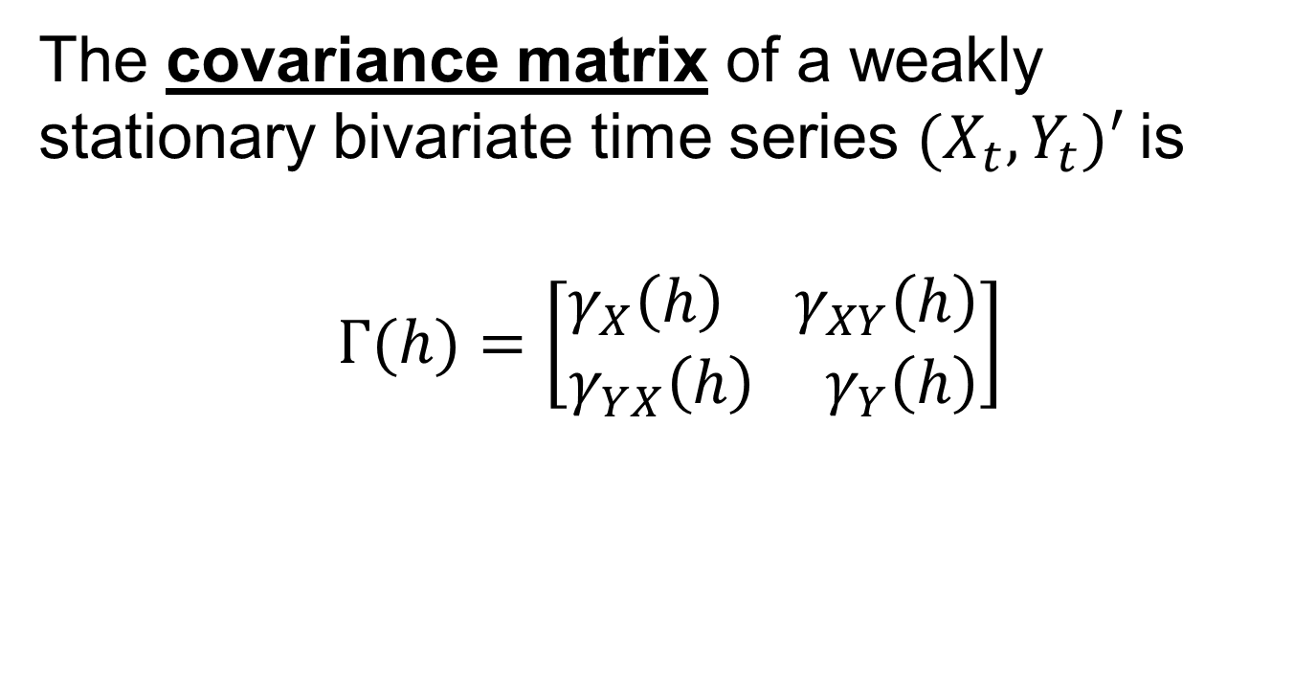
Preliminaries
The covariance matrix of a weakly stationary bivariate time series $(X_{t},Y_{t})^{′}$ is
$$Γ(h)=\left[\begin{aligned}γ_{X}\left(h\right){ γ}_{XY}\left(h\right) \\ γ_{YX}\left(h\right){ γ}_{Y}\left(h\right)\end{aligned}\right]$$

Slide 28
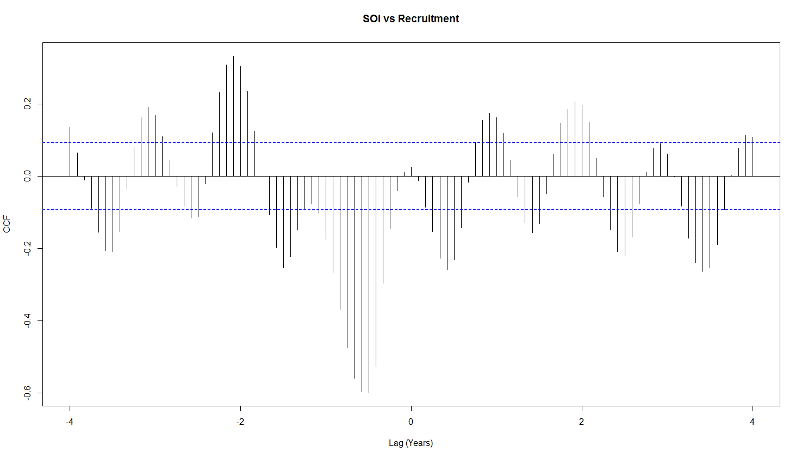
Example

Slide 29

Bivariate White Noise
$Z_{t}$ is a bivariate white noise process (0,$Σ$) if it has mean the zero vector and 2x2 covariance matrix $E({Z_{t}Z_{t}}^{′})=Σ$ (assumed to be nonsingular) and $E({Z_{t}Z_{s}}^{′})=0$for $s≠t$.

Slide 30
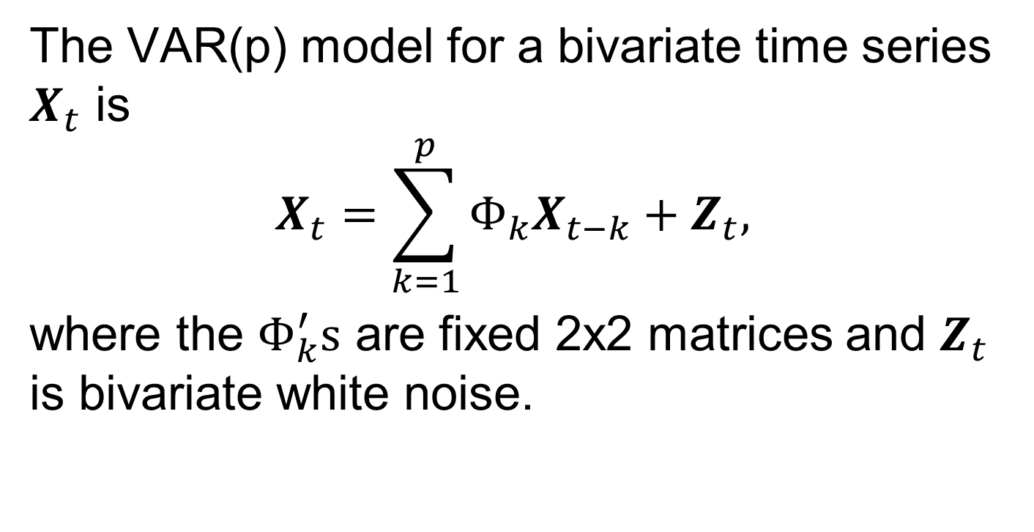
The VAR(p) process
The VAR(p) model for a bivariate time series $X_{t}$ is
$$X_{t}=\sum_{k=1}^{p}{Φ_{k}X_{t−k}}+Z_{t},$$
where the $Φ_{k}^{′}s$ are fixed 2x2 matrices and $Z_{t}$ is bivariate white noise.

Slide 31
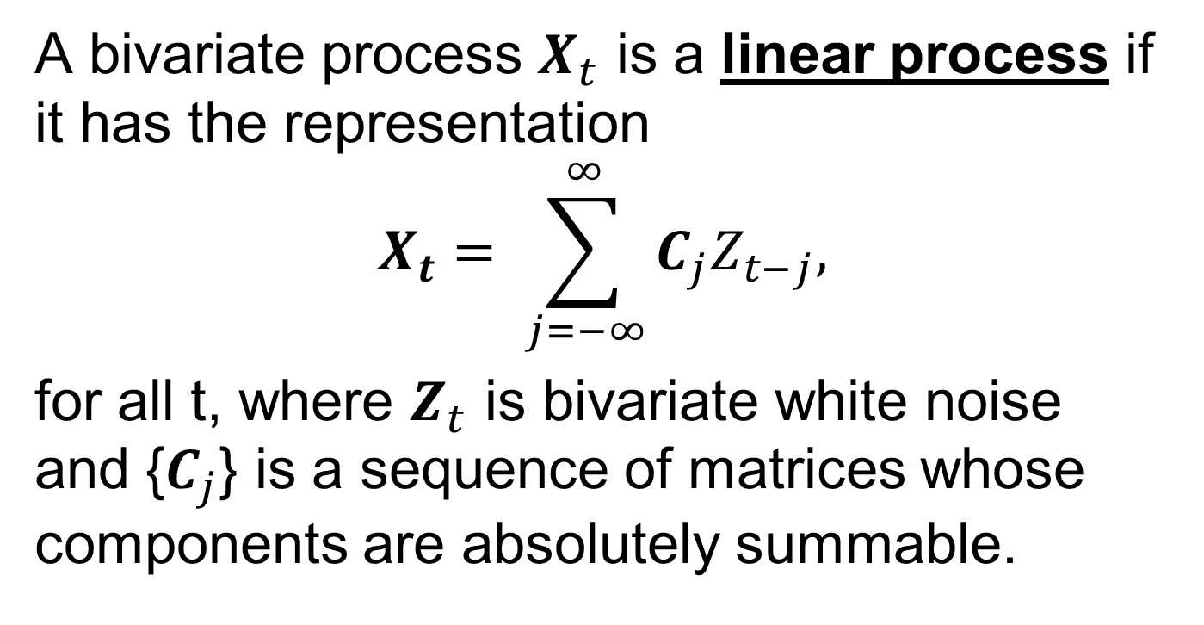
Preliminaries
A bivariate process $X_{t}$ is a linear process if it has the representation
$$X_{t}= \sum_{j=−∞}^{∞}{C_{j}Z_{t−j},}$$
for all t, where $Z_{t}$ is bivariate white noise and {$C_{j}$} is a sequence of matrices whose components are absolutely summable.

Slide 32
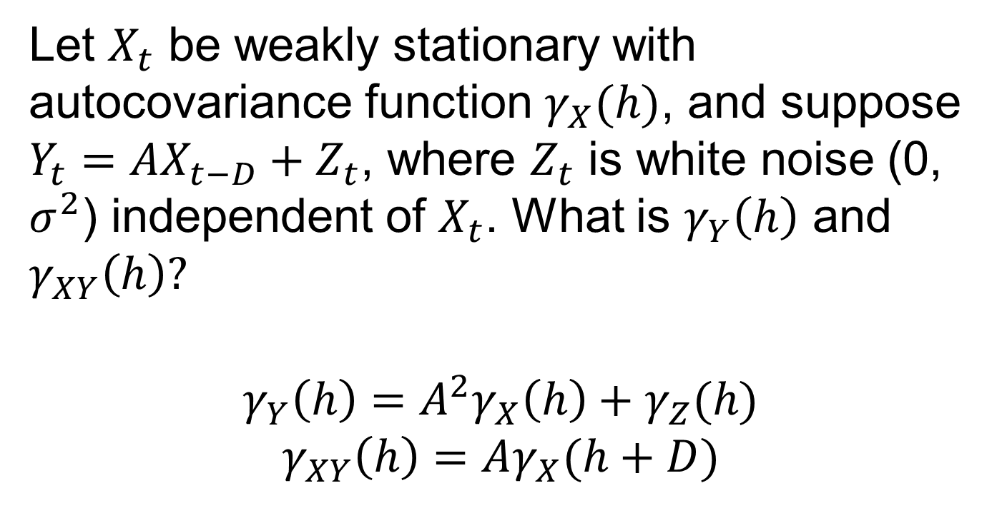
Example
Let $X_{t}$ be weakly stationary with autocovariance function $γ_{X}(h)$, and suppose $Y_{t}=AX_{t−D}+Z_{t}$, where $Z_{t}$ is white noise (0, $σ^{2}$) independent of $X_{t}$. What is $γ_{Y}\left(h\right)$ and $γ_{XY}\left(h\right)?$
$$γ_{Y}\left(h\right)=A^{2}γ_{X}\left(h\right)+γ_{Z}(h)$$
$$γ_{XY}\left(h\right)=Aγ_{X}(h+D)$$

Slide 33
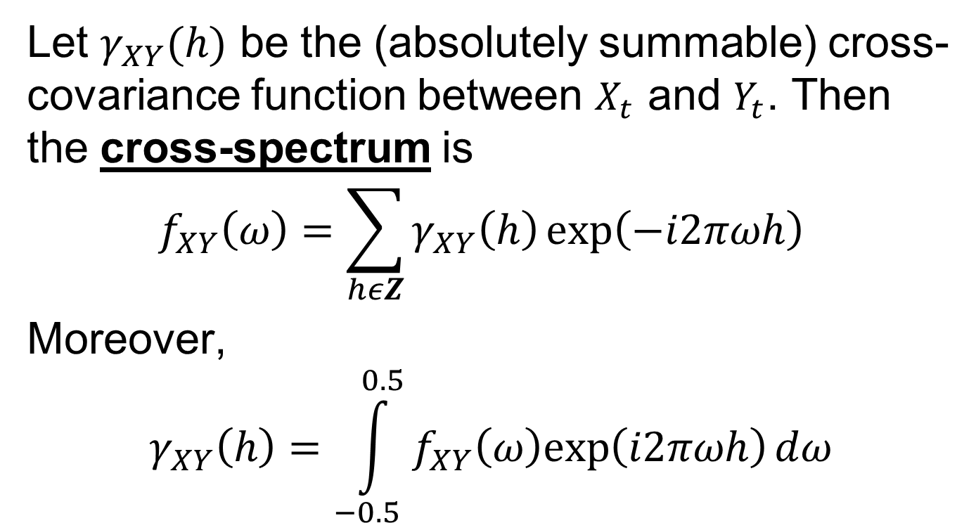
The Cross-spectrum
Let $γ_{XY}(h)$ be the (absolutely summable) cross-covariance function between $X_{t}$ and $Y_{t}$. Then the cross-spectrum is
$$f_{XY}\left(ω\right)=\sum_{hεZ}{γ_{XY}\left(h\right)\exp\left(−i2πωh\right) }$$
Moreover,
$$γ_{XY}\left(h\right)=\int_{−0.5}^{0.5}{f_{XY}\left(ω\right)exp\left(i2πωh\right)dω}$$

Slide 34
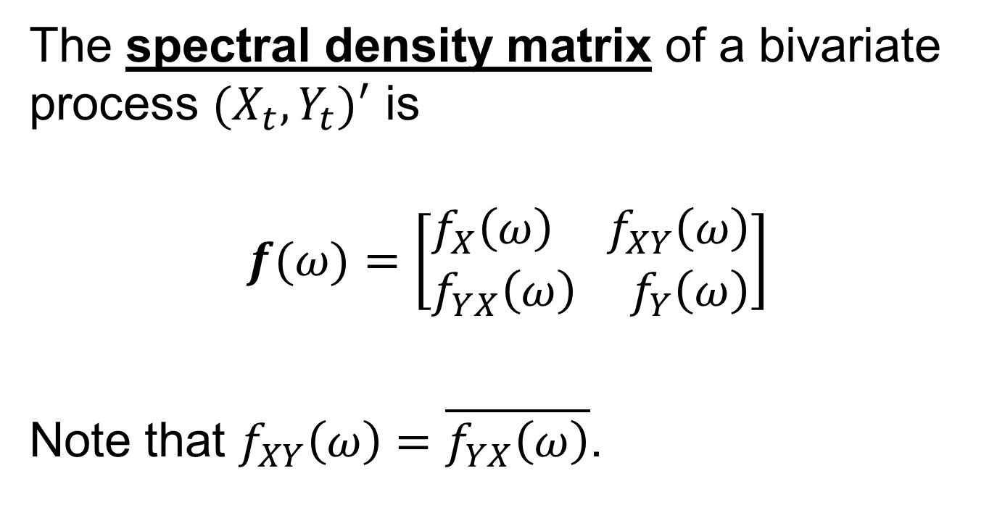
The Spectral Density Matrix
The spectral density matrix of a bivariate process $(X_{t},Y_{t})^{′}$ is
$$f(ω)=\left[\begin{aligned}f_{X}\left(ω\right){ f}_{XY}\left(ω\right) \\ f_{YX}\left(ω\right){ f}_{Y}\left(ω\right)\end{aligned}\right]$$
Note that $f_{XY}\left(ω\right)=\overline{f_{YX}\left(ω\right)}$.

Slide 35
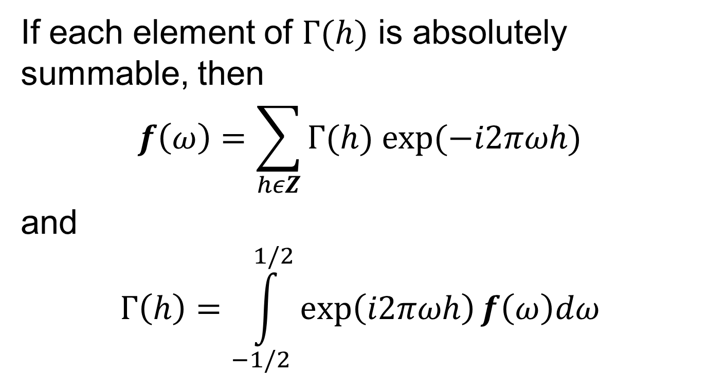
The Spectral Density Matrix
If each element of $Γ(h)$ is absolutely summable, then
$$f\left(ω\right)=\sum_{hεZ}{Γ(h) exp⁡(−i2πωh)}$$
and
$$Γ\left(h\right)=\int_{−1/2}^{1/2}{\exp\left(i2πωh\right)f\left(ω\right)dω}$$

Slide 36

Coherence
The coherence between $X_{t}$ and $Y_{t}$ is
$$ρ_{XY}^{2}\left(ω\right)=\frac{|f_{XY}\left(ω\right)|^{2}}{f_{X}\left(ω\right)f_{Y}\left(ω\right)}$$

Slide 37
Next Time
The (smoothed) periodogram matrix
Notes: 3.2, 3.3

