Slide 1
ST414 – Spectral Analysis of Time Series Data
Lecture 7
19 February 2015

Slide 2
Last Time
The spectral density matrix
The (smoothed) periodogram
Coherence analysis
Notes: 3.2, 3.3

Slide 3
Today’s Objectives
The (smoothed) periodogram
Coherence analysis
Asymptotic Properties
Notes: 3.2, 3.3, 3.4

Slide 4
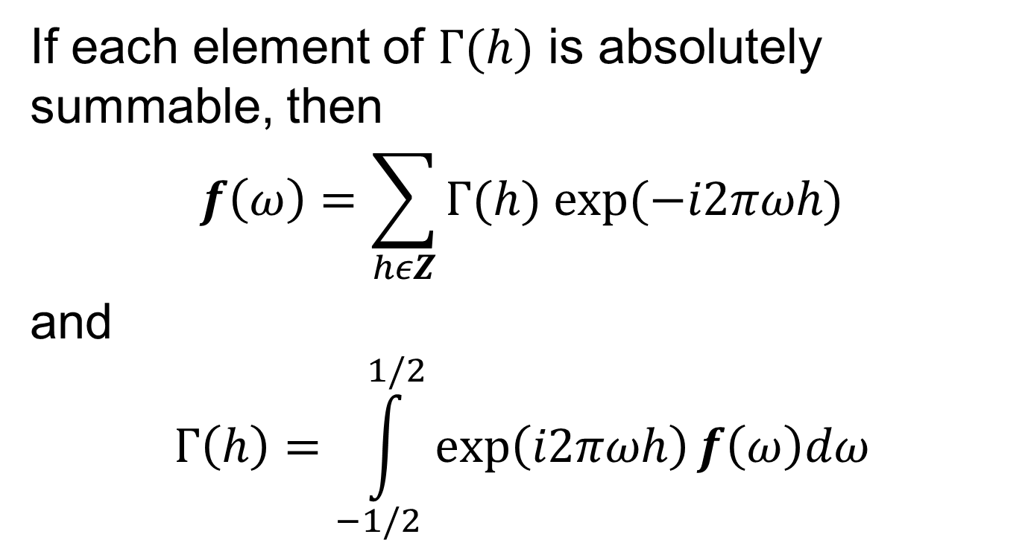
The Spectral Density Matrix
If each element of $Γ(h)$ is absolutely summable, then
$$f\left(ω\right)=\sum_{hεZ}{Γ(h) exp⁡(−i2πωh)}$$
and
$$Γ\left(h\right)=\int_{−1/2}^{1/2}{\exp\left(i2πωh\right)f\left(ω\right)dω}$$

Slide 5
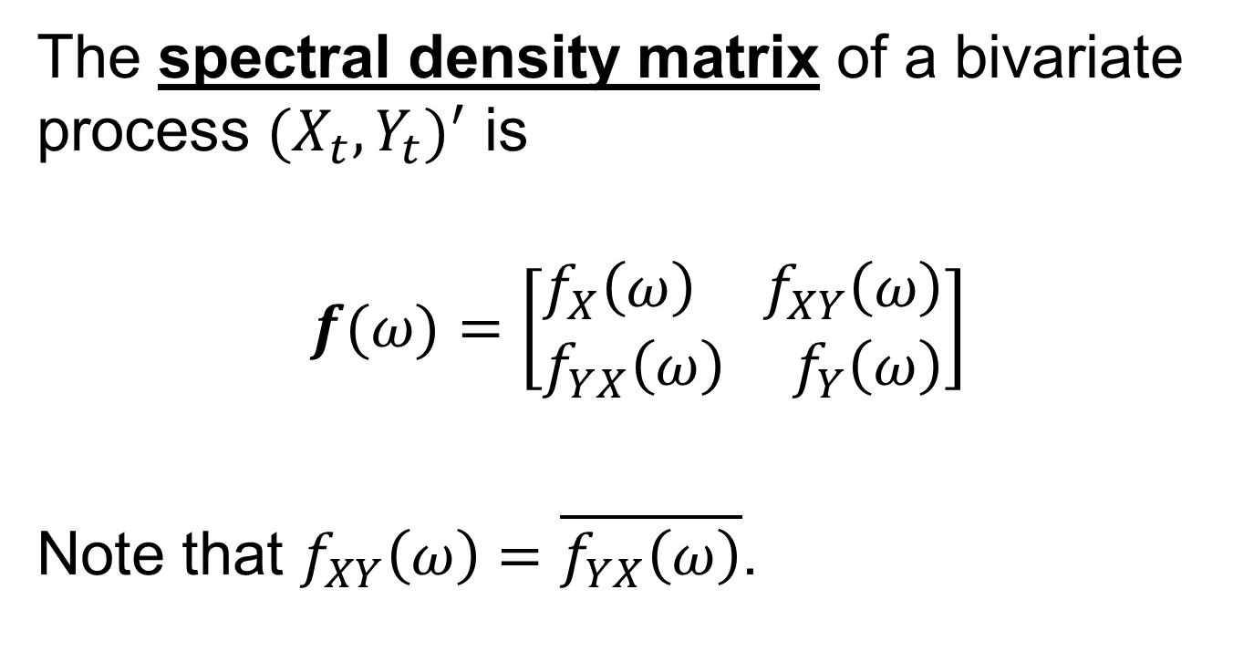
The Spectral Density Matrix
The spectral density matrix of a bivariate process $(X_{t},Y_{t})^{′}$ is
$$f(ω)=\left[\begin{aligned}f_{X}\left(ω\right){ f}_{XY}\left(ω\right) \\ f_{YX}\left(ω\right){ f}_{Y}\left(ω\right)\end{aligned}\right]$$
Note that $f_{XY}\left(ω\right)=\overline{f_{YX}\left(ω\right)}$.

Slide 6

Coherence
The coherence between $X_{t}$ and $Y_{t}$ is
$$ρ_{XY}^{2}\left(ω\right)=\frac{|f_{XY}\left(ω\right)|^{2}}{f_{X}\left(ω\right)f_{Y}\left(ω\right)}$$

Slide 7
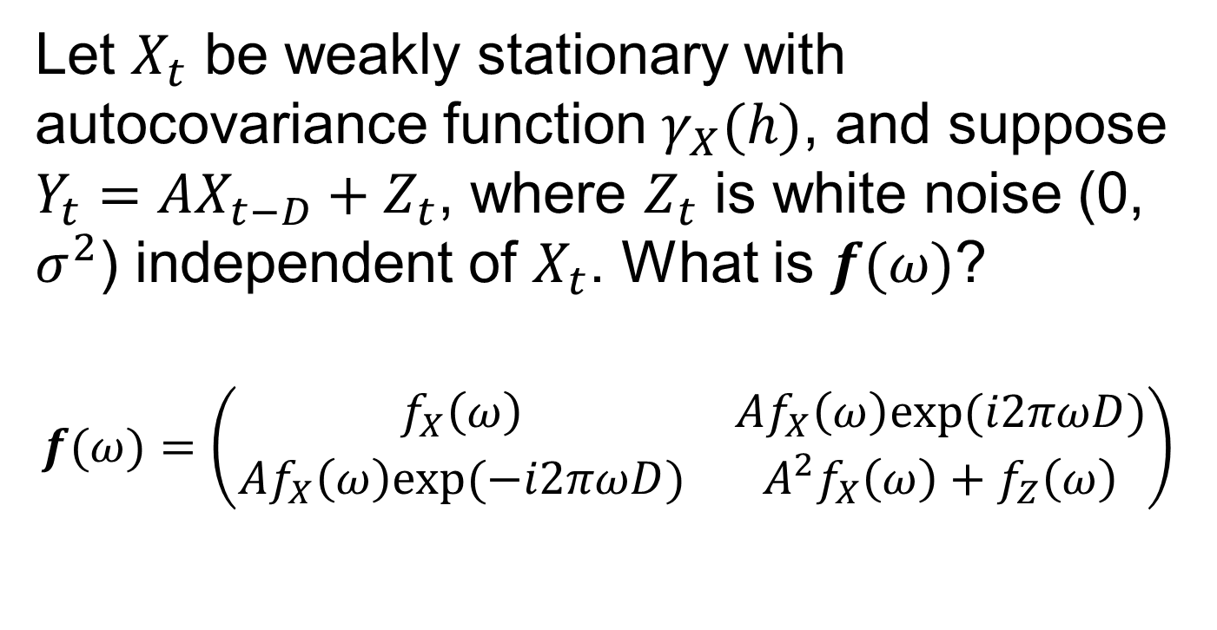
Example
Let $X_{t}$ be weakly stationary with autocovariance function $γ_{X}(h)$, and suppose $Y_{t}=AX_{t−D}+Z_{t}$, where $Z_{t}$ is white noise (0, $σ^{2}$) independent of $X_{t}$. What is $f(ω)$?
$$f(ω)=\left(\begin{matrix}f_{X}\left(ω\right) & Af_{X}\left(ω\right)exp⁡(i2πωD) \\ Af_{X}\left(ω\right)exp⁡(−i2πωD) & {A_{}^{2}f}_{X}\left(ω\right)+f_{Z}\left(ω\right)\end{matrix}\right)$$

Slide 8
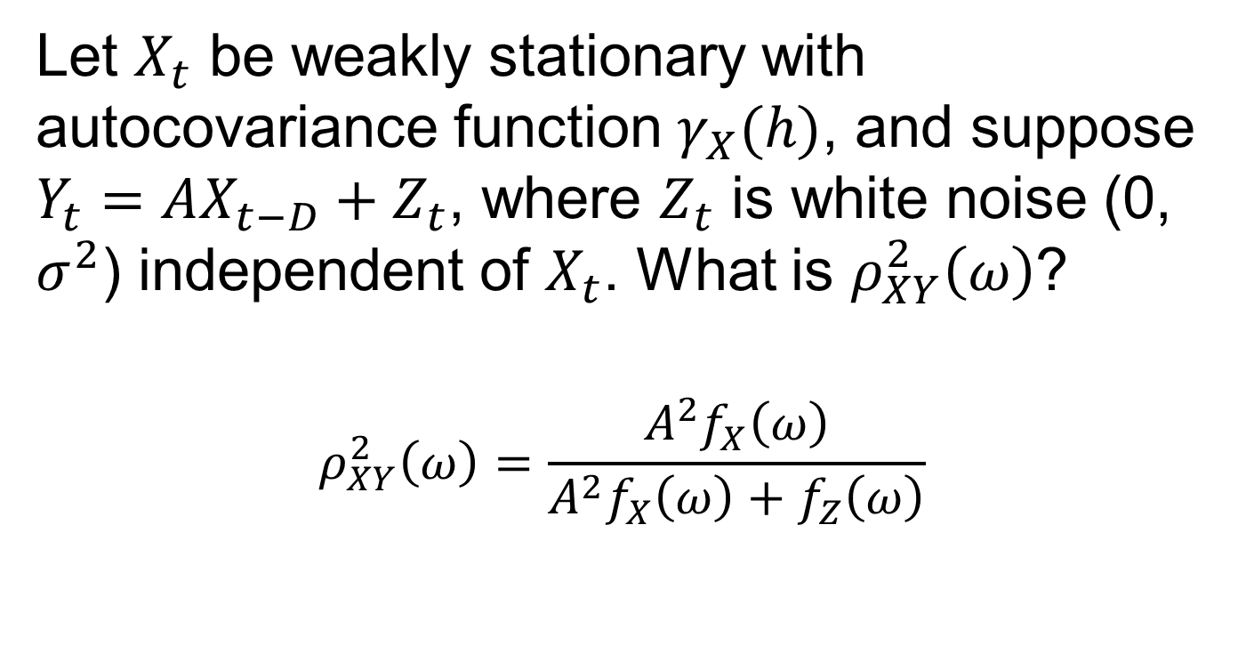
Example
Let $X_{t}$ be weakly stationary with autocovariance function $γ_{X}(h)$, and suppose $Y_{t}=AX_{t−D}+Z_{t}$, where $Z_{t}$ is white noise (0, $σ^{2}$) independent of $X_{t}$. What is $ρ_{XY}^{2}\left(ω\right)$?
$$ρ_{XY}^{2}\left(ω\right)=\frac{{A_{}^{2}f}_{X}\left(ω\right)}{{A_{}^{2}f}_{X}\left(ω\right)+f_{Z}\left(ω\right)}$$

Slide 9
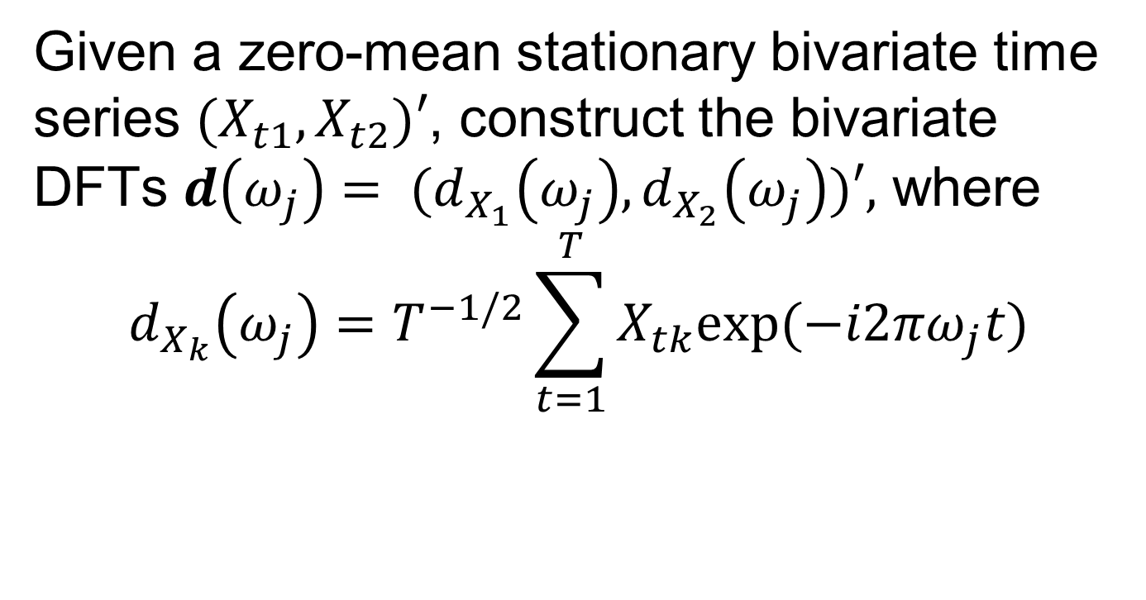
Nonparametric Estimation
Given a zero-mean stationary bivariate time series $(X_{t1},X_{t2})′$, construct the bivariate DFTs $d\left(ω_{j}\right)= {(d}_{X_{1}}\left(ω_{j}\right),d_{X_{2}}\left(ω_{j}\right))′,$ where
$$d_{X_{k}}\left(ω_{j}\right)=T^{−1/2}\sum_{t=1}^{T}{X_{tk}exp⁡(−i2πω_{j}t)}$$

Slide 10

Nonparametric Estimation
The periodogram matrix is
$$I\left(ω_{j}\right)=d\left(ω_{j}\right){d\left(ω_{j}\right)}^{∗}$$

Slide 11
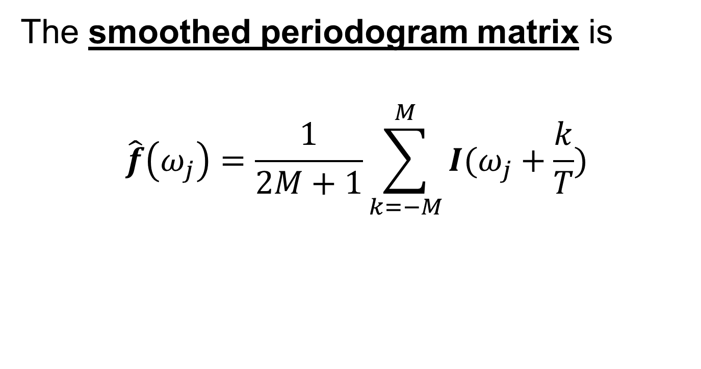
Nonparametric Estimation
The smoothed periodogram matrix is
$$\hat{f}\left(ω_{j}\right)=\frac{1}{2M+1}\sum_{k=−M}^{M}{I(ω_{j}+\frac{k}{T})}$$

Slide 12
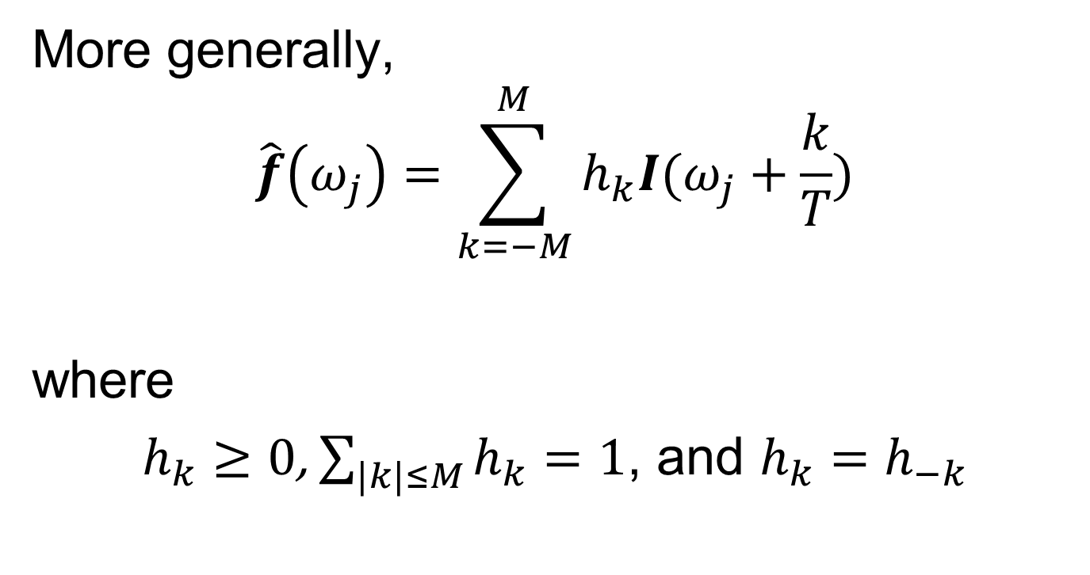
Nonparametric Estimation
More generally,
$$\hat{f}\left(ω_{j}\right)=\sum_{k=−M}^{M}{h_{k}I(ω_{j}+\frac{k}{T})}$$
where
$h_{k}≥0$, $\sum_{|k|≤M}{h_{k}}=1$, and $h_{k}=h_{−k}$

Slide 13

Nonparametric Estimation
An estimate of coherence is
$${\hat{ρ}}_{XY}^{2}\left(ω\right)=\frac{|{\hat{f}}_{XY}\left(ω\right)|^{2}}{{\hat{f}}_{X}\left(ω\right){\hat{f}}_{Y}\left(ω\right)}$$

Slide 14
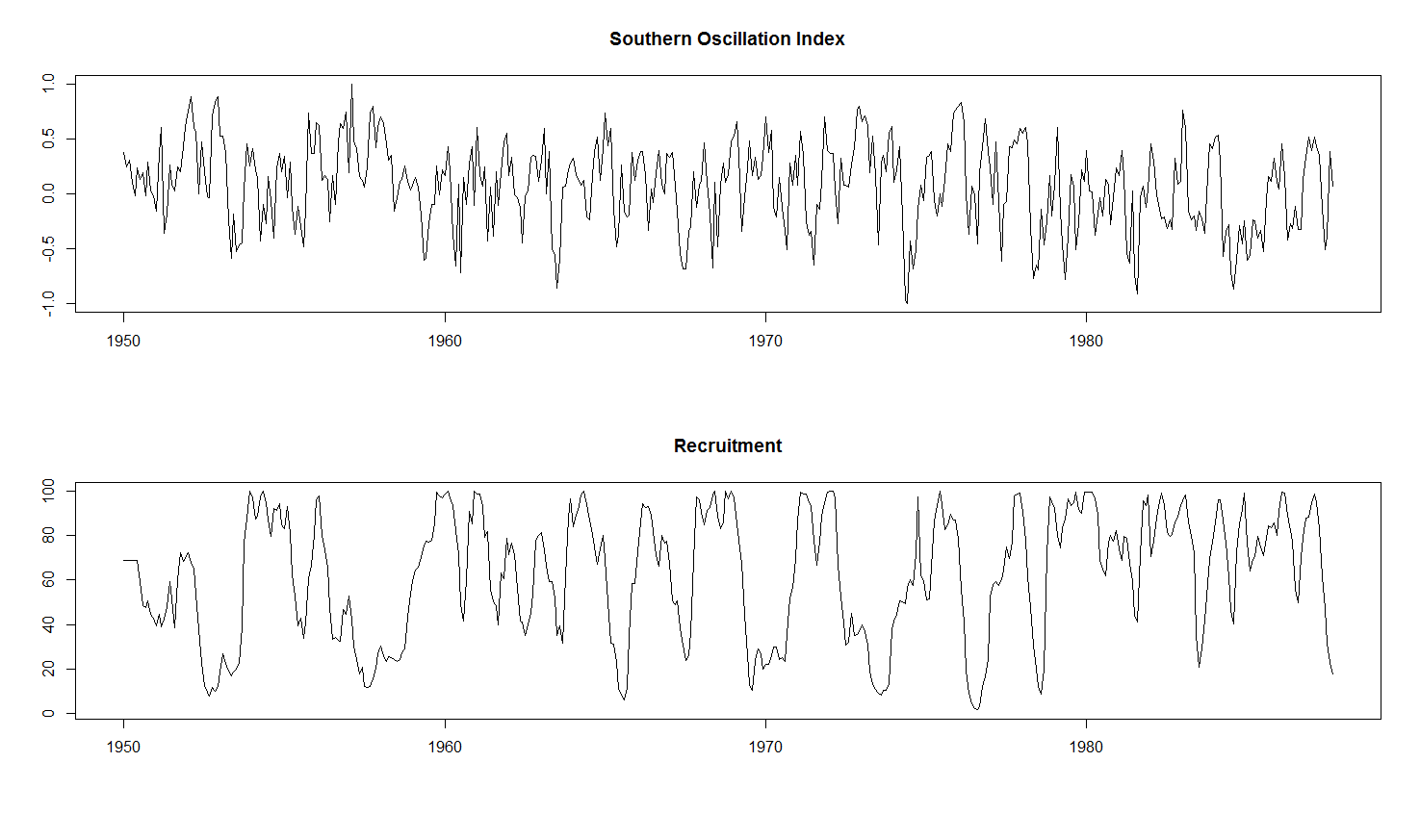
Example
r = 0.025
p = 0.298

Slide 15
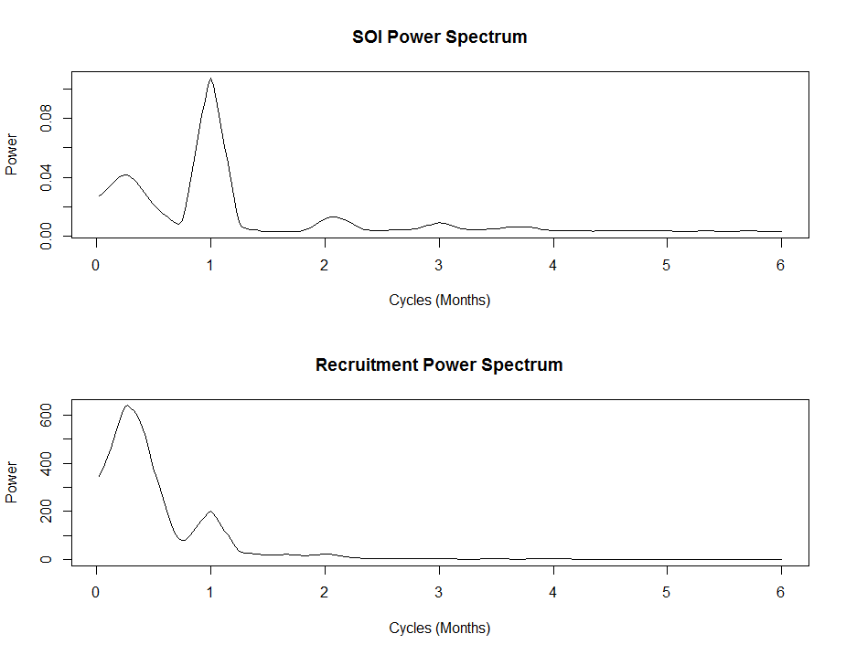
Example

Slide 16
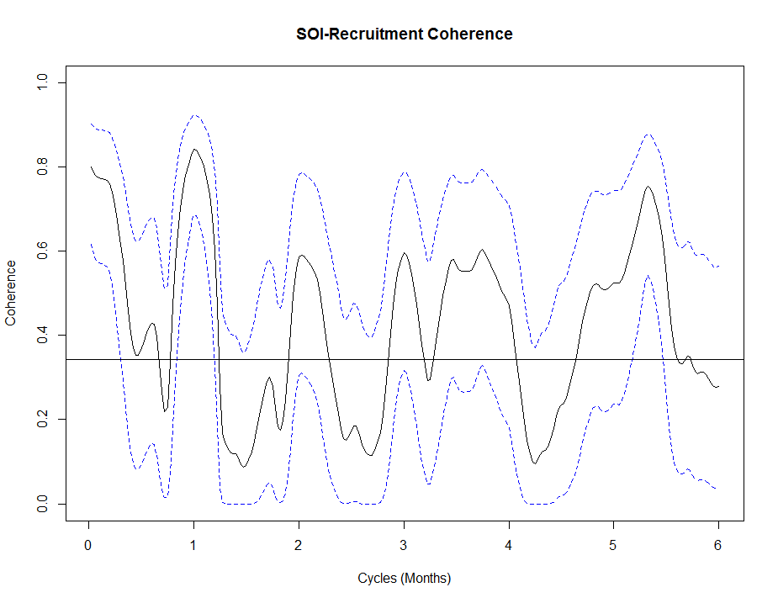
Example

Slide 17
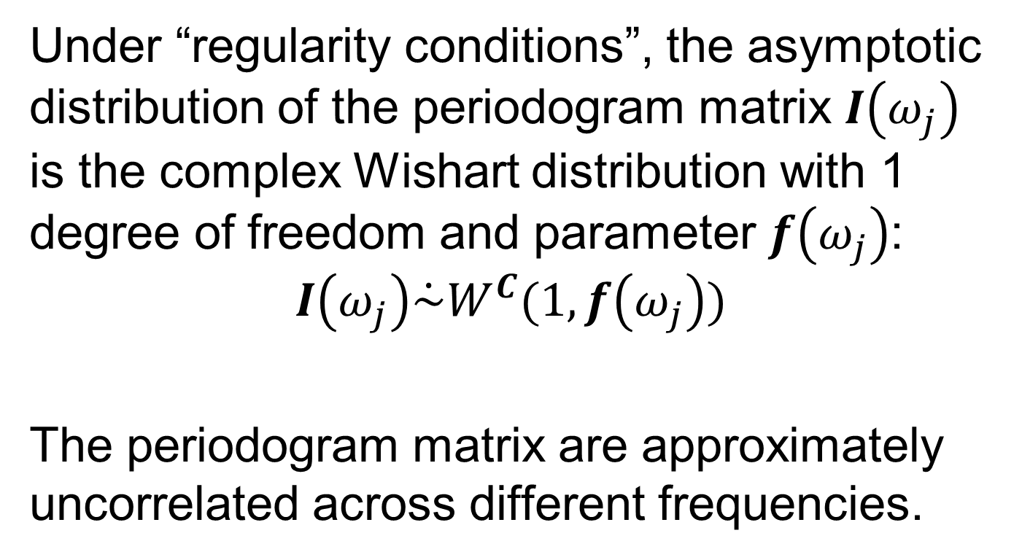
Asymptotic Distributions
Under “regularity conditions”, the asymptotic distribution of the periodogram matrix $I\left(ω_{j}\right)$ is the complex Wishart distribution with 1 degree of freedom and parameter $f\left(ω_{j}\right)$:
$$I\left(ω_{j}\right)\dot{\sim }W^{C}(1,f\left(ω_{j}\right))$$
The periodogram matrix are approximately uncorrelated across different frequencies.

Slide 18

Asymptotic Distributions
Under “regularity conditions”,
$$(2M+1)\hat{f}\left(ω_{j}\right)\dot{\sim }W^{C}(2M+1,f\left(ω_{j}\right))$$

Slide 19
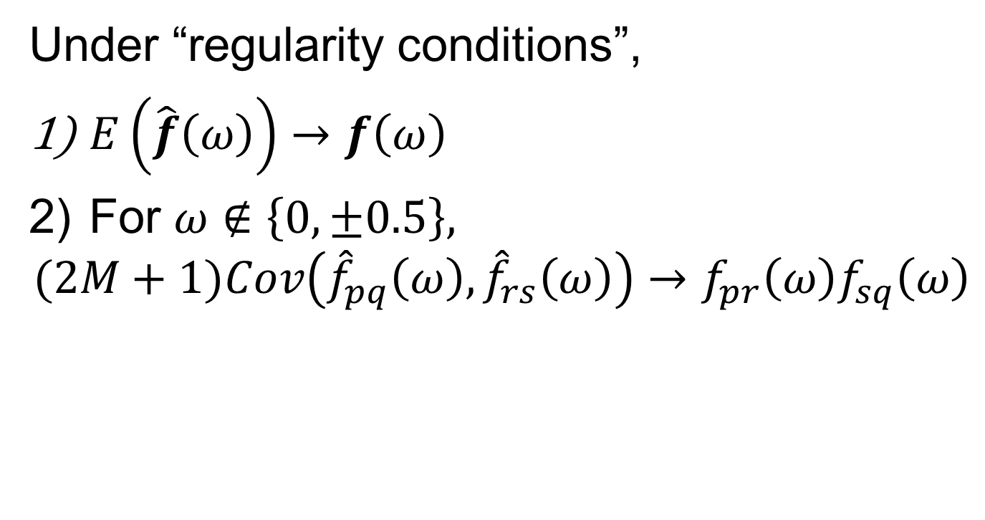
Asymptotic Distributions
Under “regularity conditions”,
$E\left(\hat{f}\left(ω\right)\right)→f\left(ω\right)$
For $ω∉\left\{0,±0.5\right\},$
$$(2M+1)Cov\left({\hat{f}}_{pq}\left(ω\right),{\hat{f}}_{rs}\left(ω\right)\right)→f_{pr}\left(ω\right)f_{sq}\left(ω\right)$$

Slide 20
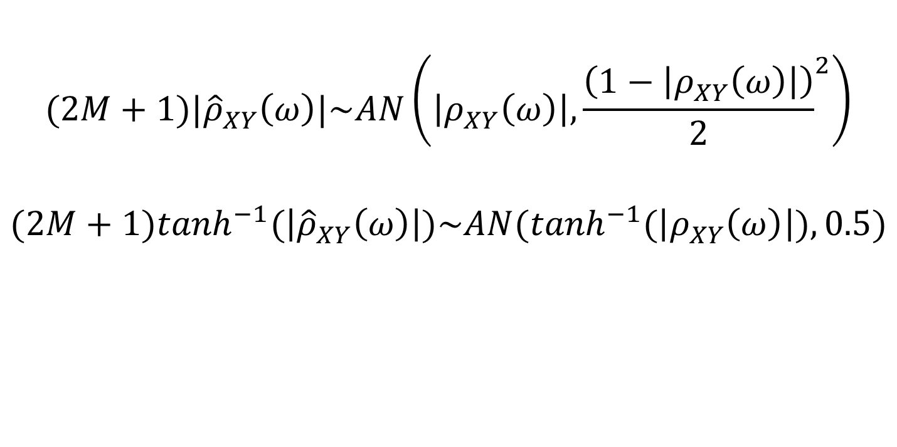
Nonparametric Estimation
$$(2M+1)|{\hat{ρ}}_{XY}^{}\left(ω\right)|\sim AN\left(\left|ρ_{XY}^{}\left(ω\right)\right|,{\frac{\left(1−\left|ρ_{XY}^{}\left(ω\right)\right|\right)}{2}}^{2}\right)$$
$$(2M+1)\tanh^{−1}(\left|{\hat{ρ}}_{XY}^{}\left(ω\right)\right|)\sim AN(\tanh^{−1}(\left|ρ_{XY}^{}\left(ω\right)\right|),0.5)$$

Slide 21
Next Time
Linear Filters
Notes: 2.6

