Slide 1
ST414 – Spectral Analysis of Time Series Data
Lecture 8
26 February 2015

Slide 2
Today’s Objectives
Asymptotics
Linear Filters
Notes: 3.4, 2.6

Slide 3
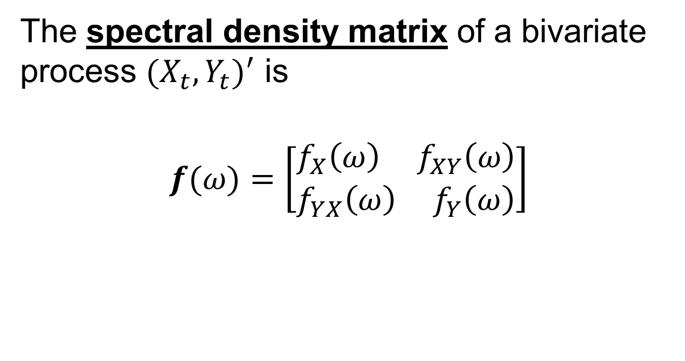
The Spectral Density Matrix
The spectral density matrix of a bivariate process $(X_{t},Y_{t})^{′}$ is
$$f(ω)=\left[\begin{aligned}f_{X}\left(ω\right){ f}_{XY}\left(ω\right) \\ f_{YX}\left(ω\right){ f}_{Y}\left(ω\right)\end{aligned}\right]$$

Slide 4

The Spectral Density Matrix
The spectral density matrix of a bivariate process $(X_{t},Y_{t})^{′}$ is
$$f(ω)≈Cov(d\left(ω\right))$$

Slide 5

Coherence
The coherence between $X_{t}$ and $Y_{t}$ is
$$ρ_{XY}^{2}\left(ω\right)=\frac{|f_{XY}\left(ω\right)|^{2}}{f_{X}\left(ω\right)f_{Y}\left(ω\right)}$$

Slide 6

Nonparametric Estimation
The periodogram matrix is
$$I\left(ω_{j}\right)=d\left(ω_{j}\right){d\left(ω_{j}\right)}^{∗}$$

Slide 7
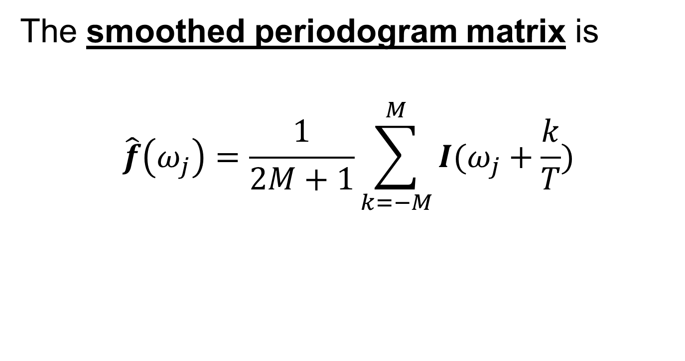
Nonparametric Estimation
The smoothed periodogram matrix is
$$\hat{f}\left(ω_{j}\right)=\frac{1}{2M+1}\sum_{k=−M}^{M}{I(ω_{j}+\frac{k}{T})}$$

Slide 8

Nonparametric Estimation
An estimate of coherence is
$${\hat{ρ}}_{XY}^{2}\left(ω\right)=\frac{|{\hat{f}}_{XY}\left(ω\right)|^{2}}{{\hat{f}}_{X}\left(ω\right){\hat{f}}_{Y}\left(ω\right)}$$

Slide 9

Asymptotic Distributions
Under “regularity conditions”,
$$(2M+1)\hat{f}\left(ω_{j}\right)\dot{\sim }W^{C}(2M+1,f\left(ω_{j}\right))$$

Slide 10
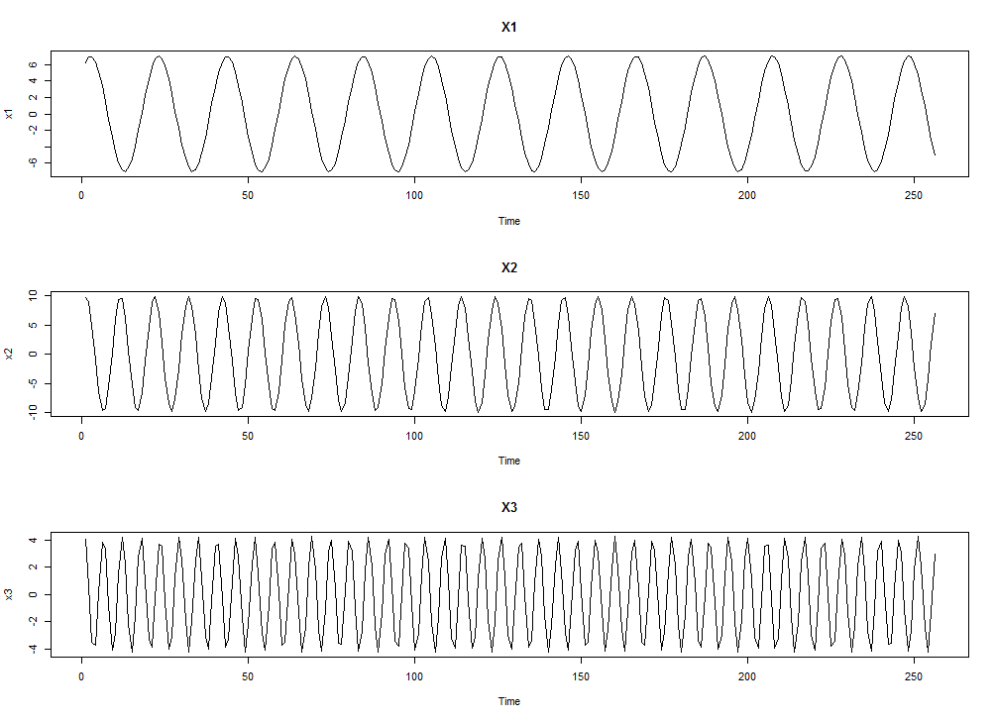
Example

Slide 11
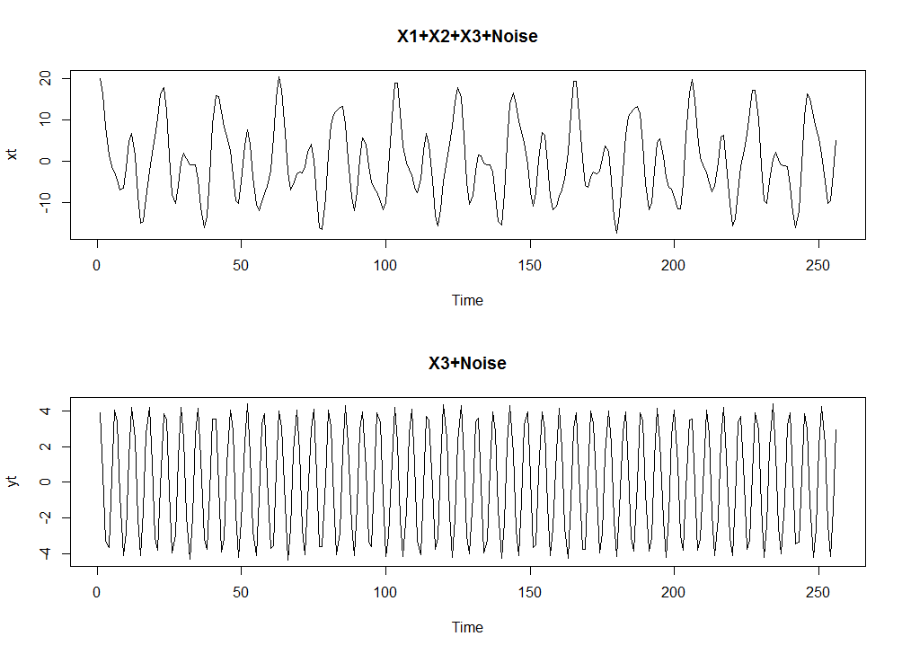
Example

Slide 12
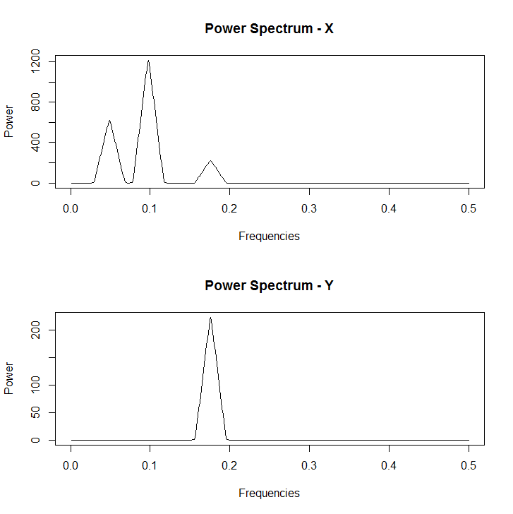
Example

Slide 13
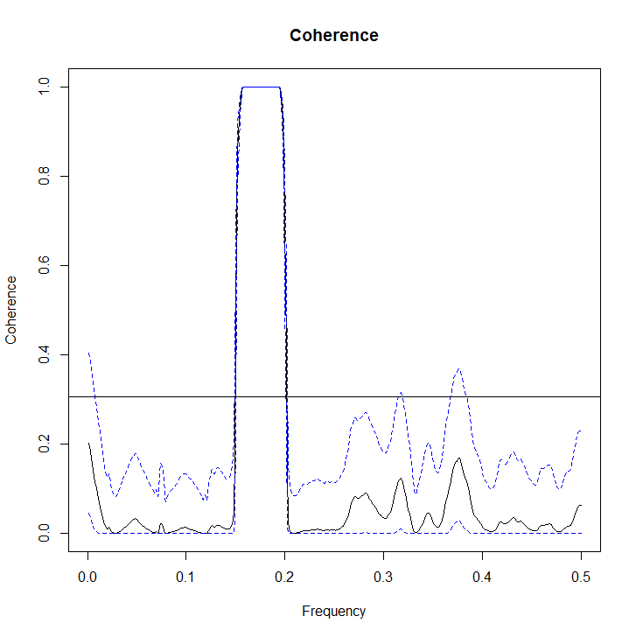
Example

Slide 14
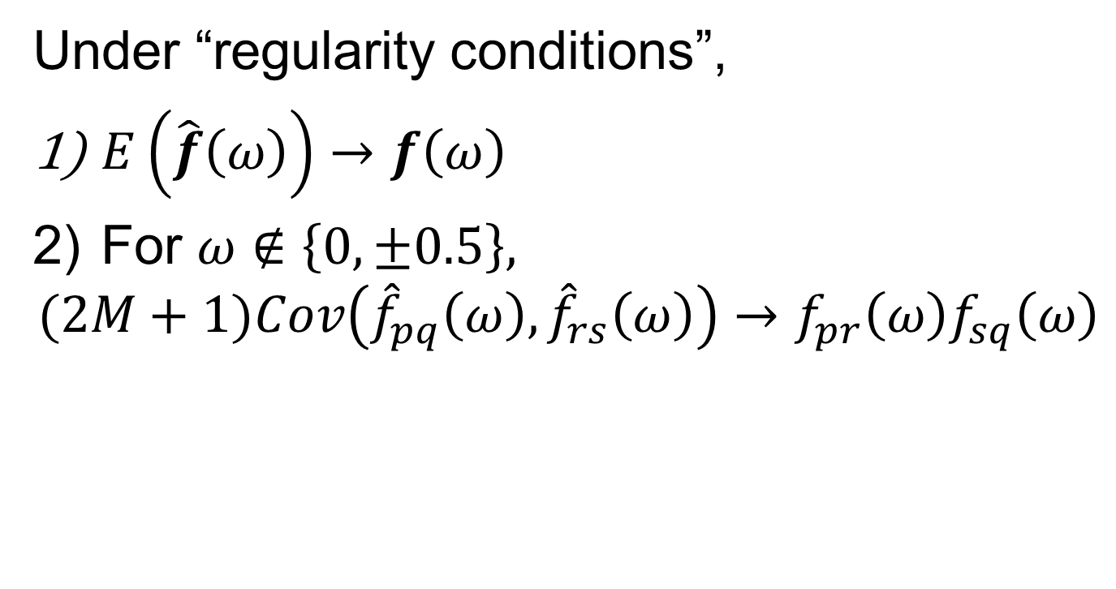
Asymptotics
Under “regularity conditions”,
$E\left(\hat{f}\left(ω\right)\right)→f\left(ω\right)$
For $ω∉\left\{0,±0.5\right\},$
$$(2M+1)Cov\left({\hat{f}}_{pq}\left(ω\right),{\hat{f}}_{rs}\left(ω\right)\right)→f_{pr}\left(ω\right)f_{sq}\left(ω\right)$$

Slide 15
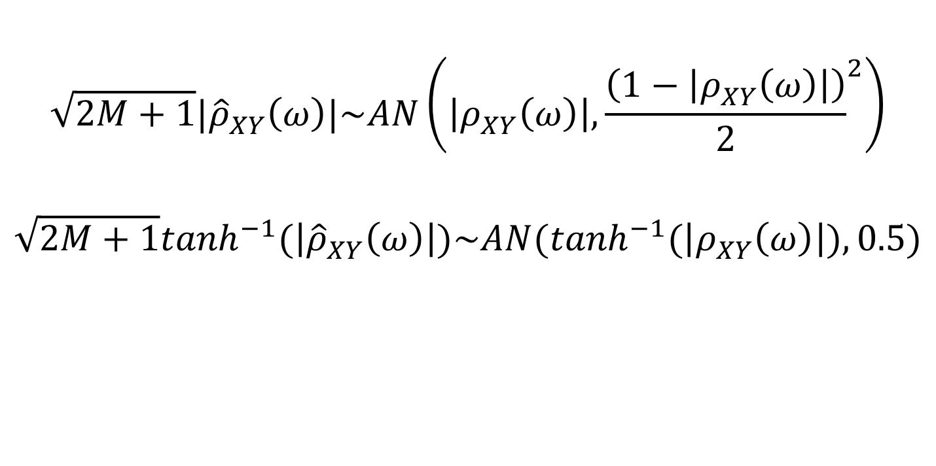
Nonparametric Estimation
$$\sqrt{2M+1}|{\hat{ρ}}_{XY}^{}\left(ω\right)|\sim AN\left(\left|ρ_{XY}^{}\left(ω\right)\right|,{\frac{\left(1−\left|ρ_{XY}^{}\left(ω\right)\right|\right)}{2}}^{2}\right)$$
$$\sqrt{2M+1}\tanh^{−1}(\left|{\hat{ρ}}_{XY}^{}\left(ω\right)\right|)\sim AN(\tanh^{−1}(\left|ρ_{XY}^{}\left(ω\right)\right|),0.5)$$

Slide 16
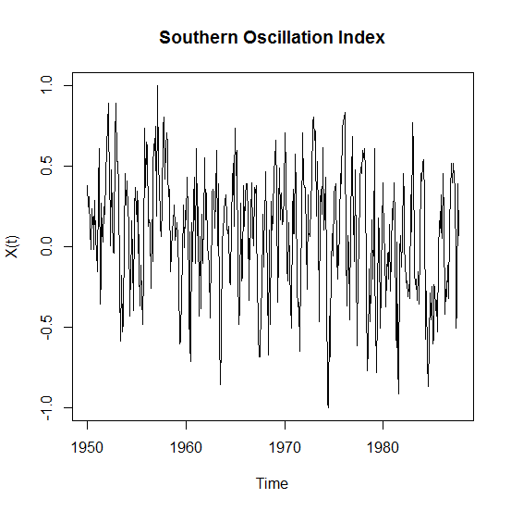
SOI Example

Slide 17

Differencing Example
Consider the first difference:
$$Y_{t}=X_{t}−X_{t−1}$$
What is the spectral density of $Y_{t}$?

Slide 18
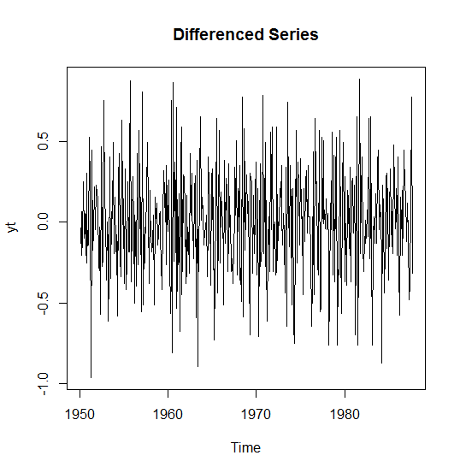
Differencing Example

Slide 19
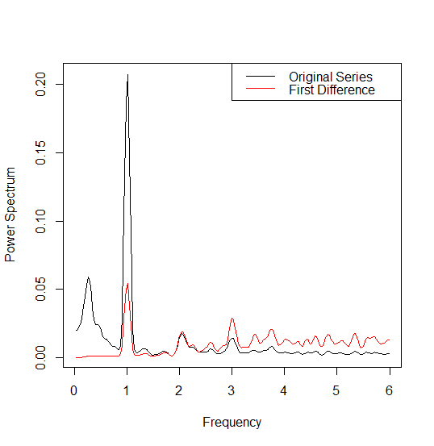
Differencing Example

Slide 20
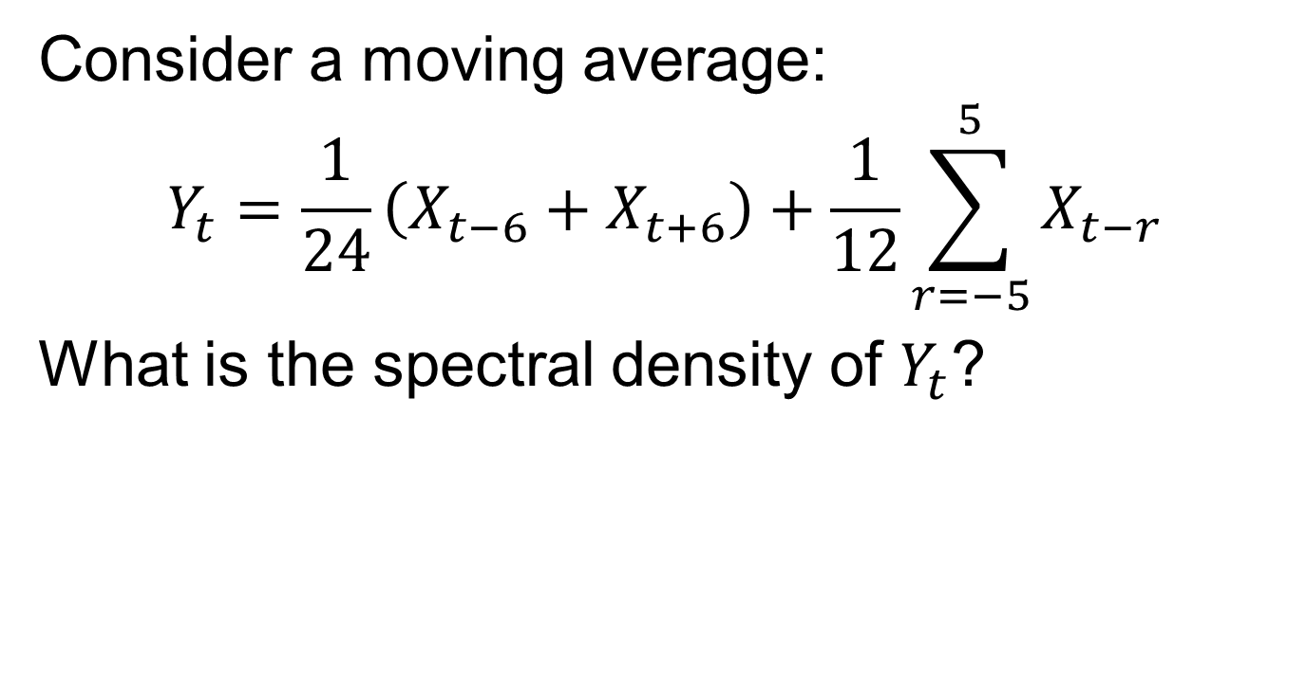
Moving Average Example
Consider a moving average:
$$Y_{t}=\frac{1}{24}\left(X_{t−6}+X_{t+6}\right)+\frac{1}{12}\sum_{r=−5}^{5}{X_{t−r}}$$
What is the spectral density of $Y_{t}$?

Slide 21
Moving Average Example

Slide 22
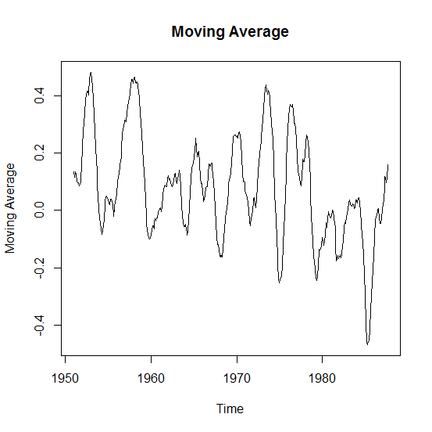
Moving Average Example

Slide 23
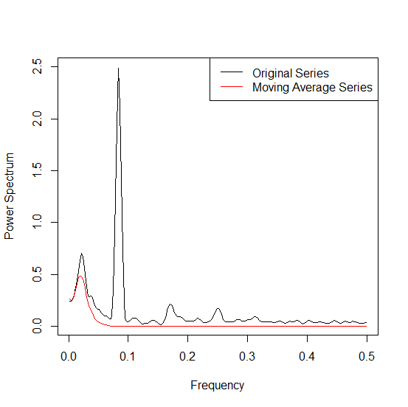
Moving Average Example

Slide 24
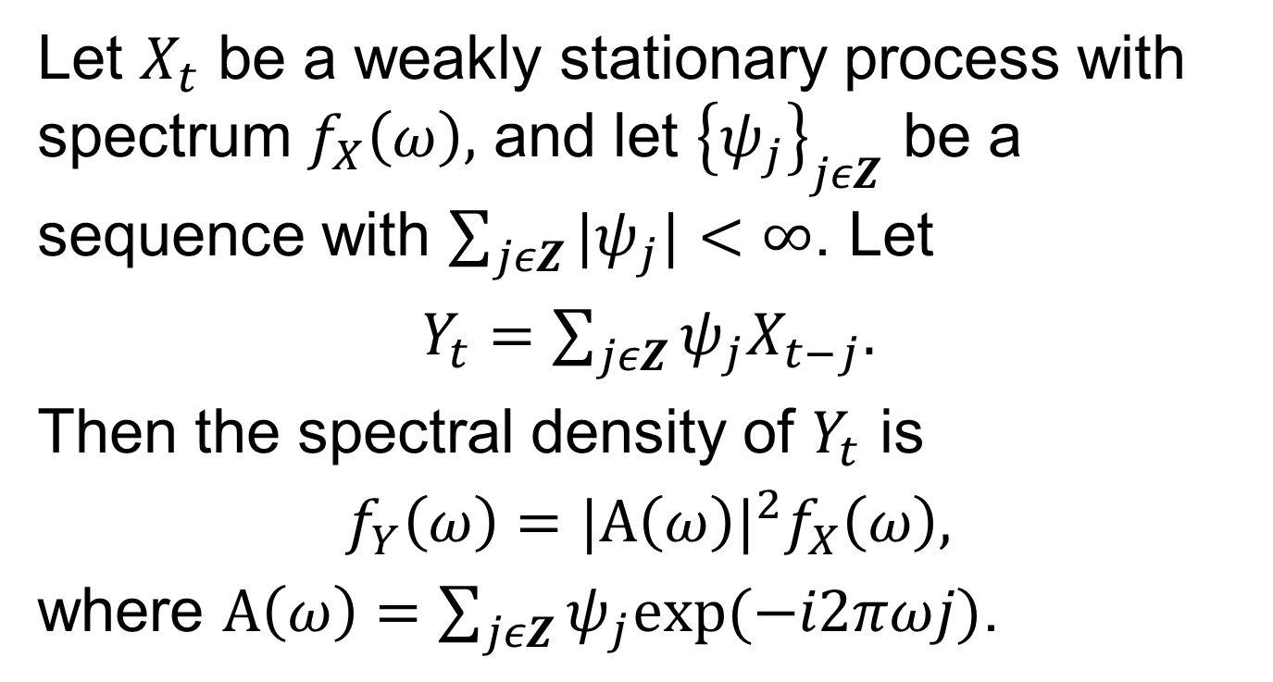
Linear Filters
Let $X_{t}$ be a weakly stationary process with spectrum $f_{X}\left(ω\right),$ and let ${\left\{ψ_{j}\right\}}_{jεZ}$ be a sequence with $\sum_{jεZ}{|ψ_{j}|}<∞$. Let
$Y_{t}=\sum_{jεZ}{ψ_{j}X_{t−j}.}$
Then the spectral density of $Y_{t}$ is
$f_{Y}\left(ω\right)=|A\left(ω\right)|^{2}f_{X}\left(ω\right),$
where $A\left(ω\right)=\sum_{jεZ}{ψ_{j}exp⁡(−i2πωj)}$.

Slide 25
Next Time
Linear Filters
The Spectral Representation Theorem
Notes: 2.6, 4.1

