Slide 1
My drawing application: Zam
Gruppo 3:
Intonti Giovanni
Memoli Federico
Pagano Adolfo
Squitieri Beniamino

Slide 2
Our final Sprint
01
02
Sprint Review
Live demo of the release
Description of functionality and quick look at the issues
Our final working version of the application
04
03
UML and Pattern used
Sprint retrospective
UML architecture and pattern used in the project
What was our process like

Slide 3
Sprint Review
Product Backlog Issues
Live-demo
Need to define new user stories for labels because of previous functionalities
SPRINT
Lots of bug fixing during integration
Lots of time spent on trying to implement mouse wheel rotation
Slight refactoring of newly created class
Interface fixing
Structural refactoring in order to improve the quality
Implementation Issues
No issues found
Release Examination Issues
Estimated VS Actual story points
34
29

Slide 4
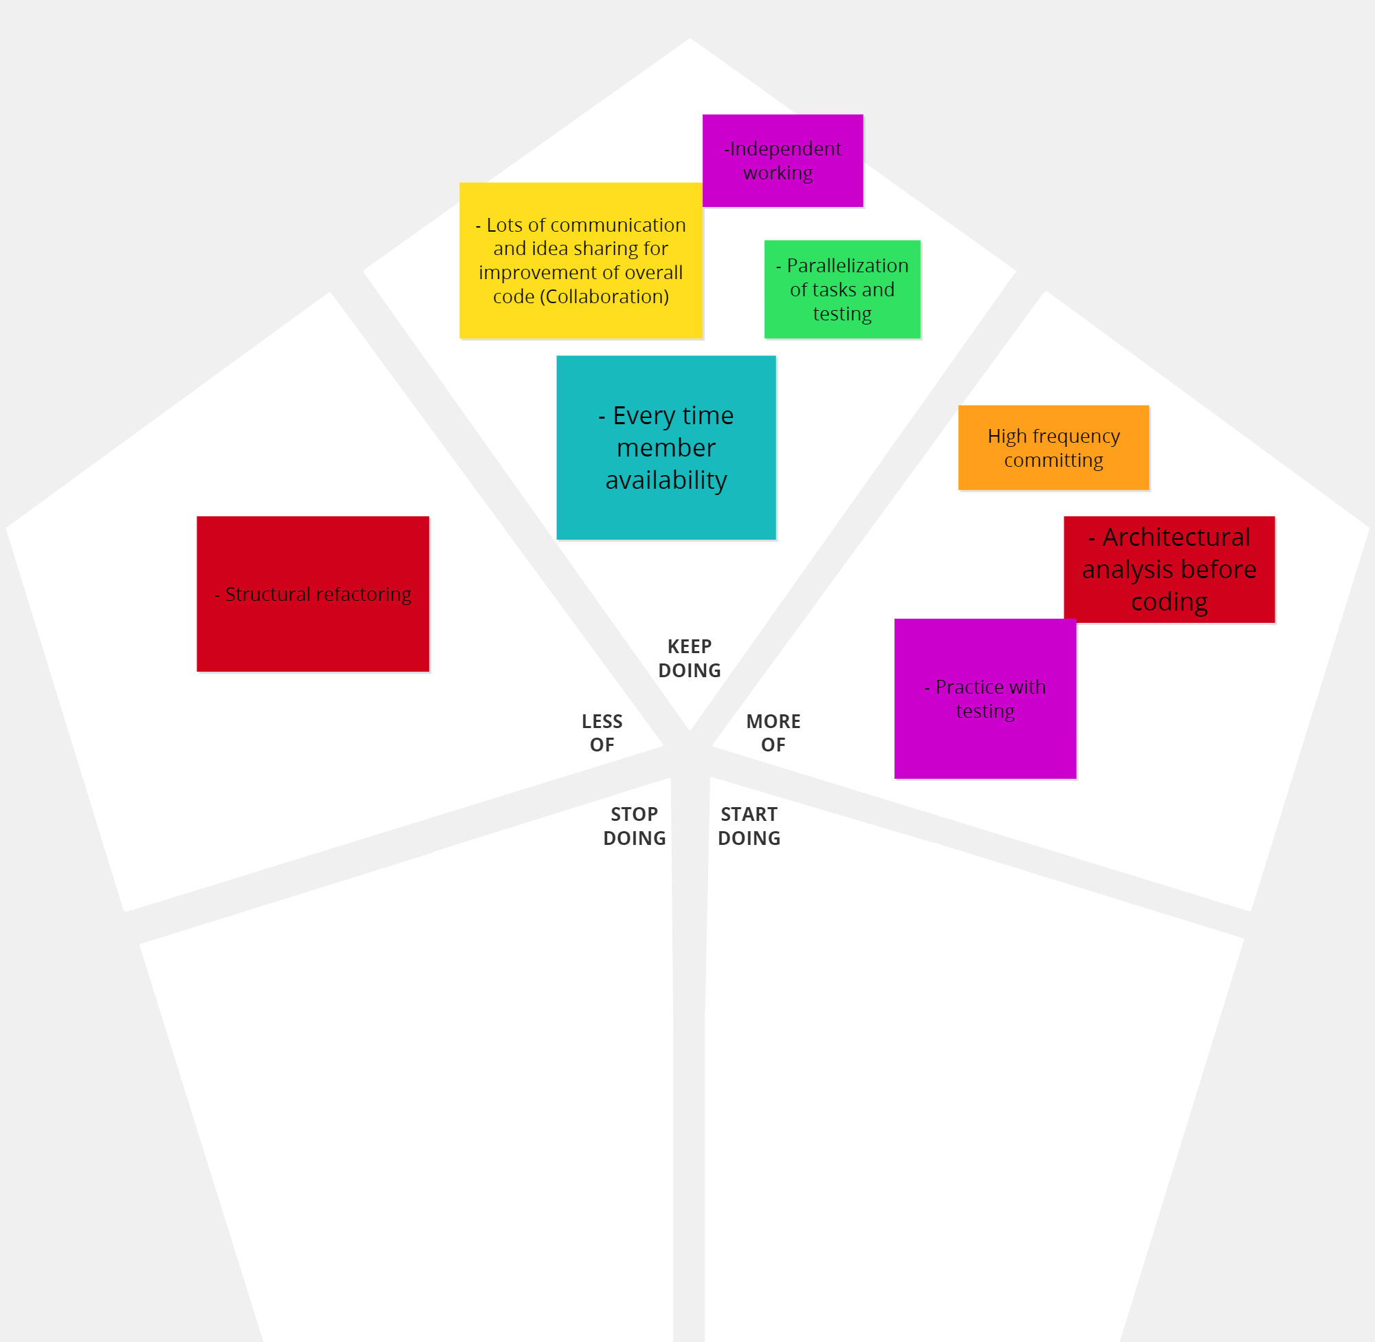
Sprint Retrospective

Slide 5
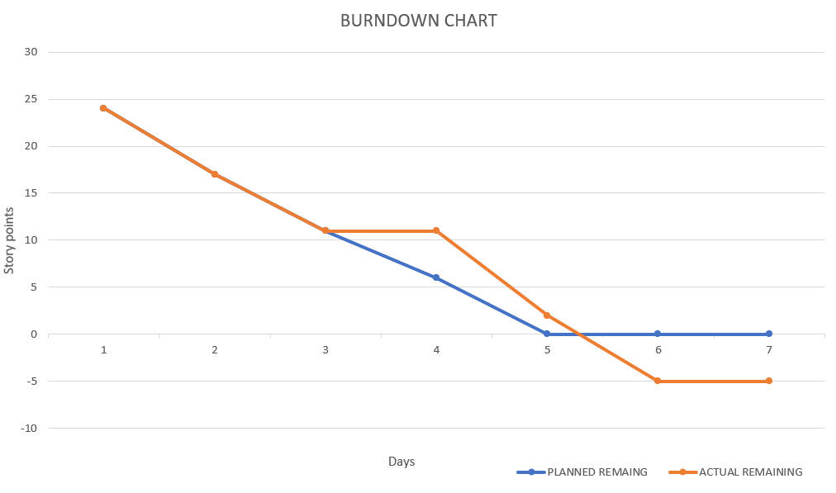
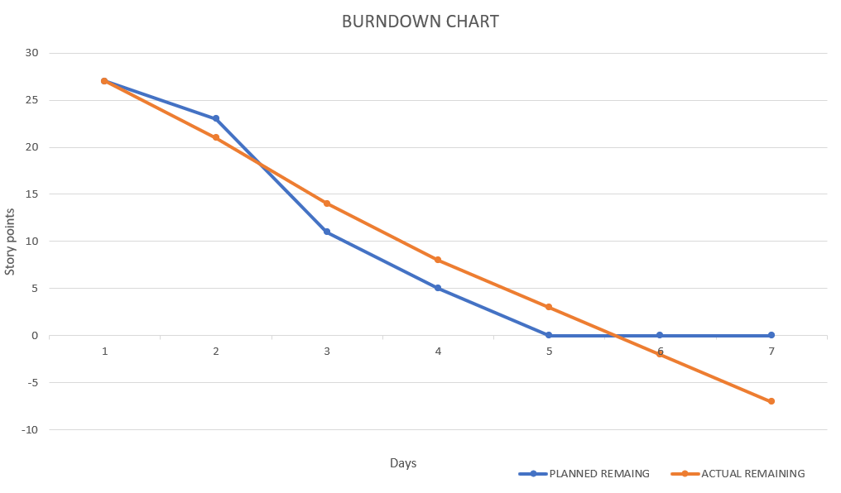
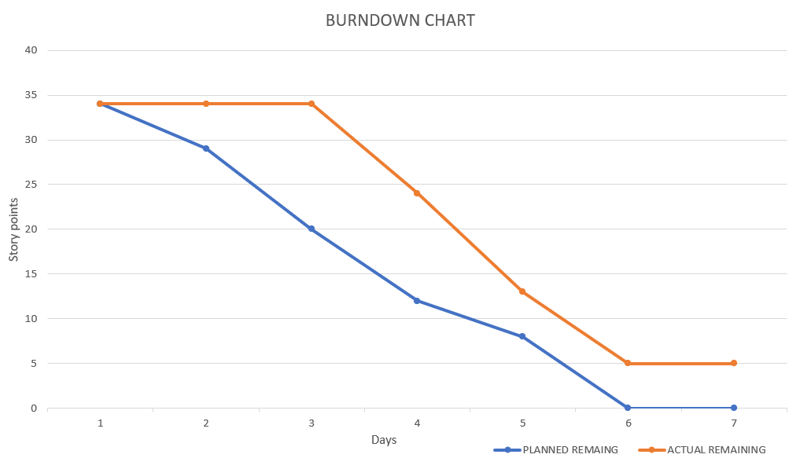
Percentage of completation of sprints
Sprint 1
Sprint 3
Sprint 2
121%
126%
85%

Slide 6
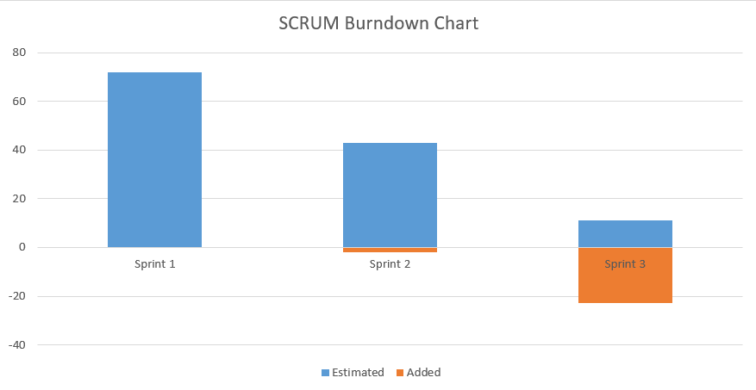
Project BurnDown Chart

Slide 7
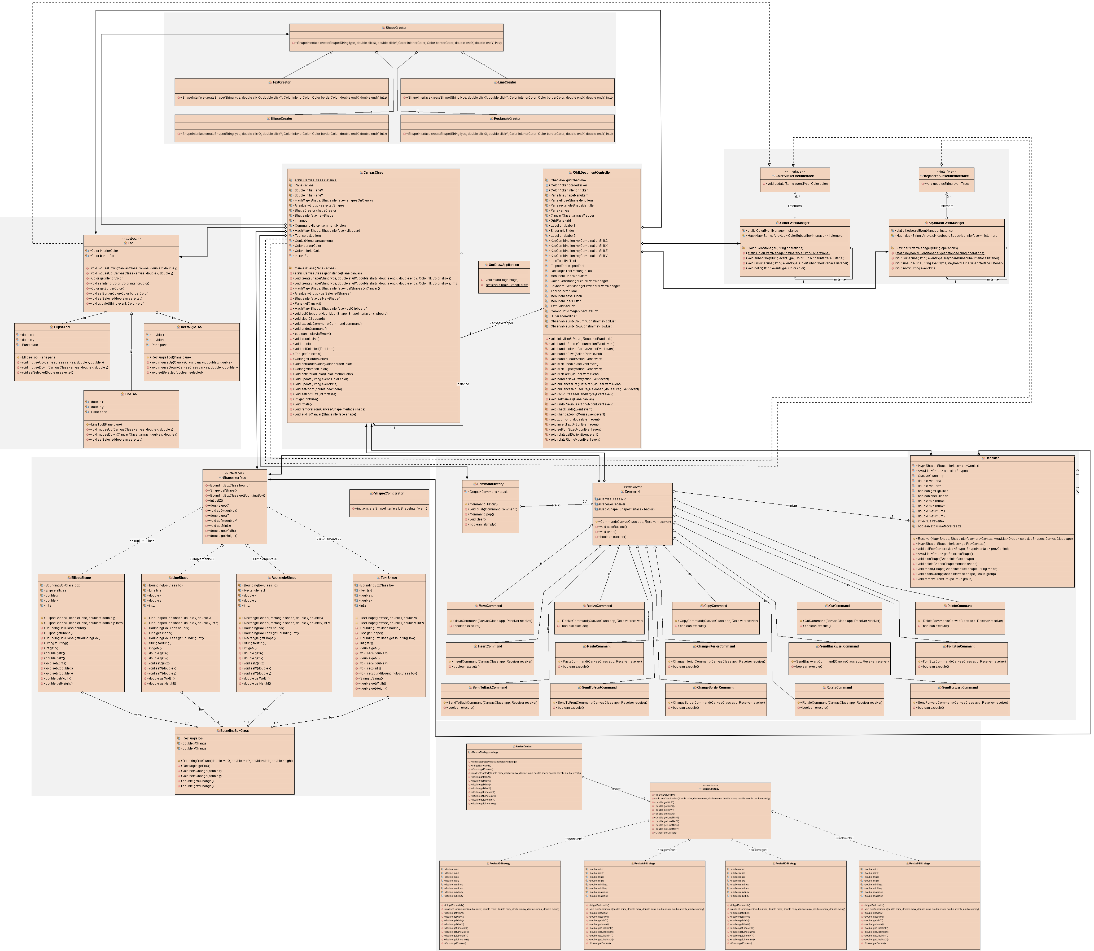
UML Class Diagram

Slide 8
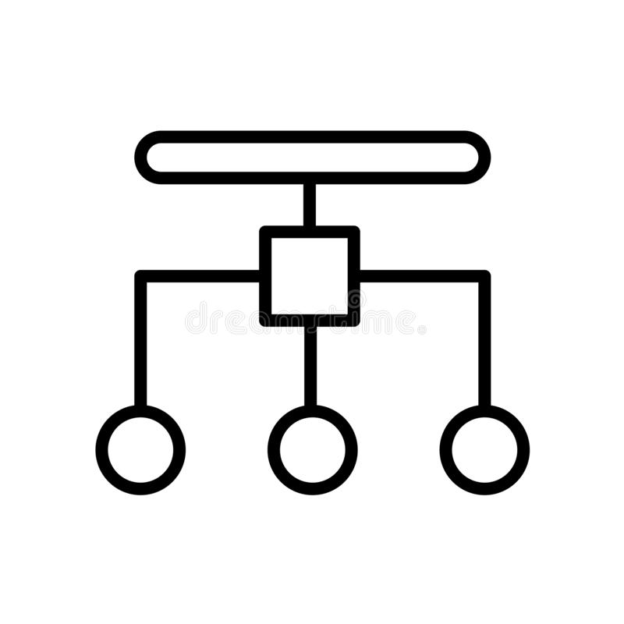
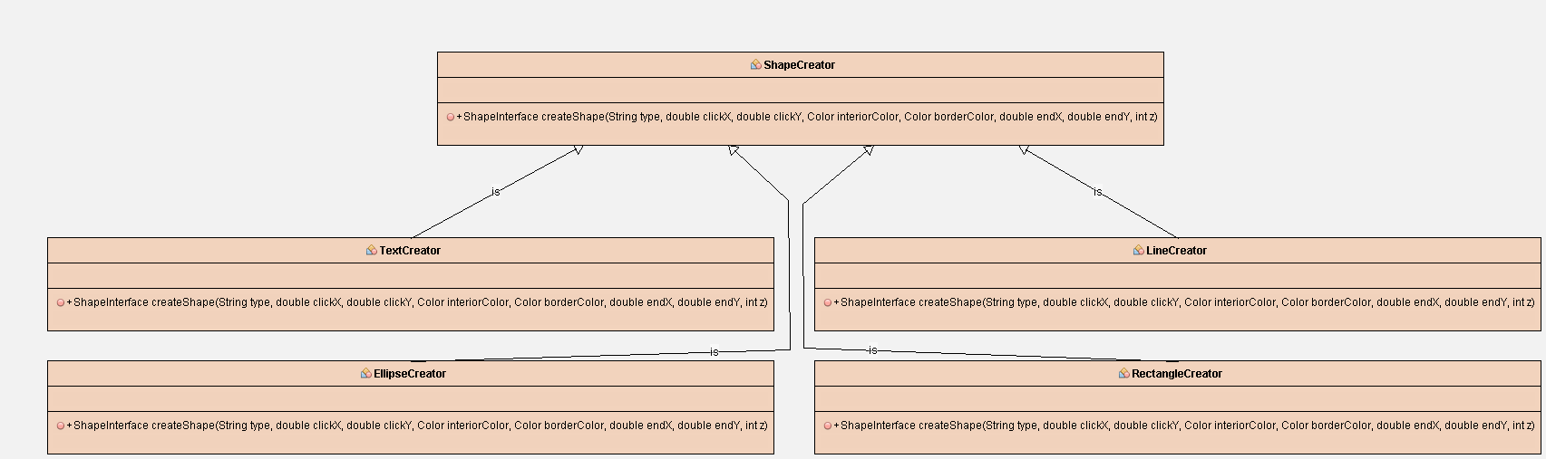
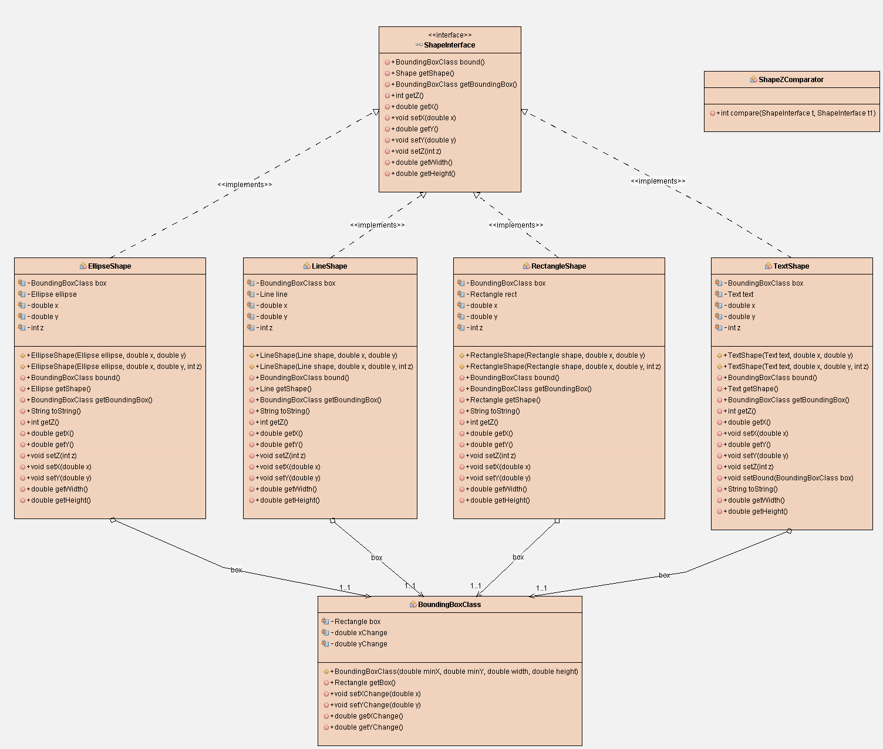
Factory Method Pattern

Slide 9
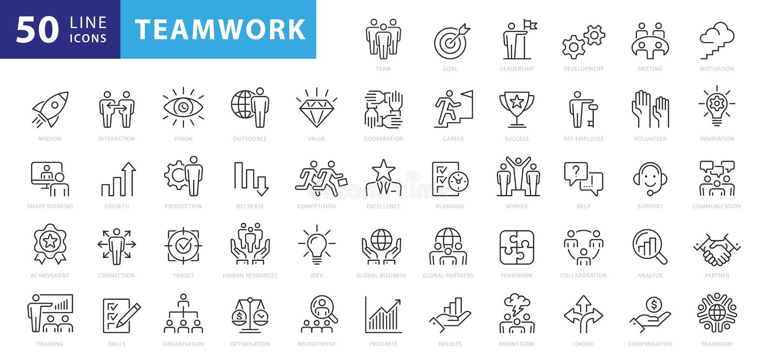
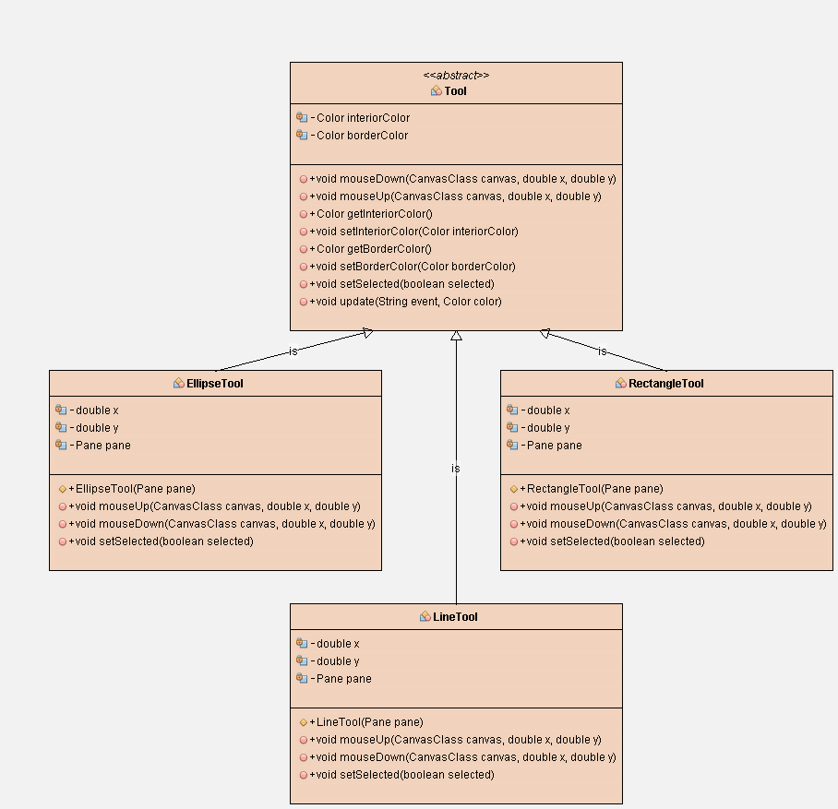
State Pattern

Slide 10

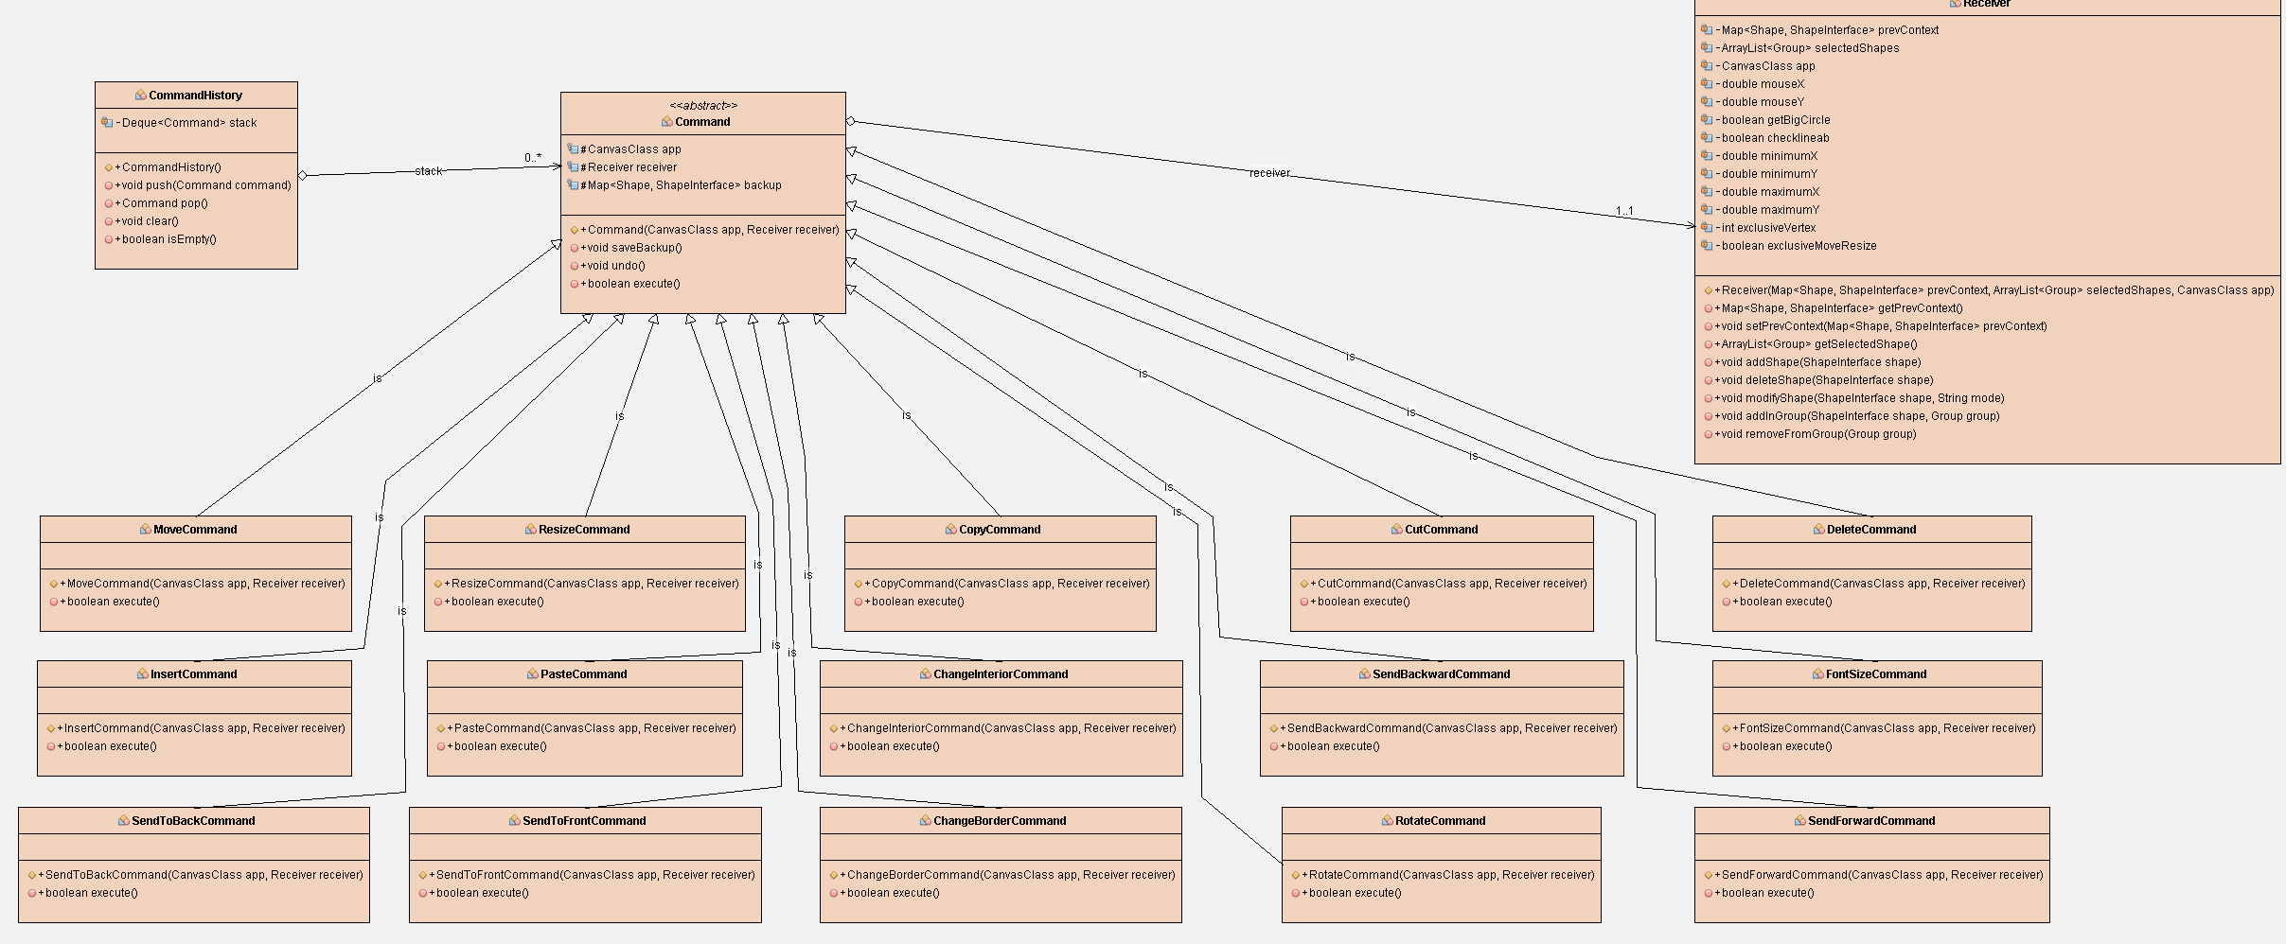
Command Pattern

Slide 11
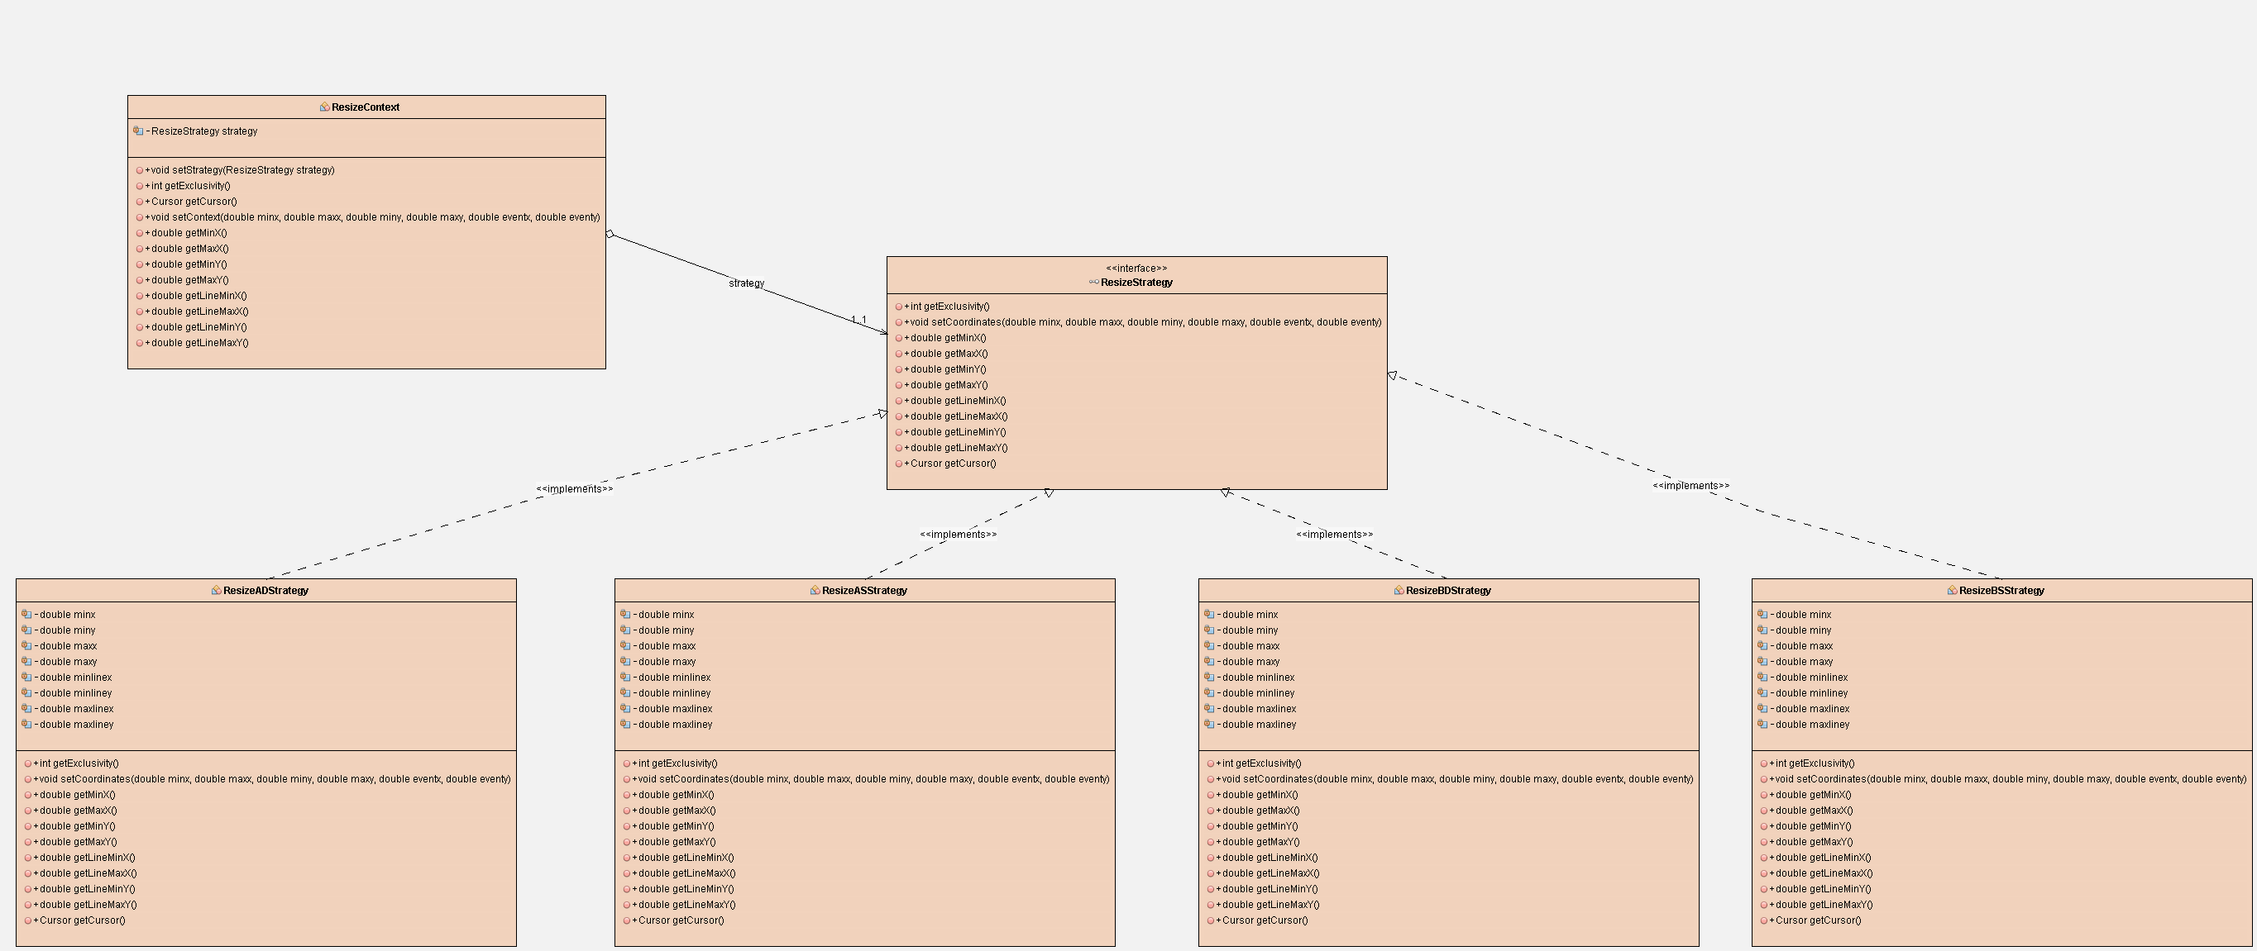
Strategy Pattern

Slide 12

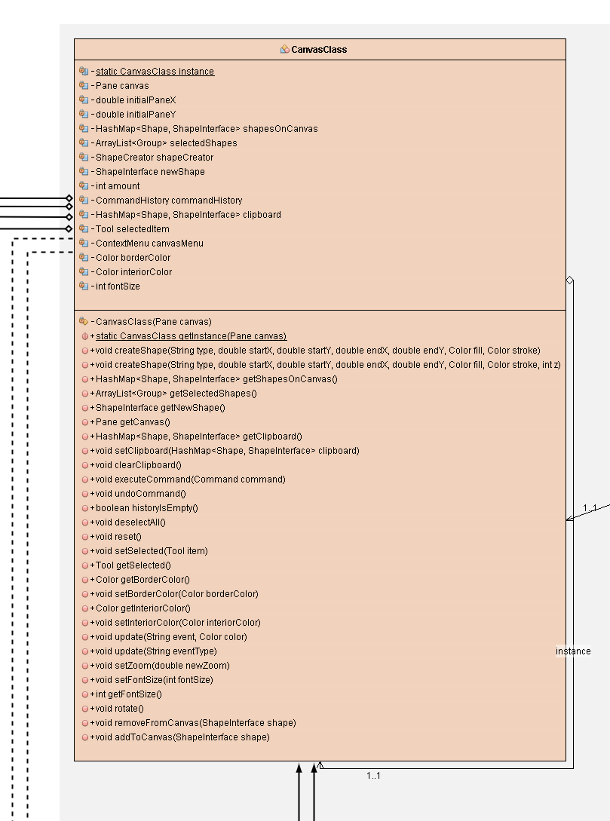
Facade Pattern

Slide 13
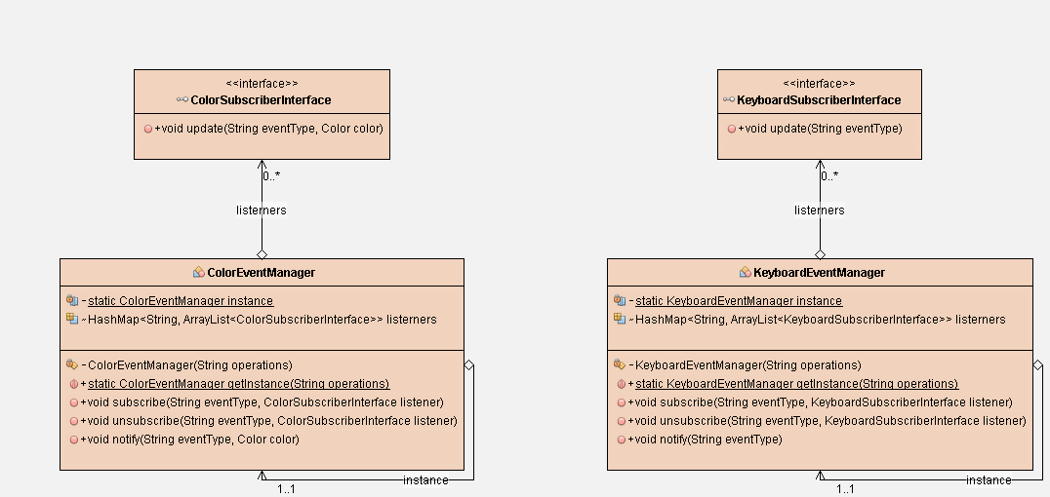
Observer Pattern

Slide 14
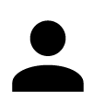
Singleton Pattern

Slide 15
Thank you for attention

