Slide 1
Security Management of DHIS2 implementations
(conscientisation for managers)
Bob Jolliffe
t
WHO/WAHIT workshop 2018

Slide 2
Background
Based on exercises done in a number of countries from 2010-2015
Different types of implementations (cloud, vps, physical)
Different levels and types of technical support
Public sector implementations of aggregate DHIS2
Different levels of success :-(

Slide 3
Why information security management?
Objective is to strengthen implementation and MOH ownership of the system
Security management is a tool amongst others which allows (requires!) system owners to exert some managerial control over technical processes and personnel
There can be public sector policy and legislative drivers which require it
There are ethical drivers (protection of employee data, supporting health service delivery, cybercrime ..)
New privacy obligations in age of tracker

Slide 4
Some Challenges
Public sector security can not be wholly outsourced
Public sector organisations might lack technical capacity and infrastructure – depend on private sector, partners, donors etc
Regulatory environment might be unclear, outdated or under development

Slide 5
Some opportunities
Standards like ISO27001 provide a framework to build around
Implementation of Information Security Management helps MOH to assert ownership over the system
“Taking over” backend technical support is a secondary goal. Establishing control over that support is more pressing.

Slide 6
Implementing an ISMS
In an ideal situation there is existing ministry-wide ICT security management system in place (eg following iso27001). DHIS is absorbed into that.
Sometimes we have to restrict scope and start bottom-up
Establish a set of practices and processes to manage one system. Can be an example for other systems and support the implementation of ministry wide system

Slide 7
ISO27001 approach
Assumes security is a top level/leadership/management concern
Assumes role is allocated with duty and mandate to implement
Process driven
At heart is a continuous active process of identifying, classifying and mitigating risk

Slide 8
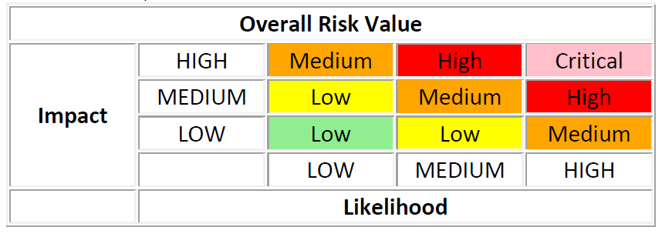
What is risk?
Risk = likelihood x impact
Risk audit register classifies risks through risk assessment and provides a guide to action

Slide 9
Living with risk
Living with risk is normal
It can never be completely eliminated
It can be managed
We should be able to show progress on risks we have identified previously
ISMS helps us monitor and manage risk

Slide 10
Required artefacts in a simplified phased approach
“Management view” security statement
Risk register – preferably web based. Provides the engine of the PDCA cycle
Other docs may emerge in response to risks identified in risk register
Incident report register, DRP, AUP, NDAs, Audit checklists etc

Slide 11
Exercise
15 minutes
Hypothetical : you are a stakeholder in a national DHIS2 implementation
In four groups identify and classify a number of risks.
Group 1 - people related risks (the sysadmin is fired and takes all her knowledge with her)
Group 2 - physical infrastructure related risks (data centre burns down)
Group 2 - risks related to cloud/outsourced service (AWS goes bust)
Group 3 – confidentiality related (code developers have access to patient data and share by gmail)
Group 4 – document/process related risks (we don’t have a backup plan)
Feed back to group, discuss mitigation

Slide 12
Concluding thoughts
ISO27001 provides a framework. There are others. Its basic proposition is that : you must have a security plan.
In ICT4D context, owning the security plan is necessary part of appropriating the system
Risk identification exercise is a useful tool for developing security consciousness amongst stakeholders
To be a guide for action requires additional people and processes to be in place
We can do a better job providing guidance on how to implement a security plan

Slide 13
Useful free Resources
ISO 27k toolkit http://www.iso27001security.com/html/toolkit.html
CIS controls - https://www.cisecurity.org/controls/
CIS benchmarks
African Centre for eHealth Excellence:
“Cyber-security: themes for Africa’s eHealth”

Slide 14
Thank you

