Slide 1
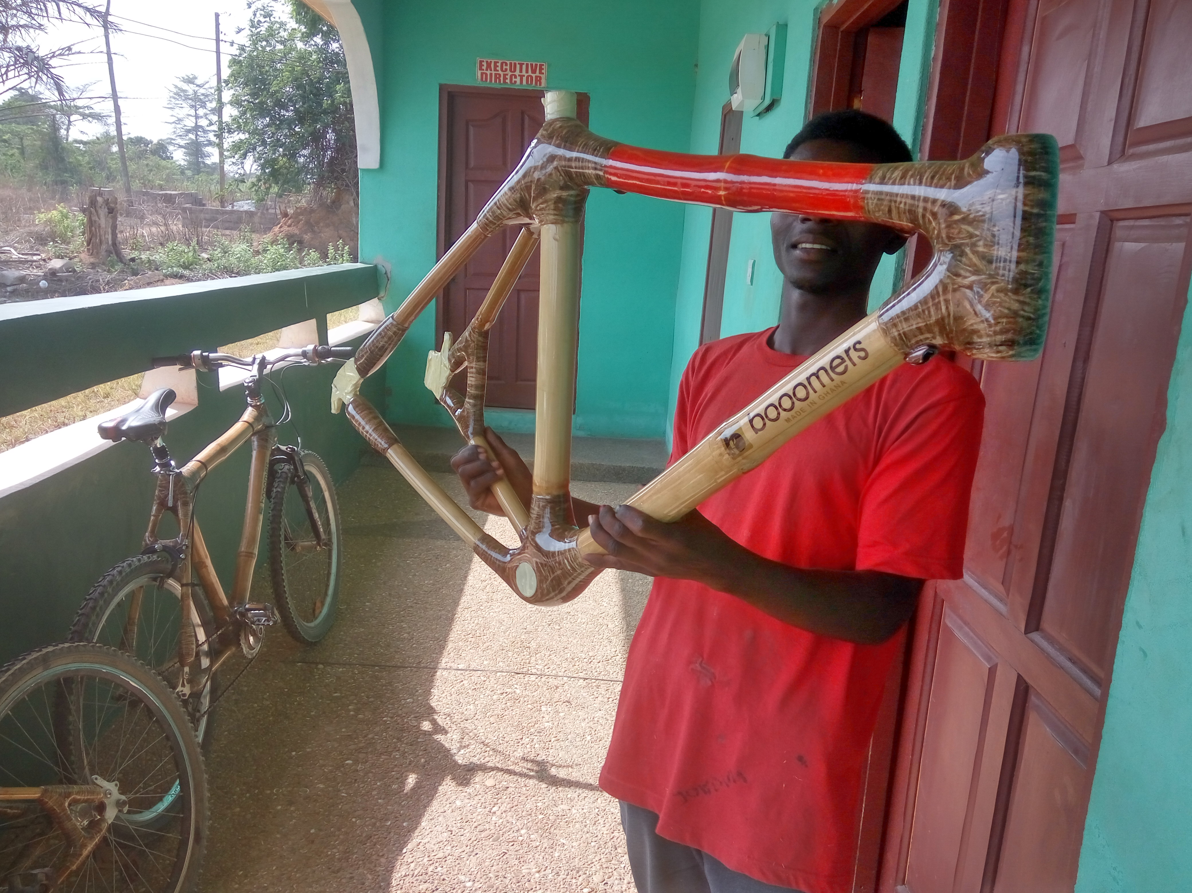
STRUCTURAL PROPERTIES OF BAMBOO FOR BIKE FRAMES

Slide 2


Health Information Security Lessons from the field
September, 2017
Bob Jolliffe
Ehealth Afro Conference

Slide 3
Self intro
Some security management background from Department Science & Technology in South Africa mid 2000‘s
Working with HISP Oslo since 2008, initially mostly on DHIS2 software development
More recently focus on:
Health information standards and interoperability
Assisting with backend support of national implementations
Security

Slide 4
Overview
Quick background of DHIS2 in Africa
Anonymous case studies of some security incidents that have happened
Lessons and open questions and suggestions
Note: I am not going to talk about technical measures like web application firewalls, intrusion detection systems etc

Slide 5
DHIS2 in Africa
Origins in 1990s created by HISP team in Western Cape
First attempt at replicating SA experience was in Mozambique and later India
DHIS 1.4 persists and has become institutionalised in many settings
Since 2008, and accelerated around 2010, most new deployments in Africa are making use of DHIS2
The web based paradigm of DHIS2 brings with it tremendous new opportunities, but also a whole new set of challenges
Extremely varied models of hardware deployment and technical support are used in practice

Slide 6
150‘000+ monthly users
60+ countries
70+ NGOs
10 global/regional organizations

Slide 7
Implications of moving to the web
Like watching a movie (who is watching the projector?)
The material and labour that produces and reproduces the application in reality is largely invisible
(Servers, datacentres, network, system administrators)
Being invisible, it is frequently ignored and virtually invisible in project proposals and plans. A technical detail which will somehow just happen. Importantly it is often not budgeted for.
Most of the known security incidents in our community have resulted from lack of awareness, planning and budgeting of the material and labour required to run the system.

Slide 8
Cases
Information security processes address Confidentiality, Integrity and Availability
The cases are just a few examples of events of the past few years. Not all, but most, relate to African DHIS2 national implementations.
Many/most did not involve an outside attacker but resulted from human error and lack of clear process of identifying and mitigating risks.

Slide 9
Case 1: Availability
Country A moved their system to an internationally based cloud provider
What they gained was substantial cost savings and a professionally managed hardware environment
One month there was a mixup with the bill
The service provider turned off the machine pending settlement
1000‘s of users were locked out of the application for nearly 24 hours while the matter was settled
There were good offsite backups so there was never a risk of substantial data loss
If system had been carrying transactional patient care data there could have been life threatening consequences. It wasn‘t.

Slide 10
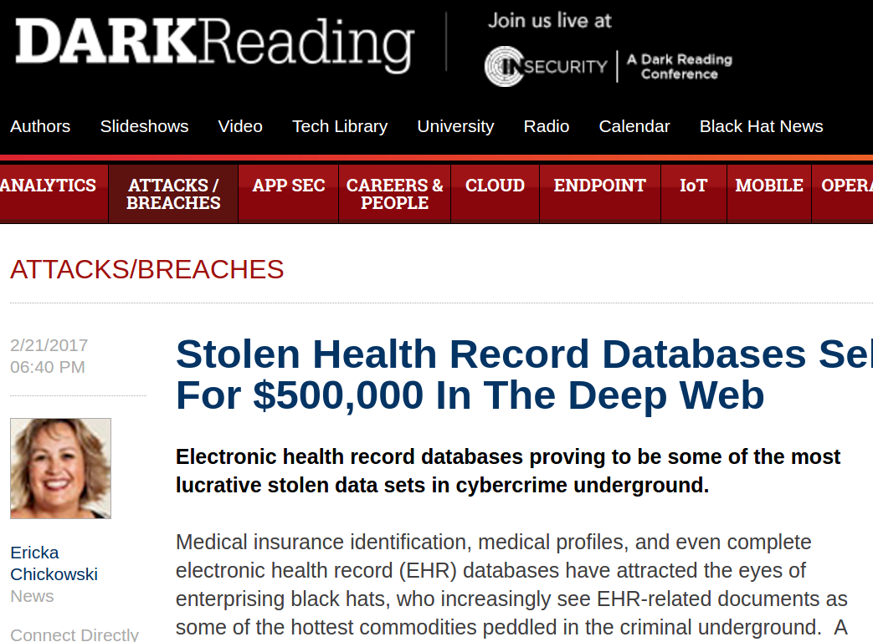
Exposure of data cases
We do not have any reported instances of targeted attacks on data within DHIS2. Many, many cases of accidental exposure.
Internationally healthrecord data is increasingly targeted for fraud, identity theft, blackmail, financial insurance data etc
Healthrecord data of poorer people has lower commercial value (though that is increasing)
It may have higher political value (for local and international intelligence agencies)

Slide 11
Case 2: Exposure of data
The hmis team had some understanding of sql and direct querying of databases
They reconfigured the database access controls and firewall so that that national department users could perform direct queries on the database
By accident I discovered that I was able to connect to the database directly without a password (from Ireland!)
All of the data was exposed to the world
Potential consequence to confidentiality, availability and integrity
It had been like that for six months!
Insufficient protection of the backend database is not uncommon

Slide 12
Case 3: Exposure of data
In March 2017 there was a vulnerability discovered in a library used by DHIS2 which allowed attackers to execute arbitrary commands on the server (zero day vulnerability)
It was detected and patched within 48 hours.
A country had been piloting an ANC register using DHIS2 back in 2015
After the pilot was finished, the machine remained live
Nobody was actively watching or maintaining this server for the past year (orphaned)
It was hacked using the recently discovered vulnerability two months after the patch had been released
All of the data was exposed
There was no indication that the data was the target of the attackers. They were using this machine to attack other machines.
Other systems also fell victim to this attack with varied consequences. Attackers were primarily from US, Russia, China

Slide 13
Case(s) 4: Permanent Data loss
MOH IT support person got fired/moved (he took the data with him!)
Catastrophic hardware failure in local servers. Three months data was lost. (there were no recent offsite backups)
A cloud server was decommisioned/erased. There was no recent backup. Six months data was lost.

Slide 14
Summary
Most cases were “self-inflicted” reflecting inadequate/naive skills and management processes
The “Cloud” is wonderful, but opens new set of management challenges
Data loss is the highest risk we have seen in country systems
Accidental exposure of data through misconfiguration is common
System vulnerabilities are being exploited. Frequency and sophistication of attacks will increase. To date these seem not to be targeted attacks
Our communities face unique conditions different to so-called first world. Mostly human resource and infrastructure constraints.
All our known attacks have originated from outside country (consider geo-ip blocking)

Slide 15
Lessons
For DHIS2 team in Oslo (self reflection)
It is not sufficient to just make software. We need to gather experiences from the field and improve management guidelines together
Constantly develop and improve our software security verification process
Work together with countries to improve security training and awareness at all levels
Current action research project working together with a country implementation to jointly develop framework of templates, guidelines and checklists to inform practice
Ongoing series of system administrator “academies” to build community of practice

Slide 16
Lessons
For country system owners:
Security is a management issue. You can not delegate it to the lowest technical geek person in your organisation
You cannot outsource your security posture. You might outsource technical implementation, but you need to take ownership of your security plan.
Have a plan! At minimum:
1 page high level security principles
Appointed security manager
Regularly audited risk register
Tested, audited backup/disaster recovery plan
A section on security should be part of every training document and event (end users, data managers etc)
Standing item on management meeting agenda

Slide 17
How do you make a plan?
Don’t wait until you have perfect security consulting or in-house skills. A simple plan is better than no plan. It can develop.
Leverage networks for advice, sharing and peer review
HISP network consists of many fellow travellers with similar concerns
African Centre for Ehealth (Acfee) have produced useful high level guidelines
National, regional and international security groups
OpenHIE community tackling standards relted to patient data exchange
Generic standards (ISO27000, ITIL, HIPAA, etc) are useful. Study these. But you need to tailor to real environment. Create practical guidelines for your systems.

Slide 18
Concluding thoughts
Information security is about people – the people who defend, the people who attack and the people whose information is compromised
Cyber security risks will increase, particuarly in the current geo political climate
Most of “our” data has little commercial interest to criminals (but that will grow)
We have little effective defence against state actors (but we try to make it difficult)
Personal data should be collected on the understanding that it may be compromised. How do we learn to live with that?

Slide 19
Thank you
Bob Jolliffe
bob@dhis2.org
bobjolliffe@gmail.com

