Slide 1
ANALYZING NEIGHBORHOODS OF TORONTO TO STARTING A NEW RESTAURANT
Applied Data Science Capstone

Slide 2
INTRODUCTION: BUSINESS PROBLEM
Toronto is the capital city of the Canadian province of Ontario. With a recorded population of 2,731,571 in 2016, it is the most populous city in Canada and the fourth most populous city in North America. Toronto’s growing population coincides with increased development and investment in the city and surrounding region. This is why the Toronto area an excellent place to set up a new restaurant.
Opening a succesful restaurant is not an easy task. One of the things that need to be done is to determine the right location to open a new restaurant. In this project, we will study the neighborhoods and find the most suitable location to starting a new restaurant. Target audience of this project is someone who want to open new restaurant in Toronto and have no idea where to build it.

Slide 3
DATA
In this project, we need the following data :
Neighborhoods of Toronto
Geographical coordinates of the neighborhoods (latitude and longitude)
Venue data related to restaurants in Toronto

Slide 4
METHODOLOGY AND ANALYSIS
Data preparation
Feature extraction
Clustering neighborhoods

Slide 5
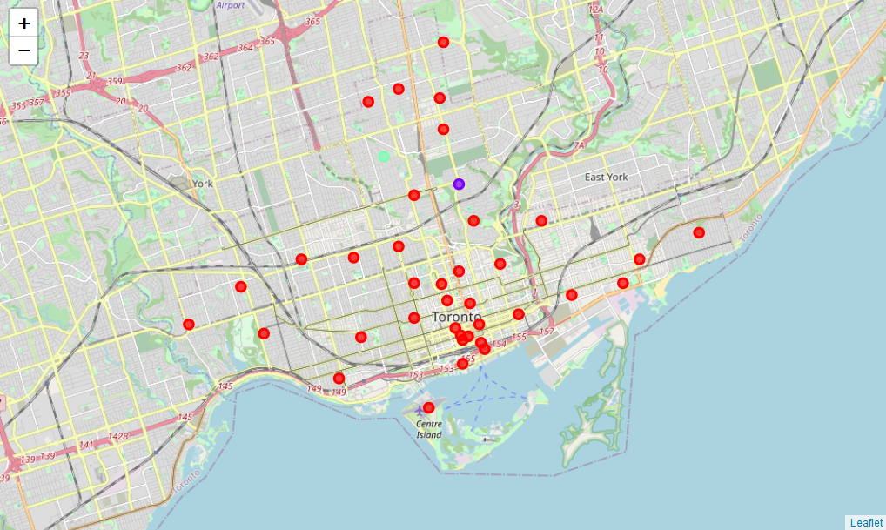
RESULTS
Most restaurants are in cluster 2 which is around Forest Hill North & West, Forest Hill Road Park. Cluster 0 show good location to starting a new restaurant in Toronto, because there are less restaurant in those area.

Slide 6
DISCUSSION
As mentioned earlier the most suitable neighbourhoods for starting new restaurant are present in the cluster number 4. The restaurant owner can go ahead and make a decision depending on other factors like availability and legal requirements that are out of scope of this project.

Slide 7
CONCLUSION
Data science can be very helpful in determining solutions for certain business problems. In this project we studied the neighbourhoods of Toronto and came up with a recommendation of neighbourhoods where our client can start their new restaurant.

