Slide 1
SSADM
BENI IYAKA

Slide 2
WHAT IS SSADM? ____________________________________

Slide 3
SSADM is short for Structured System Analysis Development Methodologies.
This is a systematic methodology used for analysing and designing information systems.
SSADM helps divide a project that is being developed into modules, tasks, steps and gives a layout for analysing projects in a suitable way to managing a project.

Slide 4
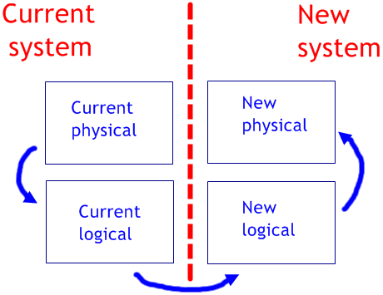
Illustration of SSADM
(Anon., 2014)

Slide 5
HISTORY OF SSADM ____________________________________

Slide 6
Developed in 1980s for analysing systems and designing of applications.
SSADM was mostly used for government computing projects in the UK.
In 1981, SSADM version 1 was developed by Consultants working for Learmonth and Burchette management Systems.
In 1983, SSADM was made mandetory for all the new Information System Development.
In 2000, SSADM was renamed as « Business System Development » by the Central Computing and Telecommunication agency (CCTA).
By changing the name, 15 modules were repackeged and 6 more modules were added.

Slide 7
Objectives ____________________________________

Slide 8
SSADM’s objectives are to:
Improve and control project management.
Make the project resillient to the loss of staff.
Improve communiication between participants in the project.
Improve quality in System Developments.
Make more effective use of experienced and inexperienced development staff.

Slide 9
Characteristics of SSADM ____________________________________

Slide 10
More of Data driven methodology.
This focuses on the logical and physical view of the system.
Uses the top-down and bottom-up techniques
This method uses a Diagrammatic and non-
diagrammatic techniques.
Provides a link between quality assurance, Project management and Risk assessment.

Slide 11
Concepts in SSADM ____________________________________
Notes:
We will explore various concepts that comes with SSADM of which techniques and stages of SSADM are included.

Slide 12
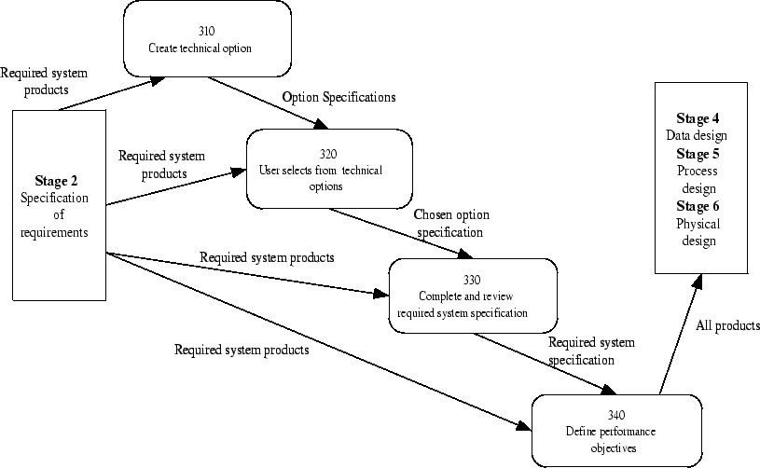
Concepts in sumary

Slide 13
1. Techniques ____________________________________
Notes:
There are 3 most important techniques in SSADM. Namely:

Slide 14
Logical Data Modelling
This is a technique that helps identify, model and documents the deta requirements of the system that is being designed. Resulting to a data model containing entities, attributes and relationship.
Data Flow Modelling
This is the technique that helps identify, model and document the movement of data within an Information System.
Entry Event Modelling
This is a technique that helps identify, model and document the event that affect each entity and sequence in which they occur.

Slide 15
2. Stages ____________________________________
Notes:
The SSADM consits of 7 stages within a project development life cycle. Namely:

Slide 16
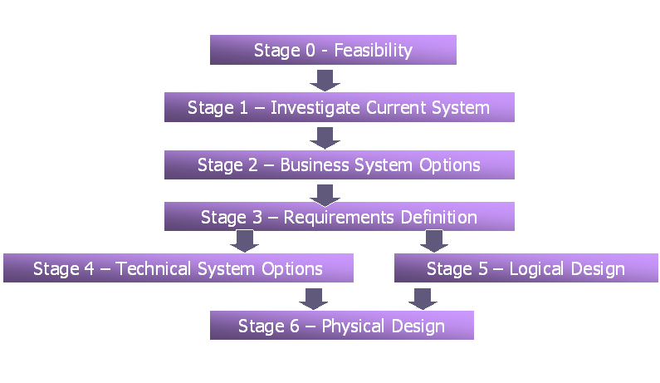
Stages of SSADM
(Fonseka, 2014)

Slide 17
Feasibility
This is a stage where by the propose Information System is assessed so as to determine if the system can meet the business requirements of the organisation and also deciding if the cost of the resolving problems are worth to benefit the projects.
Investigation of the current environment
This is a stage whereby the business activity model is developed, requirements are investigated and defined, and the current data flow model is investigated; so as to get detailed requirements of the project.
Business System Options
This is a stage where the System Analyst decide on the overall design of the new system by using the outputs of the previous stage.

Slide 18
Requirement Specification
This is a stage whereby all the functional and non-functional requirements of the project are identifies in detail.
Technical System Options
This a stage whereby the analyst determines the terms of cost, performance and what impact it has on the organisation.
Logical Design
This is a stage where by the menu structure and dialogues of the required systems are designed. This includes defining the user dialogue, designing updates and enquiry processing.
Physical design
This is a stage where the physical data and process design are specified. This stage helps focus on the environment that the new system will be running.

Slide 19
Advantages and Disadvantages of SSADM _____________________________________________________

Slide 20
Advantages of SSADM
Usability
In SSADM, the staff skills are considered so that the system could be effectively used.
Better quality
SSADM allows us to reduce errors rate by thouroughly analysing quality level in the begining of the system development.
Timelines
SSADM enables the Analyst to plan, manage and control a project.

Slide 21
Effective use of skills
SSADM’s objective is to make use of experienced and inexperienced staff because they can be taught.
Cuts cost
SSADM allows us to separate the logical and physical design so that the system should not be implemented with new hardware or software.

Slide 22
Disadvantages of SSADM
Over-analysing: Because SSADM put more focuses on the analysis of the system and it documentation.
Time and cost consumensing: Due to over analysing.
Long development times: In SSADM, every stage must be completed before going to the next stage.

Slide 23
Bibliography __________________________________

Slide 24
Anon., 2014. Context of SSAD. [Online] Available at: http://cnfolio.com/images/img408ssadm.gif [Accessed 8 October 2016].
DeMarco,Tom. Structured Analysis and System Specification. New York: YOURDON Press, 1978
Edward Yourdon and Larry L. Constantine. Structured Design: Fundamentals of a Discipline of Computer Program and System Design , 1979.
Fonseka, M., 2014. Structured Systems Analysis and Design Methodology (Structured System Analysis Design Method). [Online] Available at: http://sinhala.fit2school.com/2014/02/11-4-structured-systems-analysis-design-methodology-ssadm/ [Accessed 08 October 2016].
TechTarget, Margaret Rouse. 2008. SSADM (Structured Systems Analysis & Design Method). [ONLINE] Available at: http://searchsoftwarequality.techtarget.com/definition/SSADM. [08 October 16].
ITC Infotech India Ltd, Structured Systems Analysis and Design Methodology. Available from <http://vijaysamyal.tripod.com/SSAD.pdf>. [08 October 2016]

