Slide 1
FROM A WILD-BIRD GENOME
to an epidemiological story
PubMLST • population structure • source attribution • AMR
120 minutes
hands-on
4 mystery genomes
Opening question
“We cultured C. jejuni from a wild bird.
Does that make it a wild-bird strain?”
Ben Pascoe | Hungary workshop | 2026

Slide 2
THE STORY
The session is one connected investigation
1
2
3
4
5
6
What is it?
What lineage?
Related to what?
What source?
What AMR?
How sure?
MLST
ST / CC
Genome Comparator
Attribution
Resistance
Uncertainty
The aim is not to learn which buttons to click.
It is to decide what level of inference the genome actually supports.

Slide 3
DATASET
Case study: the livestock–wildlife interface in Sweden
561 C. jejuni genomes
265
Five ecological groups give us a built-in comparison between agriculture and a non-agricultural wild-bird population.
126
87
68
Why this dataset works for teaching
15
host-sharing STs
close cross-host genome pairs
farm-proximity AMR signal
Conventional
chicken
Organic
chicken
Ruminant
Wild bird
near farm
Wild bird
Ottenby
Project metadata and manuscript: 561 genomes; BioProject PRJNA1450089.

Slide 4
YOUR CASES
Four mystery genomes — all recovered from wild birds
Mystery A
Where does it sit?
Mystery B
Generalist or specialist?
Mystery C
Near a farm ≠ farm lineage
Mystery D
Shared type, shared transmission?
Do not assume “wild bird isolate” = “wild-bird lineage”.
Can we recognise a lineage that moves among hosts?
Ecology and bacterial ancestry are different variables.
How far can seven-locus MLST take us?
Rule for the next 90 minutes: predict first, reveal second.

Slide 5
PUBMLST
PubMLST is two linked ideas, not just a website
1. Definitions / nomenclature
2. Isolates / genomes
Allele definitions
MLST profiles
Sequence types (STs)
Clonal complexes / schemes
A stable language for describing variation.
Genome assemblies
Host and source metadata
Country and date
Phenotypes
Biological context for those lineage names.
link
As of Sep 2026: >158k C. jejuni/coli isolate records and >107k genomes
PubMLST Campylobacter jejuni/coli page, accessed Sep 2026.

Slide 6
MLST IN 60 SECONDS
MLST compresses sequence into a portable lineage name
aspA
glnA
gltA
glyA
pgm
tkt
uncA
ST
profile
45
7
17
2
4
10
3
6
allele numbers
CC45
Useful — but seven loci are a tiny summary of a whole genome.
Same ST/CC ≠ same outbreak ≠ direct transmission

Slide 7
25–45 MIN
Practical 1 — type a whole genome in PubMLST
1
2
3
4
5
6
Open sequence-definition DB
Single sequence
Upload FASTA
Choose MLST scheme
Submit
Record ST + CC
Record for A–D
7 allele numbers • ST • clonal complex • anything unexpected
Whole-genome uploads can be multi-contig FASTA files.
BIGSdb 1.54 sequence-query documentation: whole genomes can be uploaded and checked against all loci in a selected scheme.

Slide 8
EXPECTED TYPING
First reveal: the lineage labels
A
ST1347
CC1347
Contrasting wild-bird lineage
B
ST45
CC45
Generalist warning
C
ST686
CC682
Different near-farm lineage
D
ST1525
Unassigned
Shared ST across host groups
Question: what extra evidence do we need before turning these labels into ecological claims?

Slide 9
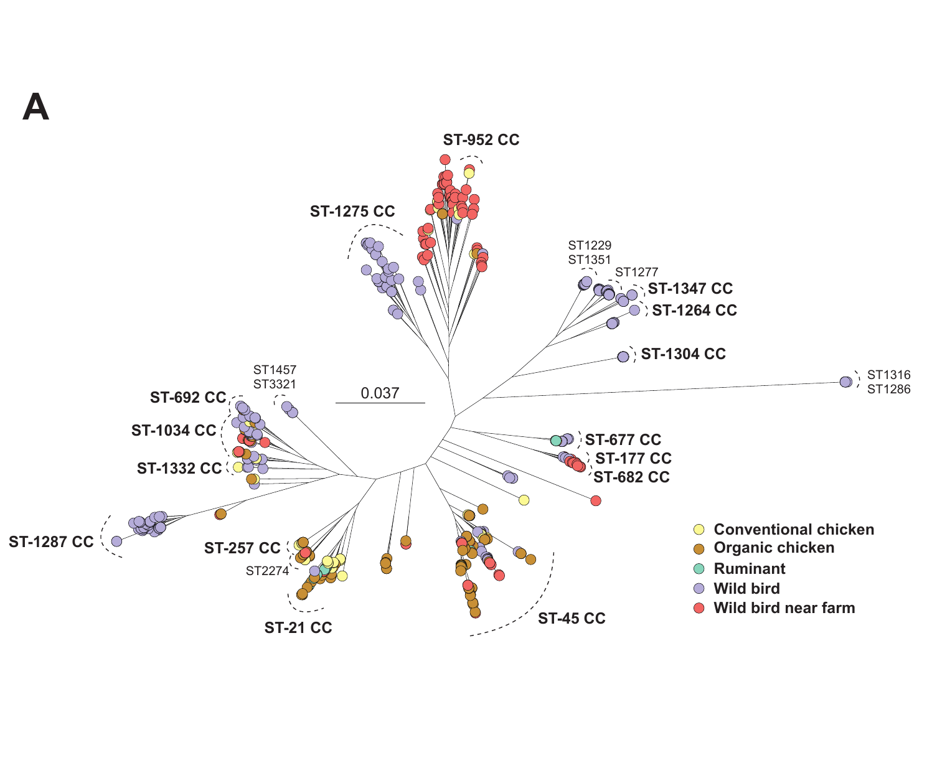
POPULATION STRUCTURE
The project tree already hints at specialists and generalists
Look for mixing
Do colours from different ecological groups occupy the same lineage?
Look for separation
Are some wild-bird lineages largely outside poultry-associated clusters?
Then ask why
Host adaptation, exposure, movement, sampling — or some combination?
Project Figure 1 (user-provided manuscript materials).

Slide 10
45–70 MIN
Practical 2 — move from seven loci to the genome
A. Search the isolate collection
B. Genome Comparator
C. Interpret — carefully
For each ST:
• which hosts/sources appear?
• is the lineage narrow or broad?
• how complete is the metadata?
Do not mistake submission frequency for prevalence.
Upload A–D as a ZIP.
Select a high-resolution defined-locus scheme.
Inspect variable loci, allelic distances and NeighborNet.
Does whole-genome structure agree with MLST?
Which is the outlier?
Does “close” establish direction or route of transmission? No.
Distance = allelic differences. It is not a universal “number of transmission events”.
BIGSdb Genome Comparator documentation: accepts one FASTA or a ZIP containing multiple FASTA genomes.

Slide 11
RELATEDNESS ≠ TRANSMISSION
A close genomic pair is powerful evidence — but not the whole causal story
Same or very similar genome
Wild bird
farm A
Chicken
farm A
Wild bird
farm B
Possible explanations
direct transfer
common source
unsampled intermediate
lineage persistence
Environment
unsampled
Other host
unsampled
Genome data sharpen the transmission hypothesis; epidemiology tests it.

Slide 12
SOURCE ATTRIBUTION
Source attribution turns population structure into probabilities
Poultry
Poultry
48%
TRAIN
classifier
Mystery
genome
Ruminant
Ruminant
12%
Wild bird
40%
Wild bird
Illustrative probabilities only
The model answers: “Which sampled source population does this genome resemble?”
It does not observe the actual transmission event.

Slide 13
70–90 MIN
Practical 3 — predict before the model does
For each mystery genome, write down:
SOURCE
CONFIDENCE
EVIDENCE
FAILURE MODE
poultry / ruminant / wild bird
low / medium / high
ST, CC, tree, metadata
what could fool you?
Then reveal the precomputed SourceRunner-ML output.
The interesting question is not “did the model get it right?” — it is “why was it confident or uncertain?”

Slide 14
GENERALISTS
The hard cases are the biology, not a nuisance
POULTRY
WILD BIRDS
RUMINANTS
ST45 / CC45
Rapid host switching can erode the genomic signal that source-attribution methods rely on.
Concept supported by Campylobacter generalist-lineage literature and the project’s shared ST45 observations.

Slide 15
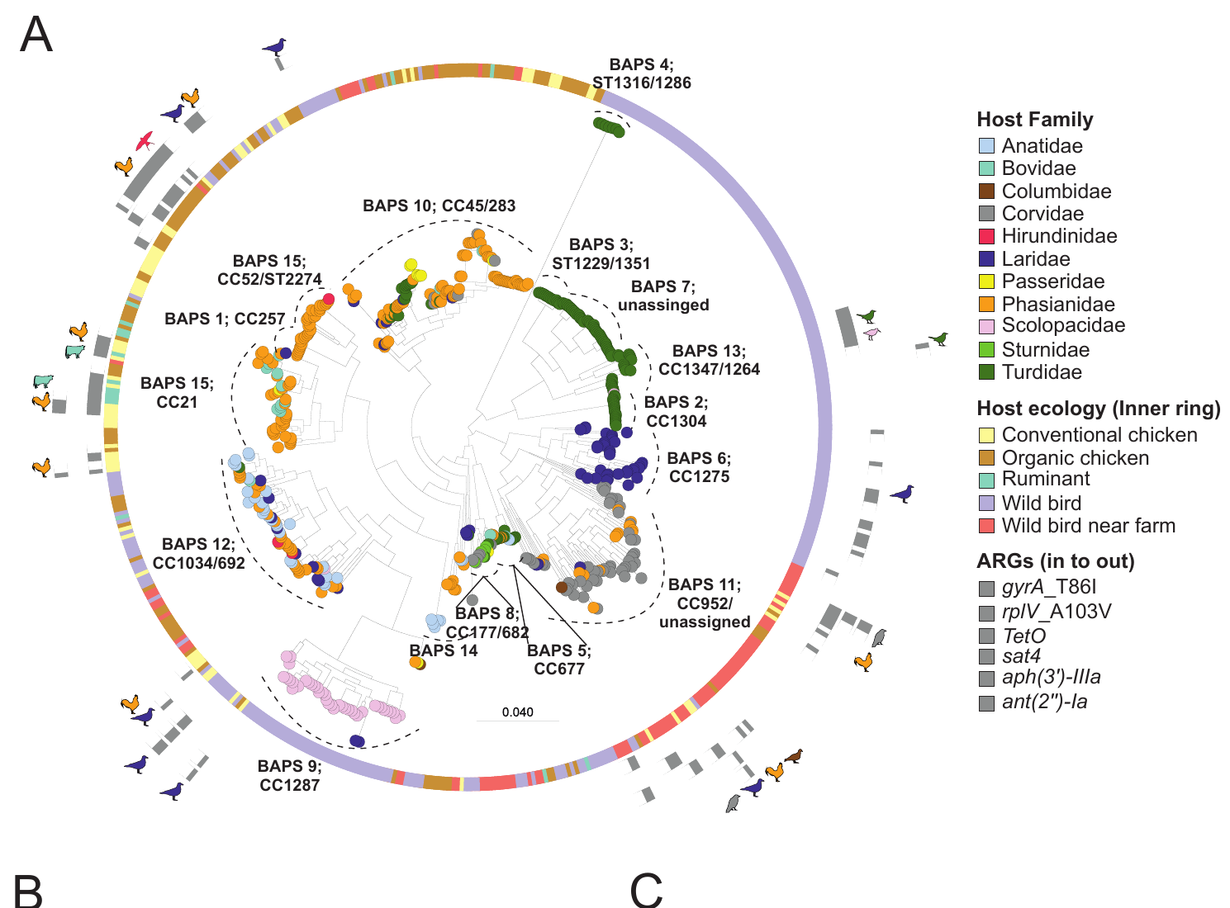
AMR
AMR makes the same point: lineage + ecology + mobile DNA
Near-farm signal
Selected resistance determinants: 18.4% near farms vs 10.9% at the non-agricultural site.
Concrete markers
tetO shows a farm-proximity association; gyrA_T86I occurs in livestock and near-farm birds.
Do not overclaim
Association can reflect clonal movement, gene movement, shared exposure or sampling.
Project Figure 4 and manuscript results (user-provided materials).

Slide 16
90–110 MIN
Practical 4 — resistance is a genomic result and an ecological question
1. What determinant?
2. Which background?
Identify the gene/mutation and expected drug class.
Is it concentrated in one lineage or many?
3. Which ecology?
4. What mechanism?
Near farm, livestock, non-agricultural birds?
Clonal spread, mobile element, repeated selection?
Best extension: long reads + denser temporal/ecological sampling

Slide 17
SYNTHESIS
Final reveal: four genomes, four different lessons
A
B
C
D
Cj_2849
Cj_10787
Cj_10726
Cj_10753
Songthrush • Ottenby
Crow • near farm 2
Crow • near farm 6
Barn swallow • near farm 5
ST1347 / CC1347
ST45 / CC45
ST686 / CC682
ST1525 / unassigned
Wild-bird population contrast
Generalist: expect attribution ambiguity
Farm proximity ≠ CC45
Shared ST ≠ demonstrated transfer
Ask one group to give the 60-second story for one genome — including the uncertainty.

Slide 18
TAKE-HOME
What I want people to remember
01
MLST names lineages
02
Genome comparison adds resolution
It does not use the whole genome.
Relatedness is not transmission direction.
03
Source attribution is conditional
04
Generalists are informative
It depends on the sampled reference populations.
Uncertainty can be a biological signal.
05
AMR needs context
06
Metadata are part of genomics
Lineage, ecology and mobile DNA all matter.
Bad labels produce bad inference.
GitHub package: participant workbook • instructor key • data templates • backup outputs • optional SourceRunner-ML follow-up

