Slide 1
Project presentation
Web Technologies
Winter Semester 2018/2019

Slide 2
Agenda
Hello
Team
Technologies
Problems

Slide 3
Team
Marita Pastore, Benjamin Hauck, Daniel Schneider
Project: drum machine
Requirements | Nice to have
Generate Loops at variable tempo and with different measures | Toggle between standard and advanced mode
Different Drumkits to be chosen | Provide Preset loops
Save Loops with own Useraccount; also Guest account | Merge loops, also with own sounds (second page)
Modify different Loop sections | Add sound effects (reverb, etc.)
Change volume ( each component individually and master volume)
Responsive design (3 key resolutions: Desktop, tablet, smartphone)

Slide 4
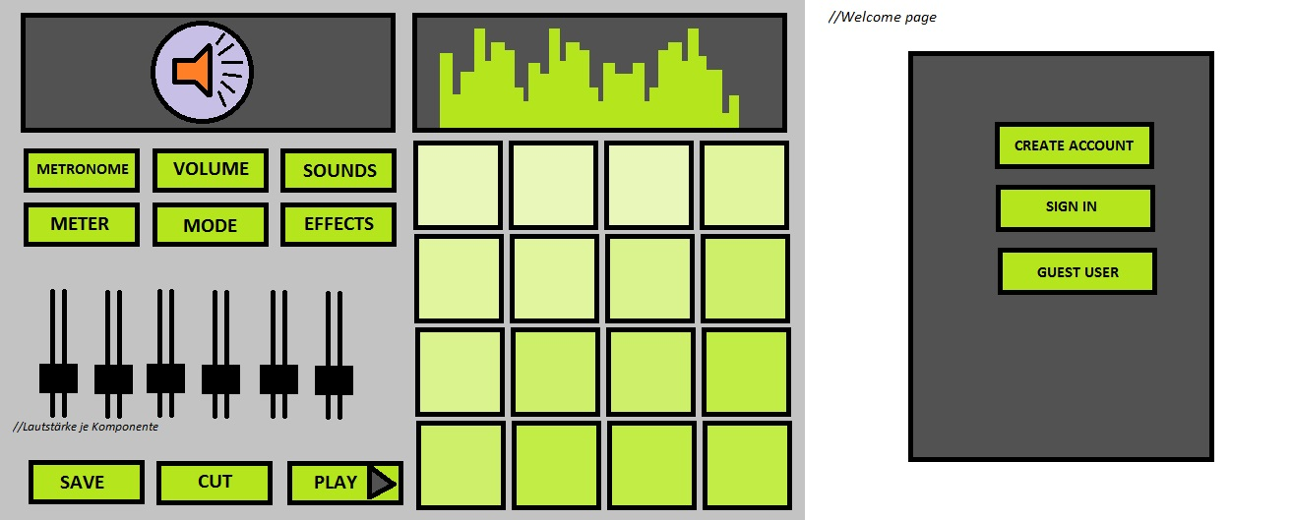
Design pattern

Slide 5
Technologies
Frontend-Framework: Angular
Database: MongoDB/MySQL
Server: Node.js
Deplyoment: Docker + Ubuntu Container
Sound database is in place; best file format tbd

Slide 6
Problems
Authentication implementation not clear yet
Audiointerface to be tested
„Multi-threading“
Play loop
Respond to user input

