Slide 1
EOMAJI
Water delineation + accounting

Slide 2
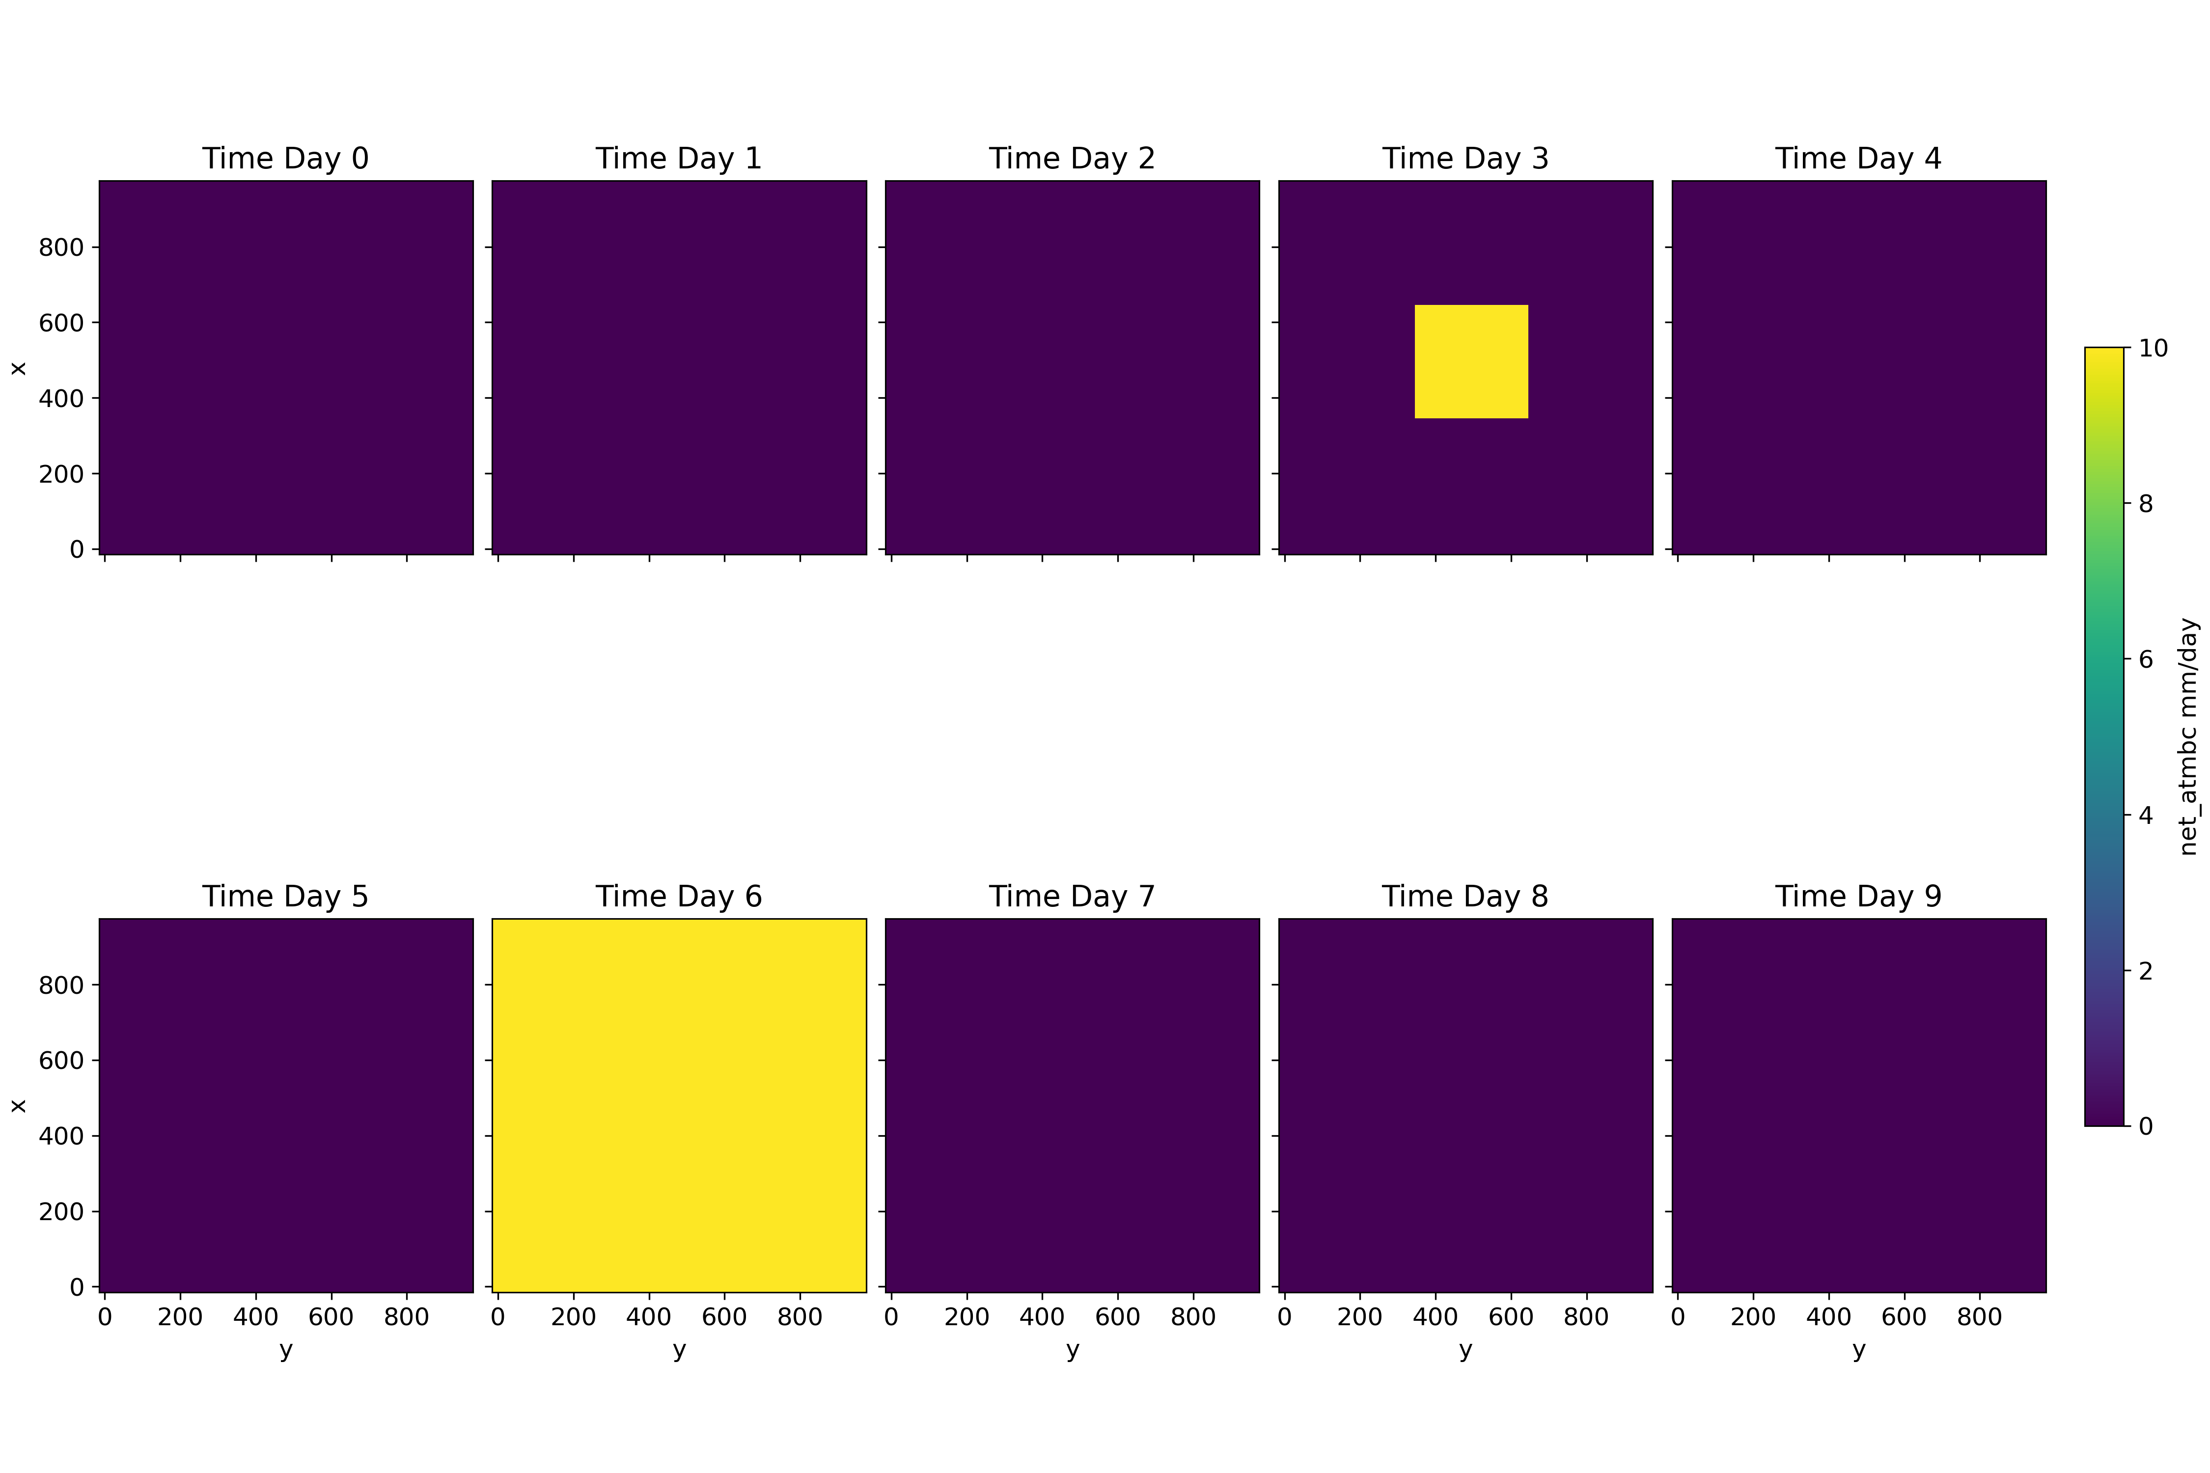
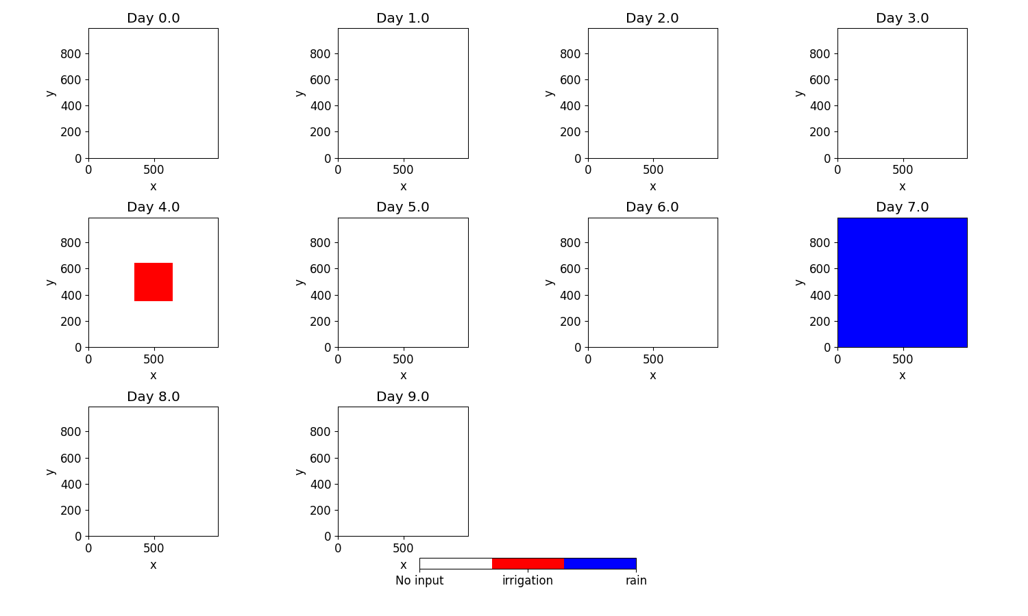
Synthetic Scenario 1 = irrigation + rain
Distribution of irrigation (time 3) and rain event (time 6)
Change in the ratio Eta/Etp LOCALLY
Change in the ratio Eta/Etp REGIONNALY

Slide 3
Synthetic Scenarios
- Scenario 0: only irrigation at one single time
- Scenario 1: irrigation + rain
- Scenario 2: irrigation on 3 different areas
- Scenario 3: = scenario 2, varying area sizes
- Scenario 4: = scenario 2, varying irrigation flow intensity
- …
- Scenario I: Varying spatial and temporal resolution of Earth Observations
- ...

Slide 4
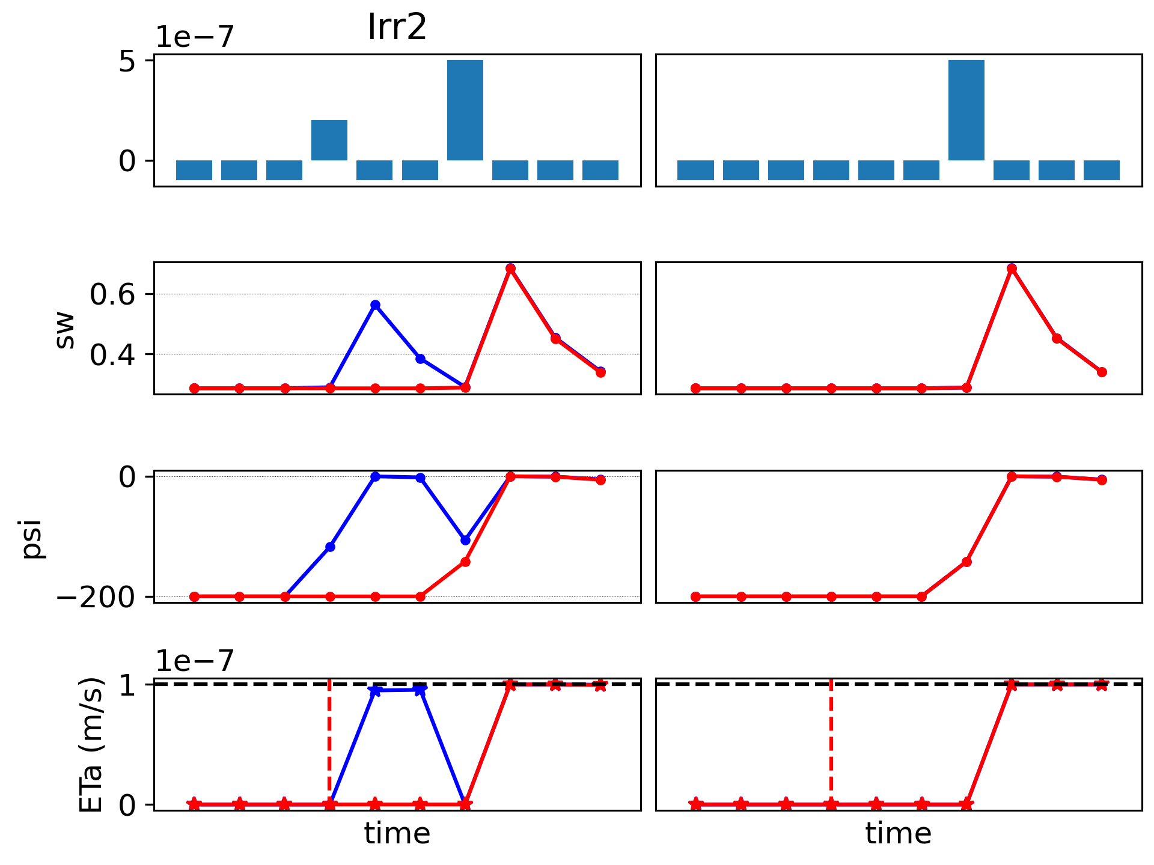
Synthetic Scenario 1 = irrigation + rain
Blue = “Earth Observations”
Red = Baseline
Baseline (in red) “sees” the rain but not the irrigation

Slide 5
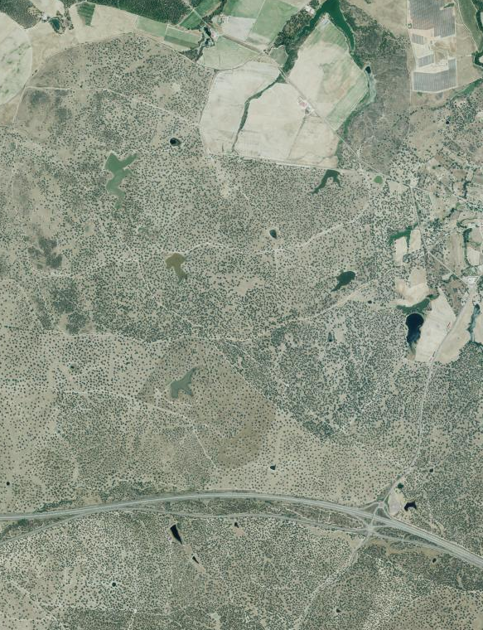
Application to Majadas
Irrigated area
Tree-grass ecosystem (no irrigation)

Slide 6
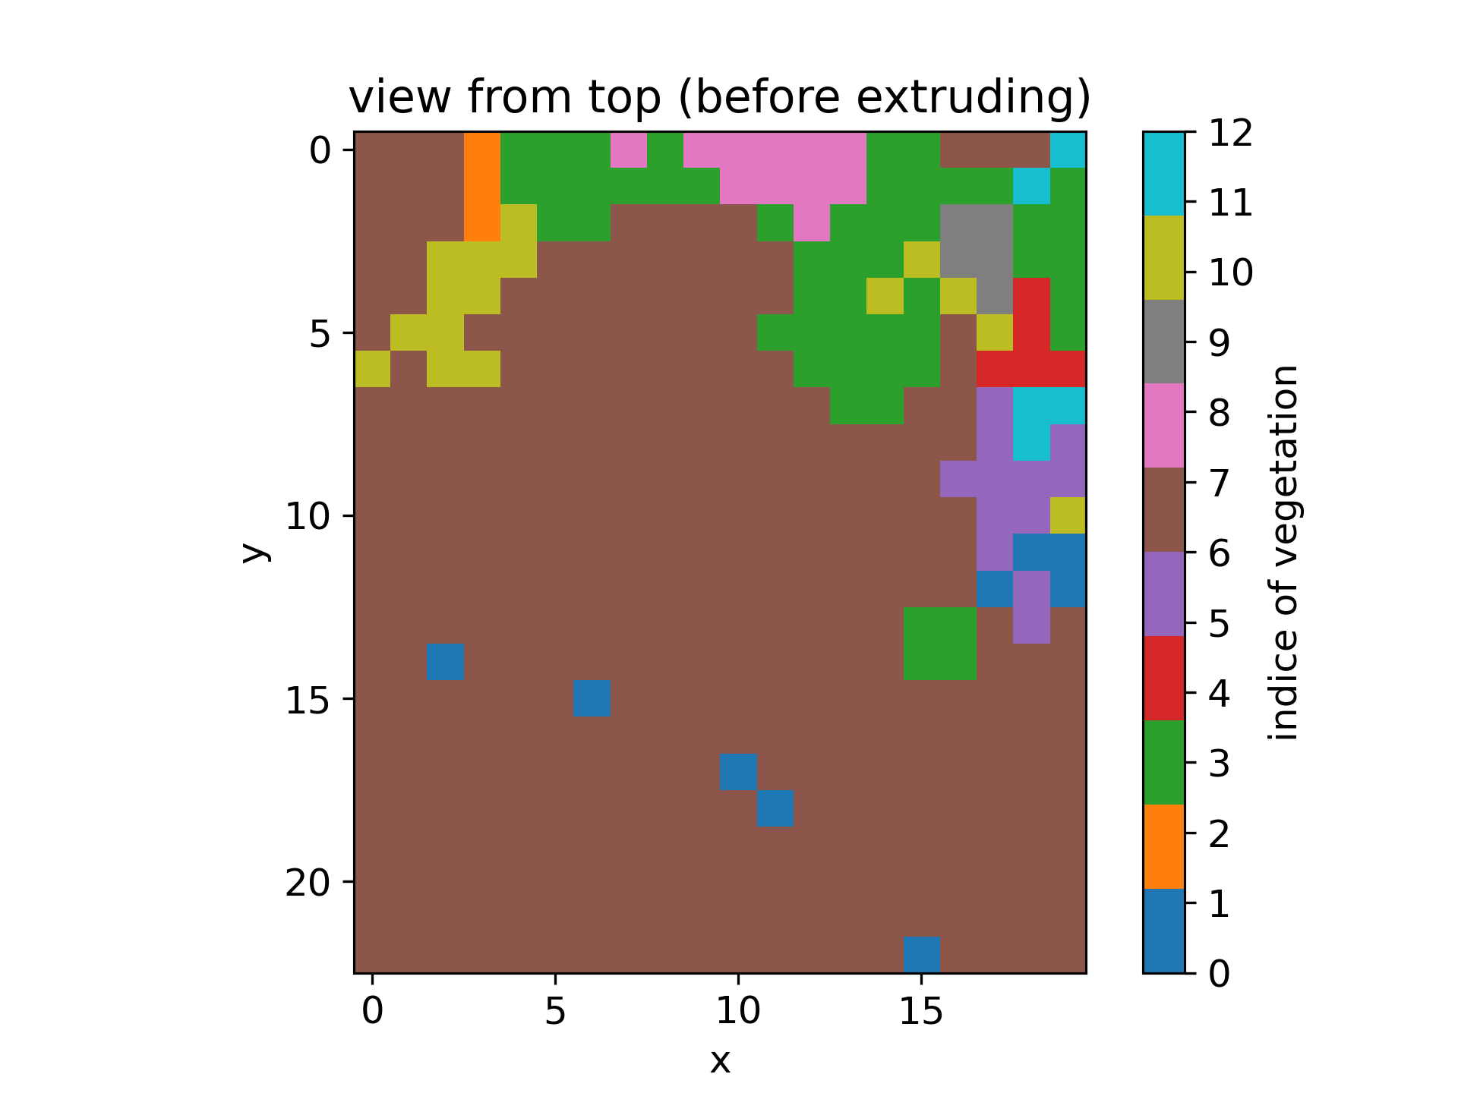
Application to Majadas
Irrigated area
Rasterized Corinne Land Cover at 30m resolution
Tree-grass ecosystem (no irrigation)

Slide 7
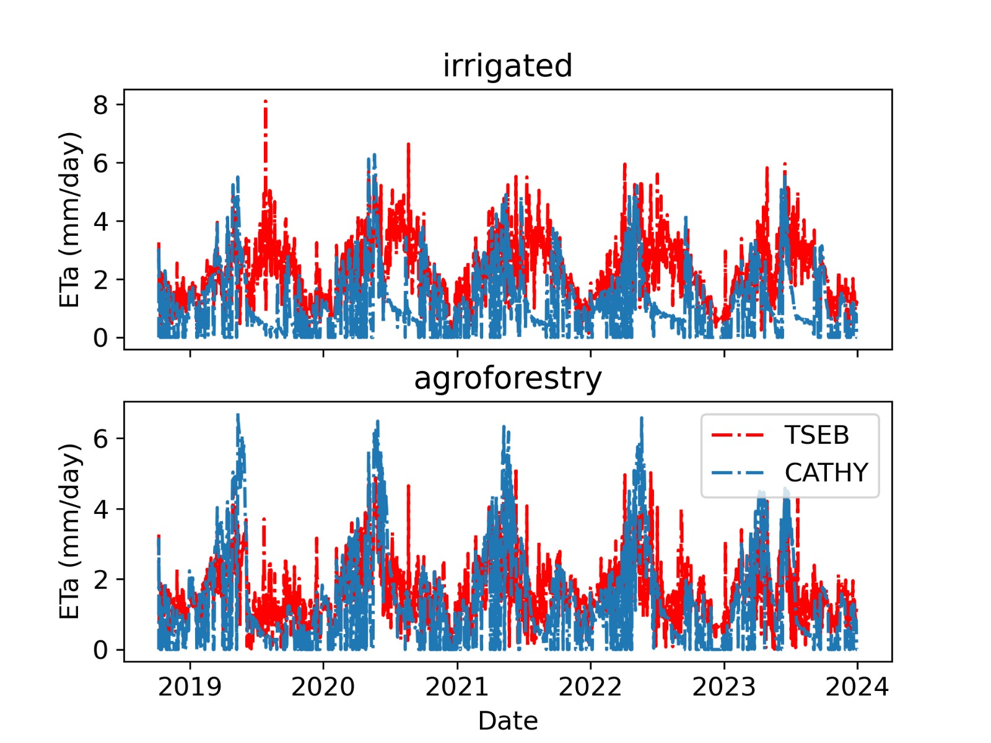
TSEB inputs
ETa(TSEB) – EtA (CATHY) = net Irrigation
CATHY
Water balance model
Baseline (without irrigation)

