Slide 1
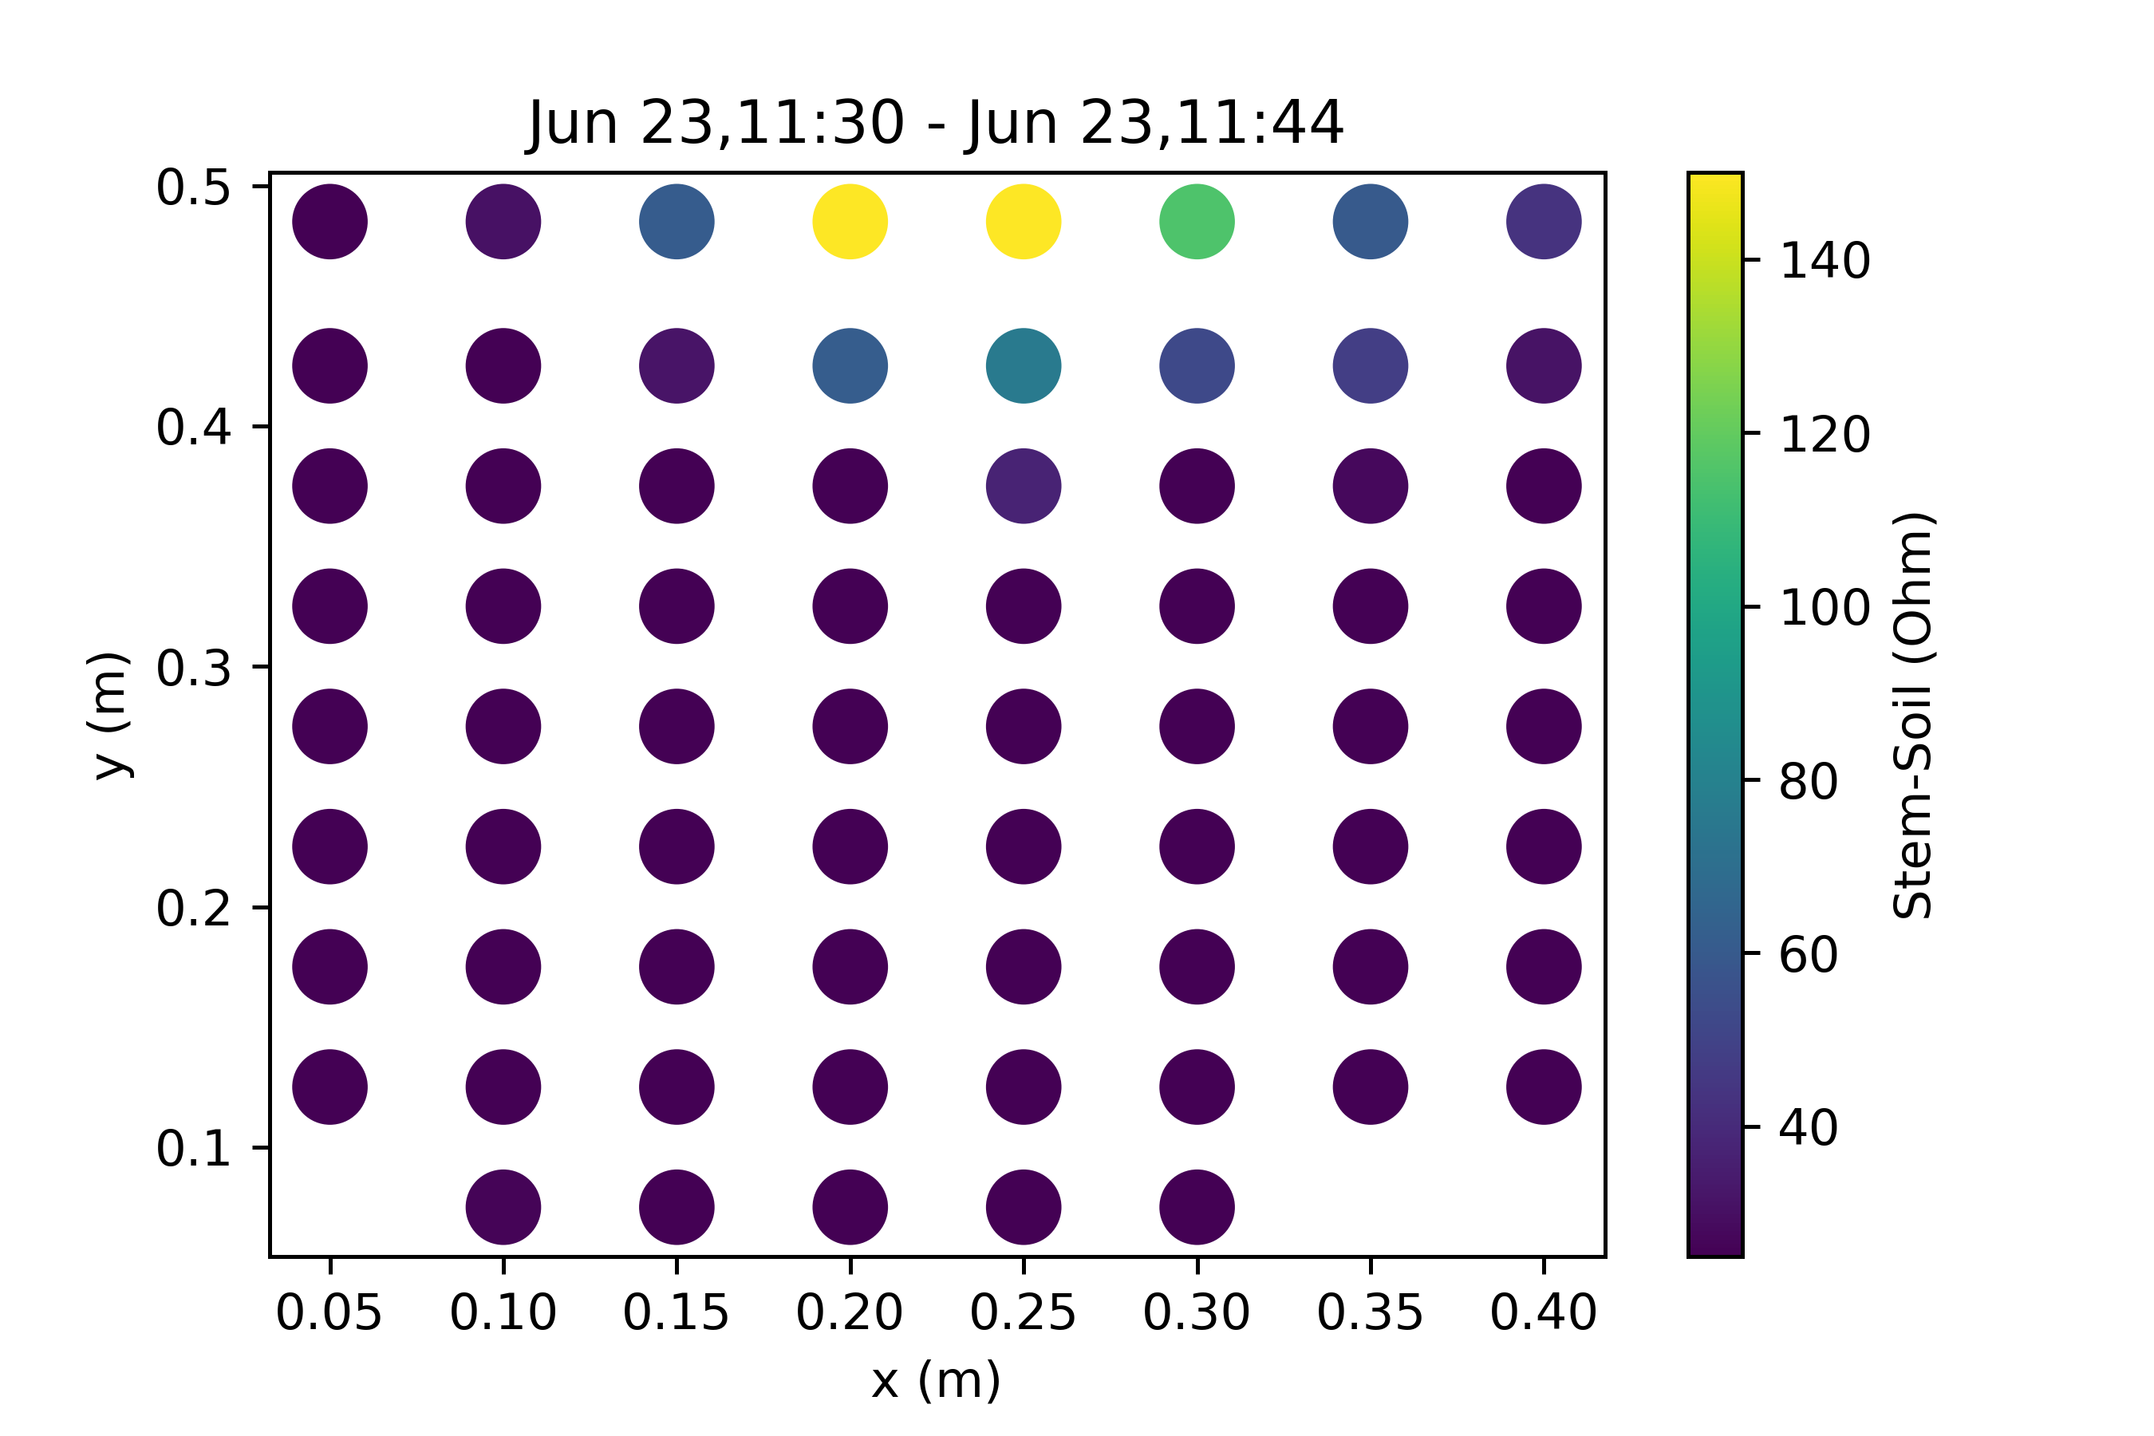
Stem - Soil

Slide 2
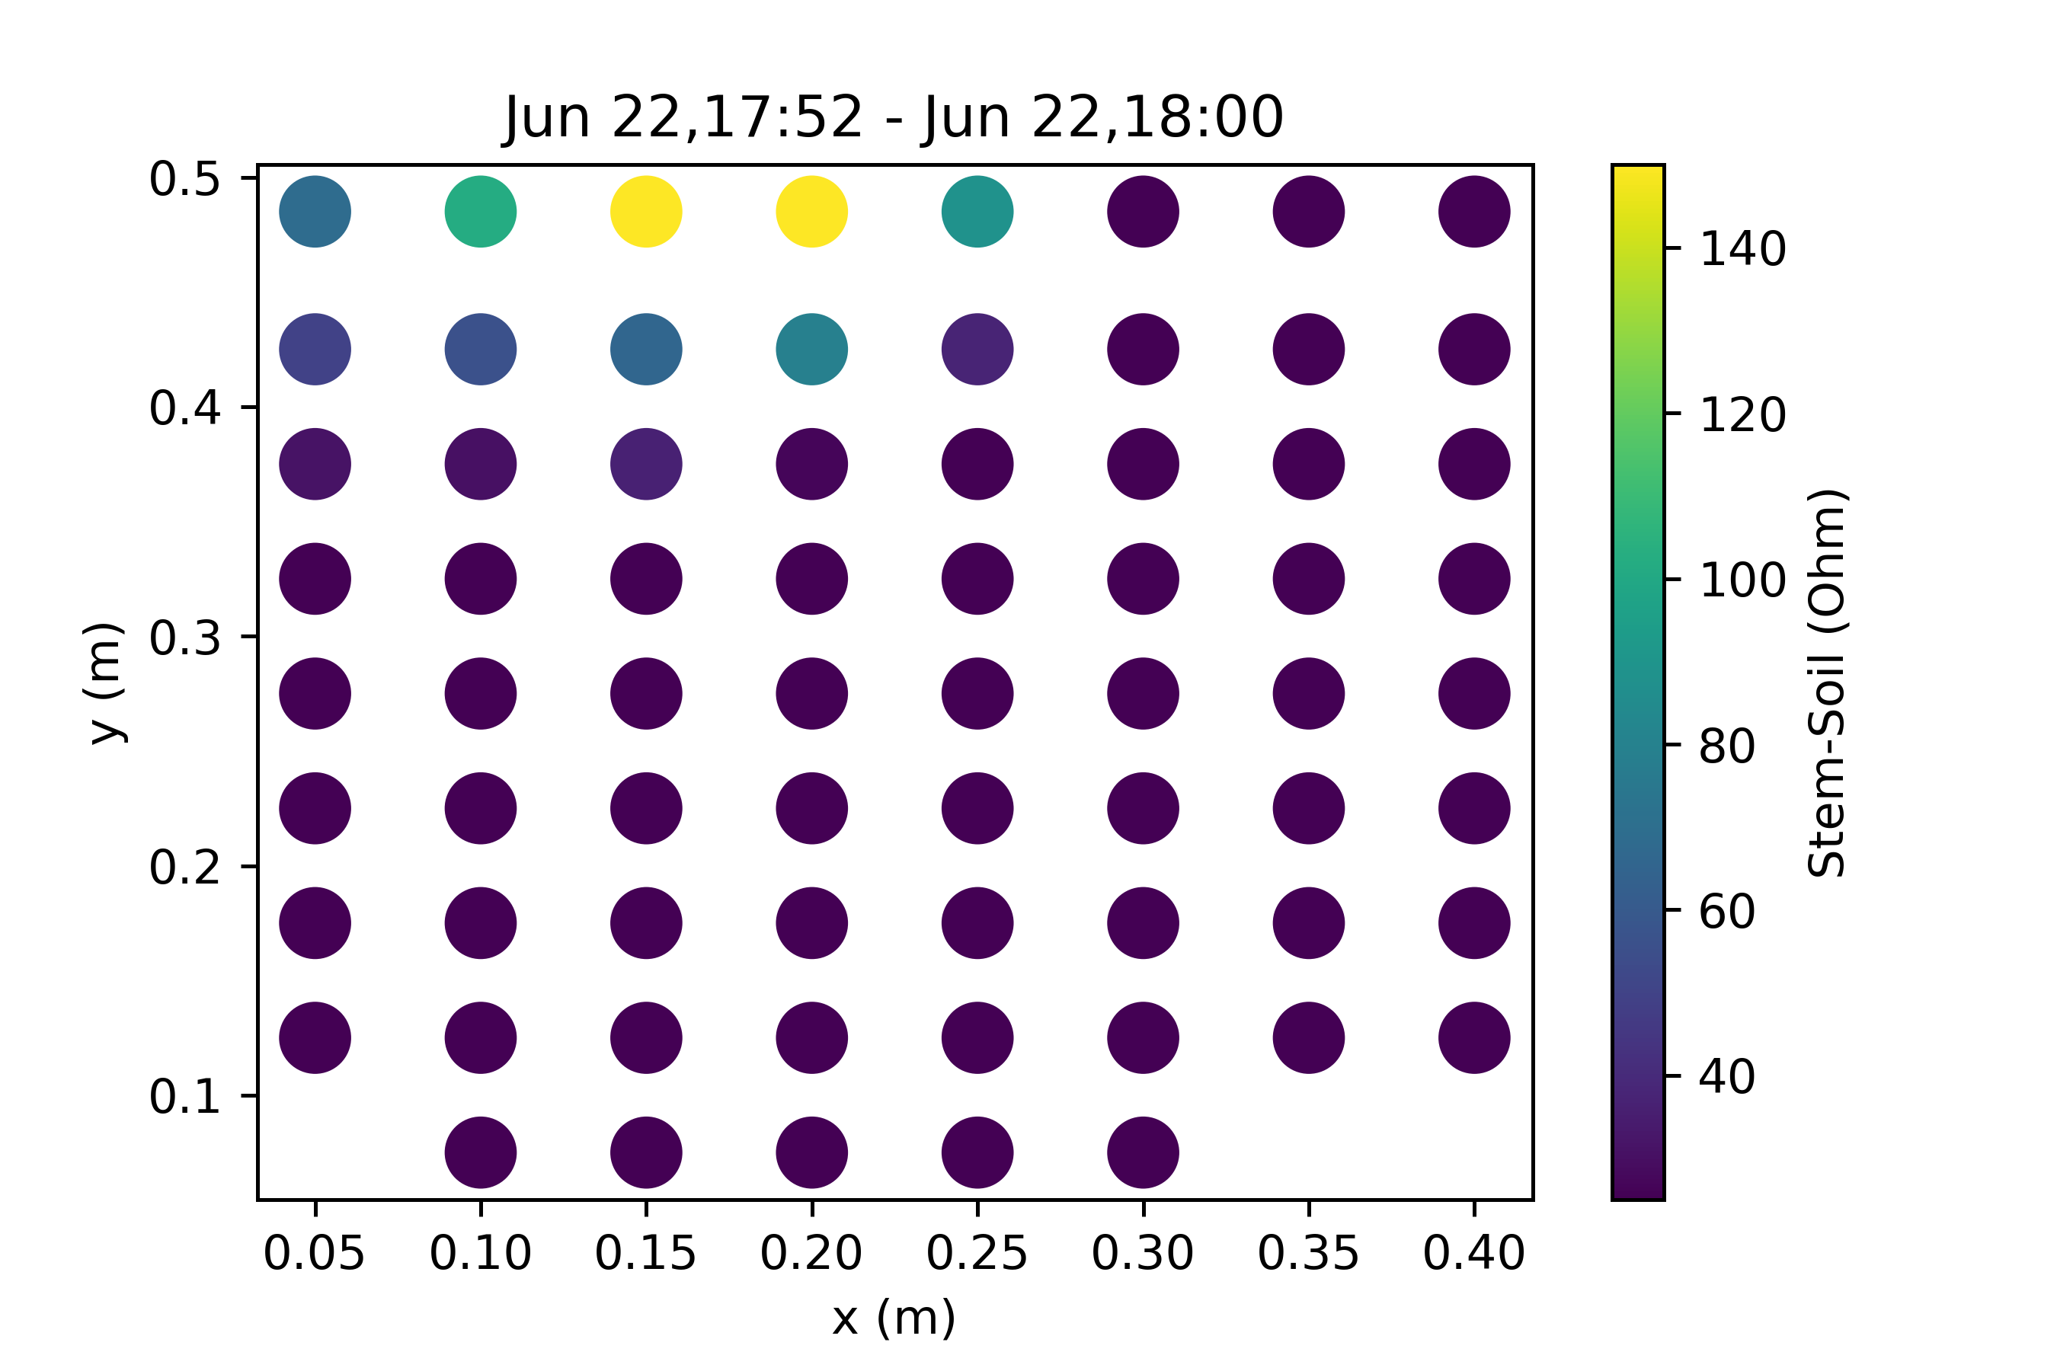
Stem - Soil

Slide 3

Stem - Soil

Slide 4
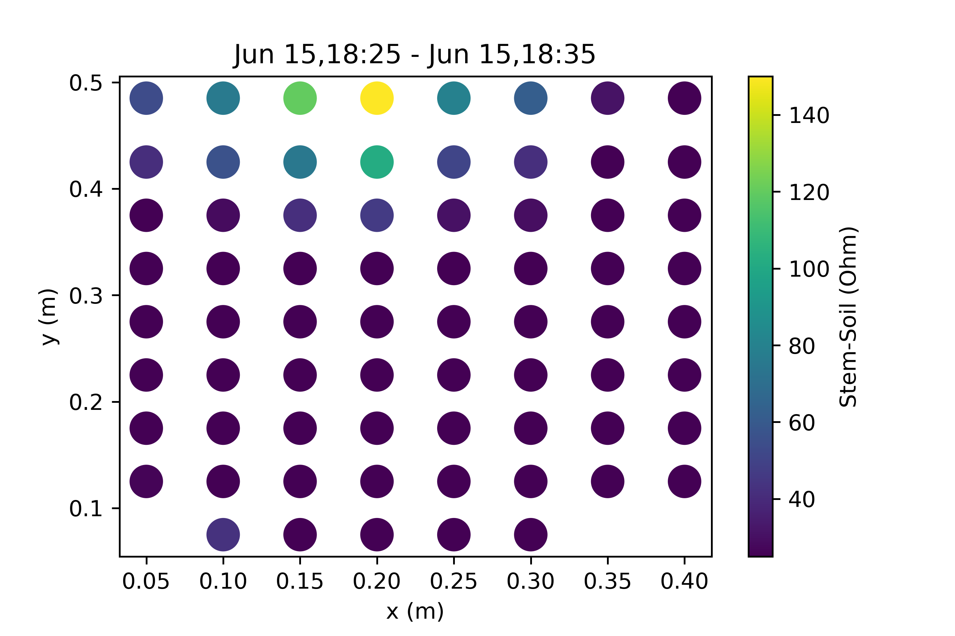
Stem - Soil

Slide 5
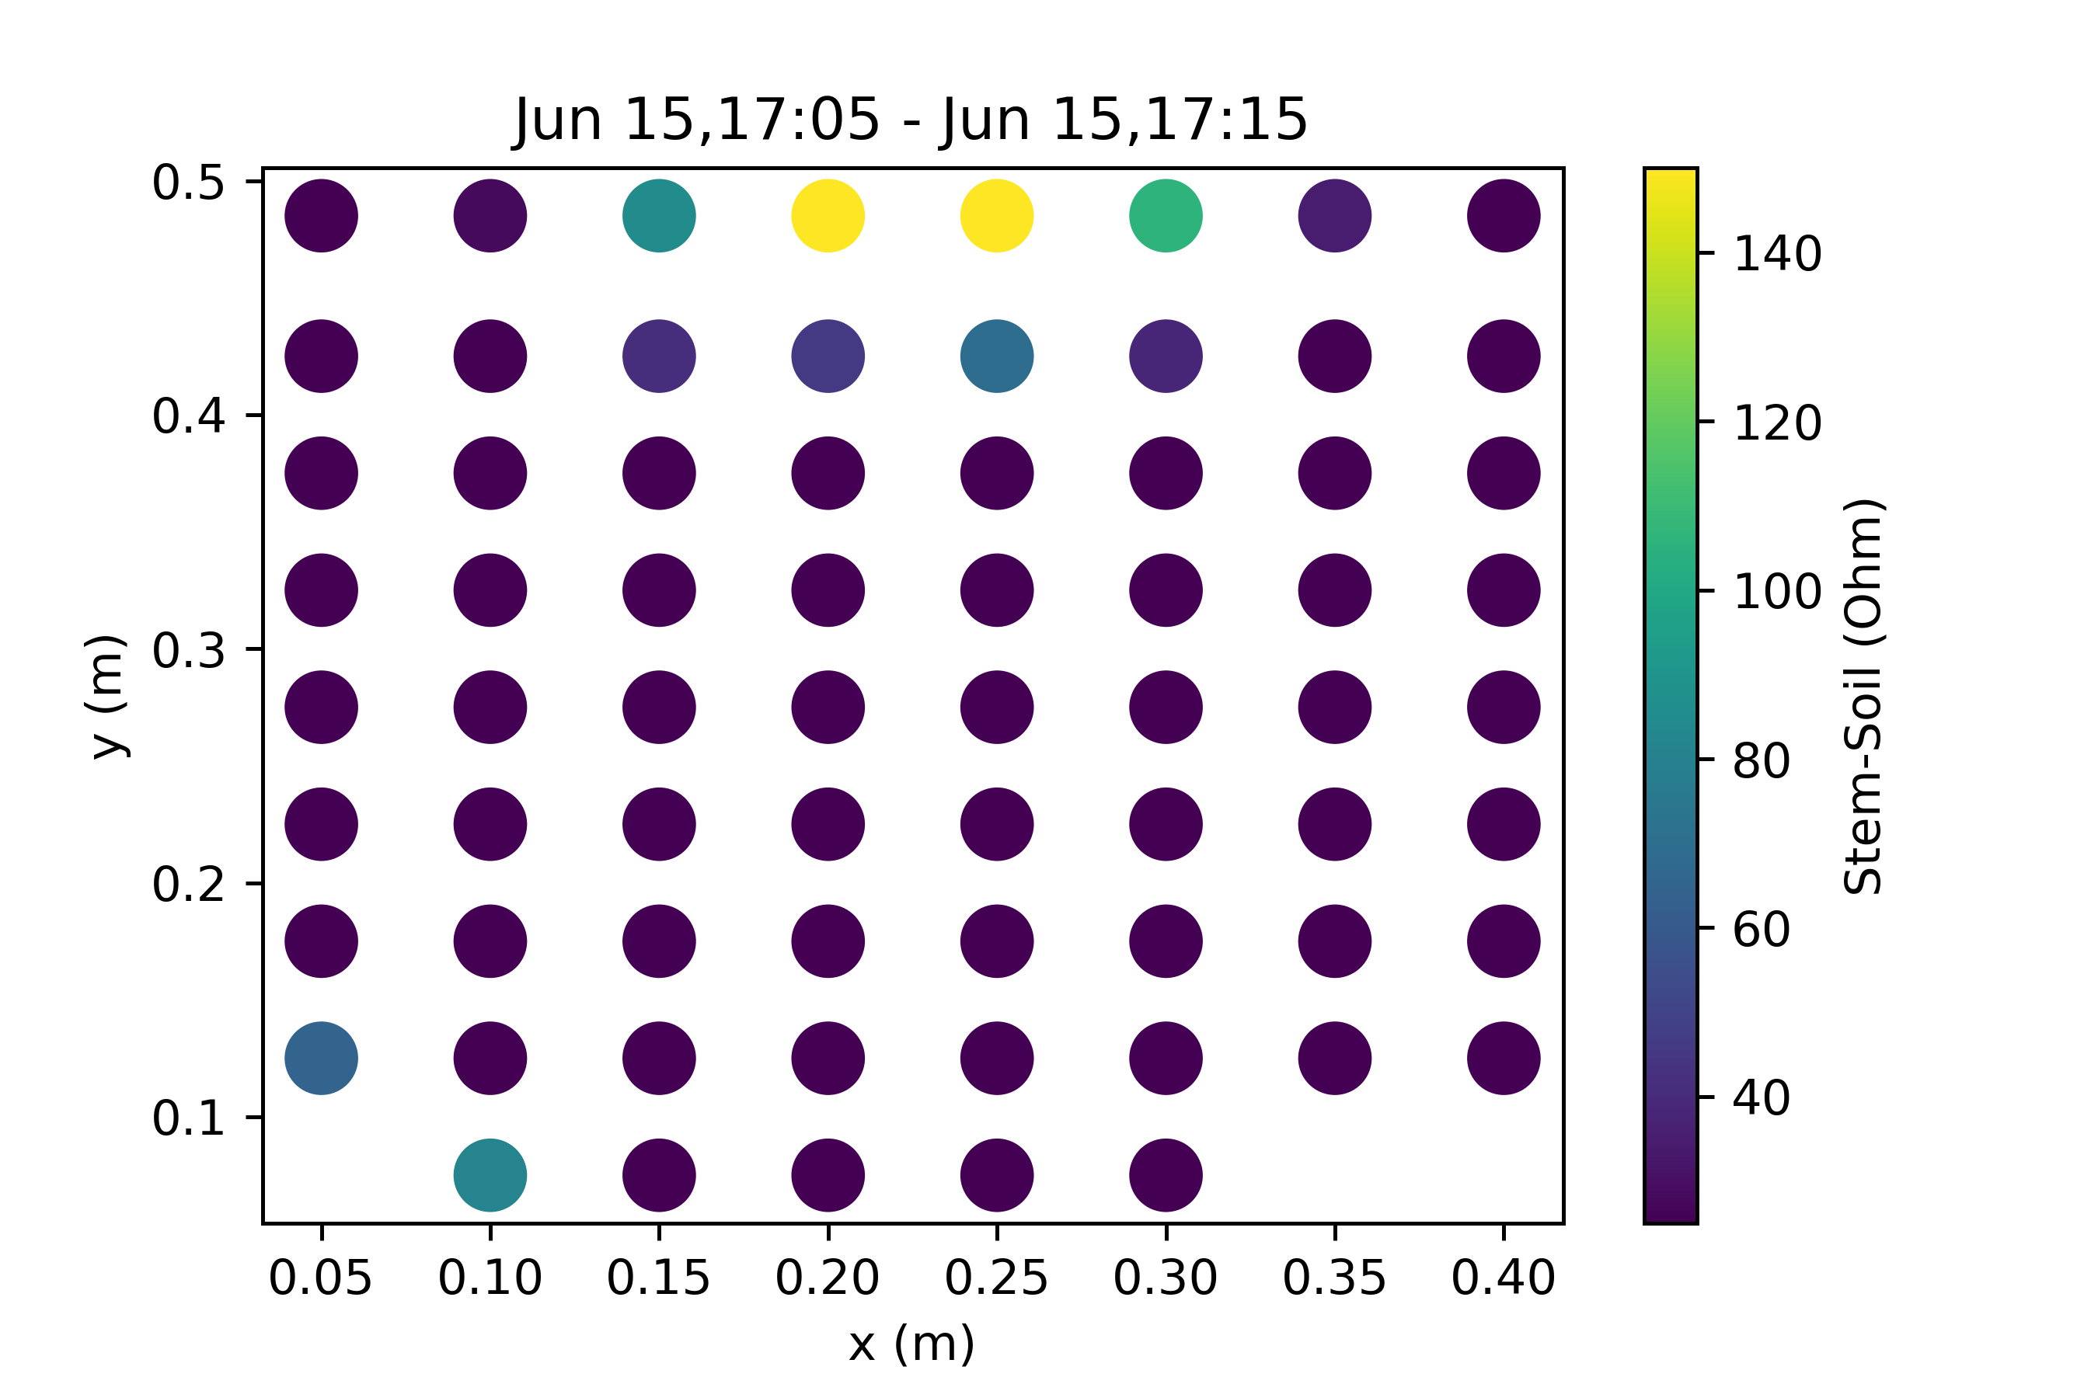
Stem - Soil

Slide 6
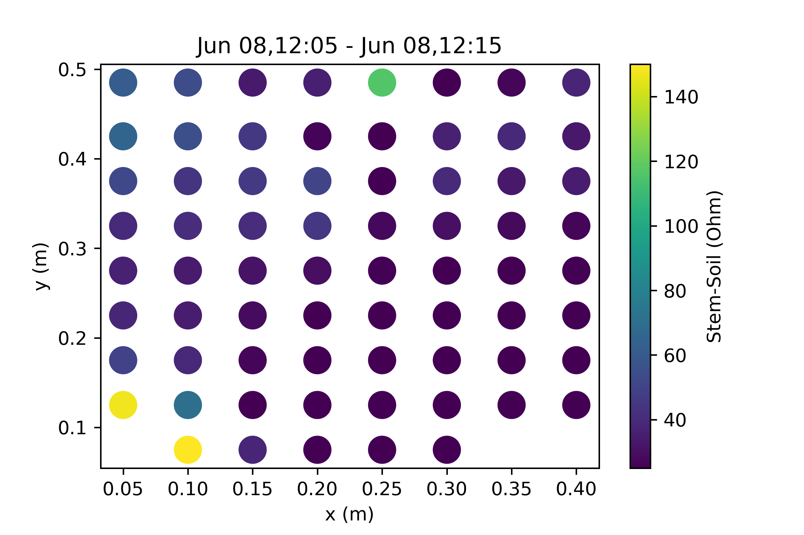
Stem - Soil

Slide 7
Stem - Soil

Slide 8
Stem - Soil

Slide 9

Stem - Soil

Slide 10
Stem - Soil

