Slide 1
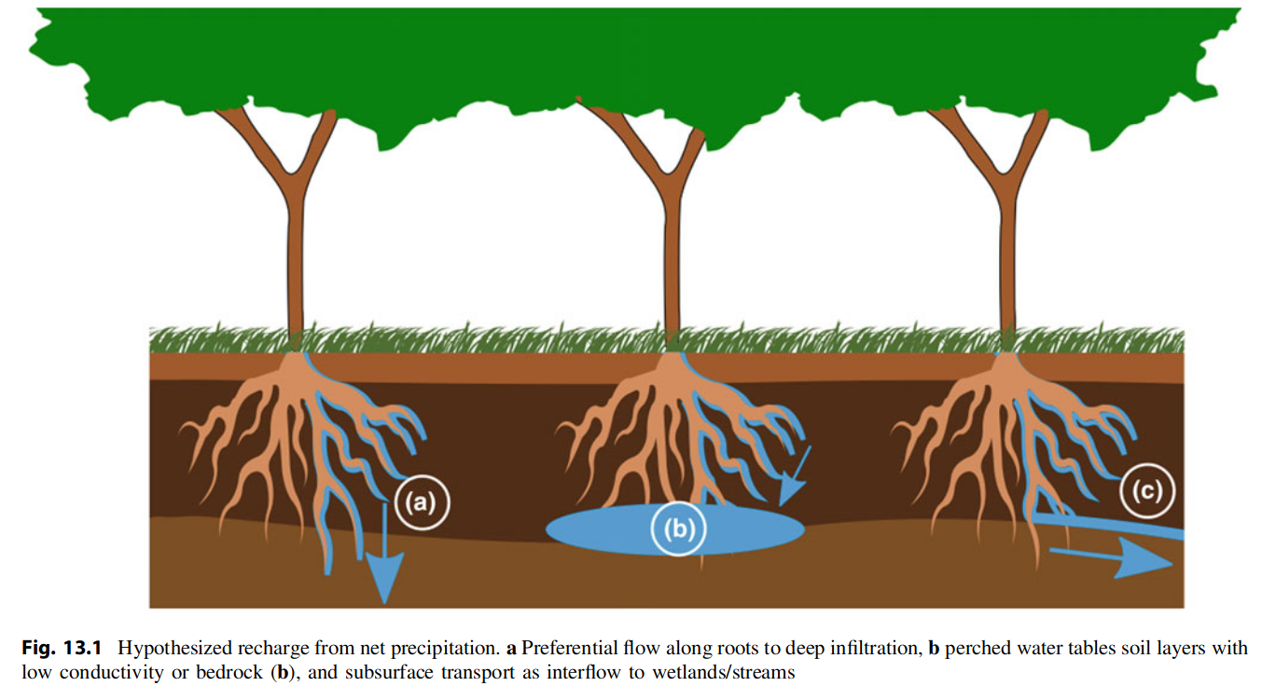

Slide 2

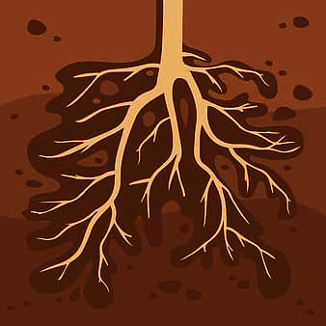
pattern recognition
Geophysical sensors
canopy
Synthetic datasets
Is(t)
Above ground measurements
variable source term in the Richards equation to stemflow
rate s(t), volume v(t)
Ks0
Ks1
Geophysics
Ks2
Surface-Subsurface hydrology model

Slide 3
uncertainties
Intensity
Time
rain event
Atmospheric demand and supply observations
3D tomography sensors
Canopy
ET
Dye event
Is
t
Root Zone Area observations
Ks₀
Ks₁
RWU
Ks₂
Calibration
↓ Uncertainties
Model par. inversion
Prediction
Coupled surface-subsurface hydrology model

Slide 4
values to show the quantification of stemflow, such as the stemflow rate, or the stemflow volume
influence stemflow, such as tree species, canopy structure, stem diameter, stem roughness, and meteorological factors such as precipitation, temperature, and wind speed.

Slide 5
uncertainties
Intensity
Time
3D tomography sensors
rain event
Atmospheric demand and supply observations
Canopy
ET
Dye event
Is(t)
t
Root Zone Area observations
Ks₀
Ks₁
RWU
Ks₂
Calibration
↓ Uncertainties
Model par. inversion
Prediction
Coupled surface-subsurface hydrology model

Slide 6
uncertainties
Intensity
Time
3D tomography sensors
rain event
Atmospheric demand and supply observations
Canopy
ET
Dye event
Is(t)
t
Root Zone Area observations
Ks₀
Ks₁
RWU
Ks₂
Calibration
↓ Uncertainties
Model par. inversion
Prediction
Coupled surface-subsurface hydrology model

