Slide 1
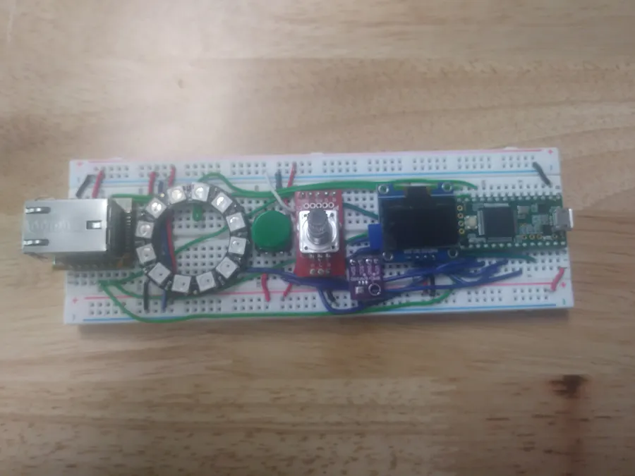
Smart Controller
By
Benjamin Hansen

Slide 2
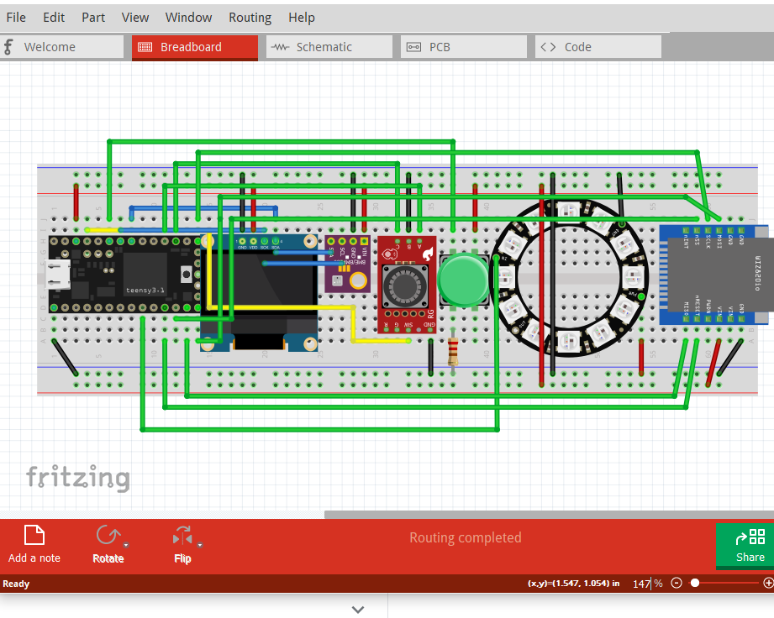
Thoughts Behind the design
Hand held
Imitates common TV remote controllers
Limitations?

Slide 3
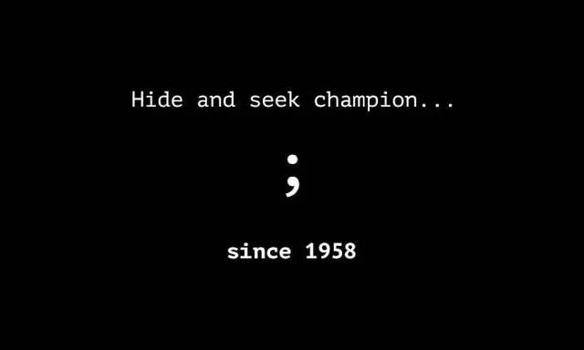
Thinking through the code

Slide 4
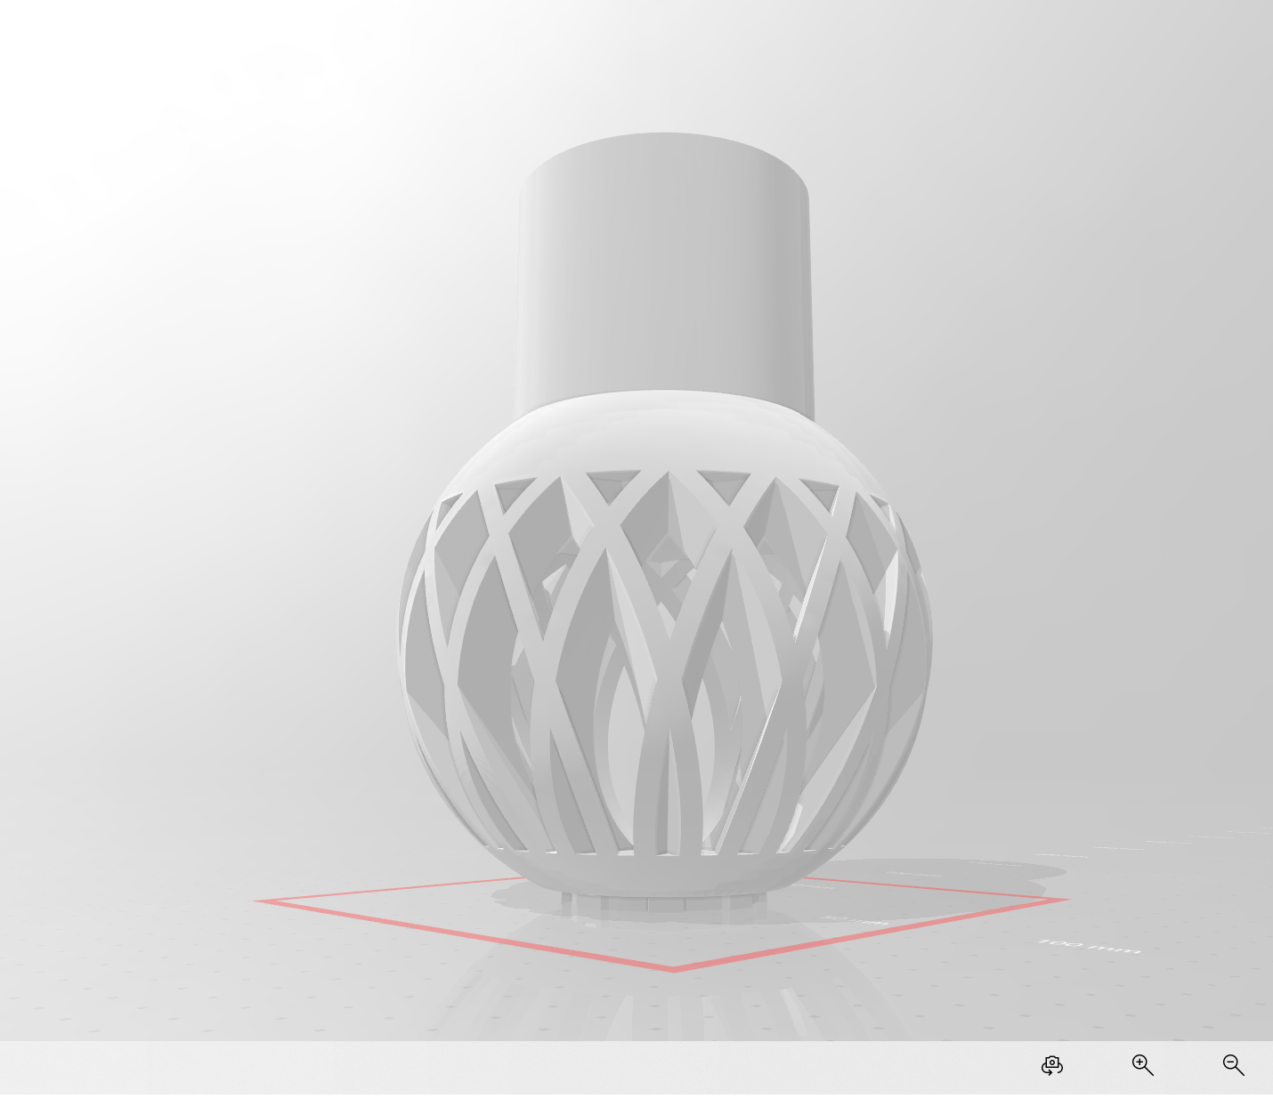
3d printing

