Slide 1
Projects and People
Technical ability and background
Interest
Experience
Responsible
Good communication skills
Responsible
Good Management skills (?)
Notes:
96

Slide 2
Project Communication
Progress affected by
how much communication is necessary
ability of project members to express their ideas
Software failures often result from breakdown in communication and understanding
Notes:
97

Slide 3
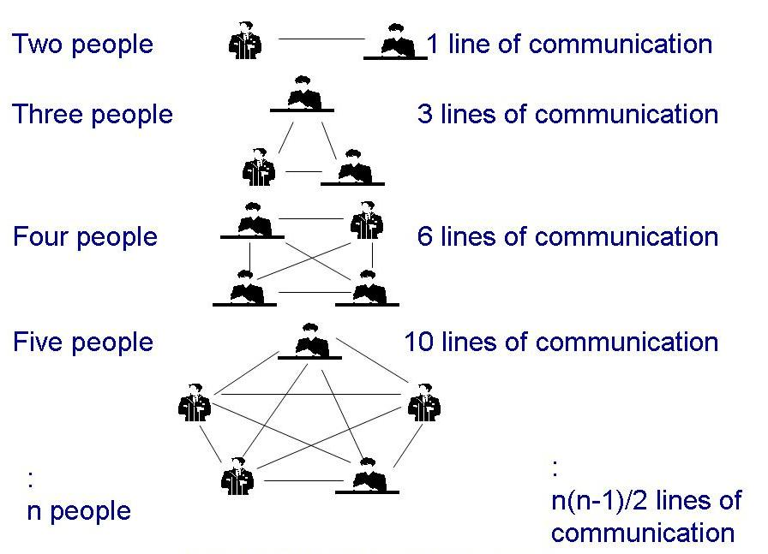
Lines of Communication
If there are n people in project, then there are n(n-1)/2 pairs of communication
Notes:
97

Slide 4
Work Styles
Extroverts: tell their thoughts
Introverts: ask for suggestions
Intuitives: base decisions on feelings
Rationals: base decisions on facts, options
Notes:
99

Slide 5
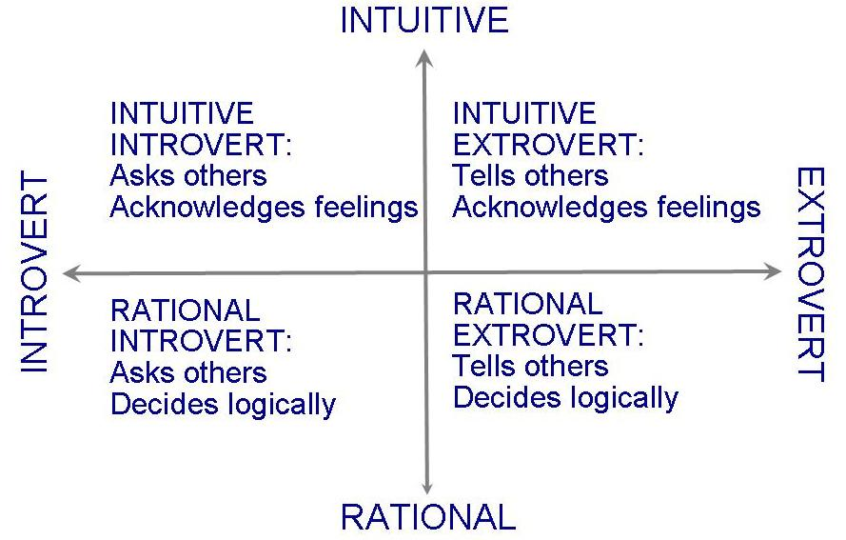
Work Styles (continued)
Horizontal axis: communication styles
Vertical axis: decision styles
Notes:
99

Slide 6
Work Styles Example
Kai (rational extrovert)
Judges colleagues: results
Top priority for decision-making: efficiency
Good at making sound decisions quickly
Only looks at bottom line
Marcel (rational introvert)
Judges colleagues: are they looking busy?
Little tolerance for those who don’t appear to be working hard
Good worker, thorough and accurate: prides himself on reputation
Won’t make decisions without all information
Notes:
100

Slide 7
Work Styles Example
David (intuitive extrovert)
Judges colleagues: trusts his gut
Top priority for decision-making: intuition
Assertive and creative - likes lots of interaction, discussing ideas with colleagues
Likes to be recognized for ideas
Ying (intuitive introvert)
Thrives on colleagues attention, wants to be liked
Sensitive and aware of emotional reactions
Good listener, project members turn to her for understanding,
Takes time to make right decision based on all information as well as relational dependencies/emotional involvement
Notes:
100

Slide 8
Work Styles (continued)
Understanding workstyles
helps you to understand another’s preferred mode of communication
helps you to understand how others make decisions
help you to be flexible in approach to other team members
Impacts interaction among customers, developers and users
Learn to give information based on other's priorities
If you want your team, boss, lead, etc. to understand you, you have to learn to speak their language
Notes:
100 -101 Communication is critical to success!

Slide 9
Work Styles Example
You are responsible for part of project that is behind schedule
Kai and David will tell you when your work MUST be ready
Kai will give you new schedule
David will offer ideas to get back on track
Marcel and Ying will ASK when the results will be ready
Marcel will want to know why it’s not ready
Ying will ask if there is anything she can do to help
Notes:
100

Slide 10
Work Styles Example
Workstyles can help you to understand the priorities of others
You are preparing presentation for Claude, your customer, on project status
Introvert? He will prefer gathering info than just getting it, give him lots of info and let him draw his own conclusions
Extrovert? Include questions to allow him to tell you what he wants or needs
Intuitive? Take advantage of his creativity, get ideas from him
Rational? Include facts and figures NOT judgments or feelings
Notes:
101

Slide 11
Work Styles Example
Workstyles can help you to make more sensible task assignments
Intuitive? May prefer design and developments that require new ideas
Rational? May prefer maintenance programming and other tasks that requires attention to detail and analysis of complex results
Extrovert? May prefer tasks in which they direct others via lots of communication and interaction
Introvert? May prefer tasks in which they gather information from others
Notes:
101

Slide 12
Project Organization
Depends on
backgrounds and work styles of team members
number of people on team
management styles of customers and developers
Examples:
Chief programmer team: one person totally responsible for a system's design and development
Egoless approach: hold everyone equally responsible
Notes:
101

Slide 13
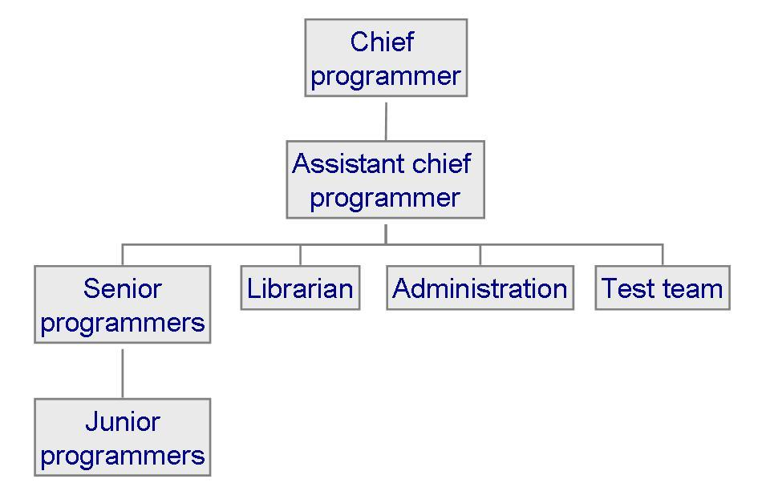
Project Organization: Chief Programmer Team
Each team member must communicate often with chief, but not necessarily with other team members
Notes:
101-102

Slide 14
Another Way of Looking at Project Organization
Democratic Decentralized
No permanent leader
Task coordinators for short duration
Group consensus
Controlled Decentralized
Defined leader/coordinator
Problem solving a group effort
Implementation by subgroups per leader
Controlled Centralized
Top level problem solving/team coordination by team leader
Notes:
Democratic teams tend to come up with more & better solutions, team morale higher, job satisfaction, but require more time
Performance is inverse relationship to communication: large projects best with controlled, highly modular best w/controlled (need proper interfacing), CD and CC have fewer defects

Slide 15
Project Organization (continued)
Characteristics of projects and the suggested organizational structure to address them
Notes:
102-103 in general, more people, more structure is needed
NSF (1983) investigation:
Projects that have high certainty, stability, uniformity, repetition - require < communication, suited to organization that stresses rules, specialization, formality, clear hierarchy
More uncertainty (requirements constantly changing, new tech) more democratic approach, loose hierarchy, open communication

Slide 16
Structure vs. Creativity
Experiment by Sally Phillip examining two groups building a hotel
structured team: clearly defined responsibilities
unstructured team: no directions
The results are always the same
Structured teams finish a functional Days Inn
Unstructured teams build a creative, multistoried Taj Mahal and never complete
Good project management means finding a balance between structure and creativity
Notes:
103

