Slide 1
Intelligent Agents
By
Phil Bording

Slide 2
Information requires Agents – Blob World
Intelligence comes from the ideas of actions based on data.
Sensors looking out
SEE ???
Logic
Actions

Slide 3
Agents interact with the sensor environment
Agents have inputs from sensors
Actions are decided and taken
Sensors looking out
Agents
Event loop over data input
Actions to be taken

Slide 4
Event Actions by Independent Agents in Blob World
Sensor
Input
Agent observing
Sensor
Actor
Action
Sensor
Input
Agent observing
Sensor
Actor
Action
Sensor
Input
Agent observing
Sensor
Actor
Action

Slide 5
Event Actions by Dependent Agents in Blob World
Sensor
Input
Agent observing
Sensor
Actor
Action
Agent interactions
In Cooperation
With
Each other
Sensor
Input
Agent observing
Sensor
Actor
Action
Sensor
Input
Agent observing
Sensor
Actor
Action

Slide 6
Does Blob World have Intelligent Agents?
Sensors looking out
Independent and Dependent
Logic
Actions
Actions by Blob

Slide 7
Agent Interactions
Assumptions about agents
Perform input analysis
Generate logical state transitions
Some logical states can perform external actions
Input and Output States have domains……. Environments of existance

Slide 8
Input – Output Domain Interactions
Agent Sensors Perceptions
Environment
Actuators Actions -Tasks
Agent actions
??????

Slide 9
Zumba World – Vacuum-Cleaner-World
Percept Sequence Actions
Area A, Clean Move to B
Area A, Dirty Clean A
Area B, Clean Move to A
Area B, Dirty Clean B
A B
Vac

Slide 10
Zumba World – Vacuum-Cleaner-World
Percept Sequence Actions
Area A, Clean Move to B
Area A, Dirty Clean A
Area B, Clean Move to A
Area B, Dirty Clean B
A B
Vac

Slide 11
Zumba World – Vacuum-Cleaner-World
Percept Sequence Actions
Area A, Clean Move to B
Area A, Dirty Clean A
Area B, Clean Move to A
Area B, Dirty Clean B
A B
Vac

Slide 12
Zumba World – Vacuum-Cleaner-World
Percept Sequence Actions
Area A, Clean Move to B
Area A, Dirty Clean A
Area B, Clean Move to A
Area B, Dirty Clean B
A B
Vac

Slide 13
Zumba World – Vacuum-Cleaner-World
Percept Sequence Actions
Area A, Clean Move to B
Area A, Dirty Clean A
Area B, Clean Move to A
Area B, Dirty Clean B
A B
Vac

Slide 14
Zumba World – Vacuum-Cleaner-World
Percept Sequence Actions
Area A, Clean Move to B
Area A, Dirty Clean A
Area B, Clean Move to A
Area B, Dirty Clean B
A B
Vac

Slide 15
Zumba World – Vacuum-Cleaner-World
Percept Sequence Actions
Area A, Clean Move to B
Area A, Dirty Clean A
Area B, Clean Move to A
Area B, Dirty Clean B
A B
Vac

Slide 16
Rational Agent Definitions
For each possible percept sequence, a rational agent should select an action that is expected to maximize its performance measure, given the evidence provided by the precept sequence and what ever built-in knowledge the agent has. (Russell and Norvig).

Slide 17
Zumba World – Vacuum-Cleaner-World
Percept Sequence Actions
Area A, Clean Move to B, if B clean wait?
Area A, Dirty Clean A
Area B, Clean Move to A
Area B, Dirty Clean B
A B
Vac

Slide 18
Input – Output Domain Interactions
Agent Sensors Perceptions
Environment
Actuators Actions -Tasks
Agent actions
??????

Slide 19
Rationality
Performance Measures that define success
Prior Knowledge of environment
Actions which can be performed from this state
Sensor input to agents to date – history….
Irrational Actions are not acted on – further the vast number of unaccounted for actions can have dire consequences…
“ crossing the street and hit by a cargo door from a plane at 33,000ft.”

Slide 20
Task Environment - PEAS
Performance
Environment
Actuators
Sensors
Agent Type | Performance Measure | Environment | Actuators | Sensors
Taxi Driver Automated | Safe Fast Legal Comfortable Profitable | Roads Parking Traffic Pedestrians Customers | Steering Brakes Accelerator Horn Turn signals Human displays | Cameras Radar Sonar GPS Engine inputs Manual controls External Knowledge

Slide 21
Blob World – What is missing? It has to have an environment!!!
Sensors looking out
SEE ???
Logic
Actions

Slide 22
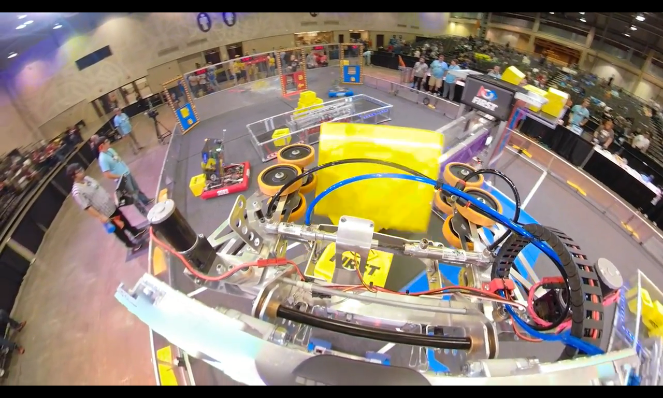
First Robotics – Huntsville, Alabama 2018
https://youtube/QNZHG5yFwJQ

Slide 23
Task Environments - Examples
Task Env. | Observable | Agents | Deterministic | Episodic | Static | Discrete
Crossword Puzzle Chess with a clock | Fully Fully | Single Multi
Poker Backgammon | Partially Fully
Taxi Driving Medical Diagnosis | Partially Partially
Image Analysis Part Picking robot | Partially Fully
Refinery Controller Interactive English Tutor | Partially Partially

Slide 24
Discussion

