Slide 1
מצגת עיבוד אותות
Benjamin Menashe

Slide 2
חלק א' – תזכורת ומבוא
בונים מודלי רגרסיה ליניארית מההתחלה

Slide 3
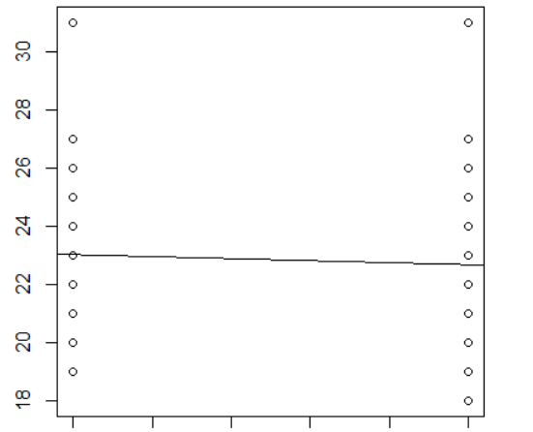
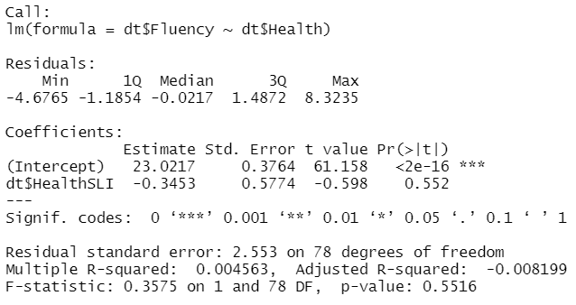

Instead of independent 2-sample t-test
$$\hat{Y}=B_{0}+B_{1}X+e$$
X = 0 if healthy 1 if SLI
Fluency
Healthy 0
SLI 1

Slide 4
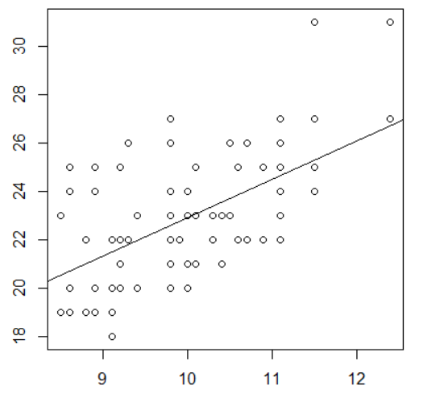
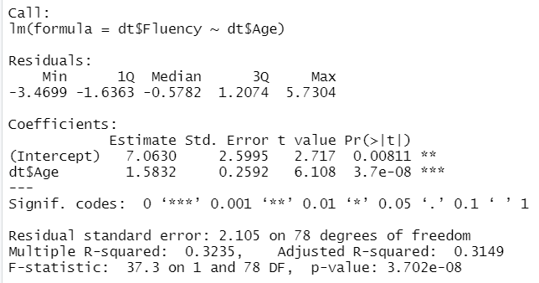

Instead of Pearson correlation test
$$\hat{Y}=B_{0}{+B}_{1}X+e$$
X = age
Fluency
Age

Slide 5
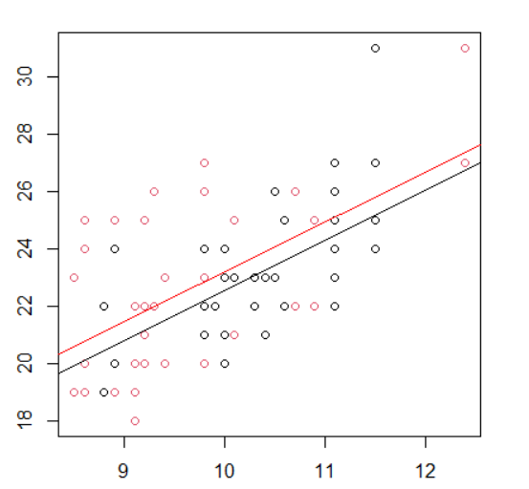
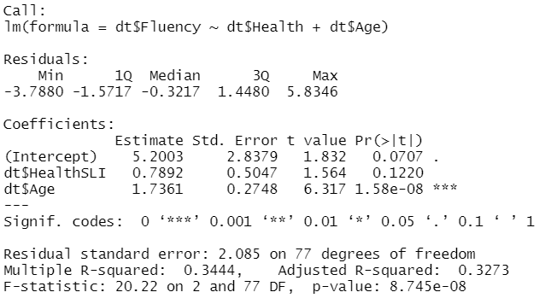

Instead of ANCOVA
SLI Healthy
$$\hat{Y}=B_{0}{+ B}_{1}X_{1}{+ B}_{2}X_{2}+e$$
X1 = 0 if Healthy 1 if SLI
X2 = age
Fluency
Age

Slide 6
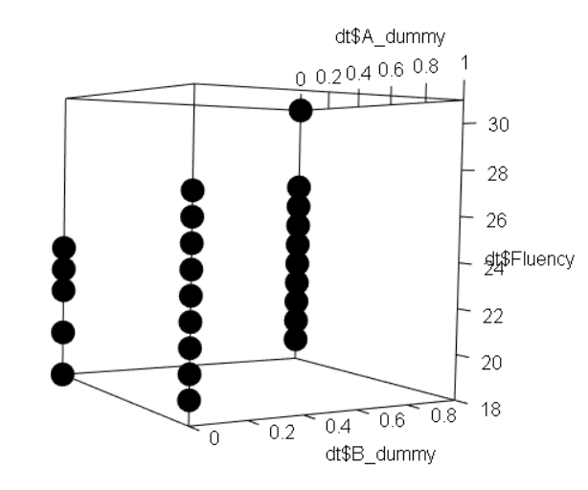
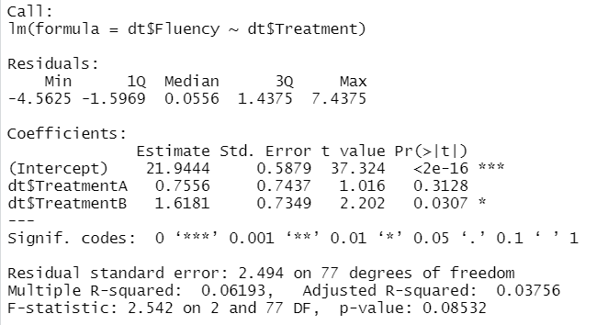
Instead of one-way ANOVA (Dummy Variables)
$$\hat{Y}=B_{0}{+ B}_{1}X_{1}{+ B}_{2}X_{2}+e$$
X1 = 1 if A 0 else
X2 = 1 if B 0 else
A
Fluency
Con
B
x2
x1

Slide 7
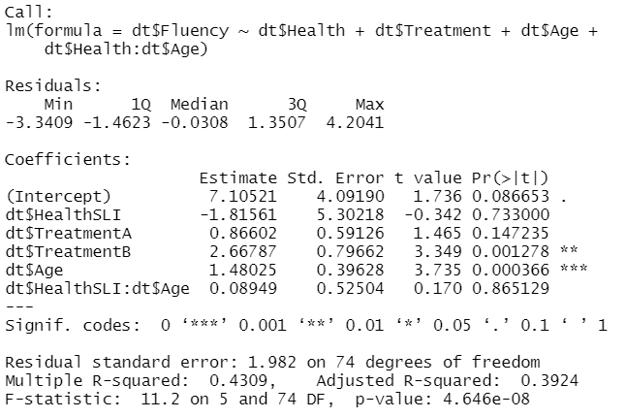
Let’s go wild!
All together and adding an interaction effect of age*health
$$\hat{Y}=B_{0}{+ B}_{1}X_{1}{+ B}_{2}X_{2}{+ B}_{3}X_{3}{+ B}_{4}X_{4}{+ B}_{5}X_{1}X_{4}+e$$
X1 = 0 if Healthy 1 if SLI
X2 = 1 if A 0 else
X3 = 1 if B 0 else
X4 = age

Slide 8
חלק ב' – הנחות המודל
מתי מותר בכלל לעשות מודלי רגרסיה?

Slide 9
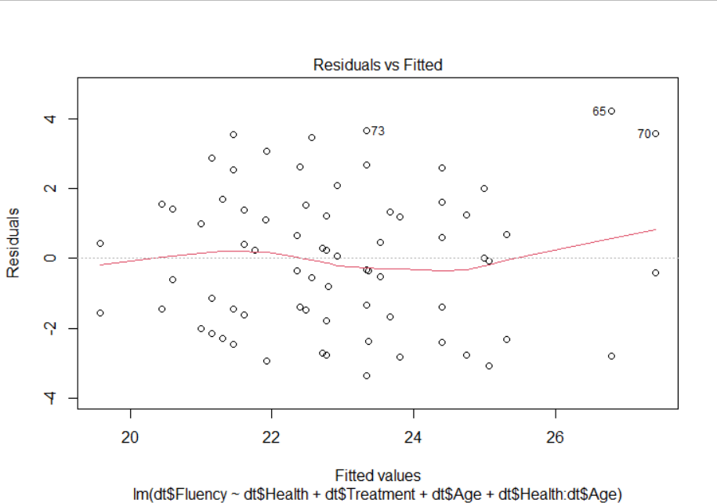
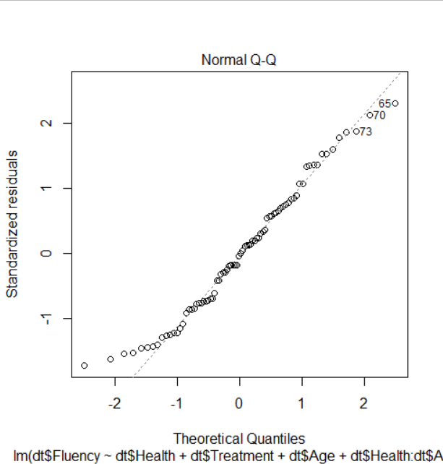
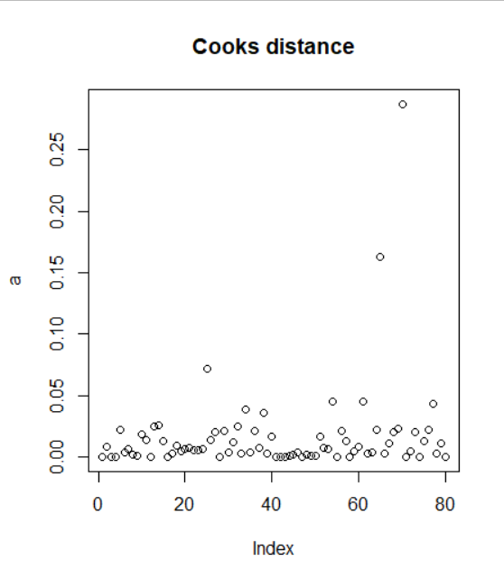
Model assumptions:
Independence between y’s (know the experiment design)
Equal variance of y for each x (equal variances in each group)
Linearity relations between x and y (if possible, plot the data)
Normality of y for each x (errors are ~ normal)

Slide 10
חלק ג' – Linear Mixed-Effects Models
מה קורה כאשר יש לנו תלות בדאטה...

Slide 11
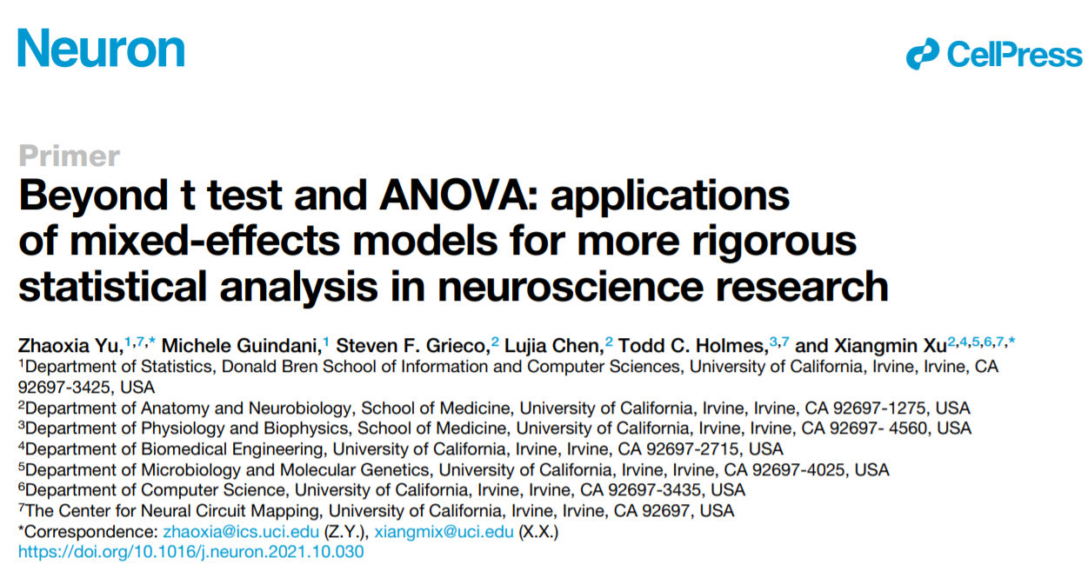

Slide 12
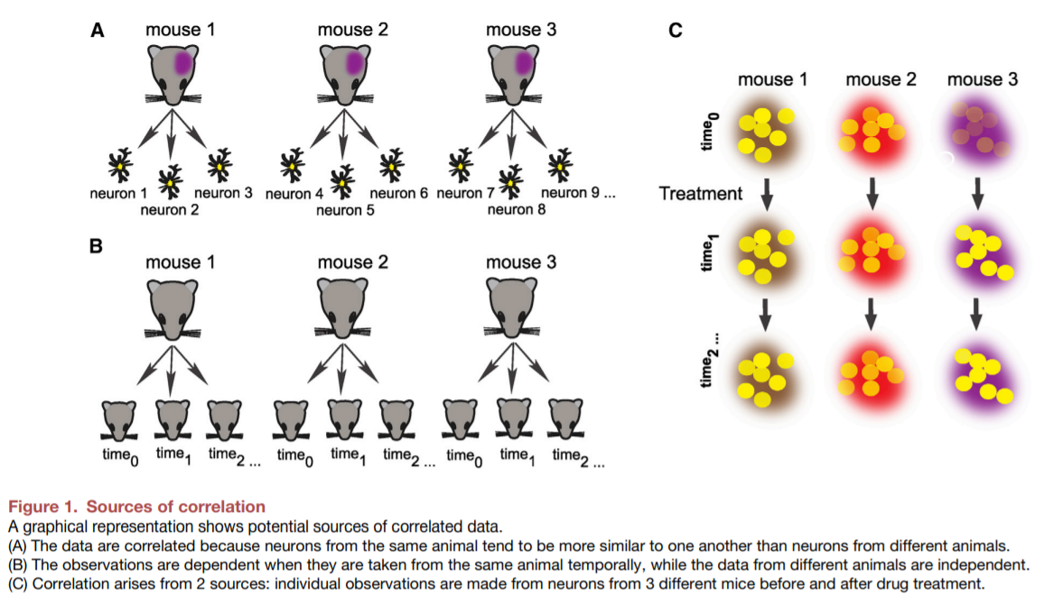
דוגמאות להפרת אי-תלות:

Slide 13
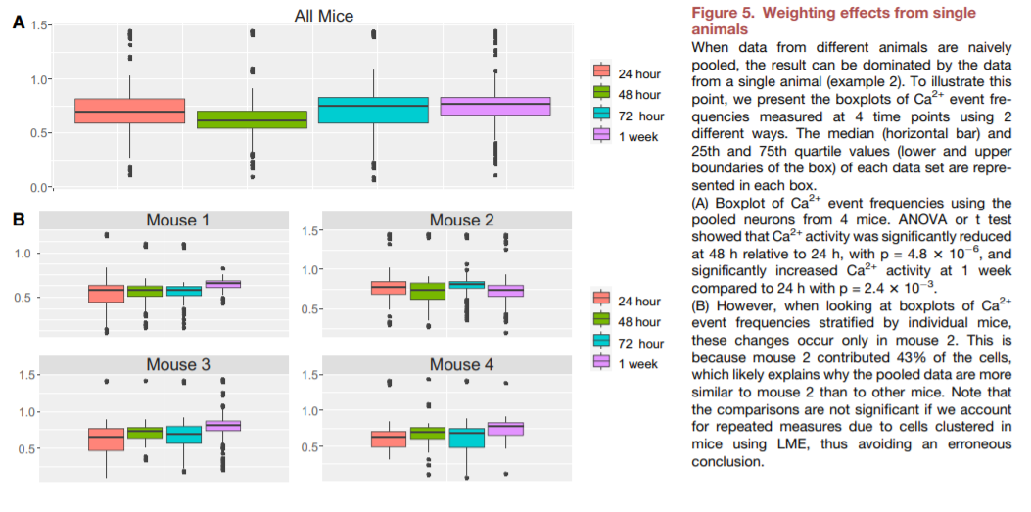
דוגמא להסקה שגויה בגלל תלות:

Slide 14
ICC, D_{eff}, and N_{eff}
Example: study if ketamine affects neuronal activity
Control group = 357 neurons from 7 mice
What’s the n?
ICC – degree to which measurements from the same group are correlated
D_{eff} – magnitude of clustering
N_{eff} – effective sample size
ICC = variance between groups / total variance
D_{eff} = 1 + (M-1)ICC M average cluster size
N_{eff} = n / D_{eff}
In our example, ICC = 0.61
In our example, M = 51, D_{eff} = 32
(32 neurons equivalent to 1 uncorrelated neuron)
In our example, N_{eff} = 11

Slide 15
Fixed Effects Vs. Random Effects
Fixed
Random
captures a parameter at the population level
should be a constant across subjects/clusters
direct scientific interest
not expected to change across subjects
cluster-specific effects
only relevant for capturing the dependence among observations
typically of no direct relevance for assessing scientific hypotheses

Slide 16
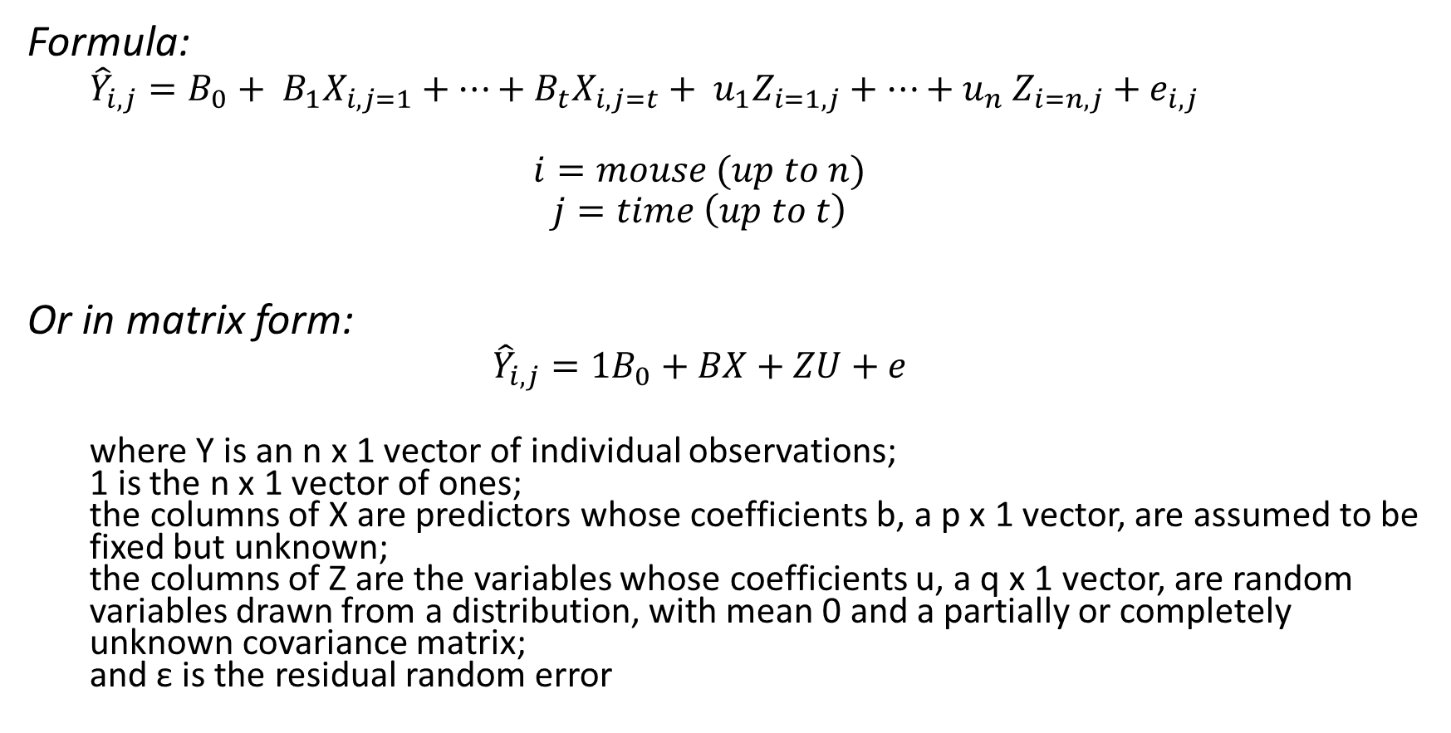
Putting it all together…
Formula:
${\hat{Y}}_{i,j}=B_{0}+ B_{1}X_{i,j=1}+…+$ $B_{t}X_{i,j=t}+ u_{1}Z_{i=1,j}+…{+ u}_{n}Z_{i=n,j}+e_{i,j}$
$$i=mouse (up to n)$$
$$j=time \left(up to t\right)$$
Or in matrix form:
$${\hat{Y}}_{i,j}={1B}_{0}+BX+ZU+e$$
where Y is an n x 1 vector of individual observations; 1 is the n x 1 vector of ones; the columns of X are predictors whose coefficients b, a p x 1 vector, are assumed to be fixed but unknown; the columns of Z are the variables whose coefficients u, a q x 1 vector, are random variables drawn from a distribution, with mean 0 and a partially or completely unknown covariance matrix; and ε is the residual random error

Slide 17
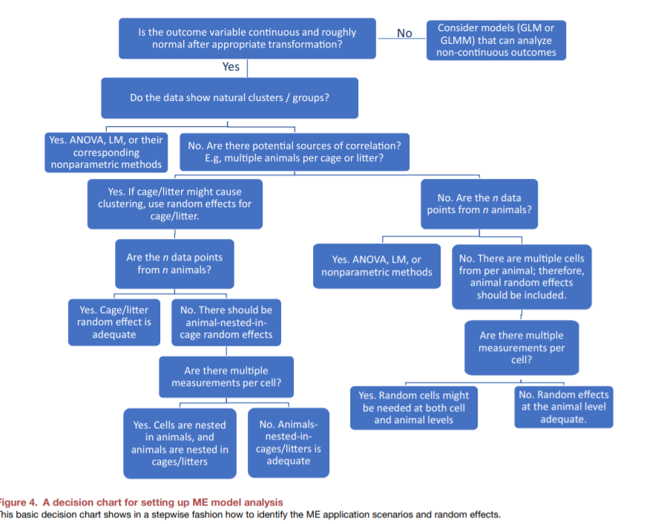

Slide 18
עוד נקודות שאפשר לקרוא במאמר
יש דוגמאות!
חשיבות של להסתכל על הדאטה
Generalized mixed-models
סטטיסטיקה בייסיאנית
פונקציות בתוכנת R-Studio

