Slide 1
DATA 301 Introduction to Data Analytics Python
Dr. Firas Moosvi
University of British Columbia Okanagan
Slides courtesy of Dr. Ramon Lawrence

Slide 2
Why learn Python?
Python is increasingly the most popular choice of programming language for data analysts because it is designed to be simple, efficient, and easy to read and write.
There are many open source software and libraries that use Python and data analysis tools built on them.
We will use Python to learn programming and explore fundamental programming concepts of commands, variables, decisions, repetition, and events.

Slide 3
What is Python?
Python is a general, high-level programming language designed for code readability and simplicity.
Python is available for free as open source and has a large community supporting its development and associated tools.
Python was developed by Guido van Rossum and first released in 1991. Python 2.0 was released in 2000 (latest version 2.7), and a backwards-incompatible release Python 3 was in 2008.
Our coding style will be Python 3 but most code will also work for Python 2.
Name does refer to Monty Python.
Notes:
Reference: https://en.wikipedia.org/wiki/Python_(programming_language)

Slide 4
Python Language Characteristics
Python supports:
dynamic typing – types can change at run-time
multi-paradigm – supports procedural, object-oriented, functional styles
auto-memory management and garbage collection
extendable – small core language that is easily extendable
Python core philosophies (by Tim Peters: https://www.python.org/dev/peps/pep-0020/)
Beautiful is better than ugly
Explicit is better than implicit
Simple is better than complex
Complex is better than complicated
Readability counts
Notes:
An important feature of Python is dynamic name resolution (late binding), which binds method and variable names during program execution. Source: Wikipedia
Full link to Python core philosophy: https://www.python.org/dev/peps/pep-0020/

Slide 5
Some Quotes
"If you can't write it down in English, you can't code it." -- Peter Halpern "If you lie to the computer, it will get you." -- Peter Farrar

Slide 6
Introduction to Programming
An algorithm is a precise sequence of steps to produce a result. A program is an encoding of an algorithm in a language to solve a particular problem.
There are numerous languages that programmers can use to specify instructions. Each language has its different features, benefits, and usefulness.
The goal is to understand fundamental programming concepts that apply to all languages.

Slide 7
Python: Basic Rules
To program in Python you must follow a set of rules for specifying your commands. This set of rules is called a syntax.
Just like any other language, there are rules that you must follow if you are to communicate correctly and precisely.
Important general rules of Python syntax:
Python is case-sensitive.
Python is particular on whitespace and indentation.
The end of command is the end of line. Semi-colon is not a required terminator.
Use four spaces for indentation whenever in a block.
def spam():
eggs = 12
return eggs
print spam()
Notes:
Line continuation character is backslash \
Note: Python does not like mixing tabs and spaces.
Semi-colon does exist as way to separate statements on one line but it is not commonly used. Example: x = 3 ; y = 24

Slide 8
Comments
Comments are used by the programmer to document and explain the code. Comments are ignored by the computer. Two types:
1) One line comment: put “#” before the comment and any characters to the end of line are ignored by the computer.
2) Multiple line comment: put “"""” at the start of the comment and “"""” at the end of the comment. The computer ignores everything between the start and end comment indicators.
Example:
# Single line comment
print (1) # Comment at end of line
""" This is a
multiple line
comment """
Notes:
Note: """ is not typical syntax for a multiline comment. It is a multi-line string that if on a statement by itself will be ignored by execution system. Note that it is not a dedicated multi-line comment syntax like /* */ in Java.
The triple quote 'comment' """ is often referred to as the docstring syntax. If the first line in a function or class is one of these, python will automatically interpret it as documentation (and will be shown if you call help() on the function or class).

Slide 9
Python Programming
A Python program, like a book, is read left to right and top to bottom.
Each command is on its own line.
A user types in a Python program in a text editor or development environment and then runs the program.
Flow of Execution
Start at first statement at top and proceed down executing each statement
# Sample Python program
name = "Joe"
print("Hello")
print("Name: "+name)

Slide 10
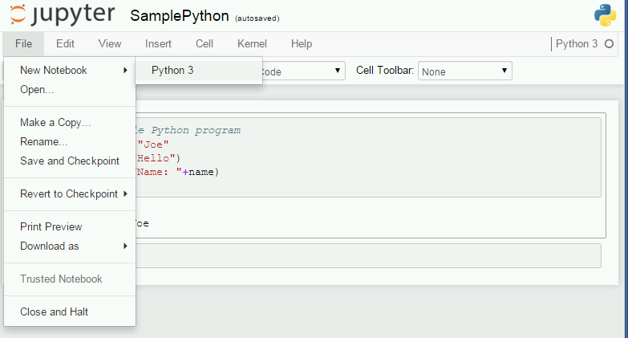
Python Editor - jupyter
jupyter is a graphical, browser-based editor for Python.
To create a new notebook, select File, New Notebook, Python3.

Slide 11
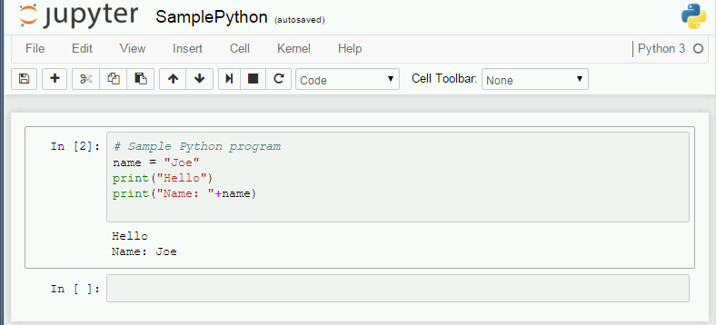
Python Editor – jupyter notebook
Button to run code (shortcut is Ctrl+Enter)
Python code
Program output
Notes:
Shortcut key to run: Ctrl+Enter

Slide 12
Python: Hello World!
Simplest program:
print("Hello World!")
The print function will print to the terminal (standard output) whatever data (number, string, variable) it is given.

Slide 13
Try it: Python Printing
Question 1: Write a Python program that prints "I am fantastic!".
Question 2: Write a Python program that prints these three lines:
I know that I can program in Python.
I am programming right now.
My awesome program has three lines!
Notes:
print("I am fantastic!")
print("I know that I can program in Python.")
print("I am programming right now. ")
print("My awesome program has three lines!")

Slide 14
Python Question
Question: How many of the following statements are TRUE?
1) Python is case-sensitive.
2) A command in Python must be terminated by a semi-colon.
3) Indentation does not matter in Python.
4) A single line comment starts with """.
5) The print command prints to standard input.
A) 0 B) 1 C) 2 D) 3 E) 4
Notes:
Answer: B
True: #1

Slide 15
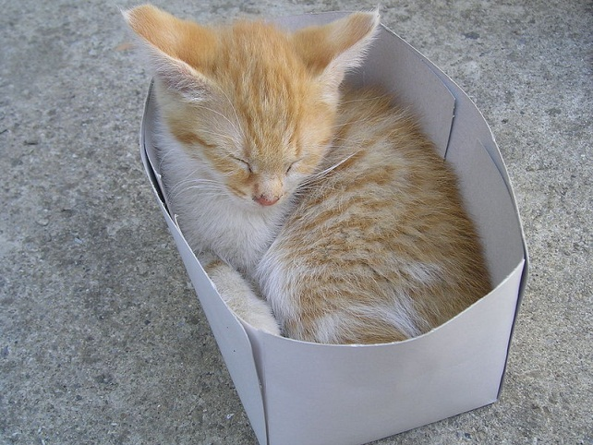
Variables
A variable is a name that refers to a location that stores a data value.
IMPORTANT: The value at a location can change using initialization or assignment.
Variable
Value (cute cat)
Location
Age
18
Value
Location
(box)
Variable
(label)
petbox
Notes:
Variable is box that stores a value.

Slide 16
Variable Assignment
Assignment using an = sets the value of a variable.
Example:
num = 10
message = "Hello world!"
num
10
message
Hello world!

Slide 17
Python Variables
To create a variable in Python, you must only provide a name.
A variable type is dynamic. It can store numbers, strings, or Boolean at any time.
Example:
val = 5
val = "Hello"
Boolean values can be either True or False. Note case matters.
isAwesome = True
isAwesome = False

