Slide 1

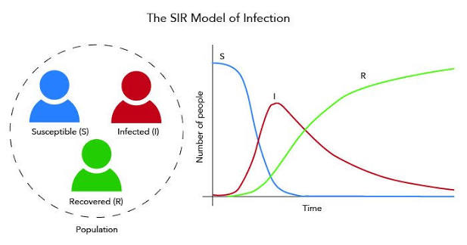
10_Modeling of infectious diseases
Lecture
Robert Heyer
27.05.2026

Slide 2
Epidemiology
Epidemiology Introduction
Compartment Models
Co
Lin
Epidemiology is a scientific discipline that studies the distribution, patterns, and determinants of infectious diseases in deﬁned populations.
It is a cornerstone of public health, and shapes policy decisions and evidence-based practice by identifying risk factors for disease and targets for preventive healthcare.
The mathematical modeling of an epidemic allows to describe the spread of an infectious disease and predicts its evolution
<number>

Slide 3
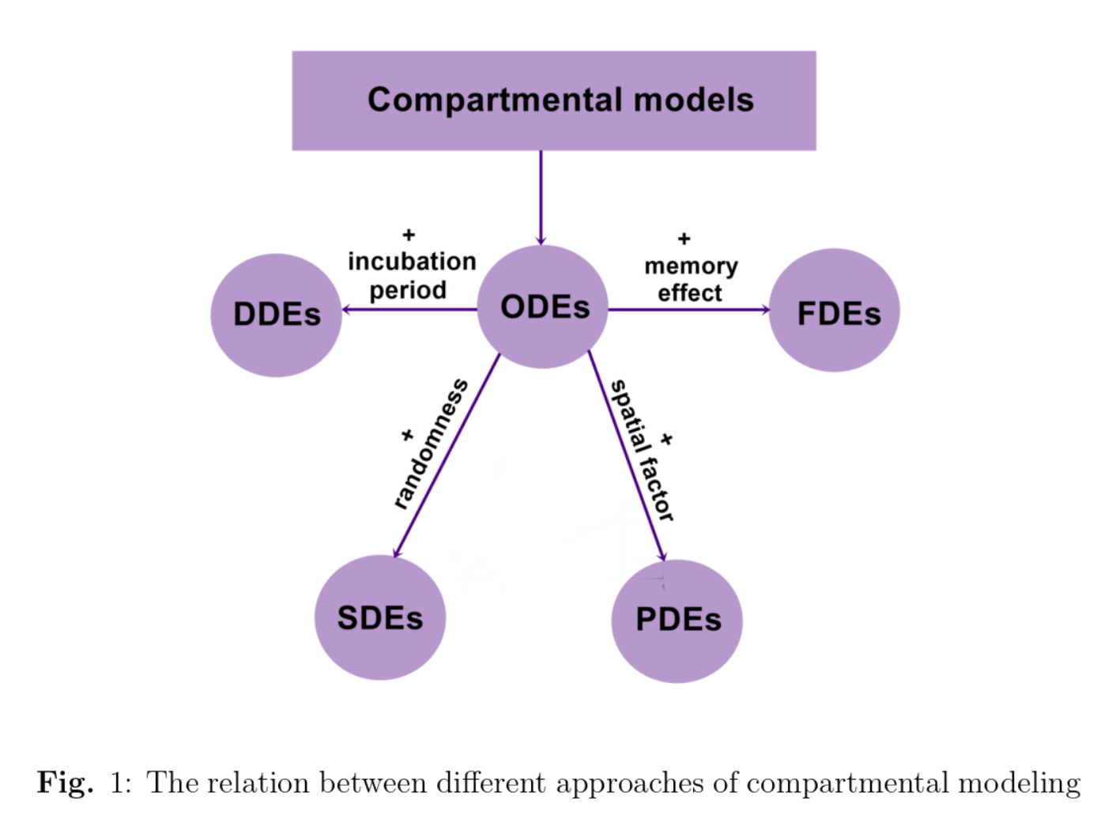
Idea Metabolic modeling
Epidemiology
Flux modes and minimal cut sets
Community models
Linkage of proteomics data
DDE:
ODE:
FDE
SDE:
PDE
0<number>

Slide 4
The foundation: compartmental models

Slide 5
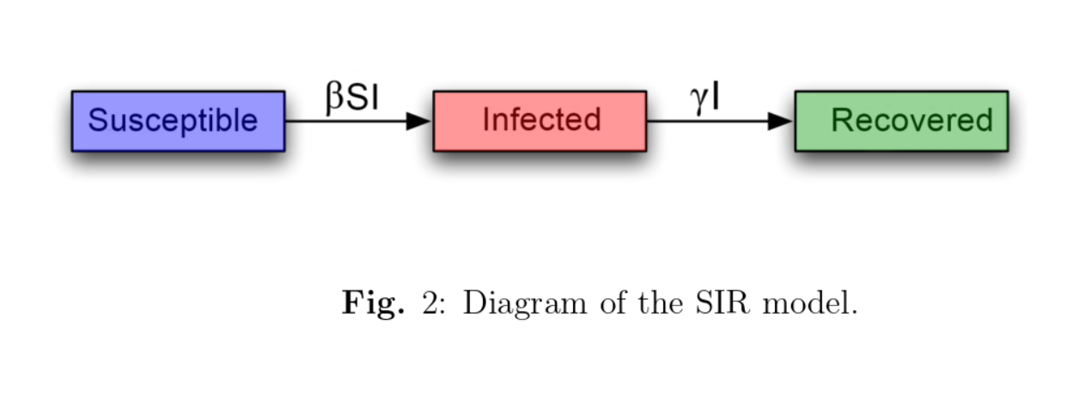
COMPARTMENTAL MODELS
Flux balance analysis
Flux modes and minimal cut sets
Community models
Linkage of proteomics data
Compartmental model use a set of differential equations t describe an epidemic
<number>

Slide 6
COMPARTMENTAL MODELS
Flux balance analysis
Flux modes and minimal cut sets
Community models
Linkage of proteomics data
Variables
S(t) : the class of those individuals who are capable of contracting the disease and becoming infected.
I(t) : the class of infected individuals, those who capable of transmitting the disease to others.
R(t) : the class of those individuals who have had the disease and are dead, or have recovered and are permanently immune or are isolated.
Parameters
β > 0 : the infection/transmission rate.
γ > 0 : the recovery/removal rate.
Limitations:
Vital dynamics (natural birth/death rate).
Assumption of all infected being infectious.
Does not consider incubation periods.
<number>

Slide 7
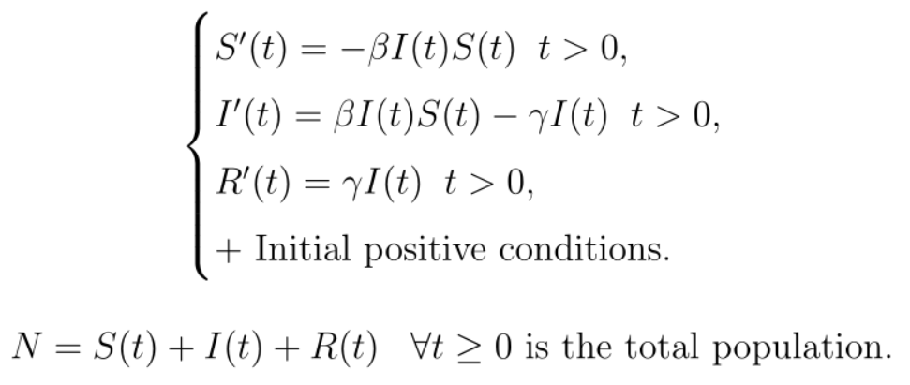
COMPARTMENTAL MODELS
Flux balance analysis
Flux modes and minimal cut sets
Community models
Linkage of proteomics data
<number>

Slide 8
COMPARTMENTAL MODELS
Flux balance analysis
Flux modes and minimal cut sets
Community models
Linkage of proteomics data
Extensions of SIR models
Usually made by considering more clinical states than just S(t), I(t), and R(t)
Examples of further compartments are: the vaccinated (V), the deceased (D), the asymptomatic (A), the hospitalized (H), the quarantined (Q)
Introducing new parameters: natural mortality rate µ > 0.
<number>

Slide 9
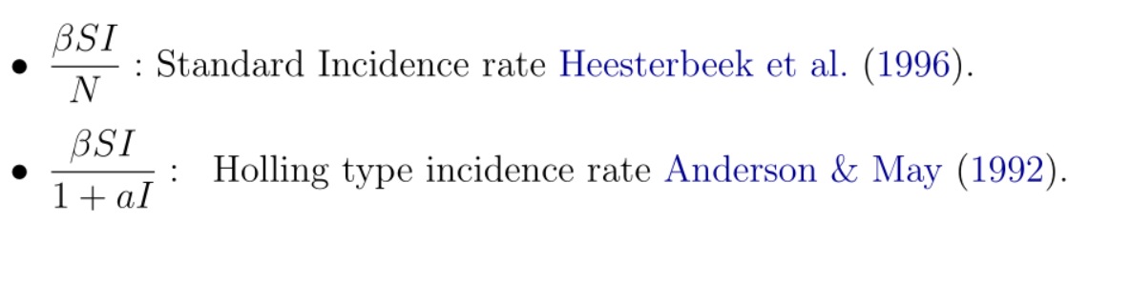
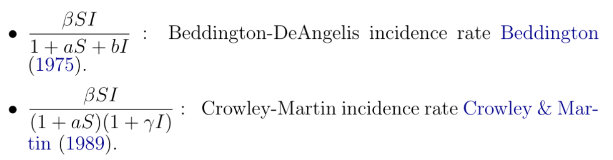
COMPARTMENTAL MODELS
Flux balance analysis
Flux modes and minimal cut sets
Community models
Linkage of proteomics data
Modification of the incidence rate
bilinear incidence rate ”βSI” of the original SIR model not accurate for large number of infected individuals because of saturation phenomena
<number>

Slide 10
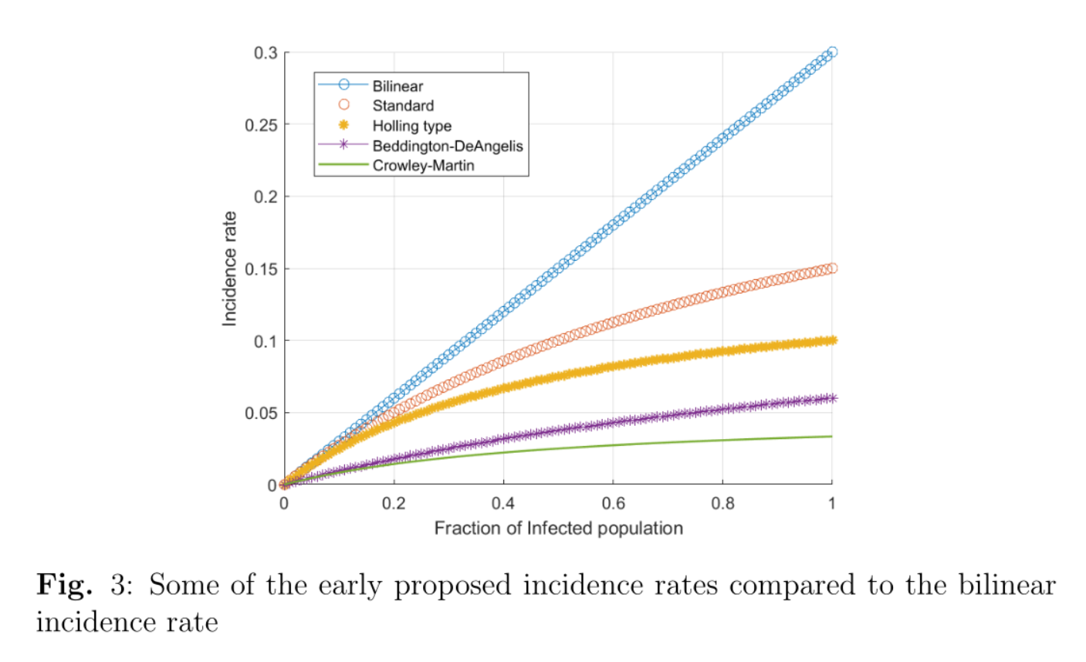
COMPARTMENTAL MODELS
Flux balance analysis
Flux modes and minimal cut sets
Community models
Linkage of proteomics data
Modification of the incidence rate
<number>

Slide 11
EFFICACY OF EPIDEMIOLOGICAL MODELING

Slide 12
Efficacy of epidemiological modeling
Flux balance analysis
Flux modes and minimal cut sets
Community models
Linkage of proteomics data
For a simple disease or infection, the limitation to a reduced number of compartments and a bilinear incidence rate may suffice but for complicated diseases, such as Covid-19, a large number of compartments is required.
The more compartments, the more intervening factors need to be mathematically modeled.
• Limitation 1: It does not capture the uncertainty and variability that is inherent in real-life epidemics due to factors such as the unpredictability of person-to-person contact.
• Limitation 2: It does not take into account the memory effects on their dynamics (People can use different precautions that affect the change in the infection dinamics)
• Limitation 3: They’re based on the assumption of instant cause and effect which is not correct in real life (Infected individual needs some time before becoming infectious and starts spreading the disease). Furthermore, when after vaccination, a time-period the efficacy of the vaccination increases progressively over time and decreases again after extended periods of time.
• Limitation 4: It does not take into account the spatial factor. For infectious diseases, the movement of individuals is a major factor of the disease spread.
<number>

Slide 13
Exam questions

Slide 14
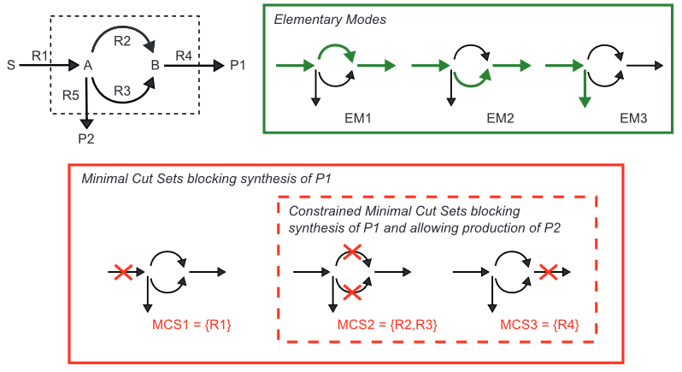
Question 03
Flux balance analysis
Flux modes and minimal cut sets
Community models
Linkage of proteomics data
F3: Create all elementary modes and all minimal cutsets for a given example network
Elementary (flux) modes
<number>

Slide 15

References
1. Palsson BØ. Systems Biology: Constraint-Based Reconstruction and Analysis. Cambridge University Press; 2015.

Slide 16

Thank you
Robert Heyer

