Slide 1

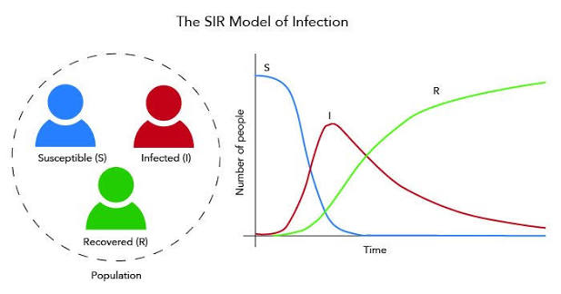
10_Modeling of infectious diseases
Lecture
Robert Heyer
27.05.2026

Slide 2
Mathematical Models to study biology of pathogens
Epidemiology
Matematical Modeling
Compartment Models (SIR)
SIR Extensions
Mathematical models have different application studying infectious diseases:
Systems Biology → processes supporting pathogen growth and spread in within the host and the effect of drugs or therapies (e.g. Metabolic Modeling). It answers questions like:
How does a pathogen grow in a new host using the nutrients available in the infected tissue to make the energy, the proteins, and all the building blocks it needs to replicate?
Epidemiology → outbreaks and design infection containment strategies. It answers questions like:
How does an outbreak spread in a population of people that interact frequently
Mathematical modeling is a main stone in public health, and shapes policy decisions and evidence-based practice by identifying risk factors for disease and targets for preventive healthcare. Epidemiology → outbreaks and design infection containment strategies
<number>

Slide 3
Mathematical Models to study biology of pathogens
Epidemiology
Matematical Modeling
Compartment Models (SIR)
SIR Extensions
Healthcare realities
Mathematical Modeling
Healthcare impact
Real-world data, patients,
and clinical systems
Turns healthcare information into
quantitative structure
Model-informed decisions
and better care
risk estimation
+
patient data
early diagnosis
disease progression
lab and imaging
results
👤✚
personalized
treatment
resource optimization
+
hospital resources
treatment evaluation
capacity planning
? ?
outbreak
preparedness
disease patterns
x(t), p, r
dx
dt
= f(x,p,t) − r x
treatment outcomes
t
policy support
Model outputs
explanation
prediction
simulation
scenario testing
?
Healthcare provides real-world data and challenges; mathematical modeling transforms them
into tools that improve decisions, efficiency, and patient outcomes.
<number>

Slide 4
Mathematical Models to study biology of pathogens
Epidemiology
Matematical Modeling
Compartment Models (SIR)
SIR Extensions
Intracellular biology
Microbiome ecology
Drug action
Epidemiology
Model
Genome-scale metabolic
networks and gene
regulation networks
Lotka-Volterra models of
species-species interaction
Models of the physical
chemistry of drugs, their
interaction with the
pathogen and the host
The SIR model
Elements
Metabolic flux; gene
expression
Species of microbes in the gut
microbiome, such as
commensal and pathogenic
bacteria and fungi
Factors such as anti-
microbial susceptibility
in vitro, host state, and
clinical metadata
The individuals
spreading the
disease in a
population
Examples of
uses
Design perturbations to
impact pathogen
physiology and hinder
its virulence; predict drug
targets; study mechanism
of drug resistance
Identify gut bacteria that
may combat pathogens;
design mixtures of
bacteria to use as probiotics
and restore gut health
Understand why a drug
that works in vitro fails
to treat a patient;
design new treatment
strategies
Predict the
duration of an
epidemic; compare
measures to stop
the spread
<number>

Slide 5

Systems thinking scientific approach
Epidemiology
Matematical Modeling
Compartment Models (SIR)
SIR Extensions
Approaches to study biological insights, which separate their components and study them separately called reductionist.
Approaches, which take in consideration at all components of the biological system are called “system Thinking”. Using the system thinking approach can provide insights that might not be obtained by the purely reductionist approach.
Infectious disease studies profit from a “system” approach, taking into account the interactions between the infectious agent, the host, the different environmental factors, and parameters modeling the infection.
<number>

Slide 6
Parameters governing infectious diseases
Epidemiology
Matematical Modeling
Compartment Models (SIR)
SIR Extensions
Infection results from a combination of processes that range widely in scale:
The biological molecules involved in the intracellular metabolism of pathogens to the interactions between individual people who may host and spread a virus across a population.
The countless infectious agents, which can infect a host (human, plant, or animal), which can be transmitted directly (oral, fluids, respiration) or indirectly (intermediate carrier like mosquitoes)
The infectious disease propagation potential depends on the parameters of the infectious agent and parameters of host dynamics behavior.
Despite the wide range of scales, in each of these processes the behavior of the system results from the interactions between many elements
<number>

Slide 7
Epidemiology and INFECTIOUS DISEASE MODELING
Epidemiology
Matematical Modeling
Compartment Models (SIR)
SIR Extensions
Epidemiology is a scientific discipline that studies the distribution, patterns, and determinants of infectious diseases in specific populations but also disease such as cancer or diabetes.
The mathematical modeling in epidemiology is broadly used specifically for infectious diseases to understand ad predict propagation of these diseases.
Exemplary questions answered by mathematical modeling of infectious diseases for healthcare purposes:
How does an outbreak spread in a population of people that interact frequently?
Which measurements have to be taken to hold the spread of infection under a threshold?
<number>

Slide 8
Epidemiology and INFECTIOUS DISEASE MODELING
Epidemiology
Matematical Modeling
Compartment Models (SIR)
SIR Extensions
Real-world
infectious disease events
Epidemiology
Infectious Disease Modeling
Describes and explains
patterns in populations
Mathematical representation
of those events
👥 🦠
•
new cases
👥
who gets sick
Transmission rate: β
?↔?
•
contacts
Recovery rate: γ
🌐 ◷
where and when
👤✚
S(t), I(t), R(t)
•
recoveries
👤🦠👤
how transmission
happens
dI/dt = βSI/N − γI
†
•
deaths
? ✚
which interventions
help
📍 ◷
•
place and time
Model outputs
⌕
↗
⚙
⚖
explanation
prediction
scenario testing
policy support
🌐
Epidemiology studies disease events in populations; infectious disease modeling
converts those observations into mathematical expressions that can explain, simulate, and predict spread.
<number>

Slide 9
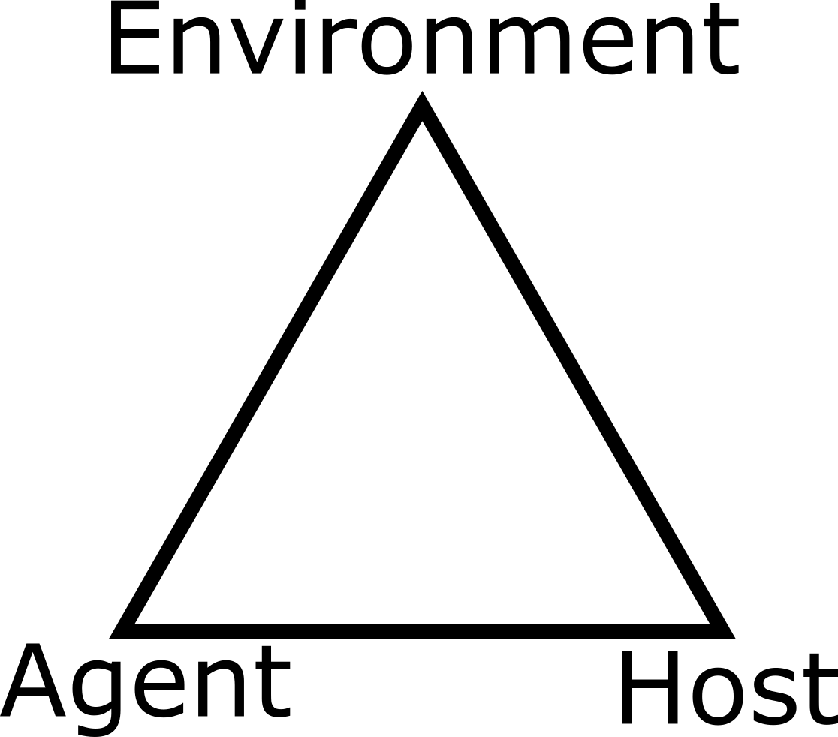
Infectious disease modeling
Epidemiology
Matematical Modeling
Compartment Models (SIR)
SIR Extensions
When modeling infectious diseases, the notion of systems consists of an epidemiological triangle where infectious agent, host, and environment interact with each other.
These components interact in complicated ways so in order to move towards quantitative understanding of how certain components affect certain outputs mathematical models are required.
<number>

Slide 10
The Foundation: compartmental models

Slide 11
COMPARTMENTAL SIR-model
Epidemiology
Matematical Modeling
Compartment Models (SIR)
SIR Extensions
Compartmental model use a set of differential equations t describe an epidemic, which assumes mass-action kinetics.
The simple SIR model contains the states: Susceptible population (S), Infected population (P), and Recovered population (P).
The elements are individual hosts, and the kinetics quantifies host transition between states.
S
I
R
βSI
γI
Flow: susceptible individuals become infectious, and infectious individuals recover.
<number>

Slide 12
equation system for SIR-model
Epidemiology
Matematical Modeling
Compartment Models (SIR)
SIR Extensions
Variables
S: Susceptible population
I: Infectious population
R: Recovered population
dS
=
−βSI
dt
dI
=
βSI − γI
dt
dR
=
γI
dt
Constants
β: Transmission rate
γ: Recovery rate
<number>

Slide 13
COMPARTMENTAL MODELS (SIR-model)
Epidemiology
Matematical Modeling
Compartment Models (SIR)
SIR Extensions
Bilinear incidence rate ”βSI” of the original SIR model not accurate for large number of infected individuals because of saturation phenomena
For this limitations there are extensions of status of the SIR models
Usually made by considering more clinical states than just S(t), I(t), and R(t)
Examples of further compartments are: the immunized (V), the deceased (D), the asymptomatic (A), the hospitalized (H), the quarantined (Q)
Introducing new parameters: like
<number>

Slide 14
equation system with vaccination and death status
Epidemiology
Matematical Modeling
Compartment Models (SIR)
SIR Extensions
Compartments
R
S: Susceptible
I: Infectious
R: Recovered
V: Immunized
γI
S
I
βSI
δI
V
4

Slide 15
equation system for SIR-model with vaccination status
Epidemiology
Matematical Modeling
Compartment Models (SIR)
SIR Extensions
Variables
S: Susceptible population
I: Infectious population
R: Recovered population
V: Immunized population
dS
=
−βSI − δI
dt
dI
=
βSI − γI
dt
dR
=
γI
dt
Constants
β: Transmission rate
γ: Recovery rate
δ: Immunization rate
dV
=
δI
dt
<number>

Slide 16
equation system with vaccination and death status
Epidemiology
Matematical Modeling
Compartment Models (SIR)
SIR Extensions
R
Compartments
S: Susceptible
I: Infectious
R: Recovered
V: Immunized
D: Death
γI
S
I
V
βSI
δI
ωI
D
4

Slide 17
equation system with vaccination and death status
Epidemiology
Matematical Modeling
Compartment Models (SIR)
SIR Extensions
Variables
S: Susceptible population
I: Infectious population
R: Recovered population
V: Immunized population
D: Death population
dS
=
−βSI − δI
dt
dI
=
βSI − γI − ωI
dt
dR
=
γI
dt
dV
Constants
β: Transmission rate
γ: Recovery rate
δ: Immunization rate
ω: Death rate
=
δI
dt
dD
=
ωI
dt
<number>

Slide 18
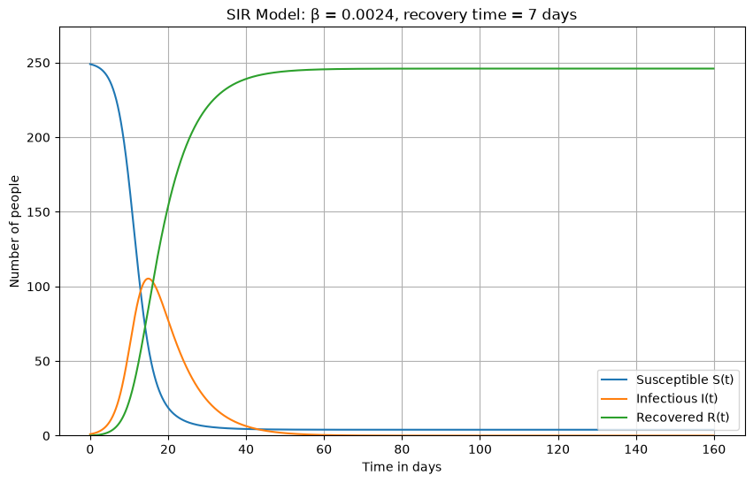
COMPARTMENTAL MODELS (SIR-model)
Epidemiology
Matematical Modeling
Compartment Models (SIR)
SIR Extensions
<number>

Slide 19
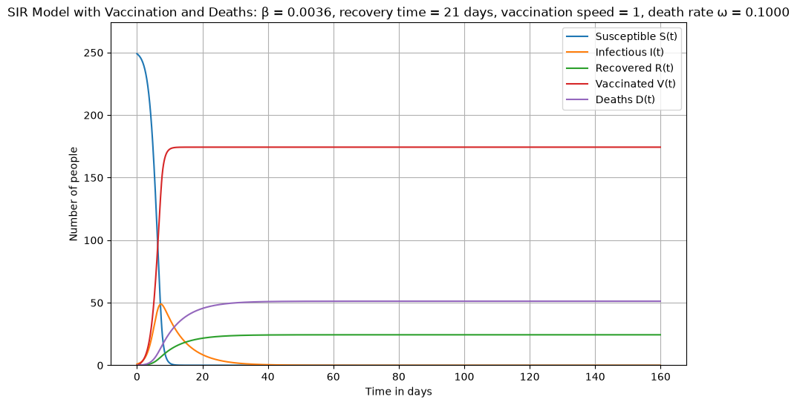
COMPARTMENTAL MODELS (SIR-model)
Epidemiology
Matematical Modeling
Compartment Models (SIR)
SIR Extensions
<number>

Slide 20
Other extensions for COMPARTMENTAL MODELS (SIR-model)
Epidemiology
Matematical Modeling
Compartment Models (SIR)
SIR Extensions
βSI
•
:
Standard Incidence rate Heesterbeek et al. (1996).
N
βSI
•
:
Holling type incidence rate Anderson & May (1992).
1 + aI
βSI
•
:
Beddington-DeAngelis incidence rate Beddington
(1975).
1 + aS + bI
βSI
•
:
Crowley-Martin incidence rate Crowley & Martin
(1989).
(1 + aS)(1 + γI)
<number>

Slide 21
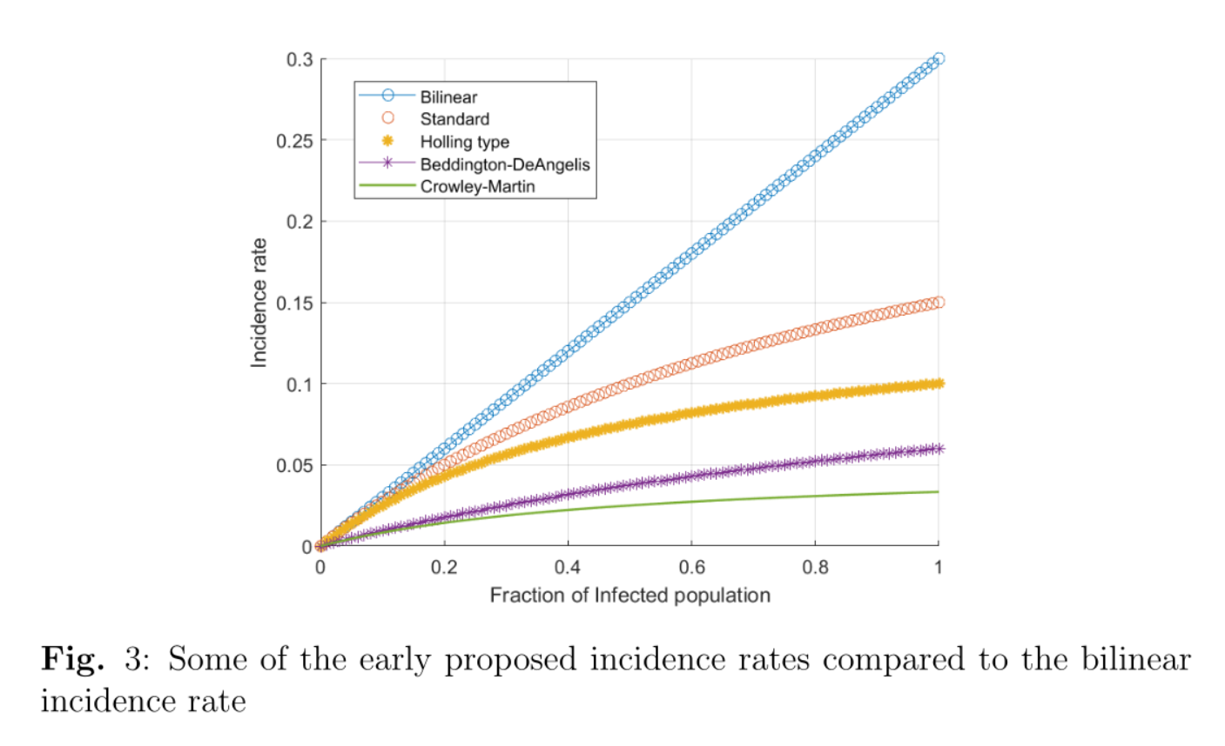
COMPARTMENTAL MODELS (SIR-model)
Epidemiology
Matematical Modeling
Compartment Models (SIR)
SIR Extensions
Modification of the incidence rate
<number>

Slide 22
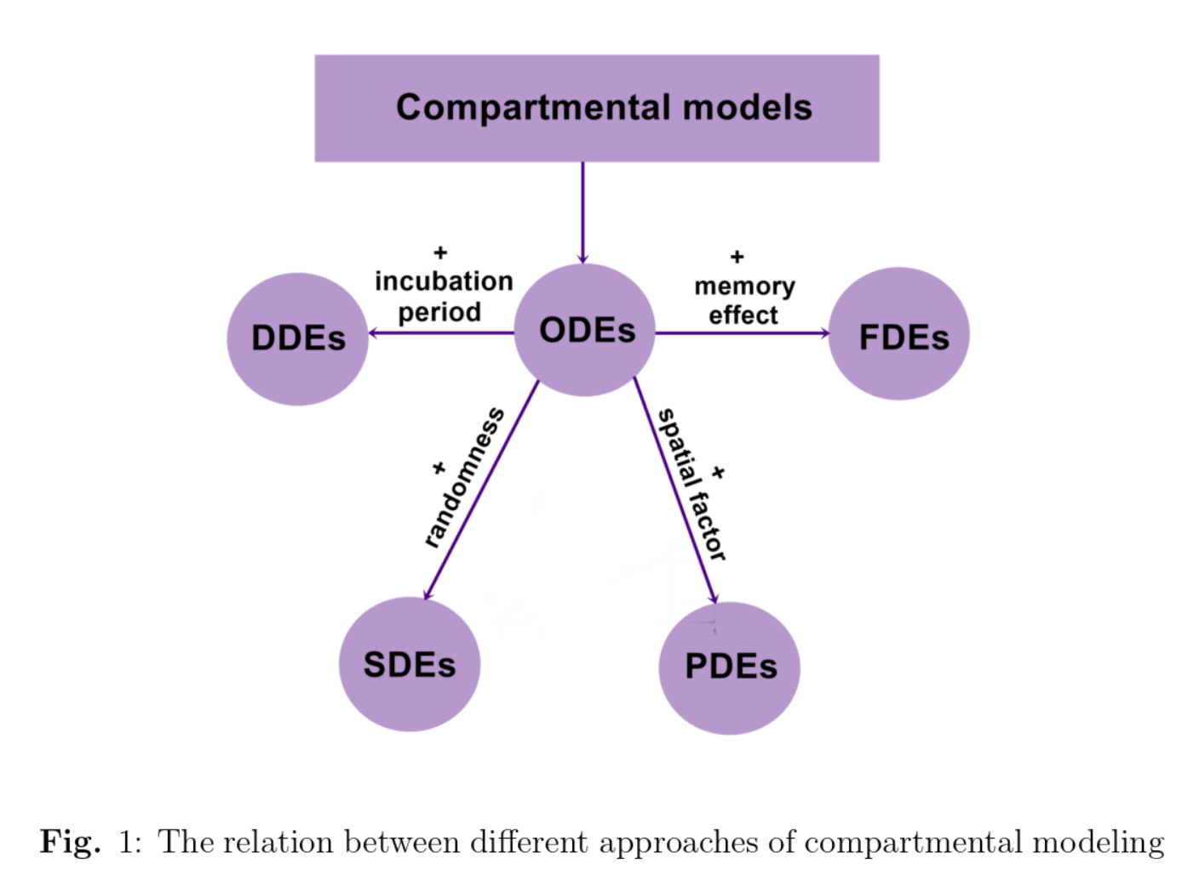
Extensions of compartmental models
ODE: ordinary differential equations: simple system.
DDE: delay differential equations: capture the incubation period for instance.
FDE: fractional differential equations: illustrate the ”memory” effect of the dynamics.
SDE: stochastic differential equations: the interactions between individuals are not uniform but have a random effect
PDE: partial differential equations: interfere when the spatial factor is included into the model.
Epidemiology
Matematical Modeling
Compartment Models (SIR)
SIR Extensions
0<number>

Slide 23
EFFICACY OF EPIDEMIOLOGICAL MODELING

Slide 24
Efficacy of epidemiological modeling
Epidemiology
Matematical Modeling
Compartment Models (SIR)
SIR Extensions
For a simple disease or infection, the limitation to a reduced number of compartments and a bilinear incidence rate may suffice but for complicated diseases, such as COVID-19, a large number of compartments is required.
The more complex the disease, the greater the number of intervening factors that must be mathematically modeled, and the more the assumptions underlying the SIR model need to be adjusted. For example:
In the classic SIR model, infection gives full immunity against any possible reinfection. However, for many important epidemiological situations, immunity is only partial and reinfection is possible.
The weakness of immunization when mutations of the pathogen agent appear.
<number>

Slide 25
SIMPLE SIR-MODEL LIMITATIONS
Epidemiology
Matematical Modeling
Compartment Models (SIR)
SIR Extensions
Limitations:
Vital dynamics (natural birth/death rate).
Dynamics (People can use different precautions that affect the change in the infection dynamics).
Spatial factors (the movement of individuals is a major factor of the disease spread).
Humans do not interact randomly as reagents in a reaction, they follow a behavior.
Assumption of all infected being infectious.
Does not consider incubation periods.
20

Slide 26
OUTLOOK- COVID pandemic

Slide 27
VACCINATION AND HERD IMMUNIZATION CONTRADICTION
Vaccines against infectious diseases are the most effective non-restrictive preventive methods in modern healthcare. Nevertheless, vaccine rejection puts in danger national and international immunization programs. In fact, vaccination rates repeatedly fall below the critical thresholds, which are necessary to eliminate diseases such as measles or polio.
Vaccination has been typically described as an individual decision making task in which the risks of being unvaccinated and contracting the disease are weighted against the risks of getting vaccinated.
The decision in favor of vaccination beneﬁts the decision maker but also supports the population because it decreases the likelihood that the disease spreads, an effect called Herd Immunity. Non-vaccination might not be the result of adverse effects weighted decision but rather the result of selﬁsh-rational behavior assuming Herd Immunity has been reached.
Infectious diseases have catastrophic human and economic consequences as we all learned from the COVID-pandemic. However, it is impossible to eradicate a disease through voluntary vaccination when individuals act according to their own interests.

Slide 28
References
Schlickeiser, R., & Kröger, M. (2024). Mathematics of epidemics: On the general solution of SIRVD, SIRV, SIRD, and SIR compartment models. Mathematics, 12(7), 941. doi:10.3390/math12070941.
Mehdaoui, M. (2023). A review of commonly used compartmental models in epidemiology. arXiv. arXiv:2110.09642.
Böhm, R., Betsch, C., & Korn, L. (2016). Selfish-rational non-vaccination: Experimental evidence from an interactive vaccination game. Journal of Economic Behavior & Organization, 131, 183–195. doi:10.1016/j.jebo.2015.11.008.
Gutierrez, M. A., & Gog, J. R. (2026). Final-size solutions for SIRI models with vaccination. Bulletin of Mathematical Biology, 88(5), Article 64. doi:10.1007/s11538-026-01610-w

Slide 29

Thank you
Robert Heyer

