Slide 1
SOCKET PROGRAMMING
Github link: https://github.com/ayeshasdina/SOCKET-PROGRAMMING-with-Python

Slide 2
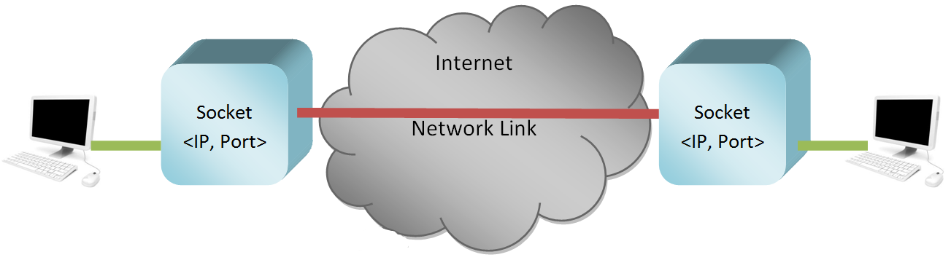
Socket
One endpoint of a two way communication link between two programs.
Socket consist of
IP address- identification label of a device/machine
Port number: virtual endpoint through which information pass.
Image source: https://www.thelearningpoint.net/computer-science/networking-an-introduction-to-client-server-programming--in-python

Slide 3
Telephone Call
A phone number is assigned to both users.
Turn on the ringer to listen for a caller.
Caller dials a phone number.
Telephone rings and receiver receive the call.
Both user start the talking and exchange the information/data.
When conversation is over they hang it up.

Slide 4
Network perspective
Endpoint is established for communication.
Address is assigned to both ends.
one end point wait for the connection
The other end point initiate a connection.
Once a connection has been established, data is exchanged.
After completing the data exchange, the end points close their connection

Slide 5
The primary socket function
Socket() – create the end point.
Bind() – assign a number.
Listen()- wait for a call
Connect() – dial a number
Accept() – receive a call
Send(), Recv() – exchange the data
Close() – close the connection.

Slide 6
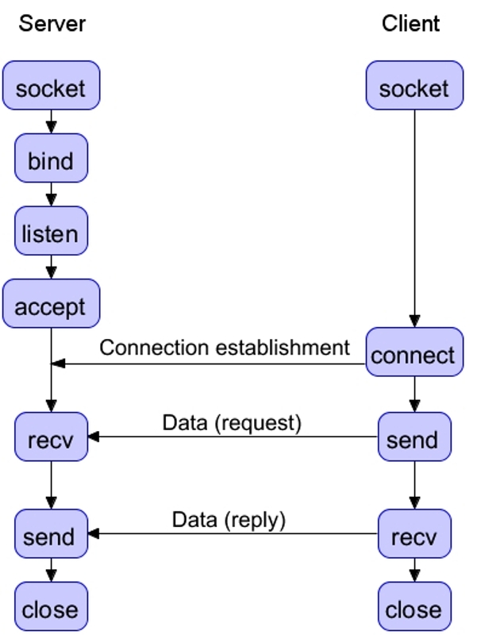
Image source: https://www.networxsecurity.de/glossary-d1/n-d1/network-socket/

Slide 7
Protocol for socket programming
TCP (Transmission Control Protocol):
packets dropped in the network are detected and retransmitted by the sender (reliable).
Connection oriented
UDP (User Datagram Protocol)
Data can be received by the receiver-end in out-of-order.
it is connectionless.
Unreliable.

Slide 8
Library
Java
Import java.net.ServerSocket
import java.net.Socket
Import java.util.concurrent.Executors
Python
Import socket
Import threading
Import os
Import sys

Slide 9
Library
C and C++
#include "client.h"
#include "server.h”
#include <sys/socket.h>

Slide 10
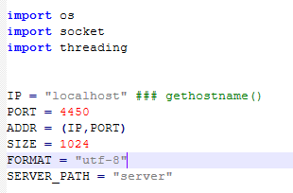
Server Program

Slide 11
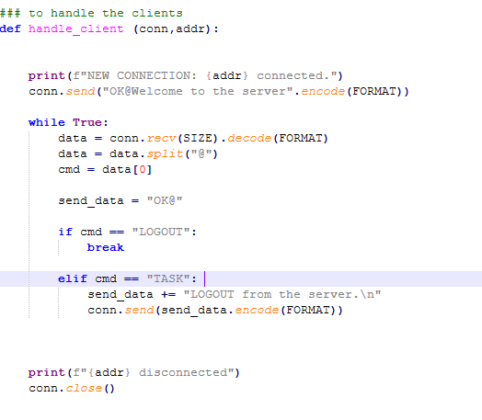
Server Program

Slide 12
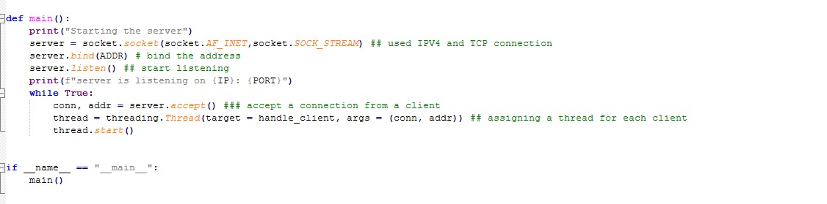
Server Program

Slide 13
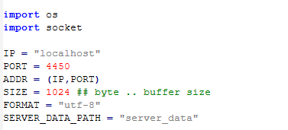
Client Program

Slide 14
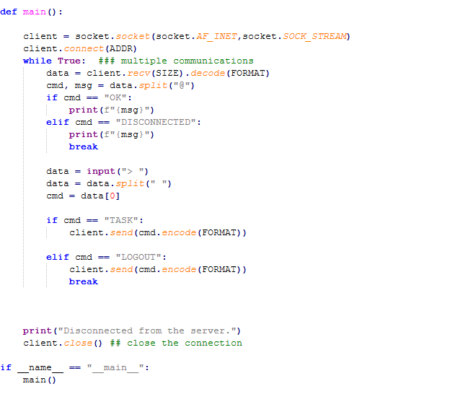
Client Program

Slide 15
References
https://realpython.com/python-sockets/
https://www.youtube.com/watch?v=TMbHg43as_E&list=PLhTjy8cBISErYuLZUvVOYsR1giva2payF&index=9
https://www.thelearningpoint.net/computer-science/networking-an-introduction-to-client-server-programming--in-python
https://www.networxsecurity.de/glossary-d1/n-d1/network-socket/
https://www.bogotobogo.com/cplusplus/sockets_server_client.php
https://cs.lmu.edu/~ray/notes/javanetexamples/
https://www.educba.com/socket-programming-in-c-plus-plus/

Slide 16
References
https://www.bogotobogo.com/cplusplus/sockets_server_client.php

