Slide 1

Salary Range Classification Using Machine Learning in Tech Organizations
A data-driven approach to transforming compensation decisions through supervised machine learning and predictive analytics

Slide 2






EXECUTIVE SUMMARY
Transforming Salary Decisions with Machine Learning
The Challenge
Our Solution
Business Impact
Salary decisions in tech organizations often rely on subjective judgment, leading to inconsistencies, potential bias, and employee dissatisfaction. As organizations scale, manual processes become increasingly unreliable.
A supervised machine learning classification system predicts salary ranges (Low, Medium, High) rather than exact amounts. Multiple models were rigorously evaluated, with Gradient Boosting achieving superior performance.
The model empowers HR teams to standardize salary recommendations, improve fairness and transparency, and enable truly data-driven compensation decisions across the organization.

Slide 3


OBJECTIVES
Problem Statement and Strategic Goals
The Core Challenge
Our Approach
Determining fair and competitive salaries manually becomes unreliable and inefficient as organizations scale. Traditional approaches lack consistency and transparency.
Goal: Classify employees into appropriate salary ranges using machine learning
Target Variable: salary_range (Low, Medium, High) — multi-class classification
Key Objectives
Analyze comprehensive employee salary-related data
Identify and address missing values, outliers, and inconsistencies
Build and rigorously compare supervised classification models
Select the best-performing model for production use
Interpret results for actionable HR decision-making

Slide 4

DATA OVERVIEW
A simulated human resource dataset capturing employee demographics, experience, performance metrics, and compensation details for salary range prediction in tech organizations.
Comprehensive Dataset Analysis
10 000
18
Employee Records
Total Variables
Comprehensive dataset covering diverse tech workforce
Numerical and categorical features
Numerical Features (8)
Categorical Features (10)
Age, years of experience, skill score
Gender, marital status, education level
Certifications and performance metrics
Job role, department, job level
Projects completed, overtime hours
Employment type, remote status
Monthly salary
Company size and location

Slide 5


ANALYSIS
Exploratory Data Analysis: Key Findings
Numerical Summary Highlights
Data Quality Assessment
Critical Insights
Average age: ~40 years with diverse age distribution
Missing values isolated to years_experience (423 records)
High salary range is the dominant category
Average experience: ~7.3 years (423 missing values identified)
Outliers detected in experience (>20 years)
Clear correlation between higher education and salary ranges
Mean monthly salary: ~996,000 with significant variation
Inconsistent education labels (Bachelor, BSc, bachelor)
Experience varies widely across employee population
Salary ranges from ~75,000 to over 6.5 million
Overall data integrity is strong
Education standardization required for modeling
Wide variability indicates diverse, multi-level workforce

Slide 6





Data Preprocessing Strategy
Missing Values
Addressed 423 missing entries in years_experience using imputation techniques
Standardization
Unified education level categories to ensure consistency
Encoding
Converted categorical variables to numerical format for modeling
Outlier Management
Carefully handled outliers to avoid introducing bias
Train-Test Split
80% training, 20% testing for robust validation

Slide 7



METHODOLOGY
Machine Learning Approach
Problem Type
Models Evaluated
Supervised Multi-Class Classification
1
Logistic Regression
Baseline linear model for classification
2
Support Vector Machine
Kernel-based classification approach
3
K-Nearest Neighbors
Instance-based learning algorithm
4
Evaluation Metrics
Decision Tree
Rule-based hierarchical classifier
Accuracy
Precision
5
Recall
F1-score
Random Forest
ROC-AUC
Ensemble of decision trees
6
Gradient Boosting
Sequential ensemble learning

Slide 8


RESULTS
Model Performance Comparison
Model
Accuracy
Precision
Recall
F1-score
ROC-AUC
Gradient Boosting
0.8185
0.8125
0.8185
0.8138
0.9095
Logistic Regression
0.8145
0.8106
0.8145
0.8104
0.9123
SVM
0.8095
0.7913
0.8095
0.8002
0.9059
Random Forest
0.8000
0.7797
0.8000
0.7873
0.8948
Decision Tree
0.7905
0.7986
0.7905
0.7875
0.8687
KNN
0.7250
0.7121
0.7250
0.7170
0.7996
Winner: Gradient Boosting achieved the best balance across all metrics with ROC-AUC above 0.90, indicating excellent class separation and predictive capability.

Slide 9

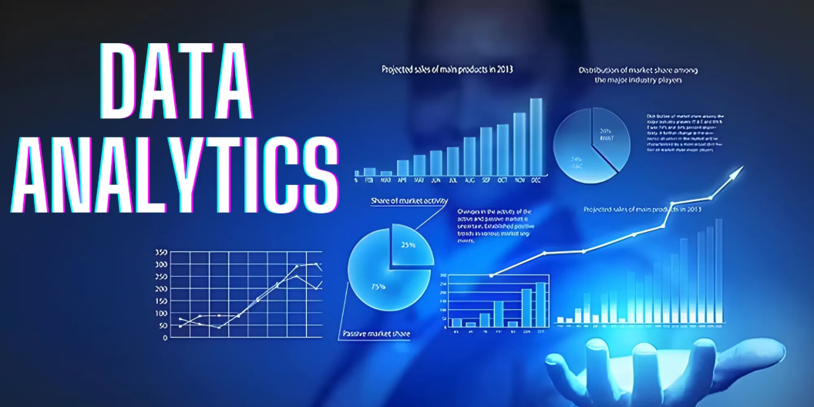
INSIGHTS
Model Interpretation and Key Findings
Most Important Predictors
01
Years of Experience
Primary driver of salary classification
02
Education Level
Strong correlation with salary range
Key Interpretation
03
Employees with higher experience, stronger skills, and advanced education are significantly more likely to fall into higher salary ranges.
Job Role
Position type significantly impacts range
Model Limitations
04
Class imbalance affects precision for some ranges
Skill Score
Warning: some labels had no predicted samples
Performance depends on historical patterns
Technical capabilities matter
Requires periodic retraining with new data
05
Performance Score
Individual contribution factor

Slide 10
Conclusion and Recommendations
Conclusion
The study shows that machine learning can effectively classify employees into salary ranges using historical HR data. After data cleaning and analysis, Gradient Boosting achieved the best performance among the tested models. Key factors such as experience, education, skills, and performance strongly influence salary ranges, demonstrating the value of a data-driven approach for fair and consistent compensation decisions.
Recommendations
Organizations should use machine learning models as decision-support tools for salary range allocation while continuing human oversight. Regular data updates, improved data quality, and handling of class imbalance are recommended to maintain model reliability. Future work should include market salary benchmarks and advanced models to further enhance decision accuracy.

Slide 11
Closing remark
Group members:
Rutayisire Jean Pierre (GL)
UMWALI Claudine
TWIZIHIRWE Benjamin
THANK YOU!!!!!!!!!!!!!!!!

