Slide 1
Stock price correlation calculation
Benjamin Rübenkamp
Notes:
This project discusses a CUDA implementation designed to calculate the correlation between the price movements of different stocks. The implementation uses the GPU to speed up the calculations using reduction and shared memory. The program reads historical stock price data from CSV files, calculates the price returns and then the correlation between two stocks.

Slide 2
Table of contents
What
Why
How
Results
Future improvements
Conclusion

Slide 3
What
Notes:
Brief overview of the purpose and objectives of the presentation

Slide 4
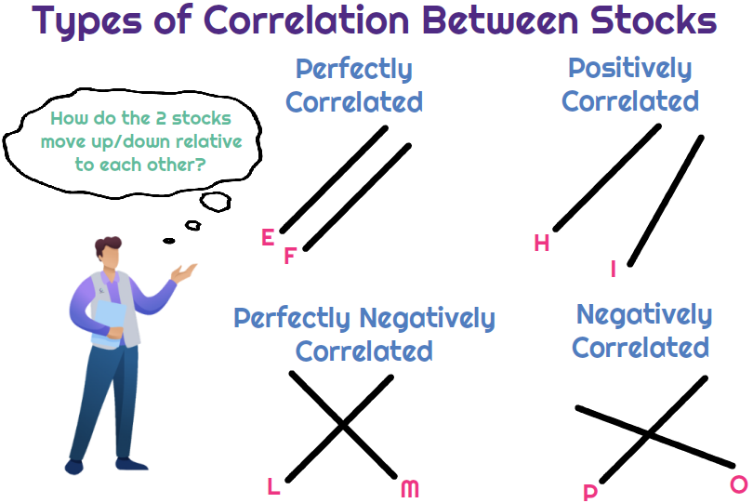
What is the correlation between stock prices?
A mutual relationship or connection between two or more things
Expressed in a range between [-1,1]
Based on multiple data points
Notes:
https://www.universalcpareview.com/wp-content/uploads/2021/08/Correlation-between-stocks.png

Slide 5
Why
Notes:
- Explanation of the steps involved in Johnson's Algorithm

Slide 6
Why would you want to know the correlation?
Portfolio diversification
Risk management
Pairs trading
Market forecasting
Notes:
The output of this program is the correlation coefficient between the price returns of two stocks. This correlation coefficient can be used for various financial analyses, including: Portfolio diversification: A low correlation between two stocks suggests that their price movements are independent of each other. This can be used to construct a portfolio that is less sensitive to fluctuations in individual stocks. Pairs Trading: Stocks with high correlation often exhibit similar price movements. This can beusedinpairs trading strategies, where an investor goes long in one stock and short in another, with the expectation that the historical correlation will continue. Risk management: Correlation analysis helps assess a portfolio’s risk. Stocks with low correlation offer diversification benefits, which can reduce the overall risk of the portfolio. Market forecasting: Changes in the correlation between two stocks can indicate changes in market conditions or industry trends. This information can be used to make trading decisions and predict future market trends.

Slide 7
How
Notes:
Nu we alle stappen die johnsonns algorithm gebruikt overlopen hebben overlopen
Now that we have discussed the steps involved in Johnson's algorithm,
let's take a look at a practical demonstration of how the algorithm works in action.
We start at the original graph
We insert a node and run bellman-ford on this graph.
That gives us a graph wich has the shortest distances from node S.
After that we modify the weights of the edges to transform the graph so its ready to be ran by dijkstras algorithm
Now we run dijkstras algorithm and that gives us the final graph.

Slide 8
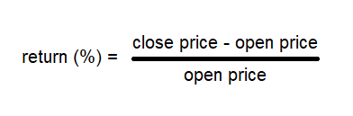
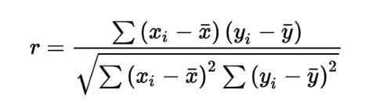
How is the correlation calculated?
OHLC-data
Calculation of returns:
Calculation of means
Calculation of correlation coëfficient:

Slide 9
Code structure
Global memory: input-output values, inter block comunication
Shared memory: stores values from global memory and partial reduction sums
Structure:
Each thread places it’s value (at index n in input data) in shared memory
Each block calculates it’s sum using reduction
The first thread of each block writes the block sum to global memory
The globally first thread sums the values of each block
Notes:
Returns is normal
Means en correlation gebruiken de following structure

Slide 10

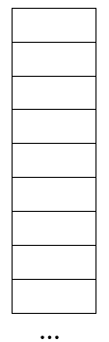

Code structure
Structure:
Each thread places it’s value in shared memory
Each block calculates it’s sum using reduction
The first thread of each block writes the block sum to global memory
The globally first thread sums the values of each block
Notes:
Returns is normal
Means en correlation gebruiken de following structure

Slide 11
Results
Notes:
Only timing kernel executions!

Slide 12
Future improvements
Notes:
- Summary of the main points covered in the presentation
- Concluding remarks on the importance and relevance of Johnson's Algorithm in graph theory and computer science

Slide 13
Future improvements
Using atomics to sum all block sums
Incorrect/inconsistent values at 20k+ datapoints
Using 1 kernel execution for calculating returns
Notes:
In this presentation we have proven how the johnsonn Algorithm, efficiently with time complexity O(n² log n + nm). Offers us a solution to the all-pairs shortest path problem.
To accomplisch this the algorithm makes use of the Bellman-for and Dijkstra algorithm.
Because this algorithm runs so efficiently it’s widely used in a whole range of applications, particularly in network routing.
In deze presentative hebben we gezien hoe het johnsson Algoritme, efficient met time complexity O(n² log n + nm). Een oplossing geeft aan het all-pairs shortest path problem.
Dit door gebruik te maken van het Bellman-ford en Dijkstra algoritme.
Omdat dit algoritme zo efficient is wordt het ook gebruikt in andere toepassingen zoals transport en wordt het vooral gebruikt in network routing.

Slide 14
Conclusion
Notes:
- Summary of the main points covered in the presentation
- Concluding remarks on the importance and relevance of Johnson's Algorithm in graph theory and computer science

