Slide 1


Dockerizing and Deploying a Modern .NET Core Application
Nicki Klein
Senior Developer Advocate - .NET
@nicki_23
AM Grobelny
Senior Technical Evangelist
@amsxg
Notes:
Brian- risk

Slide 2
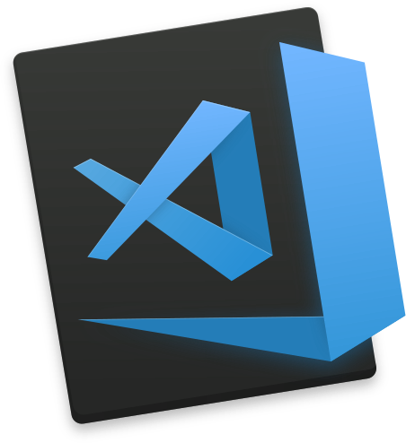
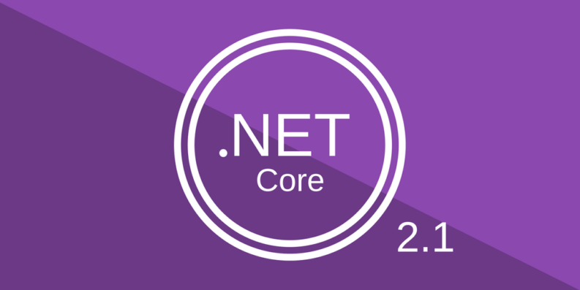
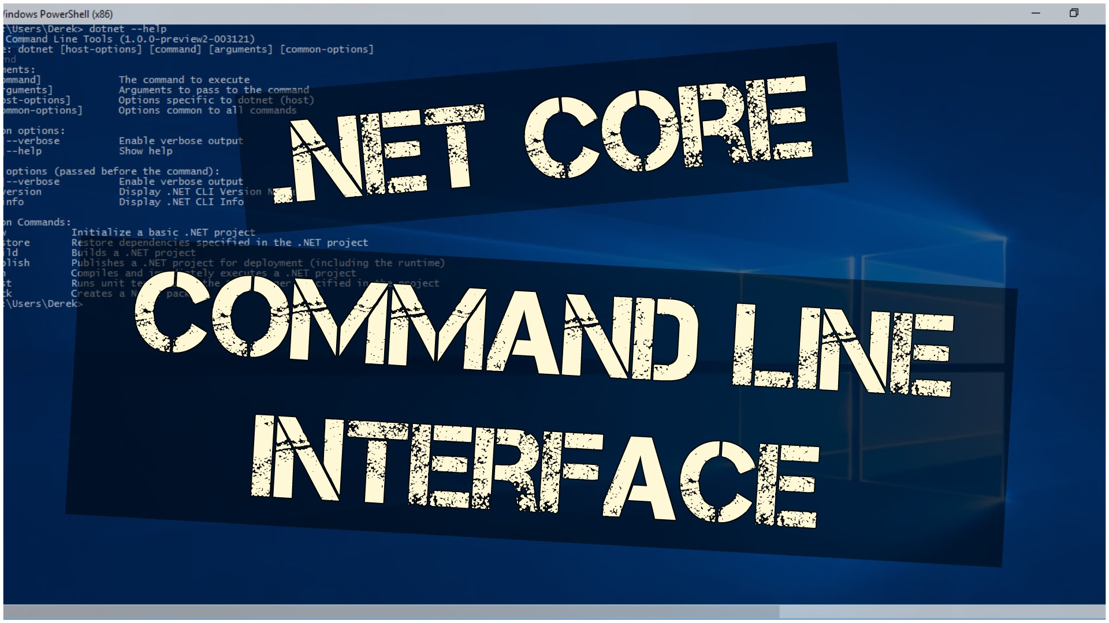
What we will use today

Slide 3
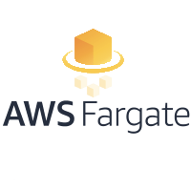

What we will cover
The Basics: What is Docker? Docker and .NET Core
Introduction to Fargate, ECS and Container Orchestration
Let’s Build it!
Notes:
Brian- overview

Slide 4
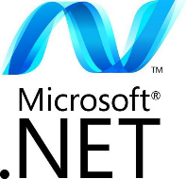
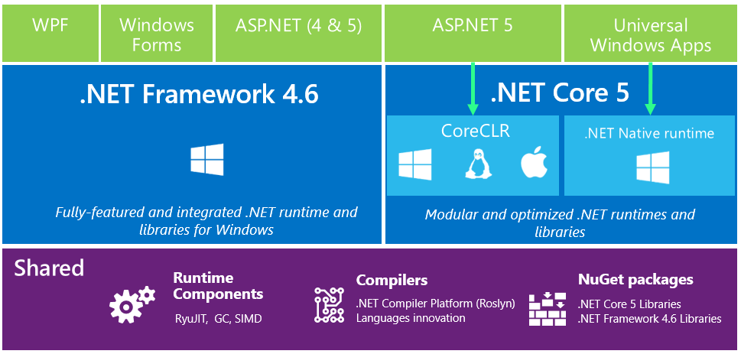
Microsoft .NET History
Notes:
Nicki
.net core is the future of .net (.net core 5 is actually 1)
.net core 2.1 is the latest. App modernization is one focus of todays talk. Talking about this because all of your apps are .NET 4.x and it’s hard to recompile them and have them work on .NET Core. Portability analyzer.
Everyone has legacy apps that they are trying to figure out what to do with. We are going to help

Slide 5
AWS loves .NET
CodeBuild for Windows with preconfigured .NET Core – 5/25
.NET Developer Center (aws.amazon.com/net) 7/2
.NET Core 2.1 on Amazon Linux and Ubuntu – 7/11
.NET Core 2.1 on Lambda – 7/9
.NET Global Tools – 9/10
PowerShell Core on Lambda – 9/11
Notes:
Nicki
.net core 2.1 shipped 5/30 and our teams quickly reacted as you can see with recent launches.
Immediately on 5/30 you were able to run .NET Core 2.1 on any of our containers and our instances. It’s our extended services where we quickly sought to add support.

Slide 6
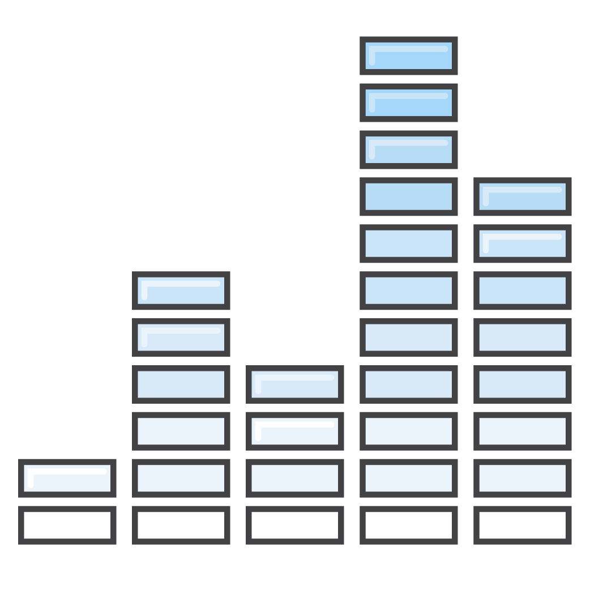

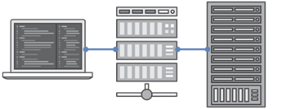
Why Containers?
Operating System Utilization
Deployment/ Runtime Consistency
Scaling
Uniform Application Development
Notes:
Nicki- overview of why containers? Go into detail later on

Slide 7
What is Docker?
Software that enables developers to easily pack, ship, and run any application as a lightweight, portable, self-sufficient container, which can run virtually anywhere

Slide 8
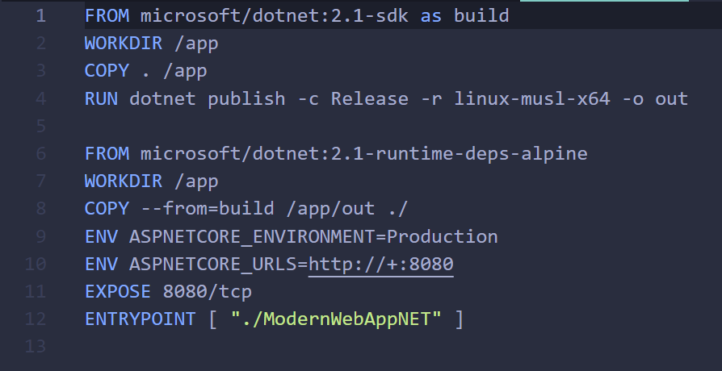
Sample Dockerfile

Slide 9
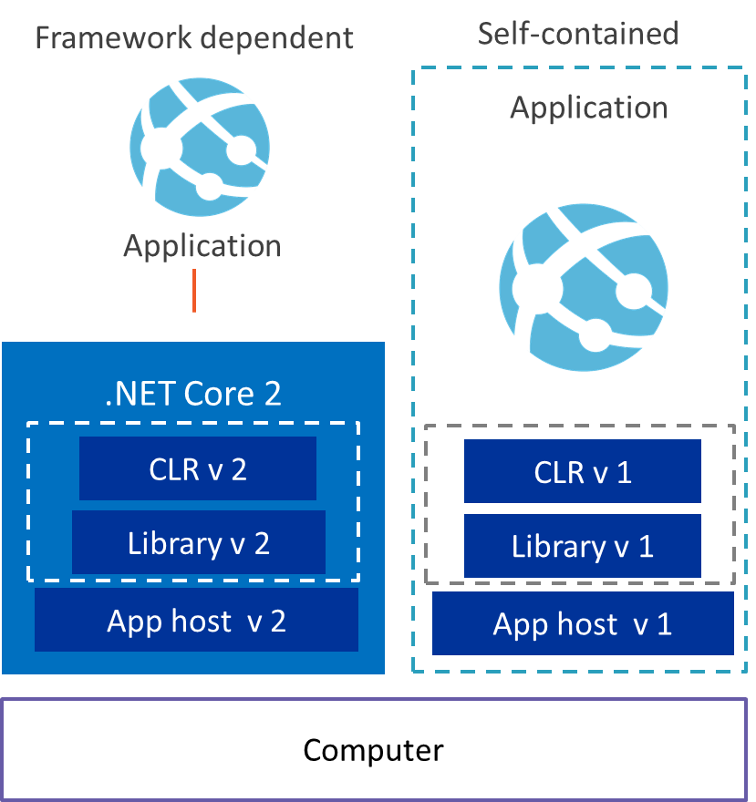
.NET Core Deployment Modes
Framework Dependent
Self-contained
Application
Notes:
Framework-dependent deployment
Shared system-wide version of .NET Core on the target system.
App only contains code and dependencies so deployment package is small
Self Contained Deployment
Doesn't rely on the presence of shared components on the target system
Runtime is included in the deployment package so no dependency on the target system
Larger deployment package but, the .NET Core IL Linker will decrease the size of .NET Core applications by 50%

Slide 10
Container Orchestration
Container orchestration is a process that automates the deployment, management, scaling, networking, and availability of container-based applications.
Orchestrator
Container
Container
Container
Container

Slide 11
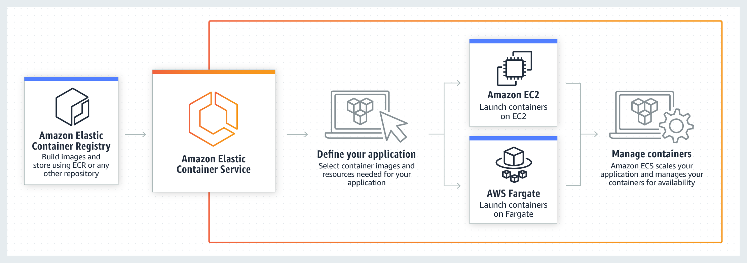
AWS ECS and AWS Fargate
Notes:
Nicki -

Slide 12
Steps to Containerize A .NET Core App
Code
Linux
Visual Studio Code
App
Notes:
Briefly show push
Nicki to ECR commands

Slide 13
Demo:
Containerize a ASP.NET Core App

Slide 14
Thank You for Attending Today!
AM Grobelny – Senior Technical Evangelist
@amsxg
Nicki Klein - Sr. Developer Advocate - .NET
@nicki_23
Code will be posted on Github, follow us for updates on when it’s posted
Notes:
Brian
Thank you for investing your time – hopefully this helps you with the risk of moving your enterprise apps to the cloud.
Please fill in session feedback – give us 10s
Nicki
In github there is a markdown file called direction which lists all the commands.

