Slide 1
EASTEREGG
SNAKE
PONG
TETRIS
SHOOTER
REEEE
TREE
WATER
SHEEP
FISH
GUY
TEA
GIRL
TIGER
DOG
GOAT
HORSE
DEER
WHALE
SEA
ROAD
PRESIDENT

Slide 2
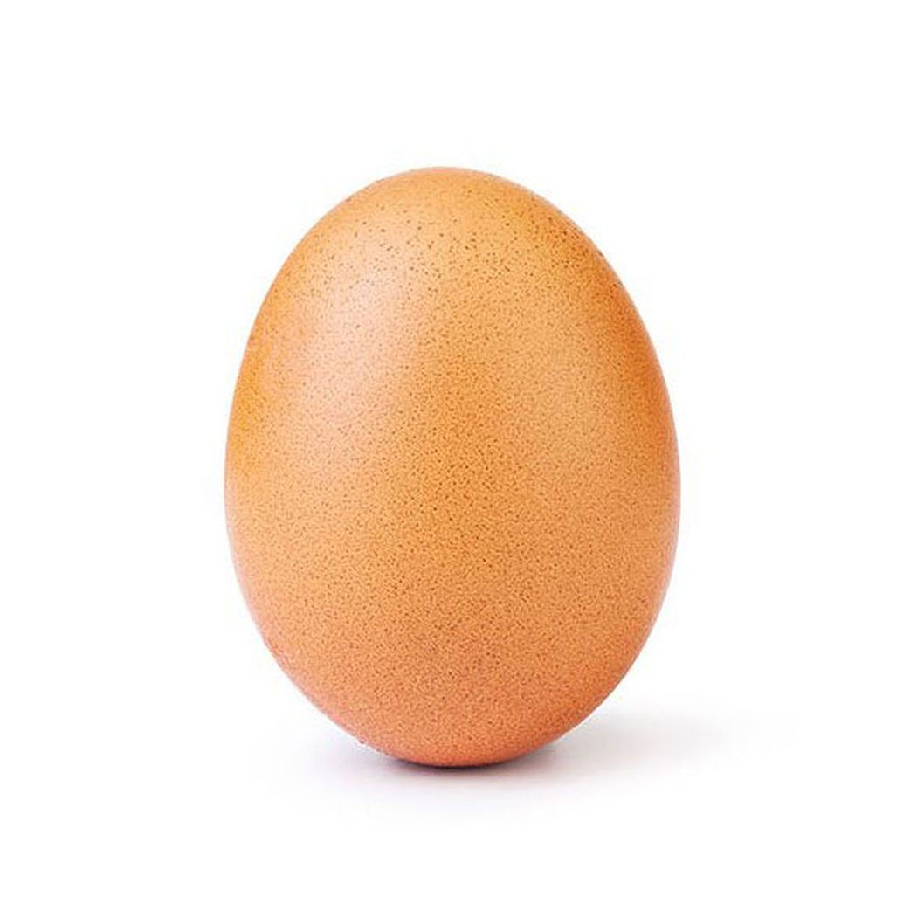

Slide 3


Slide 4


Slide 5


Slide 6


Slide 7


Slide 8


Slide 9


Slide 10


