Slide 1
Predicting Students’ Final Grades Using Machine Learning
Benjamin Batte
ITS-836 – Data Science & Big Data Analytics
University of the Cumberlands
Dr. Charles Edeki
October 5, 2025

Slide 2
Introduction (Part 1)
Why predicting student grades matters:
- Supports early interventions
- Reduces dropout rates
- Improves resource allocation
Key predictors: study time, attendance, family support, prior grades

Slide 3
Introduction (Part 2)
Research Question: Can machine learning accurately predict final student grades (G3)?
Hypothesis: Prior academic performance (G1 & G2) are the strongest predictors.
Goal: Compare Linear Regression vs Random Forest Regression

Slide 4
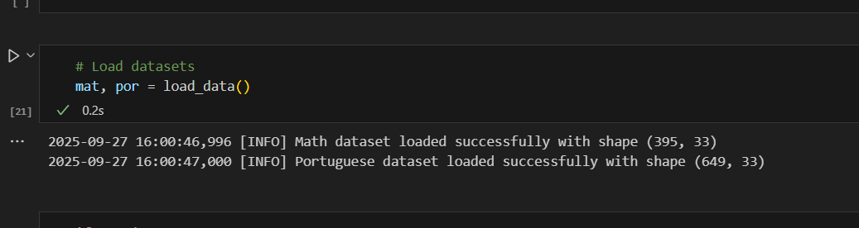
Data Source
Dataset: UCI Student Performance Dataset (Cortez & Silva, 2008)
Math: 395 students, 33 attributes
Portuguese: 649 students, 33 attributes
Features: demographic, social, academic (e.g., parental education, study time, prior grades)

Slide 5
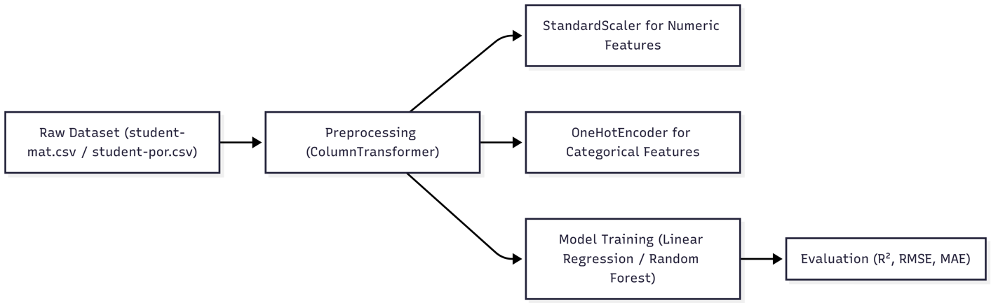
Preprocessing
Steps taken:
- Encode categorical variables
- Scale numerical variables
- Train/Test split (80/20)
Tools: scikit-learn ColumnTransformer pipeline

Slide 6
Tools & Methods
Python environment: Pandas, NumPy, Scikit-learn, Matplotlib, Seaborn
Models tested:
- Linear Regression (baseline, interpretability)
- Random Forest Regression (handles nonlinearity, robust)
Evaluation Metrics: R², RMSE, MAE

Slide 7
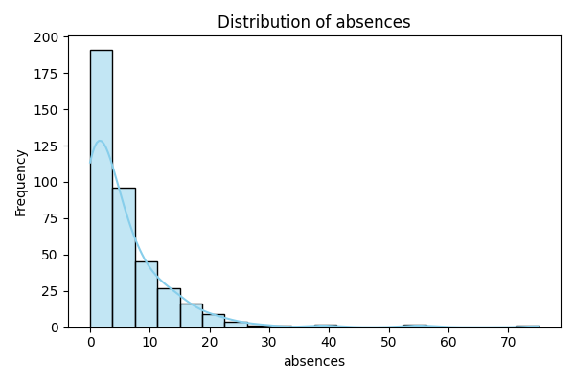
EDA (Math: Absences)
Most students have few absences
Small group shows extreme absenteeism
Absenteeism disproportionately affects minority of students

Slide 8
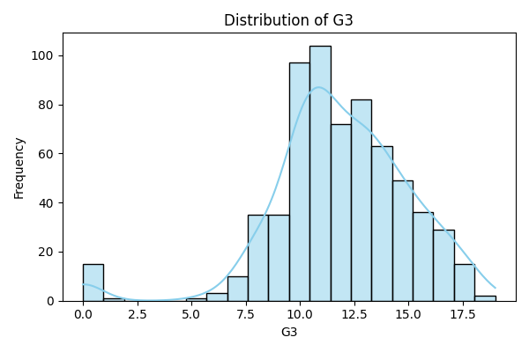
EDA (Portuguese: G3)
Final grade distribution ~ normal (10–12 out of 20)
Some students scored zero → full course failure
Reinforces need for early detection

Slide 9
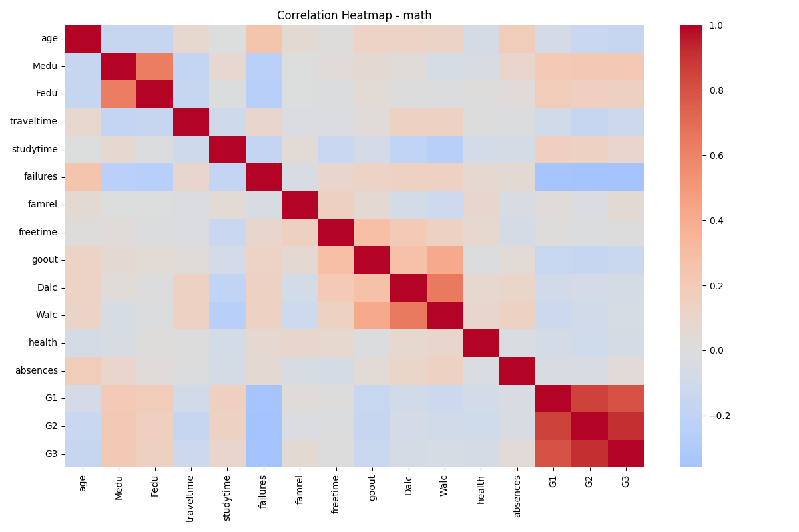
EDA (Correlation Heatmap)
Strongest predictors of G3: G1 and G2
Demographic/lifestyle variables weak correlations

Slide 10
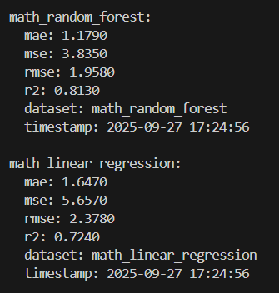
Results: Math Dataset
Linear Regression: R² = 0.724, RMSE = 2.38, MAE = 1.65
Random Forest: R² = 0.813, RMSE = 1.96, MAE = 1.18
Interpretation: Random Forest outperformed Linear Regression, reducing prediction error by ~0.4–0.5 grade points and explaining ~8% more variance in final grades.

Slide 11
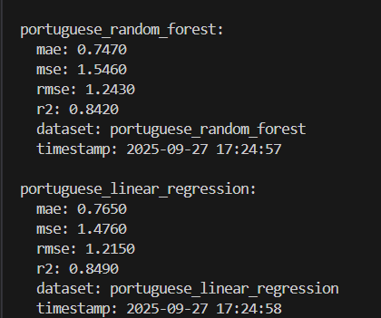
Results: Portuguese Dataset
Linear Regression: R² = 0.849, RMSE = 1.22, MAE = 0.77
Random Forest: R² = 0.842, RMSE = 1.24, MAE = 0.75
Interpretation: Both models predict within ~1 grade point. Linear Regression slightly outperformed Random Forest in this dataset.

Slide 12
Discussion (Part 1)
Random Forest outperformed Linear Regression in Math dataset
Both models strong in Portuguese dataset
Confirms hypothesis: G1 and G2 strongest predictors

Slide 13
Discussion (Part 2)
Socio-behavioral factors weak predictors
Skewness in absences/alcohol affects minority only
Educational interventions should focus on:
- Strengthening early academic performance (G1, G2)
- Targeting outlier students with high absenteeism

Slide 14
Limitations & Future Work
Dataset limited to Portuguese schools
Static dataset – lacks real-time engagement data
Future research:
- Cross-institutional datasets
- Behavioral/temporal features
- Deep learning + ensemble hybrid models

Slide 15
Conclusion
Key findings:
- RF > LR in predictive accuracy (esp. Math dataset)
- G1 & G2 = strongest predictors of G3
- Models forecast within 1–2 grade points
Practical Impact: Enables proactive, data-driven student support

Slide 16
Live Documentation
https://benjaminbatte.github.io/student-grade-prediction/

Slide 17
References
Al-Barrak & Al-Razgan (2020)
Batte (2025)
Cortez & Silva (2008)
Kumari & Singh (2023)
Manhães et al. (2022)
McKinney (2022)
Panigrahi et al. (2021)
Sasikala & Renuka Devi (2023)
Shorfuzzaman et al. (2021)

