Slide 1
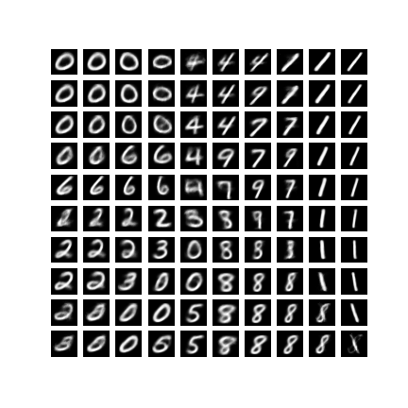
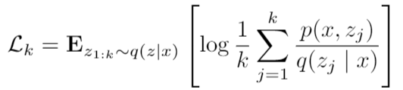

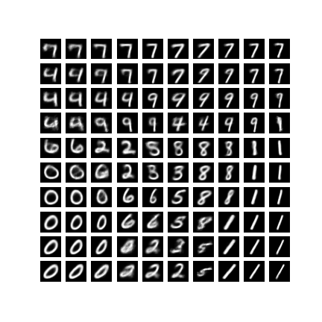
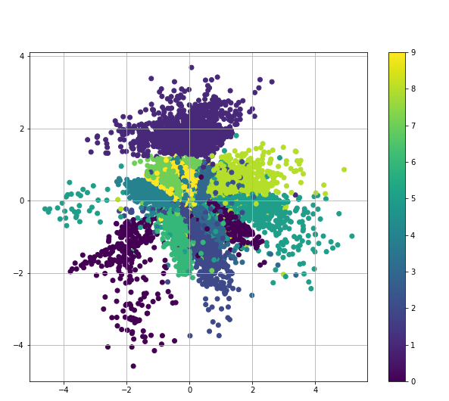
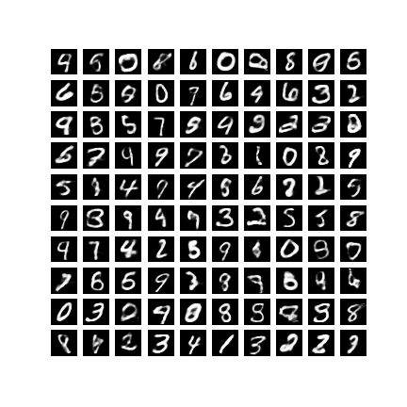

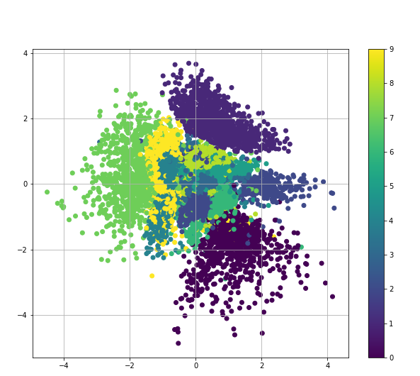
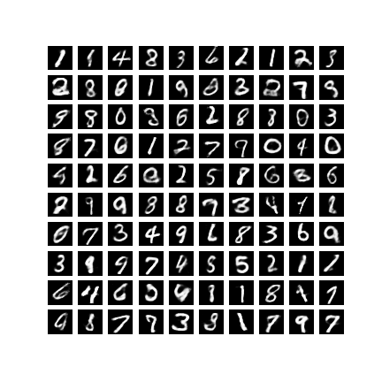
Variational Autoencoders (VAEs) and IWAE
Benjamin Rosa, Étienne Girard-Proulx, Nicholas Vachon, Hugo Lafortune-Brunet
Introduction
IWAE
Results
Results
Generative models aims at learning the true data distribution which allow us to generate new data points. They are useful for multiple task such as image generation, dimensionality reduction. One of the most commonly use generative model is the Variational Autoencoder (VAE). The VAE learn a generative model by maximizing a lower bound on the log-likelihood. The VAE is not perfect and have some downside.
The Importance Weighted Autoencoder try to improve the VAE by proposing a thigher lower bound in order to improve the estimation of the log-likelihood of the data.
We have found that empirically that he IWAE gives a lower negative log-likelihood,but that the difference is not large enough to be noticeable when generating samples.
Some assumptions are made on the posterior distribution. First, by looking at the second term of the objective D_{KL}[q(z|x) || p(z)], we can interpret that term as a regularizer that penalizes when the posterior is not close to the standard normal distribution.
Secondly, if we look at the first term of the objective function
E_{q(z|x)}[log(p(x|z))], we are trying to maximize the likelihood given z. Hence, the objective function will penalize when the encoder q(z|x) generates latent samples that do not represent well the data.
Burda and al. proposed another lower bound based on importance sampling that allow the model to better explore the latent space and increase the model flexibility.
VAE – Latent Space
Both models seems have the same flaws. They sometime generates clear digits, but they also often generates digits that seems to be the combination of 2 digits. This is due to the continuous nature of the random variable z and the assumptions made on the posterior distribution talked above.
In the VAE case, since the prior is a standard gaussian distribution and since we penalizes the model when the learned posterior distribution is far from that distribution, we kind of force the model to put the same digits close to each other in the latent space. With the IWAE model, expect that sampling with importance sampling would help on that manner by learning more complex representations. Qualitatively, it is hard to see the improvements of IWAE over VAEs.
Variational Autoencoder
IWAE – Latent Space
In the VAE settings, the generating process can be viewed as a directed graphical probabilistic model that links the latent variable z to the observed data x. In other words, we are assuming that the dataset X could be generated by using the following process:
Draw z^{i} from p_{θ} (z) then draw x^{i} from p_{θ} (x| z^{i})
This gives us a lower bound with 3 important properties:
when k = 1, we recover the prior VAE objective function.
as k increases, we get a tighter bound
it is a consistent estimator of log(p(x))
For a quantitative point of view, we consider the Negative Log-Likelihood. Table 1 clearly shows that the IWAE is outperforming the VAE model with lower NLL for all dimensions of z.
Growing the latent space (from z ϵ R²⁰ to z ϵ R⁵⁰), we see that the IWAE NLL is more stable compare to the VAE. This is a direct consequence of one advantage of the IWAE model: that it can learn expressive model over higher-dimensional latent space than VAE.
Finally, increasing the number of samples k seems to improve the model from k = 1 to k = 5, but then the NLL starts to increase a bit as we increase k more. From a theoretical standpoint, this should not be the case. In practice, this might be due to volatility in estimating the NLL since we are only taking 100 samples as mention above. It can also be due to a non-optimal choice of hyperparameters for the optimization of the neural network
Z
Results
To compare the quality of both models, we’ve done 4 tests.
Generated samples each to see if IWAE produce clearer images.
trained both model with a latent vector z ϵ R² and produce the learned latent space on a 2D grid.
3. Compared the quality of the encoder by reducing the dimension to 2D
4. Caculate and compared the negative log-likelihood
X
VAE - Dimensionality Reduction
Following the maximum likelihood criteria we would like to find θ that maximize p_{θ} (x)=∫p_{θ} (x| z) p_{θ} (z) however this is intractable. In order to solve this problem a recognition model q_{φ}(z|x) is used as an approximation to the intractable true posterior p_{θ} (z|x). Also instead of maximizing the marginal likelihood directly we are maximizing a variational lower bound.
VAE – 100 Digits generated
Objective function
Conclusions
We have compared the VAE and the IWAE on the MNSIT dataset. We have found that is an improvement in the negative log-likelihood.
It is however difficult to conclude if there is an improvement in the image generated by looking at the images for MNSIT. The difference might be easier to see on a more complicated Dataset.
X
Neural Network
P(X|Z)
IWAE - Dimensionality Reduction
Z
IWAE – 100 Digits generated
Q(Z|X)
µ
Σ
N(0,1)
Neural Network
To learn the parameter of q(z|x), we need to be able to compute the derivatives of a function of$z w.r.t θ so we can backpropagate through the network. To do this a reparametrization trick is used, to separate the randomness of z from the parameters of the distributions.
X

