Slide 1
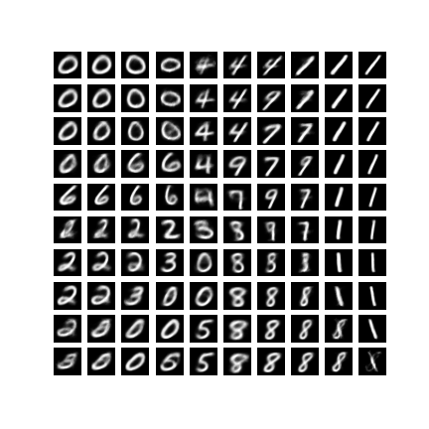
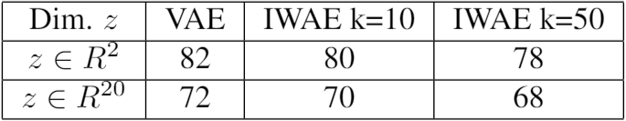
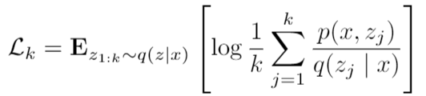
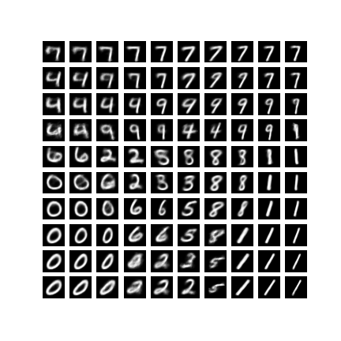
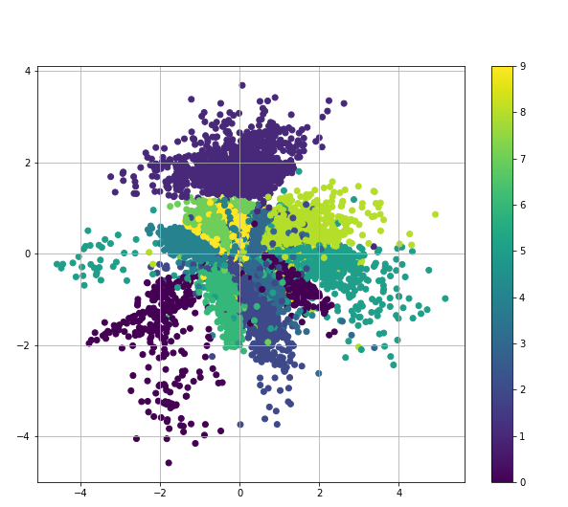
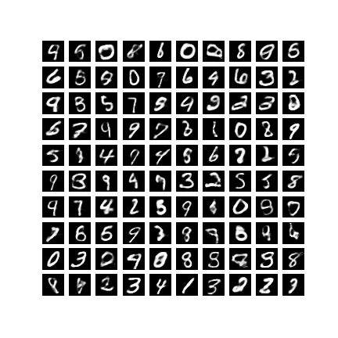

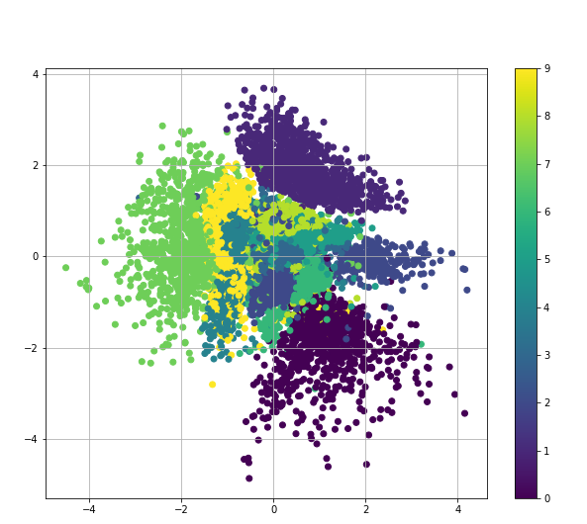
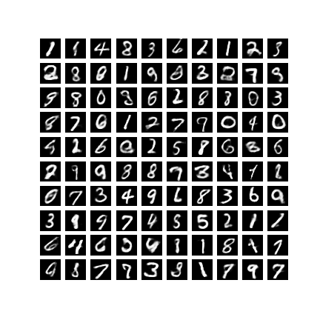
Variational Autoencoders (VAEs) and IWAE
Benjamin Rosa, Étienne Girard-Proulx, Nicholas Vachon, Hugo Lafortune-Brunet
Introduction
IWAE
Results
Results
Generative models aims at learning the true data distribution which allow us to generate new data points. They are useful for multiple task such as image generation, dimensionality reduction. One of the most commonly use generative model is the Variational Autoencoder (VAE). The VAE learn a generative model by maximizing a lower bound on the log-likelihood. The VAE is not perfect and have some downside.
The Importance Weighted Autoencoder try to improve the VAE by proposing a thigher lower bound in order to improve the estimation of the log-likelihood of the data.
We have found that empirically that he IWAE gives a lower negative log-likelihood,but that the difference is not large enough to be noticeable when generating samples.
Some assumptions are made on the posterior distribution. First, by looking at the second term of the objective D_{KL}[q(z|x) || p(z)], we can interpret that term as a regularizer that penalizes when the posterior is not close to the standard normal distribution.
Secondly, if we look at the first term of the objective function
E_{q(z|x)}[log(p(x|z))], we are trying to maximize the likelihood given z. Hence, the objective function will penalize when the encoder q(z|x) generates latent samples that do not represent well the data.
Burda and al. proposed another lower bound based on importance sampling that allow the model to better explore the latent space and increase the model flexibility.
VAE – Latent Space
Negative Log-Likelihood
Both models seems have the same flaws. They sometime generates clear digits, but they also often generates digits that seems to be the combination of 2 digits. This is due to the continuous nature of the random variable z and the assumptions made on the posterior distribution talked above.
In the VAE case, since the prior is a standard gaussian distribution and since we penalizes the model when the learned posterior distribution is far from that distribution, we kind of force the model to put the same digits close to each other in the latent space. Hence, when sampling a Random z, we can end up in a region midway between two regions of different digits.
With the IWAE model, we would have expected that sampling with importance sampling would help on that manner by learning more complex representations.
It is hard to conclude solely based on visuals. Qualitatively, it is hard
to see the improvements of IWAE over VAEs.
Variational Autoencoder
IWAE – Latent Space
In the VAE settings, the generating process can be viewed as a directed graphical probabilistic model that links the latent variable z to the observed data x. In other words, we are assuming that the dataset X could be generated by using the following process:
Draw z^{i} from p_{θ} (z) then draw x^{i} from p_{θ} (x| z^{i})
This gives us a lower bound with 3 important properties:
when k = 1, we recover the prior VAE objective function.
as k increases, we get a tighter bound
it is a consistent estimator of log(p(x))
Z
Results
To compare the quality of both models, we’ve done 4 tests.
Generated samples each to see if IWAE produce clearer images.
trained both model with a latent vector z ϵ R² and produce the learned latent space on a 2D grid.
3. Compared the quality of the encoder by reducing the dimension to 2D
4. Caculate and compared the negative log-likelihood
X
VAE - Dimensionality Reduction
Following the maximum likelihood criteria we would like to find θ that maximize p_{θ} (x)=∫p_{θ} (x| z) p_{θ} (z) however this is intractable. In order to solve this problem a recognition model q_{φ}(z|x) is used as an approximation to the intractable true posterior p_{θ} (z|x). Also instead of maximizing the marginal likelihood directly we are maximizing a variational lower bound.
Conclusions
VAE – 100 Digits generated
We have compared the VAE and the IWAE on the MNSIT dataset. We have found that is an improvement in the negative log-likelihood.
It is however difficult to conclude if there is an improvement in the image generated by looking at the images for MNSIT. The difference might be easier to see on a more complicated Dataset.
Objective function
X
Neural Network
P(X|Z)
IWAE - Dimensionality Reduction
Z
IWAE – 100 Digits generated
Q(Z|X)
µ
Σ
N(0,1)
Neural Network
To learn the parameter of q(z|x), we need to be able to compute the derivatives of a function of$z w.r.t θ so we can backpropagate through the network. To do this a reparametrization trick is used, to separate the randomness of z from the parameters of the distributions.
X

