Slide 1
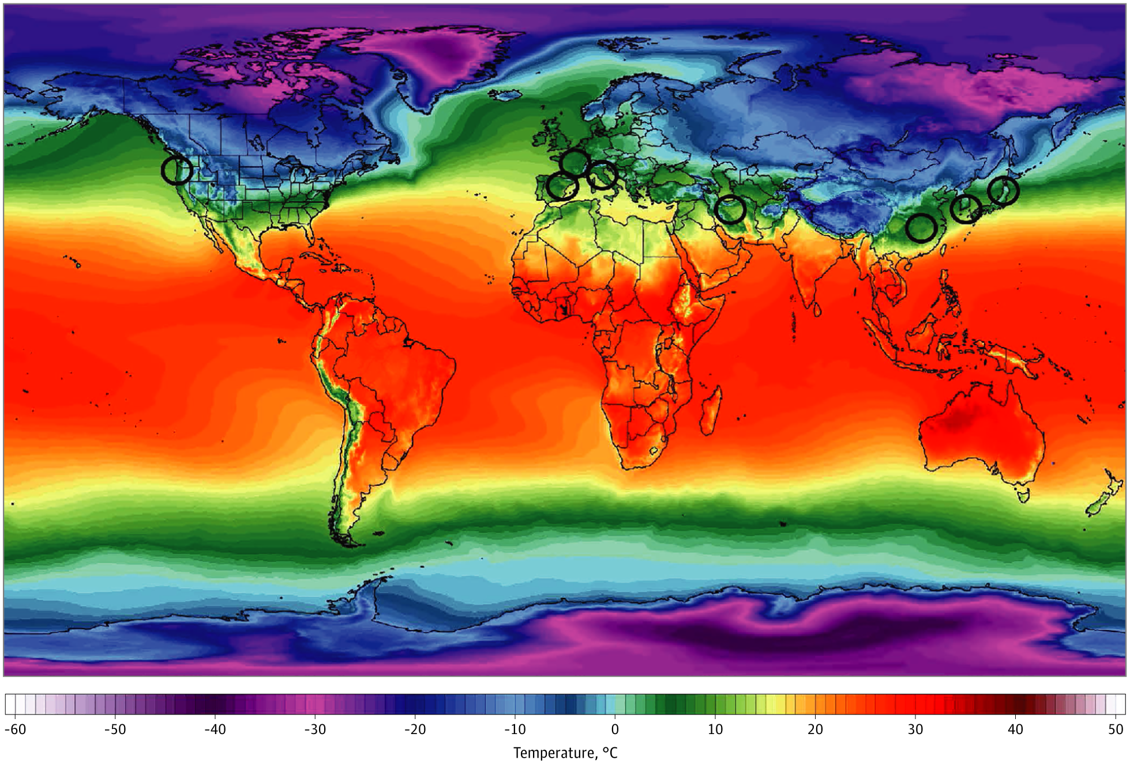
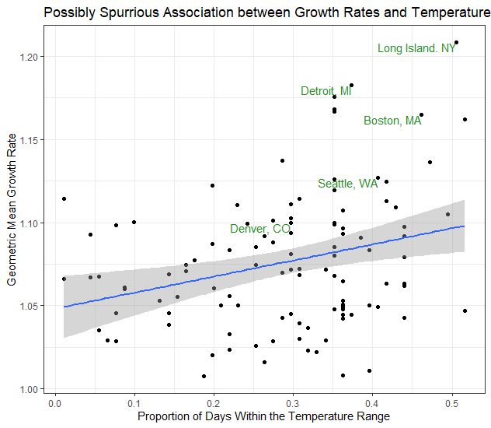
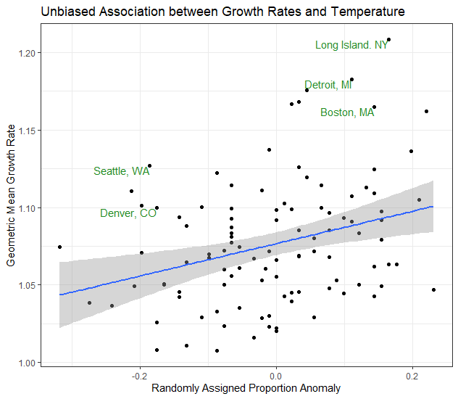


Random Weather Fluctuations are Associated with Reproduction Rates of SARS-CoV-2 in US Cities Brian Knaeble Benjamin Buss
Utah Valley University Utah Valley University
bknaeble@uvu.edu 10764793@my.uvu.edu
Sajadi et al. observed elevated growth rates over time when cities had temperatures in the range 5 to 11 degrees Celsius.
We conducted a prospective analysis of COVID-19 data from 108 US cities. For each city, data was collected for 28 days after its 100th case. We observed a positive association between mean growth rates and the proportion of days within the temperature range specified by Sajadi et al. We also observed a positive association between mean growth rates and randomly assigned (by weather) temperature anomalies. The latter association admits causal interpretation. It provides a simple example of ignorable exposure assignment conditional on a covariate. Conditional on climate we were able to harness the randomness of the weather for causal inference. In the field of environmental epidemiology this data analytic technique can provide warrants for causal interpretation of associations between exposures and an outcomes.
Reference: Sajadi MM, Habibzadeh P, Vintzileos A, Shokouhi S, Miralles-Wilhelm F, Amoroso A. Temperature, Humidity, and Latitude Analysis to Estimate Potential Spread and Seasonality of Coronavirus Disease 2019 (COVID-19). JAMA Netw Open. 2020;3(6):e2011834. doi:10.1001/jamanetworkopen.2020.11834.

