Slide 1
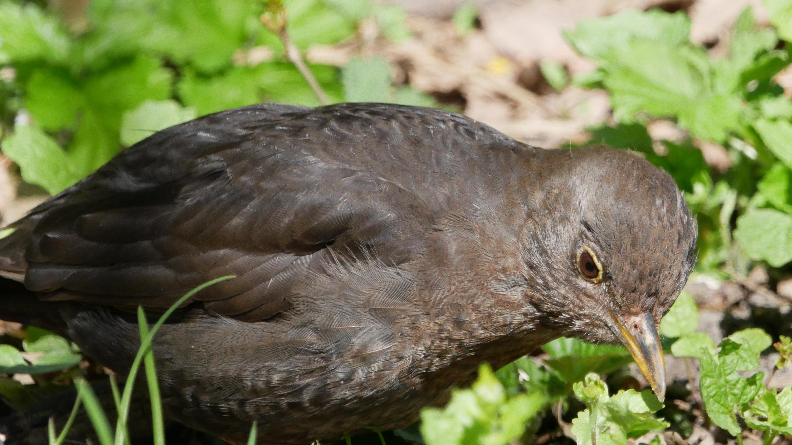
Genkendelse af Fugle
Via fuglesang
Notes:
Fun thing, when adding this picture, it produced different design and this alt text “A picture containing outdoor, bird, grass, rail”

Slide 2
Overview
Dataset
Buildup
Features
Samples
Set-up
Classifiers
Data split
Resulter
Konkusion

Slide 3
Dataset

