Slide 1
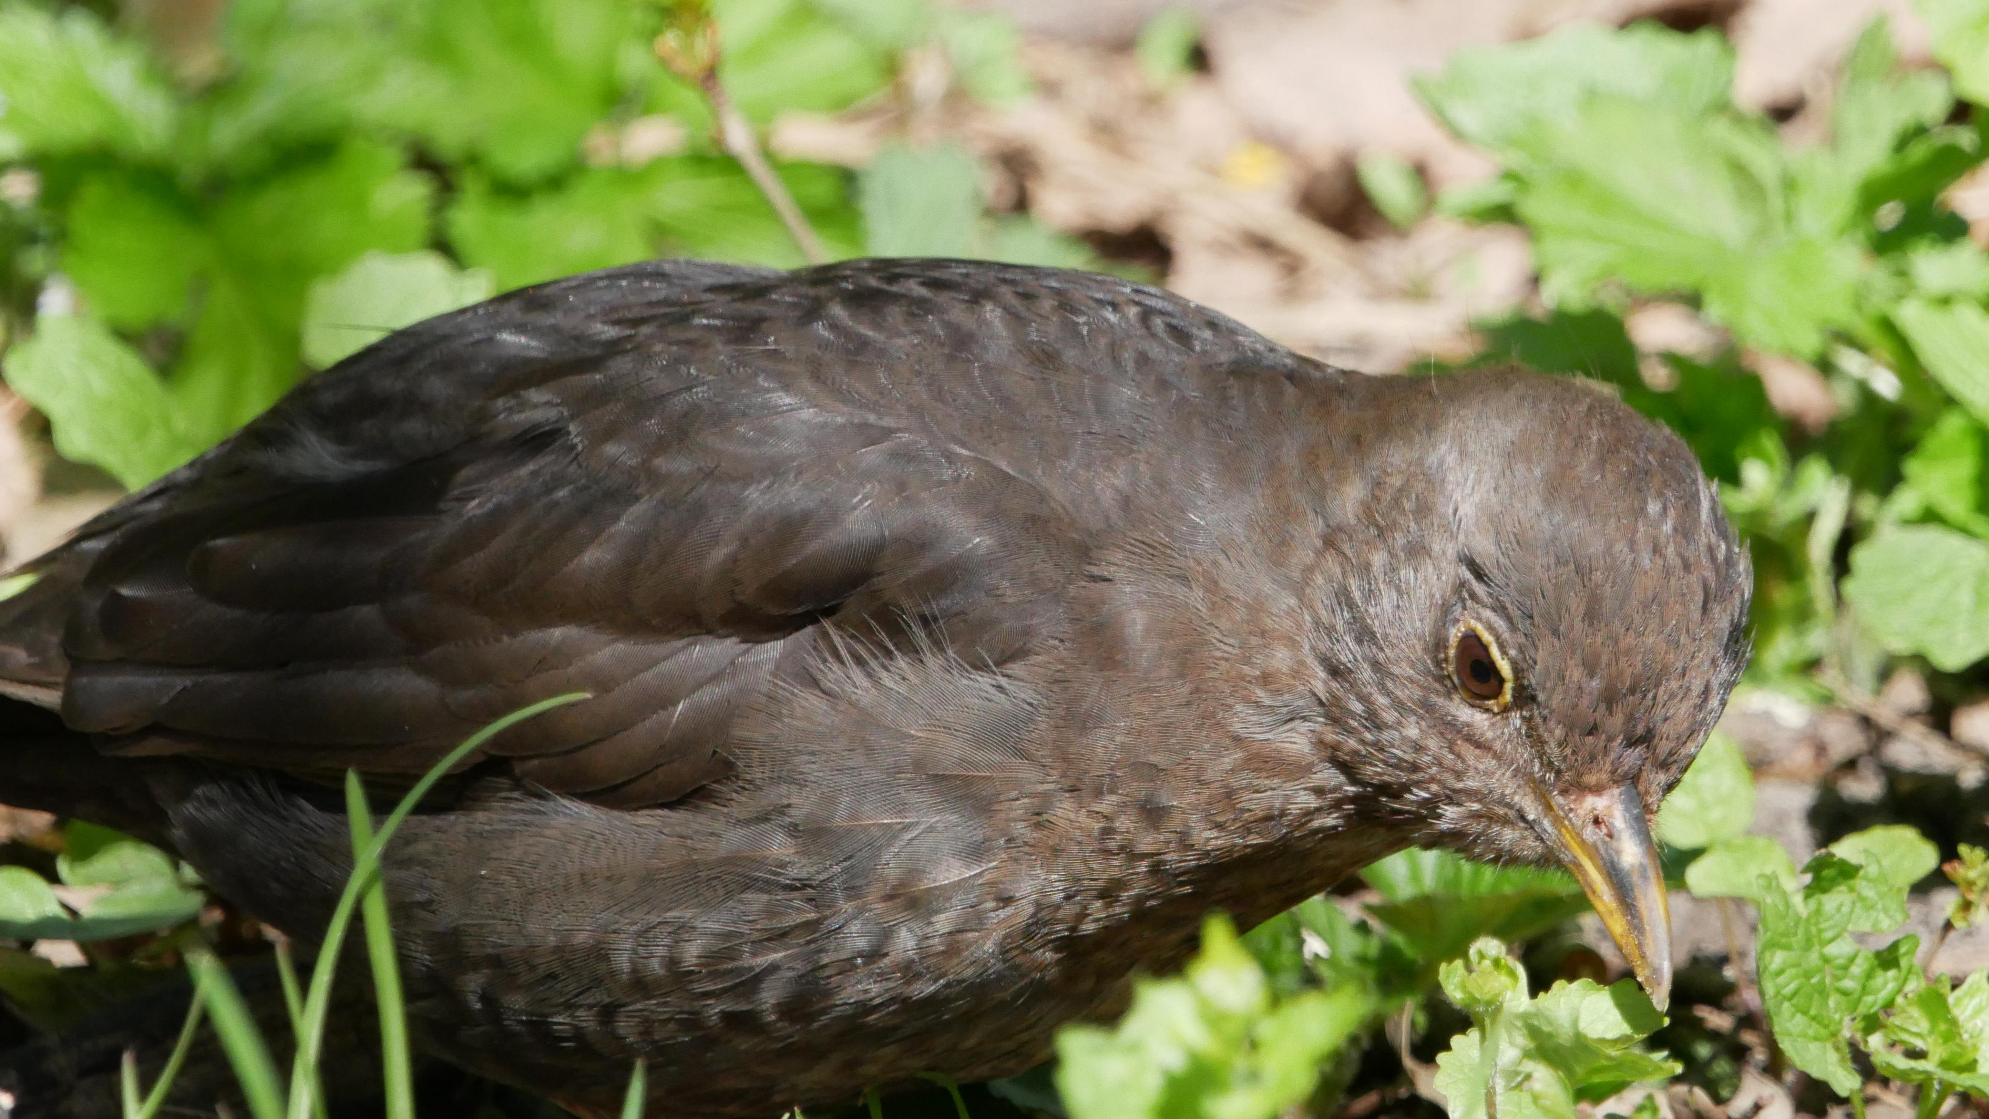
Genkendelse af Fugle
Via fuglesang
Notes:
Fun thing, when adding this picture, it produced different designs and this alt text “A picture containing outdoor, bird, grass, rail”

Slide 2
Overview
Formål
Dataset
Buildup
Features
Samples
Set-up
Classifiers
Data split
Resulter
Konkusion

Slide 3
Formål
Genkendelse af fugle
Numeriske data

Slide 4
Dataset
Features
Samples
172 kolunner
169 features af to slags
1 id
2 label (slægt og art)
2 labels samlet sammen til en enkel ”slægt art”.
Træningsdataset
1760 fugle
Testdataset
16626 fugle
Testdataset mangler en enkel fugleart (Motacilla flava, Gul vipstjert).

Slide 5
Features
Chromagram
Spectral Centroid
156 kolunner
Opdelt i 12 chorma bætter
13 spectrogram frammer
13 kolunner
Notes:
Chromagrams bruges i forhold vesten musik skaler. En bætte for hver tonehøjde klasse
Spectral Centroid er

Slide 6
Dataset - Analyse
//get image of all birds together in one plot

Slide 7
Set-up
Datasæts
Klassifierer
Forfatterens egen datasæts
Egen opdeling af træning og test data
Test data 25 % af det fulde datasæt
K-nearest Neighbour
Linear Stochastic Gradient Desent
Linear Support Vector Classication
Support Vector Classification with Linear Kernel
Gaussian Naïve Bayes
Decision Tree Classifier
Multi-Layer Perceptron Neural Network

Slide 8
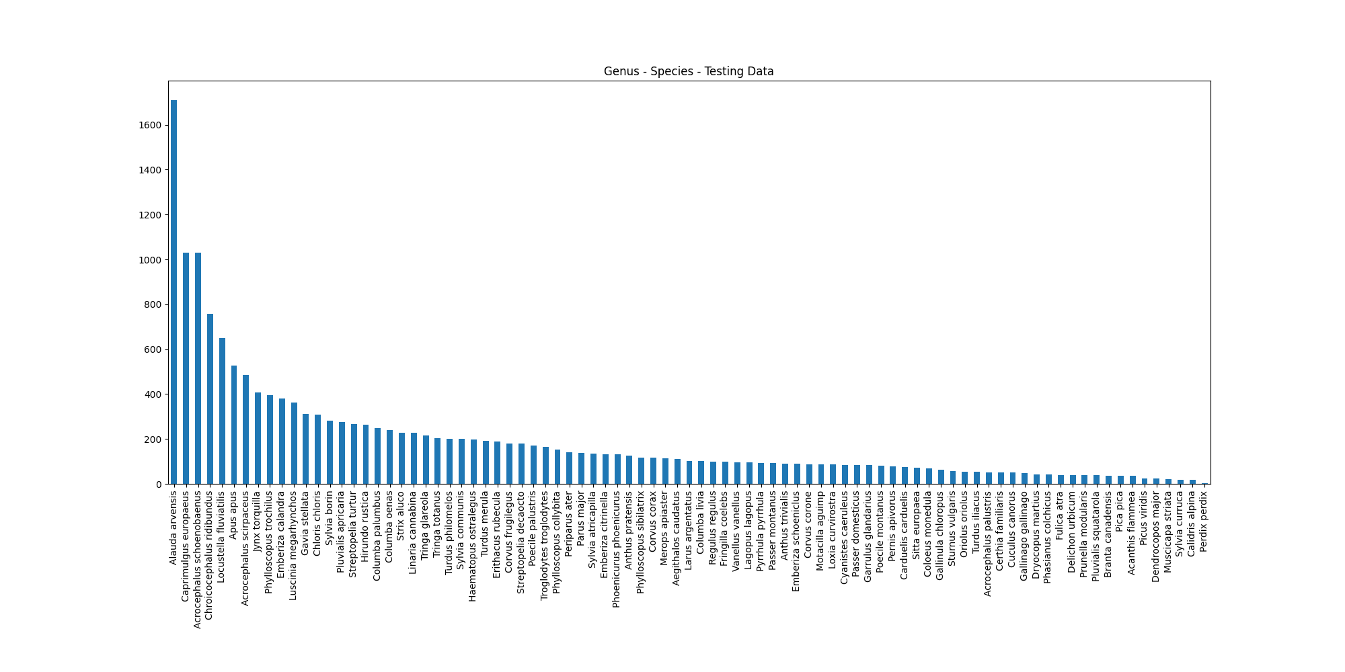
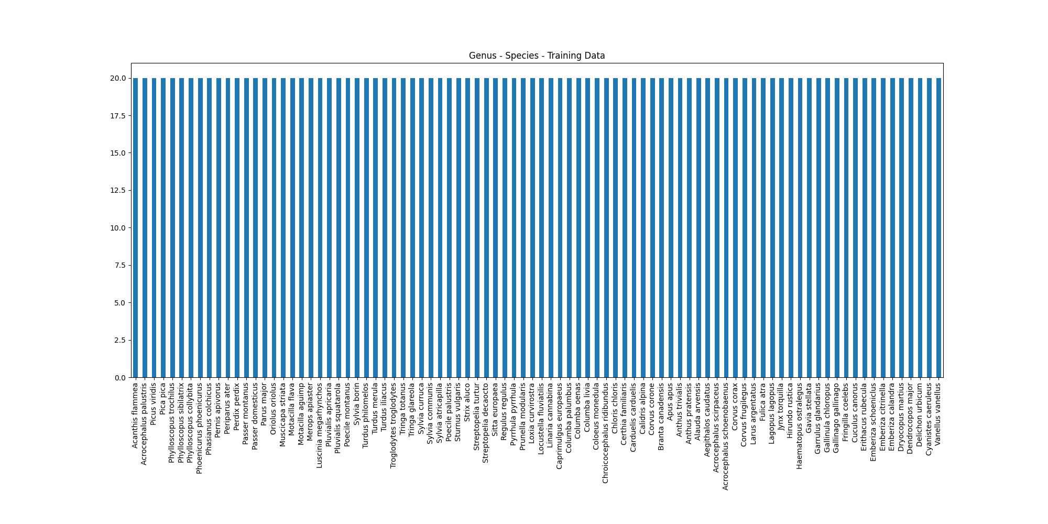
Forfatter data
Test
Træn

Slide 9
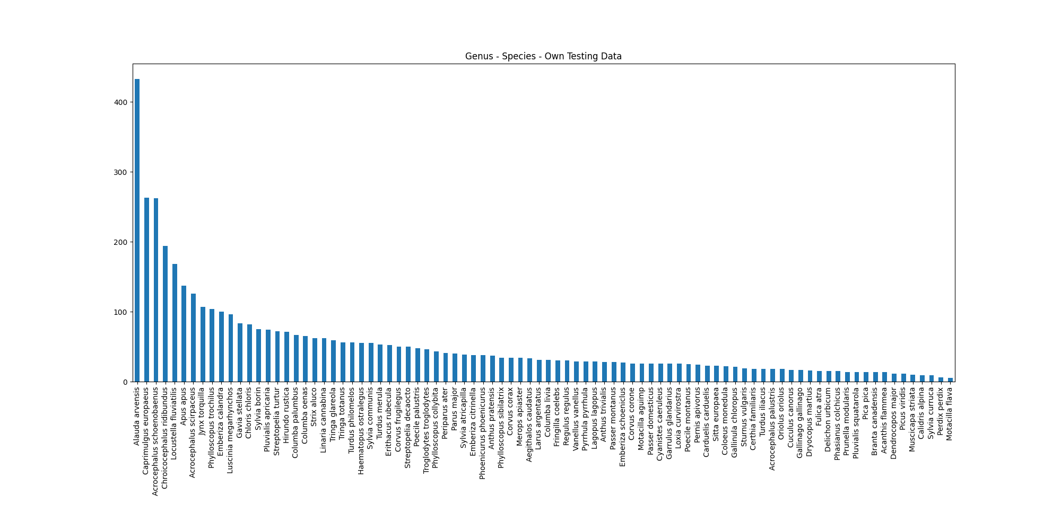

Egen data
Test
Træn

Slide 10
Resultater

Slide 11
Results – Præsision
 | Currated | Random
K-Nearest Neighbour | 0.2802237459400938 | 0.8194474657385251
Linear SGD | 0.9648742932755925 | 0.9889058081357407
Linear SVC | 0.976482617586912 | 1.0
SVC Linear Kernel | 0.982256706363527 | 0.9989123341309549
Gaussian Naive Bayes | 0.9283652111151209 | 0.9517076354144007
Decision Tree Classifier | 0.9009382894261999 | 0.9899934740047858
Neural Network | 0.7553831348490316 | 0.9825973460952795

Slide 12
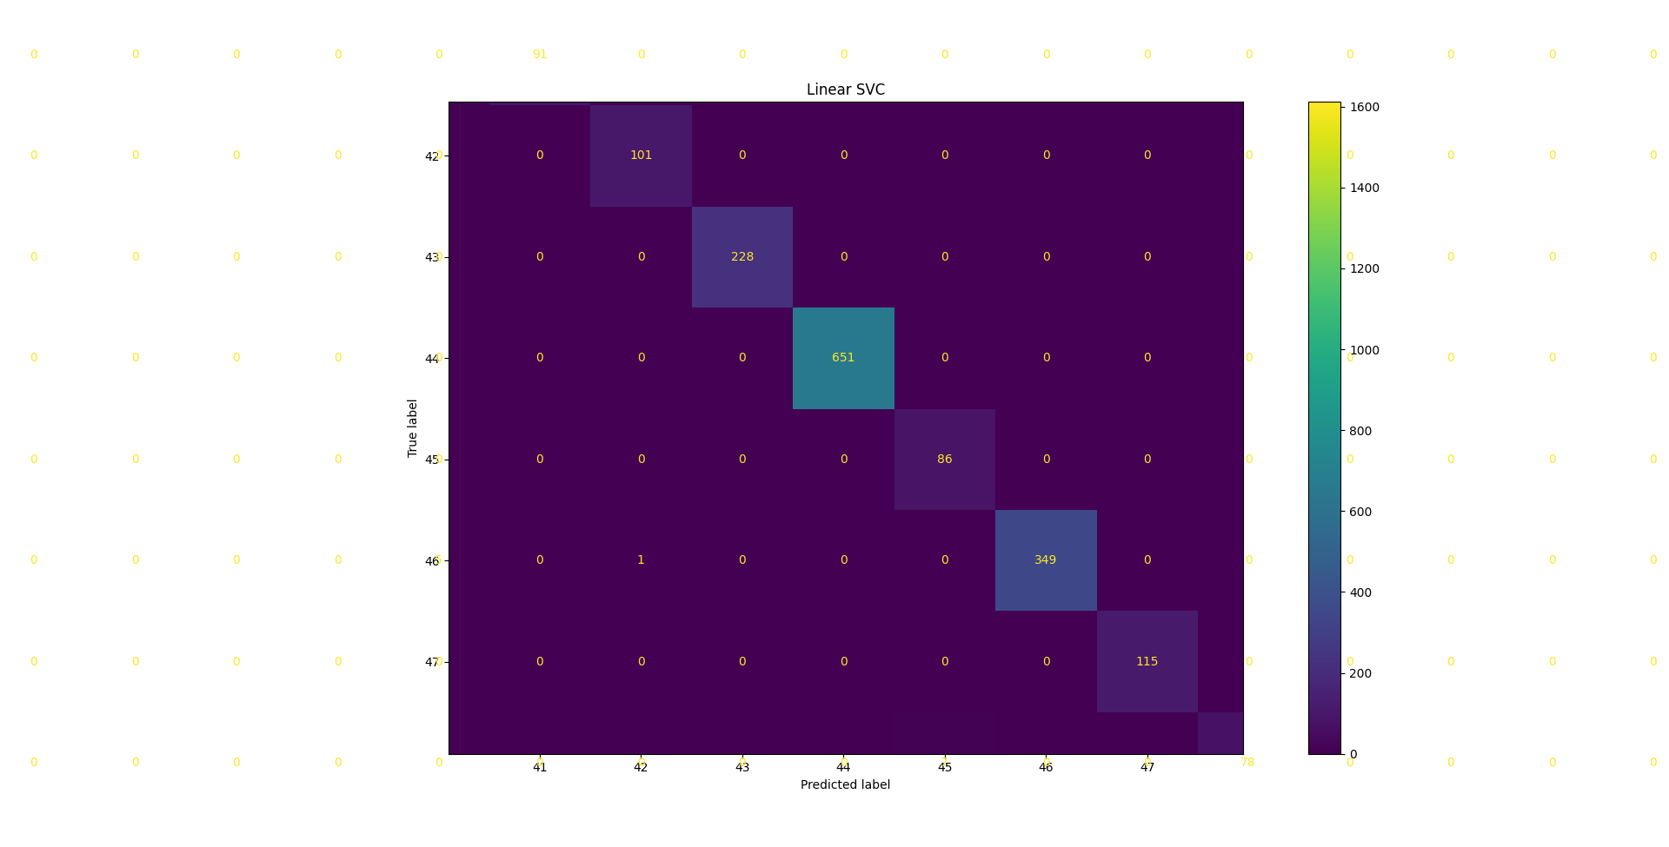
Resultater

Slide 13
Konklusion

Slide 14
Links
Brugt dataset
https://www.kaggle.com/datasets/fleanend/birds-songs-numeric-dataset
Baseret på dette dataset
https://www.kaggle.com/datasets/rtatman/british-birdsong-dataset

