Slide 1
MIDTERM PROGRESS · CSCI 6806 / INFO 4205 · SUMMER 2026
Reproducing and Stress-Testing
Learning-to-Rank Scheduling for LLM Serving
Base paper: “An Empirical Study on Latency Reduction Techniques for Large Language Models”
Built on vllm-ltr (Fu et al., 2024) · vLLM 0.4.1 · Llama-3-8B-Instruct
Yuze (Benjamin) Gao · Chenxi Li · Mengze Hu
June 2026 · FDU Vancouver, MSACS

Slide 2
BACKGROUND
FCFS wastes latency; the base paper ranks requests instead
LLM serving (vLLM) defaults to first-come-first-serve.
Output lengths vary wildly, so short requests queue behind long ones (head-of-line blocking).
Base paper: predict relative output length with a small OPT-125M ranker, run predicted-short requests first (approximate shortest-job-first).
Backed by vLLM swap-based preemption: paused requests park their KV cache in CPU memory.
Paper reports up to 2.1× latency reduction vs FCFS under high load.
THE LTR SERVING LOOP
1
Requests arrive in the queue
2
OPT-125M scores each prompt
3
Scheduler sorts: high score first
4
vLLM generates; on memory pressure, low-priority requests swap out
LLM Scheduling Capstone — Midterm Progress
2

Slide 3
REPRODUCTION SETUP
Faithful single-GPU reproduction, every knob pinned
CODE
MODEL
PREDICTOR
vllm-ltr @ 13bbf6ff
(vLLM 0.4.1, built from source)
Meta-Llama-3-8B-Instruct
FP16 · max-model-len 8192
Official OPT-125M
lmsys-score (released weights)
HARDWARE
WORKLOAD
FAIRNESS
RTX 3090 24 GB
23 GiB container RAM
LMSYS trace replay
500 prompts · seed 0 · rates 2–32
Identical server flags both arms
swap-space 4 · chunked prefill
Why Llama-3 and not the paper’s “3.1”: every public artifact the paper depends on (traces, predictor weights) is a Llama-3-8B product, and the pinned 2024 stack cannot parse 3.1’s rope_scaling. We match the artifacts and state the deviation.
LLM Scheduling Capstone — Midterm Progress
3

Slide 4
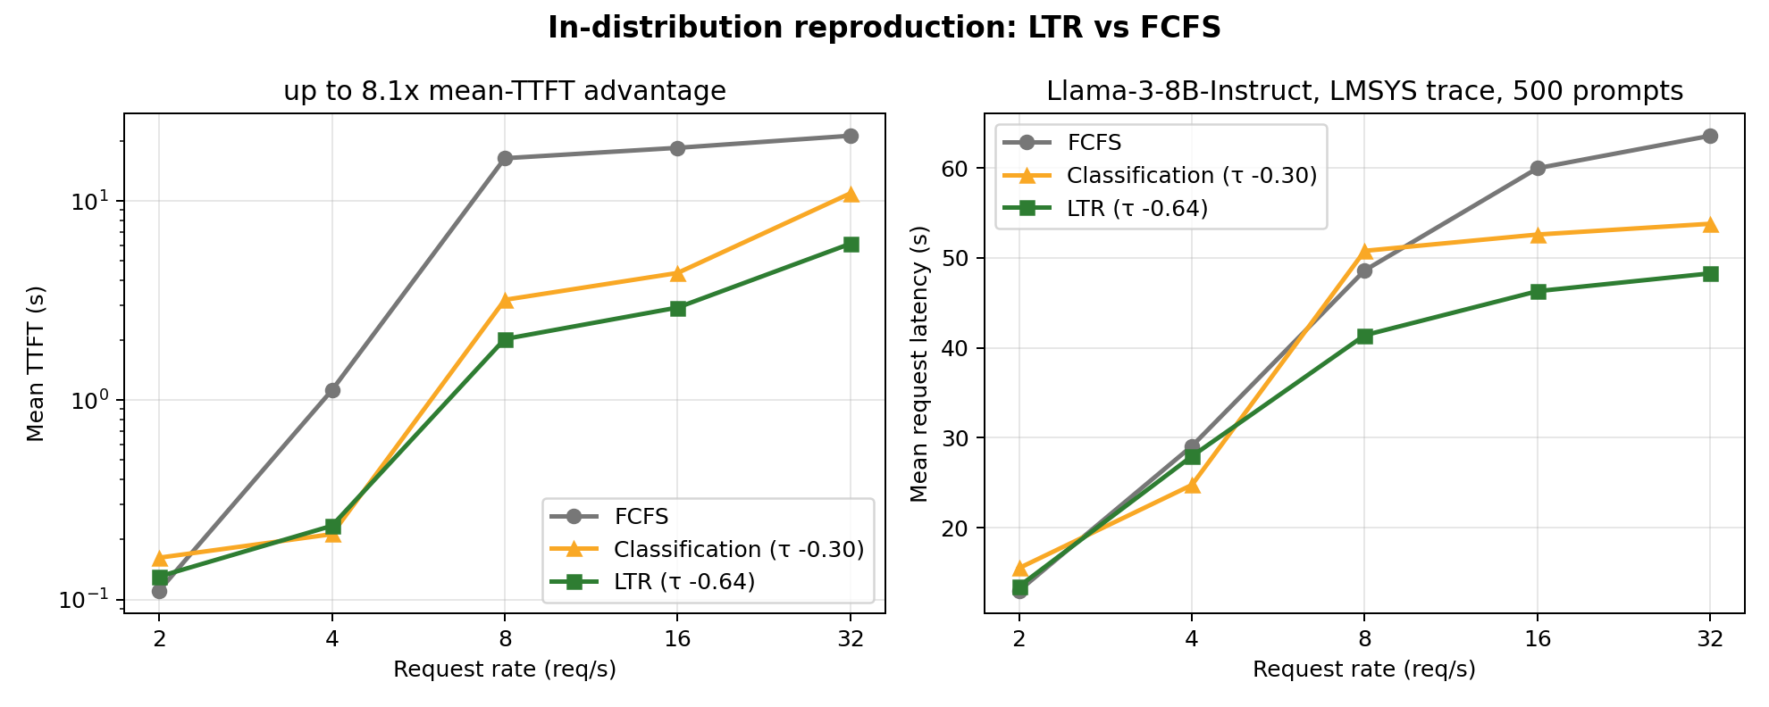
RESULT 1 — REPRODUCTION
In distribution, LTR wins exactly as the paper claims
8.1×
mean TTFT advantage (rate 8)
1.32×
mean request latency (rate 32)
Stable predictor quality: ranking correlation τ = -0.642 at every rate (5/5 runs) — the scheduler is reordering on real signal, not noise. At rate 2 the queue is empty and both arms tie, as expected.
LLM Scheduling Capstone — Midterm Progress
4

Slide 5
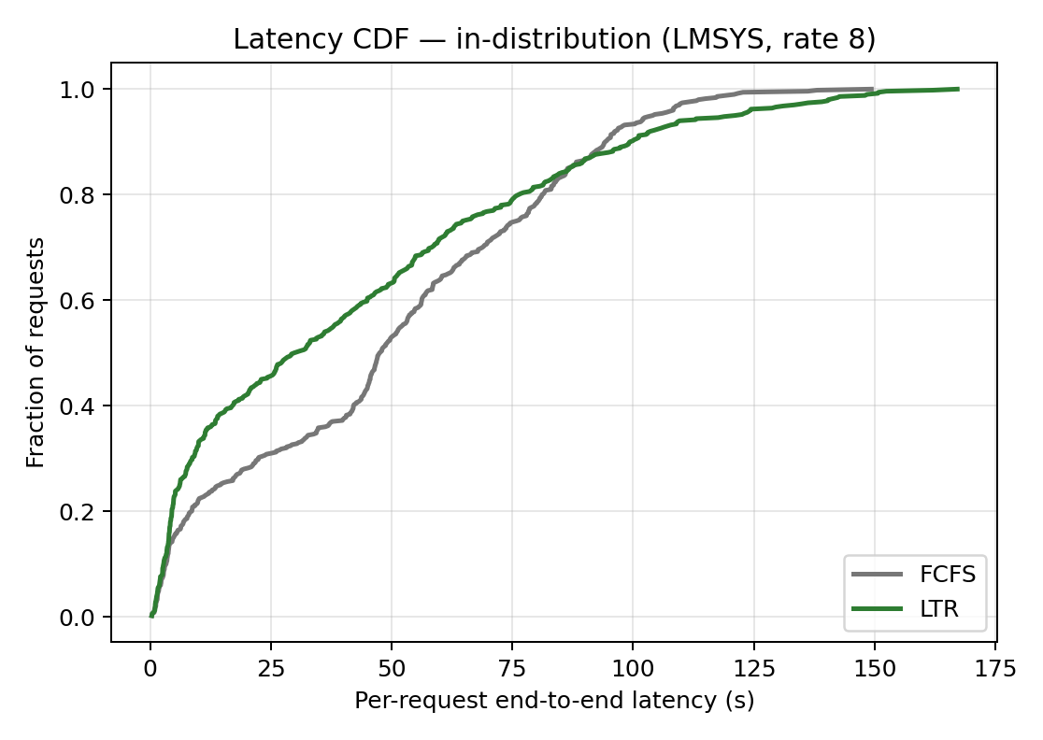
RESULT 1 — MECHANISM
Textbook shortest-job-first: most requests win, the tail pays
Per-request latency CDF at rate 8, in distribution.
LTR (green) leads FCFS for ~85% of requests — short jobs jump the queue.
Curves cross near the 85th percentile: the longest jobs finish later under LTR (p99 121 s → 148 s).
This is the inherent SJF bargain — acceptable when the predictor ranks correctly.
Question for the second half: what happens when it ranks wrongly?
LLM Scheduling Capstone — Midterm Progress
5

Slide 6
STRESS TEST
Out-of-distribution probe: same rig, mismatched predictor
The base paper itself reports its predictor fails to generalize (its “dataset 2” collapse) — we reproduce that failure deliberately and measure it.
Swap the workload to the ShareGPT trace; keep the LMSYS-trained predictor (deliberate mismatch).
Everything else identical: model, flags, seed, 500 prompts.
Measured three ways: serving latency, ranking quality τ, and an offline scoring pipeline that cross-validates τ without serving (agreement < 0.002).
DESIGN
Trace
LMSYS → ShareGPT
Predictor
LMSYS-trained (kept)
Rates
4 (clean) · 8 (crashed)
Arms
FCFS vs LTR, paired
LLM Scheduling Capstone — Midterm Progress
6

Slide 7
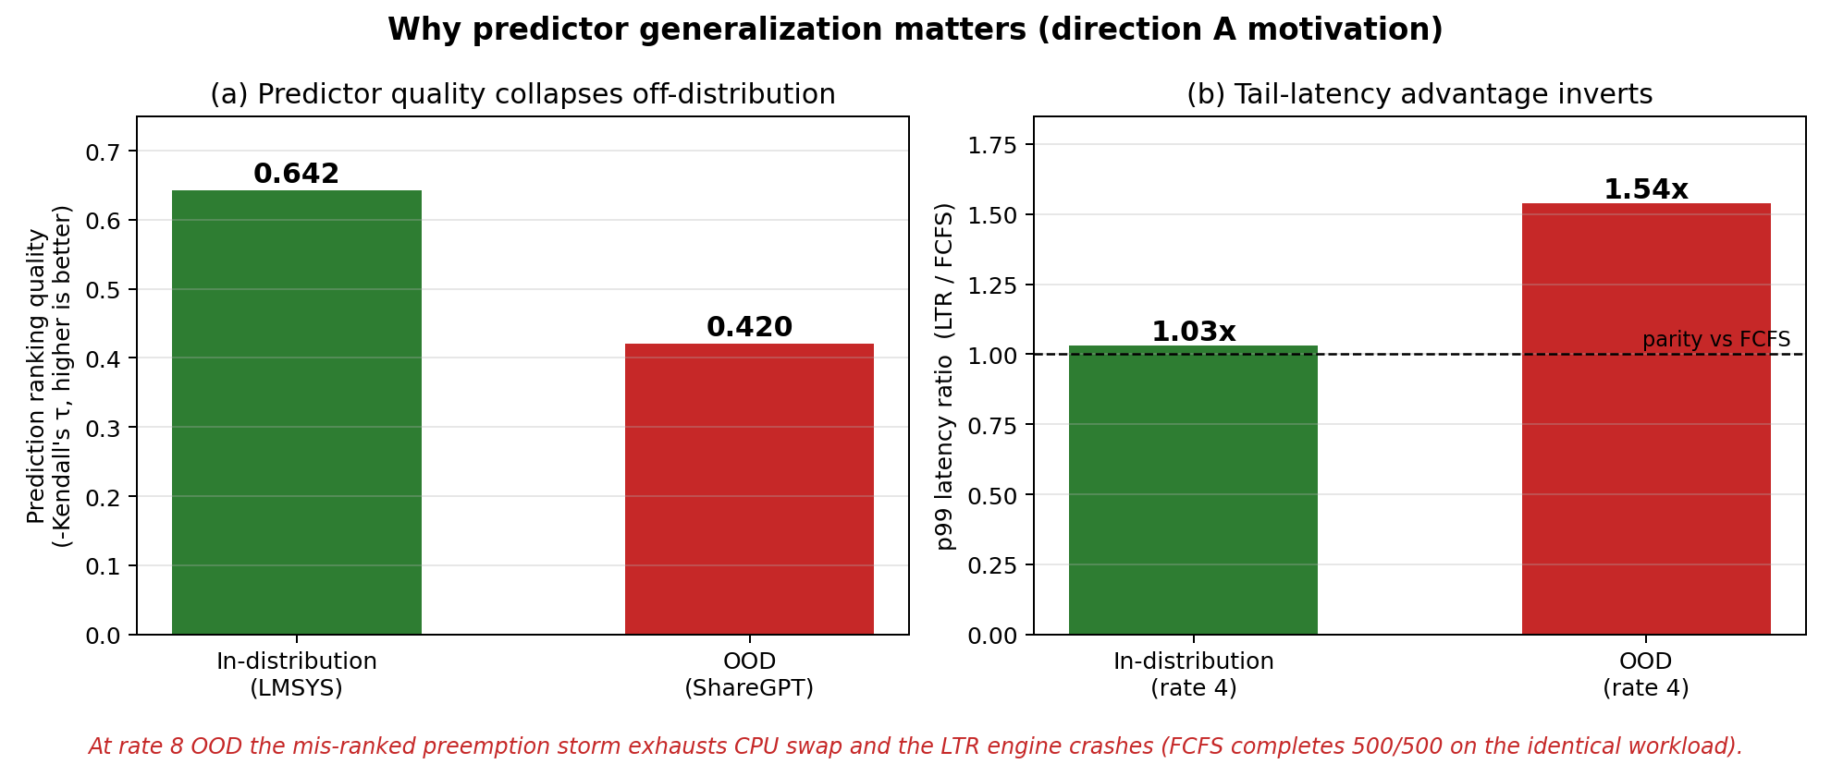
RESULT 2 — OOD
Off distribution, the ranking collapses and the tail inverts
LLM Scheduling Capstone — Midterm Progress
7

Slide 8
RESULT 2 — OOD, RATE 8
The failure is not just slower — it takes the service down
Mis-ranked long jobs scheduled first
→
Preemption storm (swap-out churn)
→
4 GB CPU swap pool exhausted
→
Engine aborts mid-run
RuntimeError: Aborted due to the lack of CPU swap space. (vllm/core/scheduler.py:1830 — swap-mode preemption is hard-coded in this fork)
15 / 500
500 / 500
23 GiB
LTR requests survived
FCFS, identical workload
container limit — raising swap was not an option
LLM Scheduling Capstone — Midterm Progress
8

Slide 9
SCOPE & HONESTY
Where our reproduction differs from the paper
Aspect | Base paper | Ours | Why
GPU | A100 40 GB | RTX 3090 24 GB | Budget; pressure scenario preserved
Model | “Llama-3.1-8B” | Llama-3-8B | All public artifacts are Llama-3; 3.1 unparsable on pinned stack
Predictor | Retrained, 23.8k samples | Official 10k weights | Paper’s weights never released
Baselines | FCFS / classification / LTR | FCFS / classification / LTR | Complete — full three-line comparison reproduced
Headline № | 2.1× latency | 8.1× TTFT · 1.32× mean latency | Different metric, rates, hardware — direction reproduced, numbers not comparable
LLM Scheduling Capstone — Midterm Progress
9

Slide 10
DIRECTION A — EVIDENCE
Two gate experiments: kill the shortcut, validate the method
STAGE 1 — ZERO-TRAINING SIGNALS: FAIL
STAGE 2 — TRAINED HEAD ON HIDDEN STATES: PASS
Raw scalars from the main model (first-token entropy, mean entropy, NLL) cannot rank lengths:
best |τ| = 0.17 vs OPT-125M’s 0.64.
15 GPU-minutes to rule out the trivial version — the trained-head complexity is justified, not assumed.
|τ| | LMSYS | ShareGPT | Alpaca
OPT-125M | 0.640 | 0.420 | 0.579
Ours (last32/mlp) | 0.713 | 0.428 | 0.674
A 4096→256→1 MLP on the last-token prefill hidden state, trained only on LMSYS, beats OPT-125M on every distribution — at near-zero serving cost.
Honest ablation: entropy weighting underperforms — the value is the representation, not the entropy.
LLM Scheduling Capstone — Midterm Progress
10

Slide 11
DIRECTION A — VALIDATED
Drop the external predictor; rank with the model’s own states
Stage-2 gate passed: model-internal ranking matches in-distribution and is more robust off-distribution.
The “predictor” shrinks from a 240 MB OPT-125M to a tiny MLP on a hidden state the engine already computes.
Cross-distribution matrix shows retraining on the target trace alone cannot fix OOD (ShareGPT is intrinsically hard) — representations help where retraining cannot.
Stage 3 (final): integrate into the vllm-ltr scheduler — ranking becomes available post-prefill, so the scheduling point moves; plus preemption guardrails so a bad ranking can degrade but never crash the engine.
OUR ITERATION ADVANTAGE
GPU-free iteration loop
Offline τ pipeline (serving-validated to <0.002) plus 425 MB of cached prefill features: every head/-loss/-architecture iteration now runs on a laptop.
GPU is paid only for stage-3 end-to-end latency validation.
LLM Scheduling Capstone — Midterm Progress
11

Slide 12
ROADMAP
From midterm to final defense
DONE
Reproduction + OOD evidence
8B three-line sweep (FCFS / classification / LTR), τ chain, crash forensics
DONE
Generalization landscape
2×3 predictor-trace τ matrix; retraining alone does not fix OOD
DONE
Direction A gates 1 & 2
Scalar signals fail (0.17) → trained head on hidden states wins everywhere (0.713)
FINAL
Stage 3: scheduler integration
Post-prefill ranking point + preemption guardrails; end-to-end latency on the rig
github.com/BenjaminGao2025/Capstone — data · scripts · figures · experiment reports

