Slide 1
Midterm Progress: Related-Work Evaluation
Using my Llama-3-8B results to extend LLM request scheduling
My contribution
Papers used
Reproduced the base FCFS vs LTR scheduling experiment.
Tested two related scheduling ideas on the same Llama-3-8B trace.
Compared which signals are useful for lowering latency.
Base paper: learning-to-rank request scheduling.
SLO-Aware Scheduling: request priority from SLO pressure.
Apt-Serve: runtime batching and cache awareness.
Current direction
Keep LTR as the core, then add SLO urgency and system/cache awareness.
LLM Scheduling Capstone - Midterm Progress
1

Slide 2
Background
FCFS is simple, but it ignores output-length variation
Problem
Base idea
Open gap
LLM requests have very different output lengths.
Short jobs may wait behind long generations.
This increases average latency and queueing delay.
Predict relative output behavior.
Rank requests before serving.
Approximate shortest-job-first scheduling.
Length is not the only useful signal.
Applications have different SLOs.
The system also has cache and batch limits.
Research question: what signals should be added to the base LTR scheduler?
LLM Scheduling Capstone - Midterm Progress
2

Slide 3
Experiment Setup
Real serving result + trace-driven related-work validation
Base reproduction
Related papers
Caveat
vLLM-LTR / vLLM 0.4.1
Meta-Llama-3-8B-Instruct
RTX 3090 24GB, CUDA 12.1
500 LMSYS requests, 8 qps
FCFS vs LTR
Use Llama-3-8B trace outputs
Rates: 2, 4, 8, 16
Paper-inspired policies
Measure average latency trend
Trace-driven validation
Base result is live serving.
SLO/Apt results are simulation-style validation.
Use trends, not absolute numbers, for method choice.
LLM Scheduling Capstone - Midterm Progress
3

Slide 4
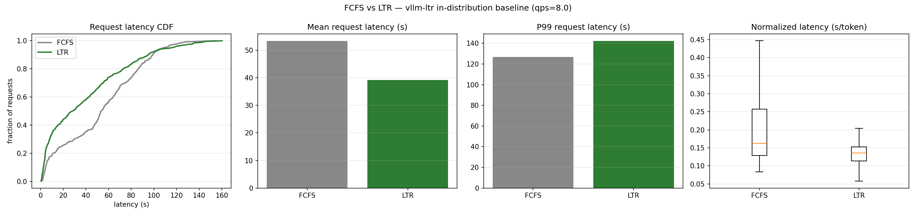
Base Paper Reproduction
LTR improves average latency, but the tail can still be worse
18.02s -> 2.27s
501.5 -> 139.6ms
2.83 -> 3.04
P99 higher
Takeaway: LTR works, but pure shortest-job-first behavior needs guardrails.
Mean TTFT
Normalized latency
Throughput req/s
Tail tradeoff
LLM Scheduling Capstone - Midterm Progress
4

Slide 5
Related Papers: What They Add
Both papers extend scheduling beyond plain FCFS
SLO-Aware Scheduling
Apt-Serve
Adds task/application-level latency objectives.
Priority depends on SLO, input length, and possible output length.
Useful signal for deciding which request is urgent.
Targets memory and batching bottlenecks.
Uses hybrid cache and adaptive runtime scheduling.
Useful signal for system pressure and batch composition.
Relation to base: both reorder requests, but SLO-Aware adds deadline pressure.
Relation to base: both challenge FCFS, but Apt-Serve adds cache awareness.
LLM Scheduling Capstone - Midterm Progress
5

Slide 6
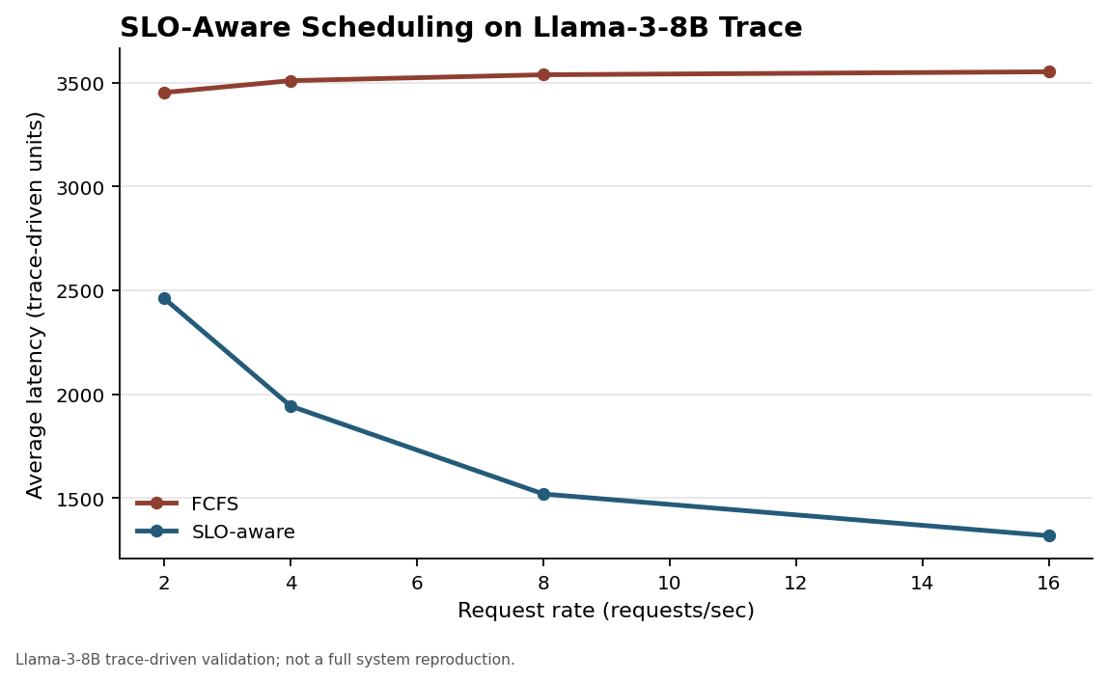
SLO-Aware Trace Result
SLO urgency becomes more useful under higher request rates
Rate | FCFS | SLO-aware | Lower
2 | 3452 | 2461 | 28.7%
4 | 3509 | 1943 | 44.6%
8 | 3538 | 1519 | 57.1%
16 | 3552 | 1318 | 62.9%
Interpretation
SLO-aware priority avoids treating every request equally.
This is a natural extra term for LTR ranking.
Note: paper-inspired trace-driven validation; not a full vLLM reproduction.
LLM Scheduling Capstone - Midterm Progress
6

Slide 7
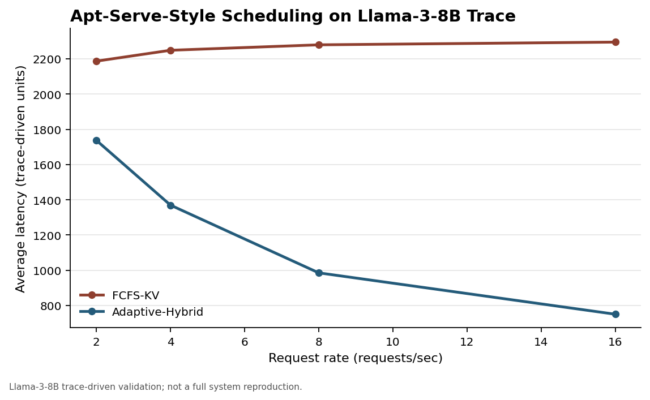
Apt-Serve Trace Result
Cache and batch awareness also reduce simulated latency
Rate | FCFS-KV | Adaptive | Lower
2 | 2187 | 1738 | 20.5%
4 | 2249 | 1370 | 39.1%
8 | 2279 | 985 | 56.8%
16 | 2295 | 750 | 67.3%
Interpretation
Latency is affected by runtime system state.
Implementation is harder, so it fits as a later extension.
Note: Apt-Serve-style trace validation; not a full cache-system reproduction.
LLM Scheduling Capstone - Midterm Progress
7

Slide 8
Conclusion and Proposal
A practical extension path for our group
Method | Signal | Role
Base LTR | output length | core baseline
SLO-Aware | urgency / deadline | first extension
Apt-Serve | cache / batch state | future extension
Proposal
Scoring sketch
Keep the base LTR scheduler.
Add SLO urgency to request priority.
Use uncertainty/cache pressure as guardrails.
final_score = LTR_score
+ alpha * SLO_urgency
+ beta * system_signal
Takeaway
Best current choice: add SLO urgency to LTR first; keep Apt-Serve-style cache/batch awareness as a later system extension.
LLM Scheduling Capstone - Midterm Progress
8

