Slide 1

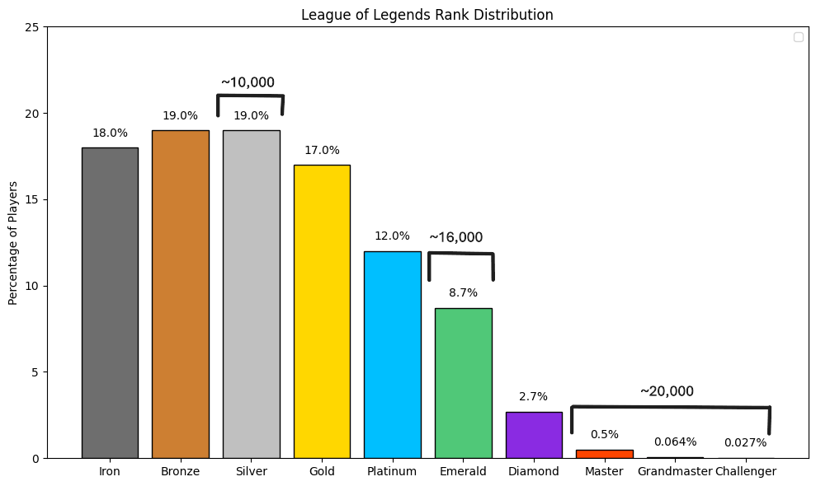
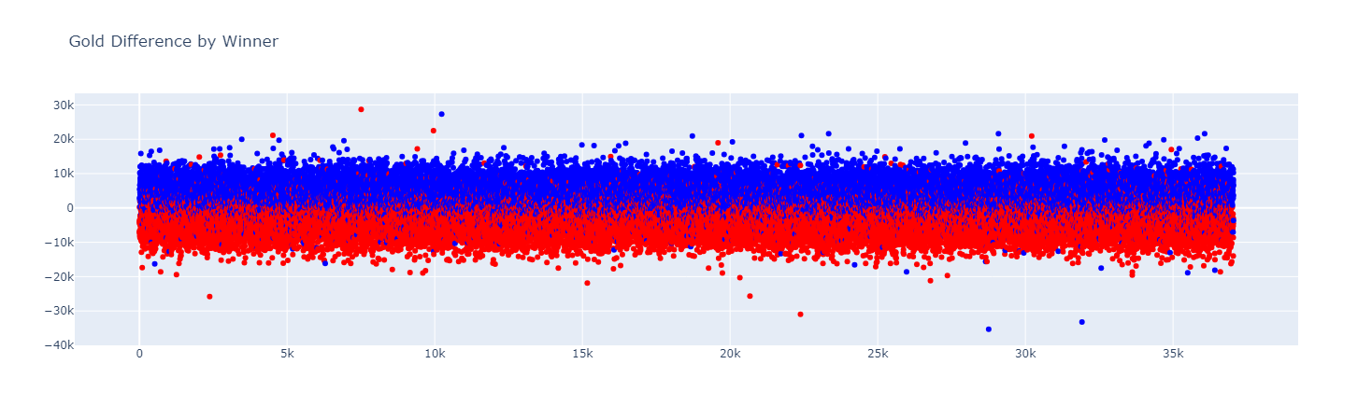
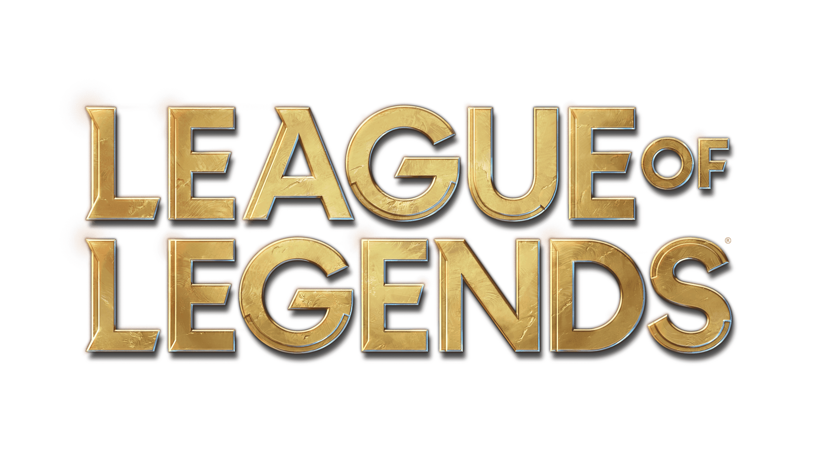
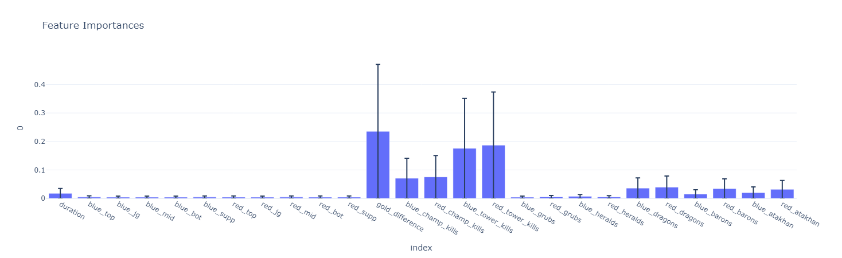
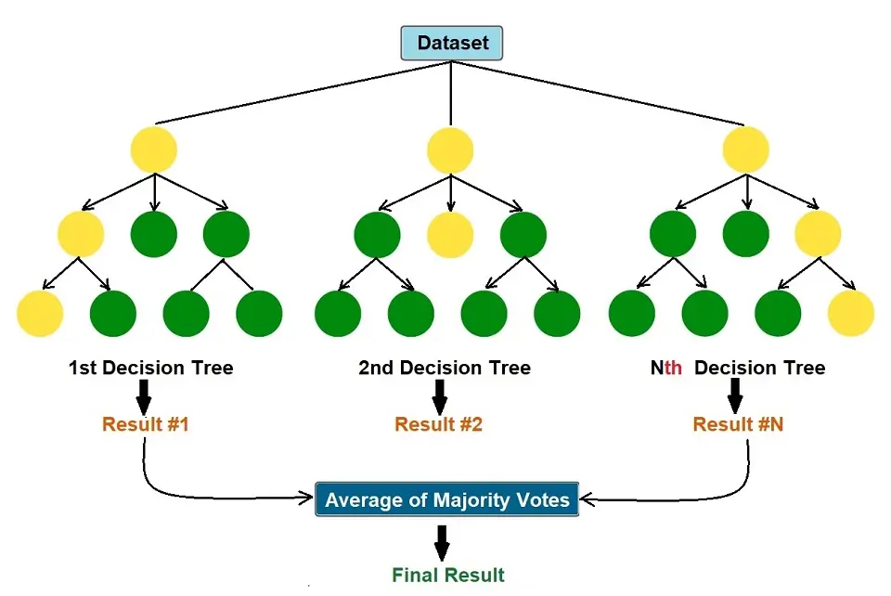
Victory Curve: Realtime Analysis of League of Legends
Benjamin Groseclose, Ira Woodring
Abstract
Analyzing League of Legends games in real time is challenging even for experienced players. This project aims to create a consistent and data-driven method to predict the outcome of matches. This desktop application leverages machine learning algorithms to predict the likely winner based on real-time game data. By automating this analysis, the tool provides valuable insights and helps players make better in-game decisions.
Results/Implementation
Technical Details
Data
In any machine learning project data is key. You need the correct features and enough to build a strong model. League of Legends has several key data points I wanted to track. Luckily League of Legends provides an API that allows you to fetch match details. Initially I analyzed only highly rated games, from Master+ tiers. Belief was this would provide me with the “best” data. Later I included other tiers of play to balance the model. I ultimately fetch around 35k matches. The API provided an enormous amount of data point that I could use to train my model. I started with just champions, realized that is not
Introduction
characters. According to Priori Data in the last 30 days, over 100 million players globally have played League of Legends. There are over 170 characters (champions) a player can choose to play and eight different objectives that can be captured. No two games are the same. I have played League of Legends for many years and have always wondered while playing, “Are we winning or losing right now?”. This question motivated me to work on this project. I was curious if my years of experience playing would align with what the machine was telling me. This project aims to create a machine learning-based system that can predict the winning team in real time based on game data. This is achieved by utilizing historical match data, training a machine learning model, and then using that trained model to predict the outcome. For this project, I attempted several common machine learning algorithms including k-nearest neighbors (kNN), Decision tree, and Random Forest. I found that random forest provided the best results. Random Forest classifier is an ensemble algorithm meaning they combine multiple “weaker” models to create a stronger model. In Random Forest’s case, it uses multiple decision trees to classify the data, hence the word “forest”. In addition, each tree is taken from a random subset of the data. Random Forest is ideal for reducing overfitting and bias.
consistent enough and expanded to include gold difference and the other objectives in the game. By adding in more data points, my model’s accuracy improve greatly. There were 26 features in total used to train my model. 10 champions (5 per team), gold difference, and the remaining objectives (kills, towers, Grubs, Heralds, Dragons, Barons, and Atakhan
League of Legends is a five vs five strategic online video game, where players take control of a specific character. The ultimate goal is to destroy the enemy team’s base, which is achieved by increasing your character's strength, via capturing various objectives or defeating the enemy team’s
Model
.
.
.
.
.
.
.
.
Future Work
Bibliography

