Slide 1

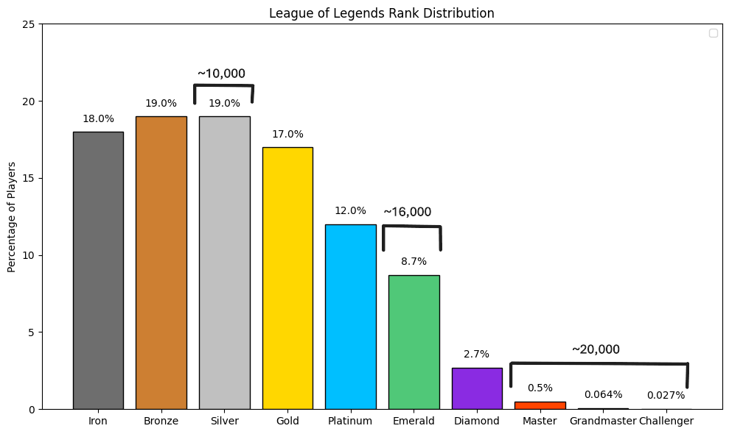
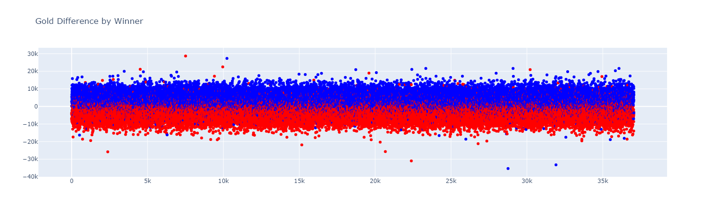
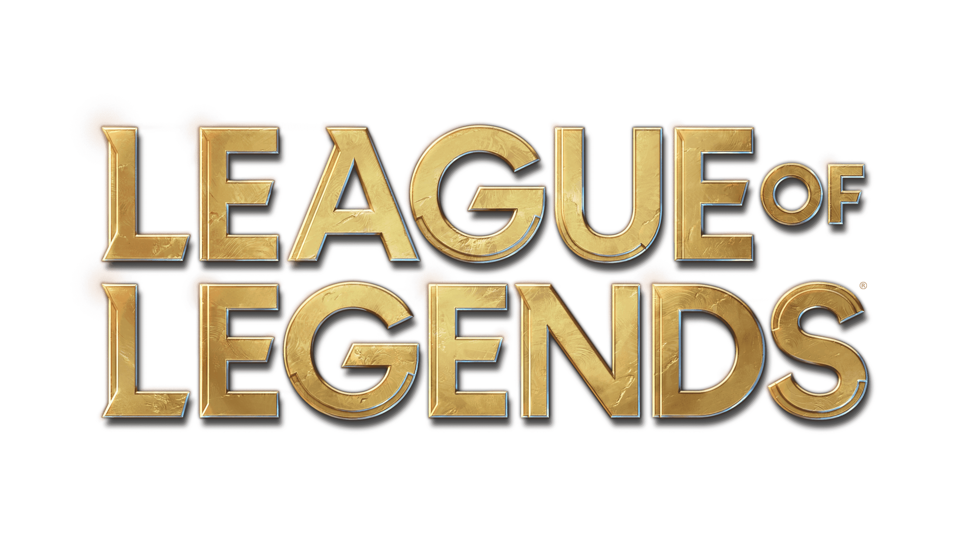
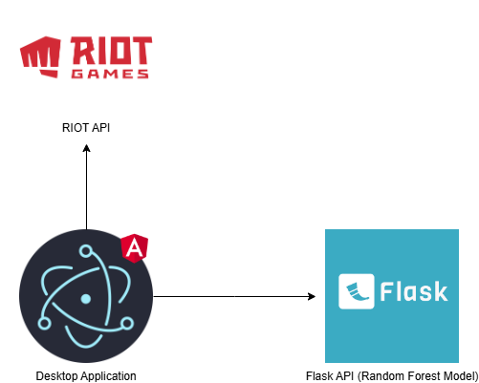
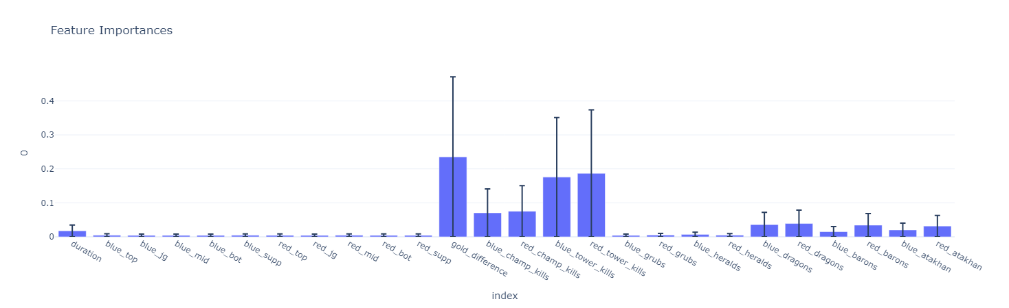
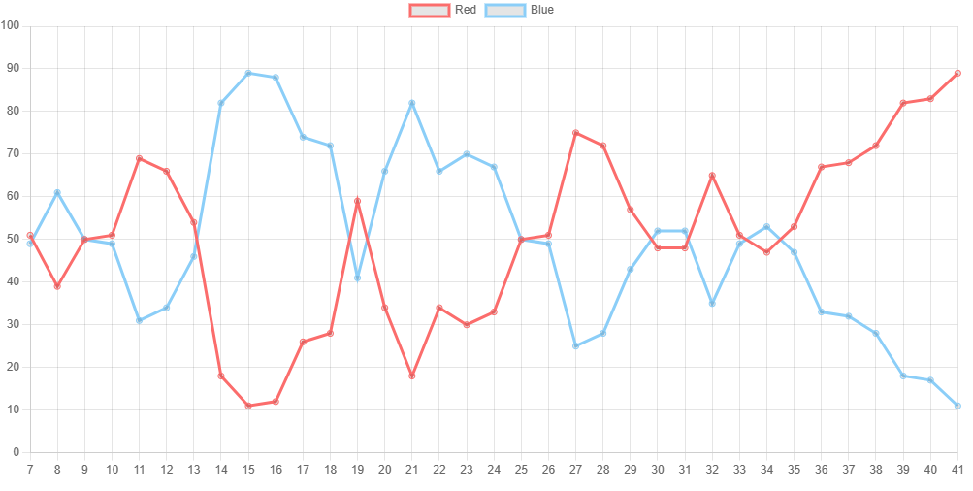
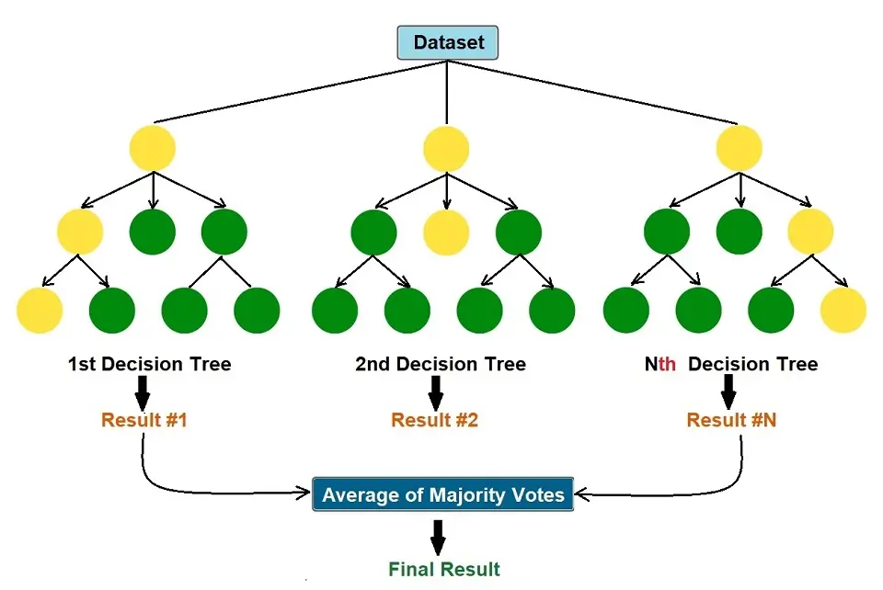
Victory Curve: Realtime Analysis of League of Legends
Benjamin Groseclose, Ira Woodring
Abstract
Analyzing League of Legends games in real time is challenging even for experienced players. This project aims to create a consistent and data-driven method to predict match outcomes. This desktop application leverages machine learning algorithms to predict the likely winner based on real-time game data. By automating this analysis, the tool provides valuable insights and helps players make better in-game decisions.
Results/Implementation
Technical Details
Data
In any machine learning project data is key. Machine learning algorithms require the right number of features and a large quantity of data to build a strong model. League of Legends has several crucial data points worth tracking. Fortunately, RIOT Games provides an API that allows you to fetch detailed match information. Initially, we focused on highly rated games (Master tier and above) under the assumption that these would provide reliable data. However, the dataset was expanded to include other tiers. In total, we collected approximately 36k matches. The API provides a massive amount of data points. We began with just champions and realized that is not
For this project, several software components were used to bring everything together. Beginning with Jupyter notebooks to fetch and store the data from the RIOT API. For training and testing the random forest machine learning model sciket-learn python library was utilized.
Once the model was trained and the data thoroughly analyzed, the desktop application was developed using Electron, a popular framework for building cross-platform desktop apps with web technologies like JavaScript, HTML, and CSS. On top of that, Angular was used to structure and build the front-end interface.
The desktop app communicates with a Flask-based Python API. This API exposes a single endpoint that accepts the required features and returns a prediction from the trained model.
Introduction
characters. According to Priori Data in the last 30 days, over 100 million players globally have played League of Legends. There are over 170 characters (champions) a player can choose to play and eight different objectives that can be captured. No two games are the same. Players in League of Legends matches benefit from additional insights during gameplay, hoping to increase their chances of winning. This motivated me to work on this project. We were curious if years of experience playing would align with what the model was telling us. This project aims to create a machine learning-based system that can predict the winning team in real-time based on game data. This is achieved by utilizing historical match data, training a machine learning model, and then using that trained model to predict the outcome. For this project, We attempted several common machine learning algorithms including k-nearest neighbors (kNN), Decision tree, and Random Forest. We found that the random forest model provided the best results. Random Forest classifier is an ensemble algorithm meaning they combine multiple “weaker” models to create a stronger model. In Random Forest’s case, it uses multiple decision trees to classify the data, hence the word “forest”. In addition, each tree is taken from a random subset of the data. This makes random forest models ideal for reducing overfitting and bias.
League of Legends is a five vs five strategic online video game, where players take control of a specific character. The ultimate goal is to destroy the enemy team’s base, which is achieved by increasing your character's strength, by capturing various objectives or defeating the enemy team’s
consistent enough to produce accurate results. So, incorporating additional features such as gold difference and key objectives significantly boosted the model’s accuracy.
In total, 26 features were used to train the model, this included 10 champions (5 per team), gold difference, kills, towers, Grubs, Heralds, Dragons, Barons, Atakhan, and the match’s duration.
Model
The random forest model was selected due to its ability to handle complex data, capacity to identify the importance of features, and reduce the risk of overfitting. After training the model, the model achieved 98% accuracy. Using 50% of the dataset for training and the remaining 50% for testing. The
model identified gold difference and tower kills as the strongest predictors of match outcome. This result is not surprising given gold is awarded to the team as they progress towards winning the game, and a prerequisite to defeating the enemy base is destroying at least 5 towers, but this is usually much higher. In contrast, other objectives like Dragons or Barons may provide strategic advantages but do not directly result in a win.
Application
The final product of this project was a desktop application designed to allow users to analyze their game in real-time. RIOT Games offers a “live client” API that provides live match data while a game is in progress. With a single click, users can start tracking their match through the application. However, this API provides data already available to the player. It does not provide information they do not already know, to avoid giving users any unfair advantage. Because of this limitation, the model starts after a three-minute delay. This prevents the system from falsely interpreting the lack of early game data as a massive advantage for the user’s side. After the
Future Work
This application could be most effective in an esports setting, where it could function as a spectator. This approach eliminates the point-of-view limitation. As a spectator, the model would have complete, unfiltered access to all in-game information, enabling it to provide the most accurate and comprehensive analysis. In addition, adding more features would only increase the model’s strength such as gold difference at various points in the match.
initial delay, the application fetches all necessary features and processes them using the trained model. The results are then visualized in a real-time graph. Players may find this helpful while playing League of Legends, as it is a complex game with many factors that are easy to overlook during gameplay.
The image to the left is an example of a graph from the user playing the “red side”
Bibliography
Data sourced from RIOT API
https://developer.riotgames.com/apis
Model created using scikit-learn package
https://scikit-learn.org/
Images Sources:
https://brand.riotgames.com/en-us/league-of-legends/logos/
https://www.ejable.com/tech-corner/ai-machine-learning-and-deep-learning/random-forest-in-machine-learning/

