Slide 1
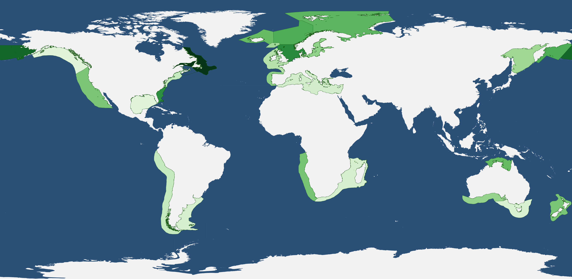
Notes:
Mean chlorophyll-a by LME in mg/m^3, time series is from 1996-2014
Chlorophyll-a is a proxy for primary productivity

